Slide 1
July 2025
Core epidemiology slides

Slide 2
Global estimates for adults and children  2024
People living with HIV 40.8 million [37.0 million–45.6 million]
New HIV infections 1.3 million [1.0 million–1.7 million]
Deaths due to AIDS 630 000 [490 000–820 000]

Slide 3
About 3600 new HIV infections (adults and children) a day  2024
About 50% are in sub-Saharan Africa
About 300 are among children under 15 years of age
About 3300 are among adults aged 15 years and older, of whom:
  ─ 1600 are among women
  ─ 1000 are among young people (15–24)
  ─ 570 are among young women (15–24)

Slide 4
Global estimates for children (<15 years)  2024
Children living with HIV 1.4 million [1.1 million–1.8 million]
New HIV infections 120 000 [82 000–170 000]
Deaths due to AIDS 75 000 [50 000–110 000]

Slide 5
Regional HIV and AIDS statistics and features  2024
 | Adults and children living with HIV | Adults and children newly infected with HIV | Adult and child deaths due to AIDS
Eastern and southern Africa | 21.1 million [19.5 million - 23.4 million] | 490 000 [390 000 - 620 000] | 260 000 [210 000 - 330 000]
Western and central Africa | 5.2 million [4.5 million - 6.0 million] | 160 000 [110 000 - 250 000] | 120 000 [93 000 - 170 000]
Middle East and North Africa | 240 000 [190 000 - 310 000] | 23 000 [16 000 - 37 000] | 7000 [4700 - 11 000]
Asia and the Pacific | 6.9 million [6.2 million - 7.8 million] | 300 000 [260 000 - 370 000] | 150 000 [110 000 - 200 000]
Latin America | 2.5 million [2.2 million - 2.8 million] | 120 000 [94 000 - 160 000] | 27 000 [19 000 - 38 000]
Caribbean | 340 000 [290 000 - 400 000] | 15 000 [9900 - 21 000] | 4800 [3300 - 6900]
Eastern Europe and central Asia | 2.1 million [2.0 million - 2.3 million] | 130 000 [110 000 - 140 000] | 48 000 [38 000 - 57 000]
Western and central Europe and North America | 2.4 million [2.1 million - 2.6 million] | 62 000 [51 000 - 72 000] | 9000 [6800 - 11 000]
Global | 40.8 million [37.0 million - 45.6 million] | 1.3 million [1.0 million - 1.7 million] | 630 000 [490 000 - 820 000]
The ranges around the estimates in this table define the boundaries within which the actual numbers lie, based on the best available information.

Slide 6
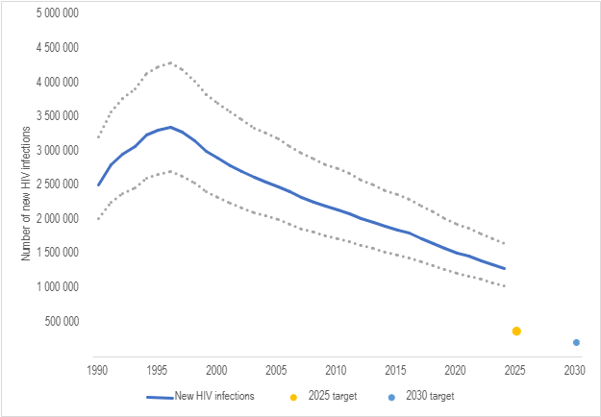
Number of new HIV infections, global, 1990–2024, 2025 and 2030 targets
Source: UNAIDS 2025 epidemiological estimates

Slide 7
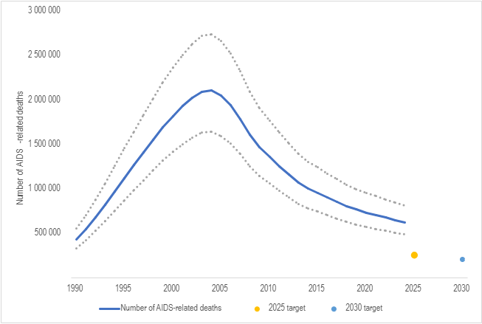
Number of AIDS-related deaths, global, 1990–2024, 2025 and 2030 targets
Source: UNAIDS 2025 epidemiological estimates

Slide 8
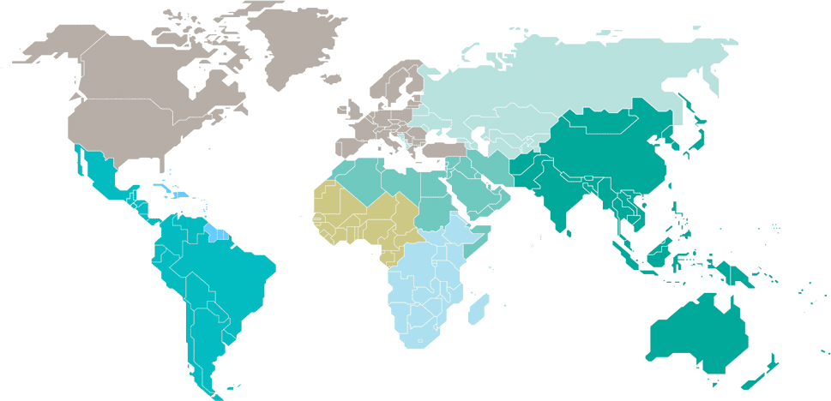
Adults and children estimated to be living with HIV  2024
Eastern Europe
and central Asia
2.1 million
[2.0 million–2.3 million]
Western and central Europe and North America
2.4 million
[2.1 million–2.6 million]
Caribbean
340 000
[290 000–400 000]
Middle East and North Africa
240 000
[190 000–310 000]
Western and central Africa
5.2 million
[4.5 million–6.0 million]
Asia and the Pacific
6.9 million
[6.2 million–7.8 million]
Latin America
2.5 million
[2.2 million–2.8 million]
Eastern and southern Africa
21.1 million
[19.5 million–23.4 million]
Total: 40.8 million [37.0 million–45.6 million]
Source: UNAIDS 2025 epidemiological estimates

Slide 9
Estimated number of adults and children newly infected with HIV  2024
Eastern Europe
and central Asia
130 000
[110 000–140 000]
Western and central Europe and North America
62 000
[51 000–72 000]
Caribbean
15 000
[9 900–21 000]
Middle East and North Africa
23 000
[16 000–37 000]
Western and central Africa
160 000
[110 000–250 000]
Asia and the Pacific
300 000
[260 000–370 000]
Latin America
120 000
[94 000–160 000]
Eastern and southern Africa
490 000
[390 000–620 000]
Total: 1.3 million [1.0 million–1.7 million]
Source: UNAIDS 2025 epidemiological estimates

Slide 10
Estimated adult and child deaths from AIDS  2024
Eastern Europe
and central Asia
48 000
[38 000–57 000]
Western and central Europe and North America
9 000
[6 800–11 000]
Caribbean
4 800
[3 300–6 900]
Middle East and North Africa
7000
[4700–11 000]
Western and central Africa
120 000
[93 000–170 000]
Asia and the Pacific
150 000
[110 000–200 000]
Latin America
27 000
[19 000–38 000]
Eastern and southern Africa
260 000
[210 000–330 000]
Total: 630 000 [490 000–820 000]
Source: UNAIDS 2025 epidemiological estimates

Slide 11
Children (<15 years) estimated to be living with HIV  2024
Eastern Europe
and central Asia
18 000
[16 000–21 000]
Western and central Europe and North America
…*
Caribbean
11 000
[8 600–14 000]
Middle East and North Africa
9 800
[7 800–13 000]
Western and central Africa
370 000
[290 000–470 000]
Asia and the Pacific
130 000
[110 000–150 000]
Latin America
25 000
[22 000–29 000]
Eastern and southern Africa
810 000
[680 000–1.1 million]
*Estimates for children are not published because of small numbers.
Total: 1.4 million [1.1 million–1.8 million]
Source: UNAIDS 2025 epidemiological estimates

Slide 12
Estimated number of children (<15 years) newly infected with HIV  2024
Eastern Europe
and central Asia
1 200
[1 000–1 400]
Western and central Europe and North America
…*
Caribbean
1 500
[990 – 2 000]
Middle East and North Africa
1 600
[1 100–2 400]
Western and central Africa
43 000
[28 000–61 000]
Asia and the Pacific
11 000
[8 700–16 000]
Latin America
4 000
[3 300–4 800]
Eastern and southern Africa
55 000
[38 000–82 000]
*Estimates for children are not published because of small numbers.
Total: 120 000 [82 000–170 000]
Source: UNAIDS 2025 epidemiological estimates

Slide 13
Estimated deaths in children (<15 years) from AIDS  2024
Eastern Europe
and central Asia
680
[520 – 870]
Western and central Europe and North America
…*
Caribbean
870
[540 – 1 200]
Middle East and North Africa
960
[690–1 400]
Western and central Africa
29 000
[19 000–41 000]
Asia and the Pacific
7000
[5 500–10 000]
Latin America
2 300
[1 800–2 800]
Eastern and southern Africa
34 000
[22 000–48 000]
*Estimates for children are not published because of small numbers.
Total: 75 000 [50 000–110 000]
Source: UNAIDS 2025 epidemiological estimates

