Slide 1

REPORT SLIDES

Slide 2
Table of contents
Introduction: renewing commitment to avoid reversing decades of progress
1. Momentum is faltering to end AIDS as a public health threat
Fragile HIV prevention programmes are at risk
Progress on treatment has been maintained—but for how long?
Essential community-led organizations supporting HIV prevention and treatment services are in jeopardy
2. A window for solidarity and transformation
Lifting societal barriers that impede progress
Access to innovations can amplify impact and optimize efficiency
Integration of HIV services into national systems shows promising results
Closing the funding gap and securing sustainable financing
3. The 2026–2031 Global AIDS Strategy: a bold blueprint to end AIDS
Three priorities to end AIDS as a public health threat by 2030
Renewed commitments and country-focused targets

Slide 3
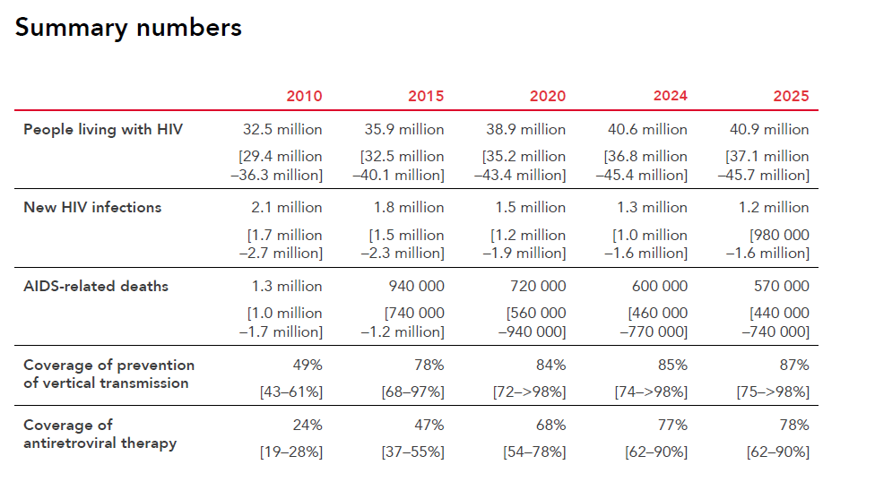

Slide 4

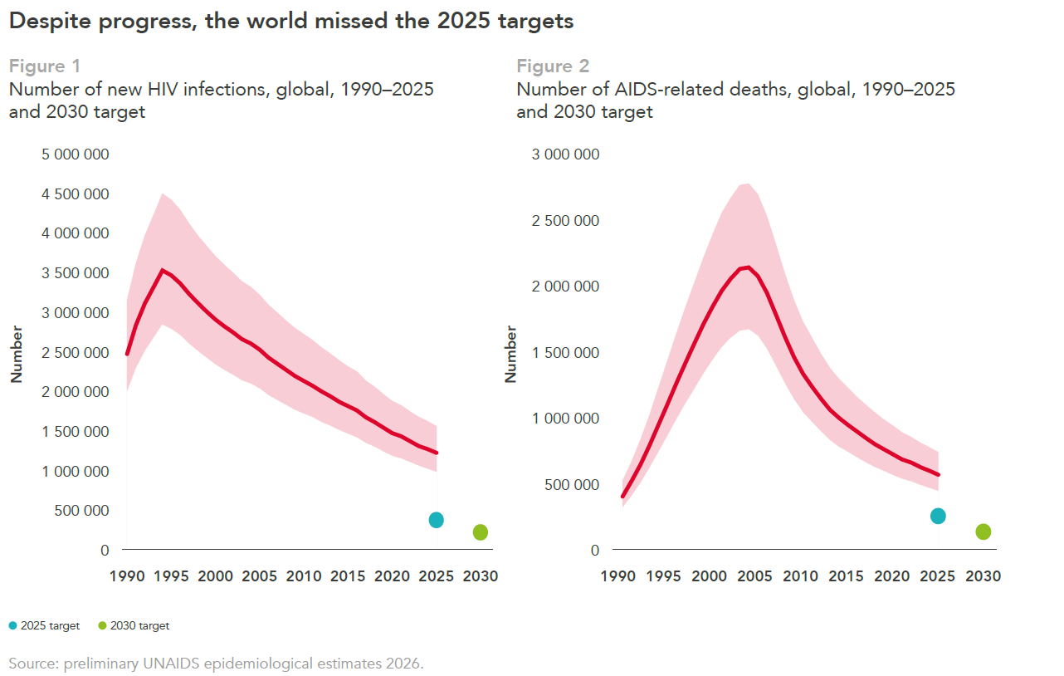

Slide 5
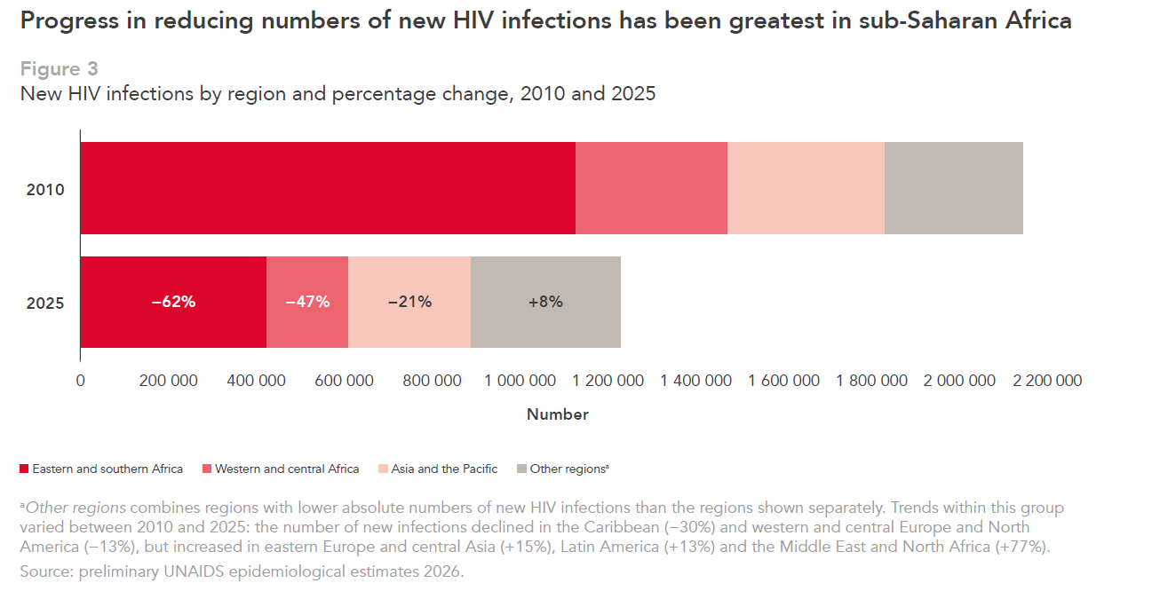

Slide 6
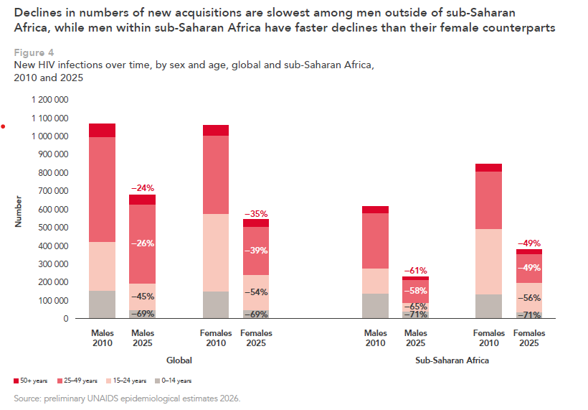

Slide 7
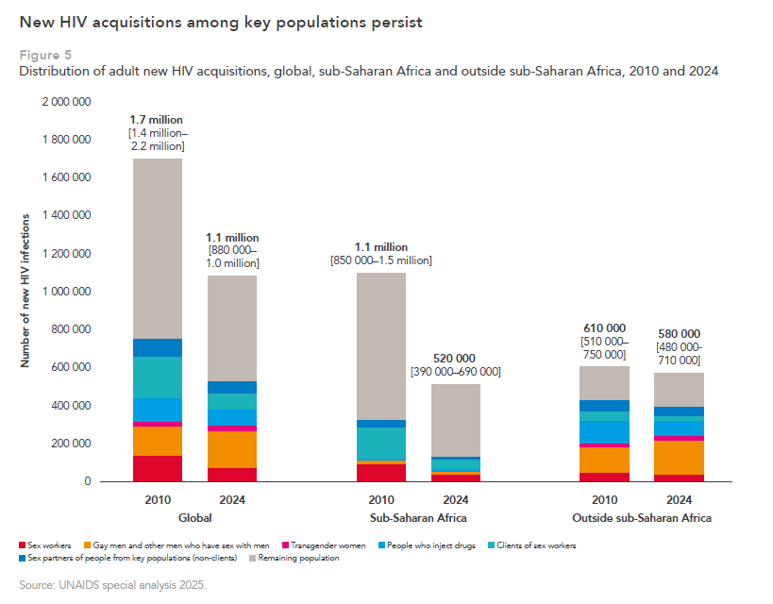

Slide 8
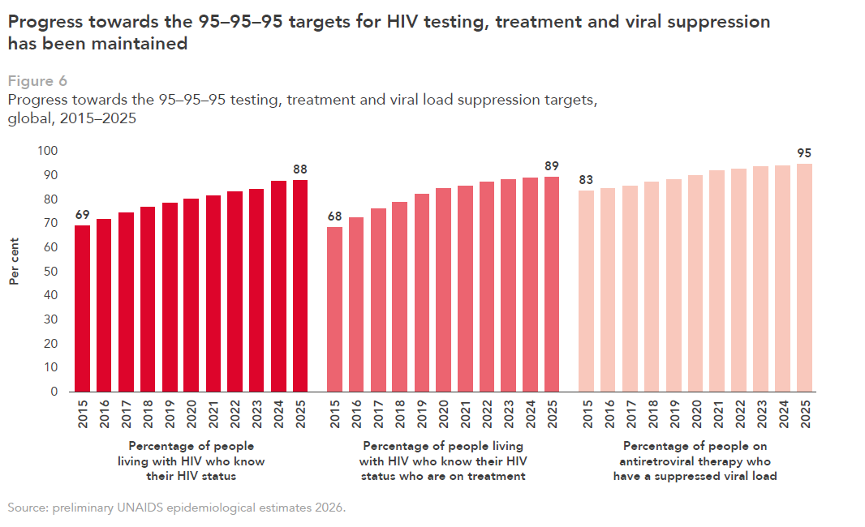

Slide 9
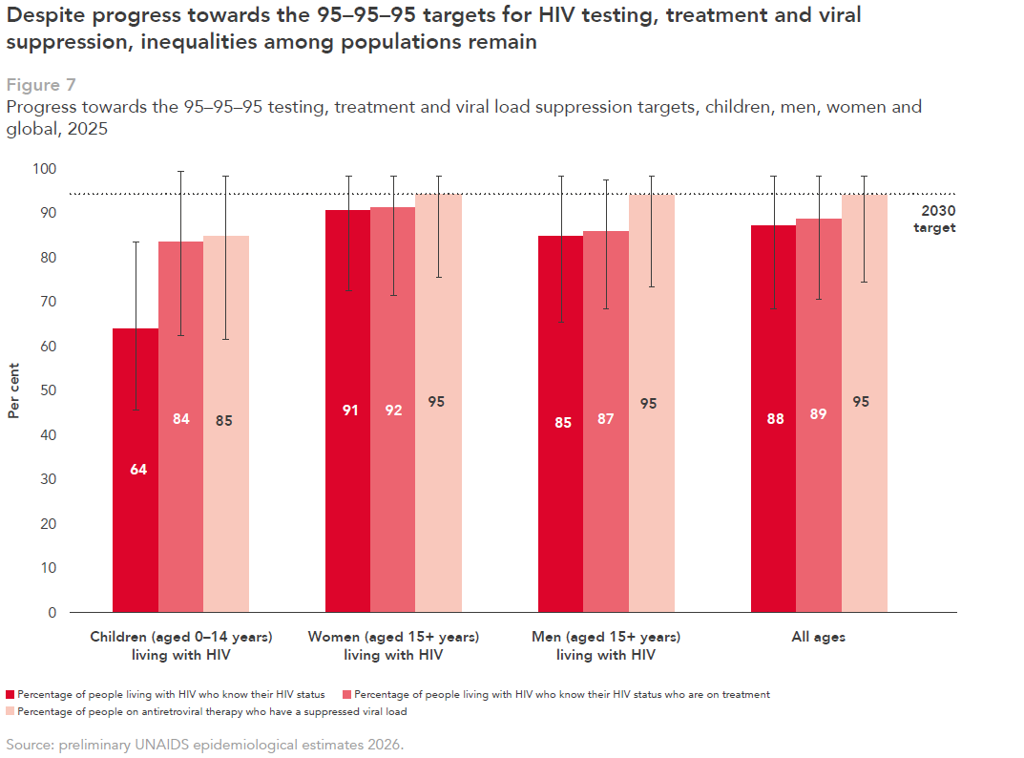

Slide 10
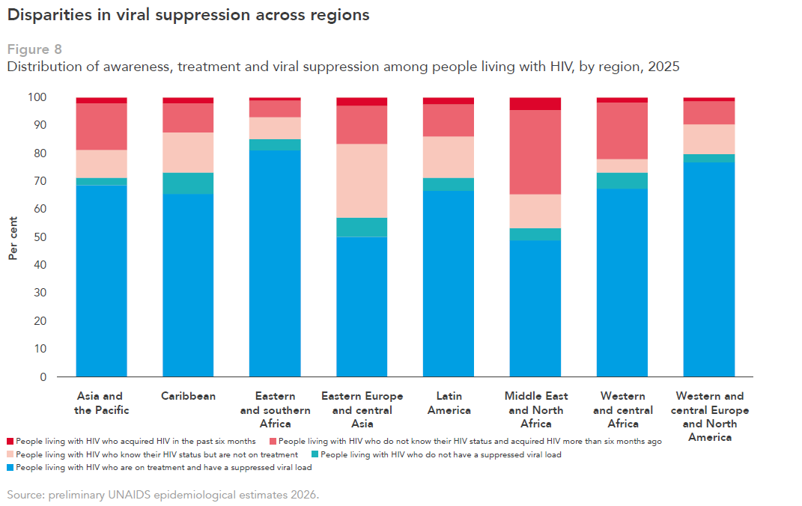

Slide 11
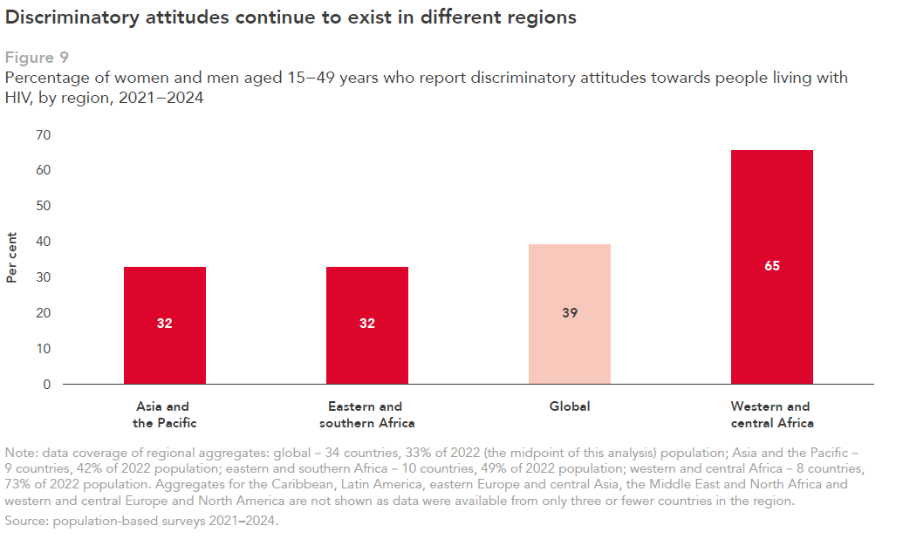

Slide 12
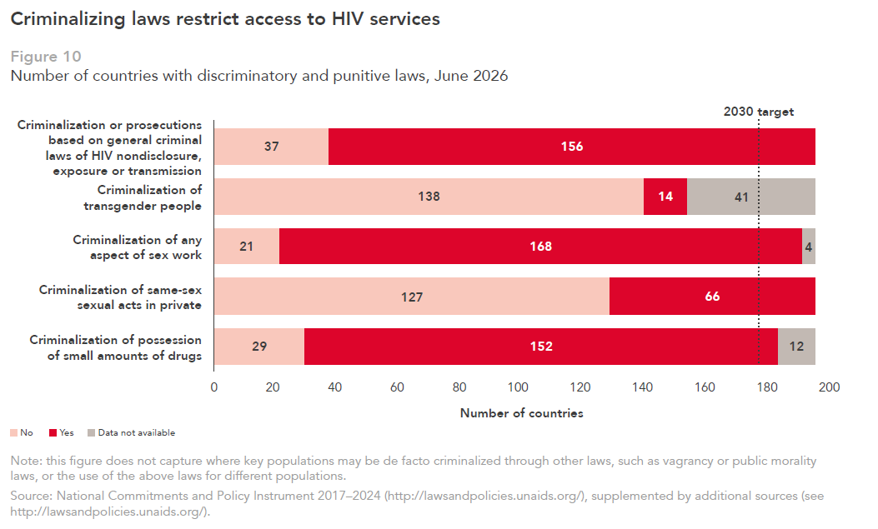

Slide 13
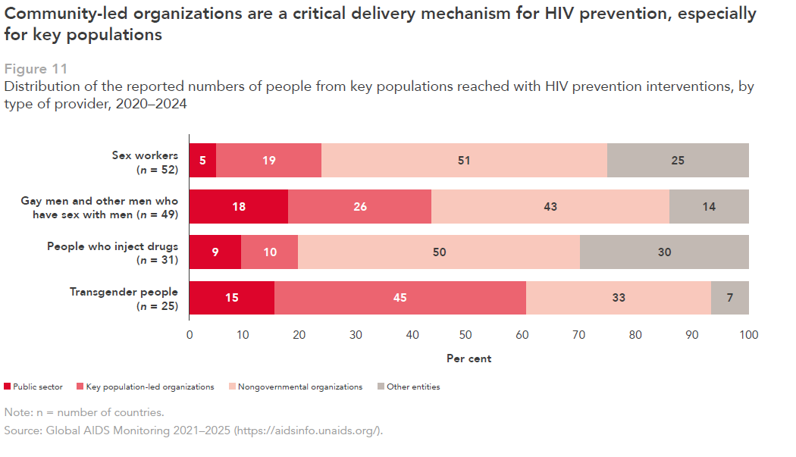

Slide 14
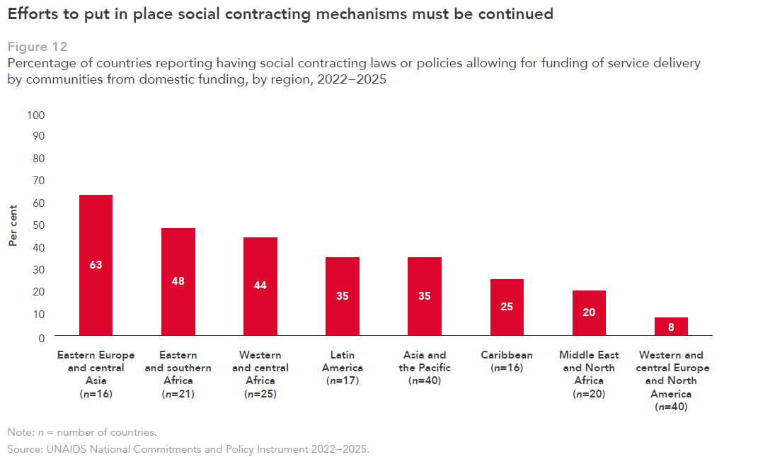

Slide 15
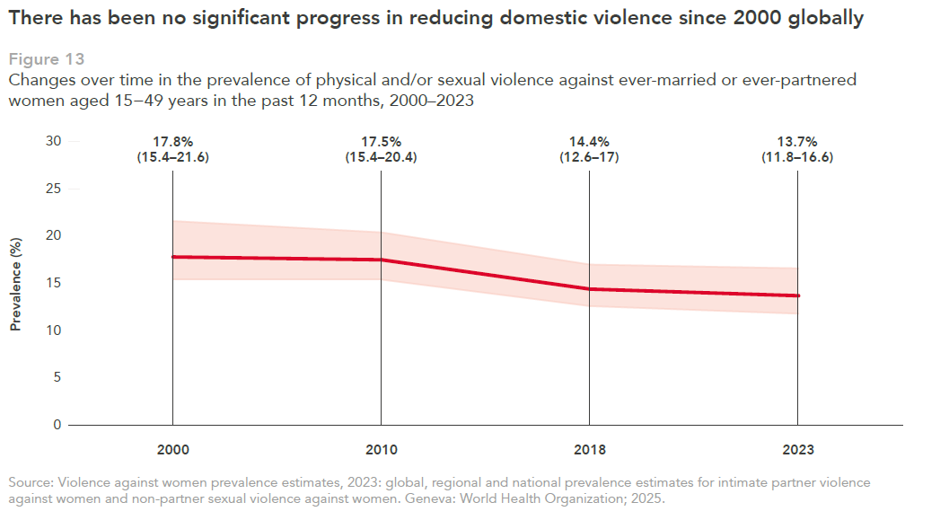

Slide 16
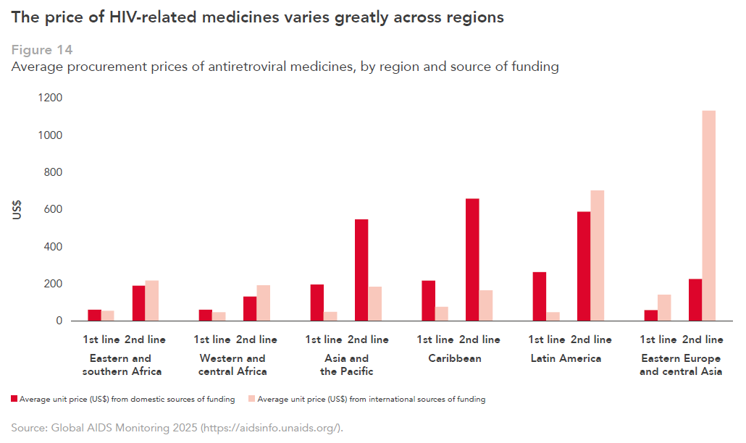

Slide 17
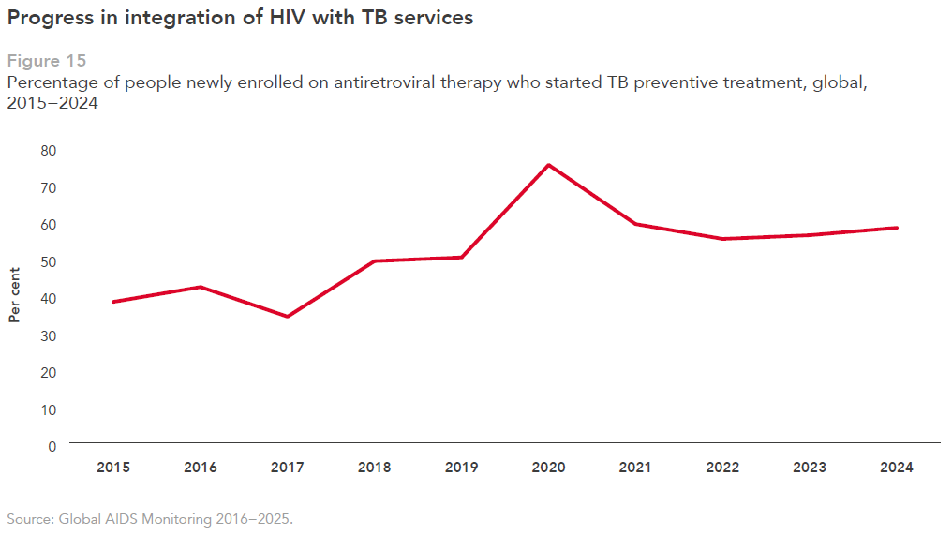

Slide 18
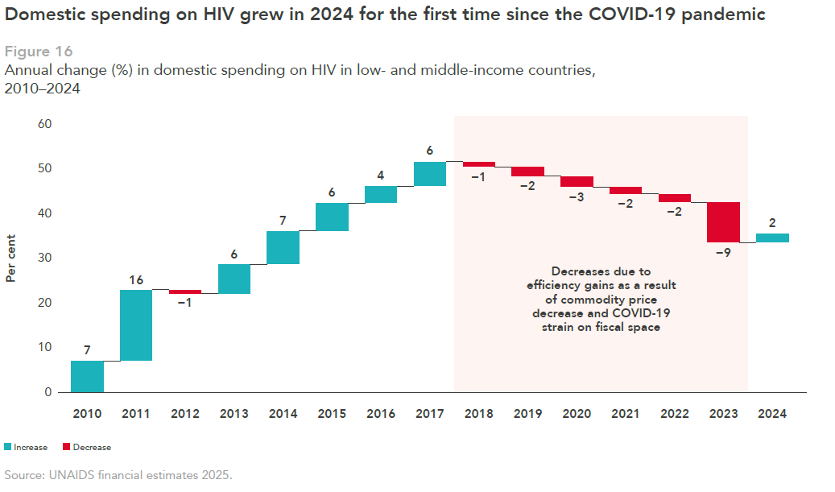

Slide 19
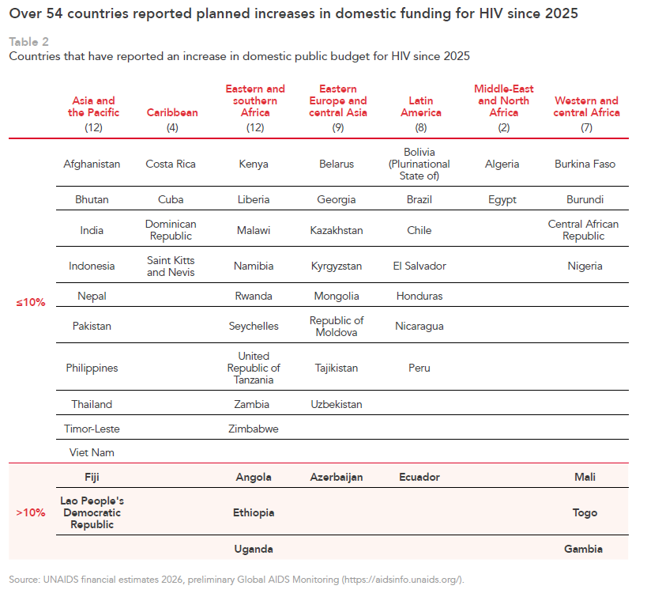

Slide 20
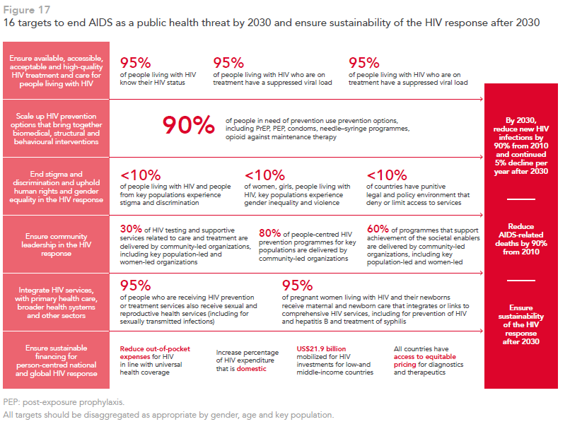

Slide 21
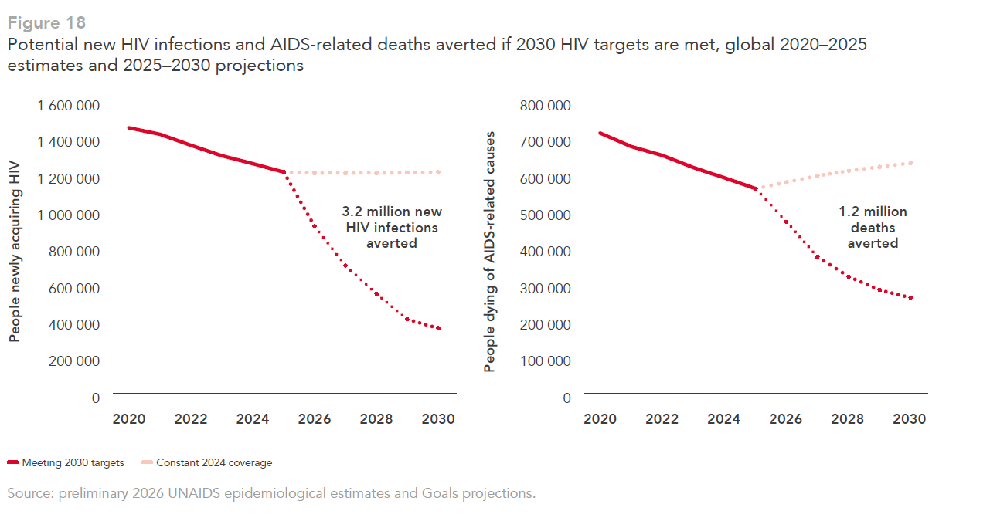

Slide 22
More information: https://aidsinfo.unaids.org/

