Slide 1
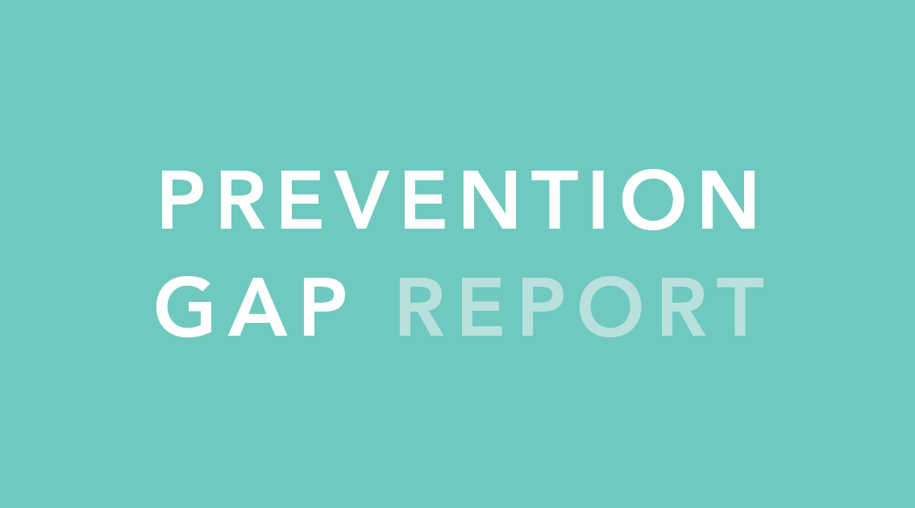

Slide 2
INTRODUCTION

Slide 3
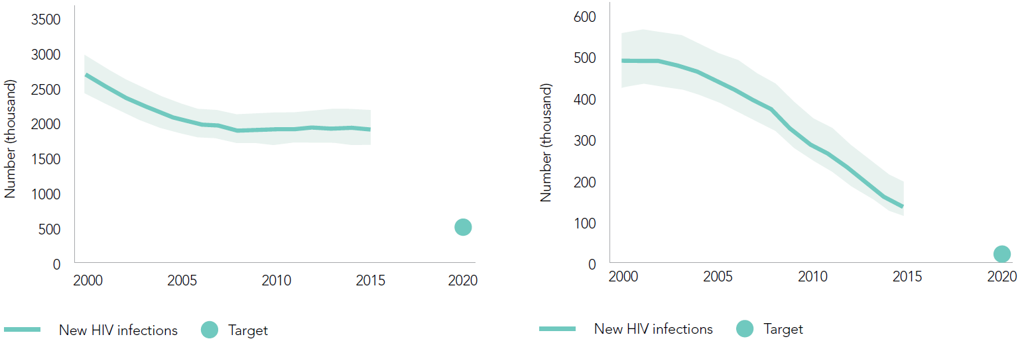
New HIV infections among adults (aged 15 years and older),
global, 2000–2015
New HIV infections among children (aged 0–14 years), global,
2000–2015
Source: UNAIDS 2016 estimates.

Slide 4
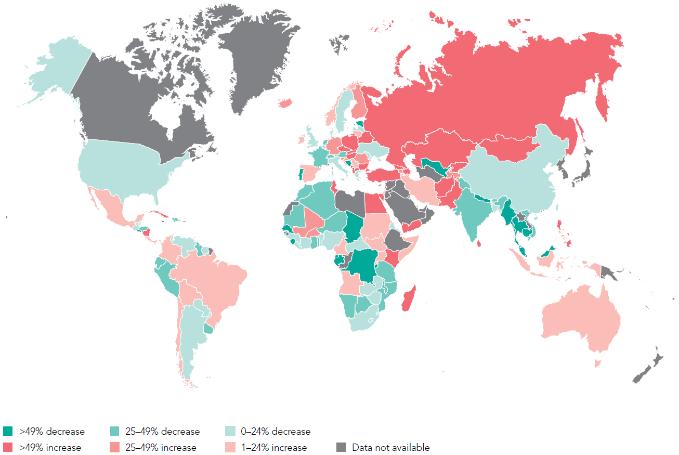
Percent change in new HIV infections among adults (aged 15 years and older), from 2005 to 2015
Sources: UNAIDS 2016 estimates; European Centre for Disease Prevention and Control (Austria, Belgium, Bulgaria, Croatia, Cyprus, Czech Republic, Denmark, Estonia, Finland, France, Germany, Hungary, Iceland, Ireland, Lithuania, Luxembourg, Malta, Netherlands, Norway, Poland, Portugal, Romania, Slovakia, Slovenia, Sweden, United Kingdom, Albania, Andorra, Bosnia and Herzegovina, Macedonia, Israel, Montenegro, San Marino, Serbia, Switzerland and Turkey); Centers for Disease Control and Prevention. HIV Surveillance Report, 2014; vol. 26. http://www.cdc.gov/hiv/library/reports/surveillance/. Published November 2015. Accessed [10 July 2016]. Russian Federation 2016 Global AIDS Response Progress Reporting submission. China 2016 Global AIDS Response Progress Reporting submission.

Slide 5
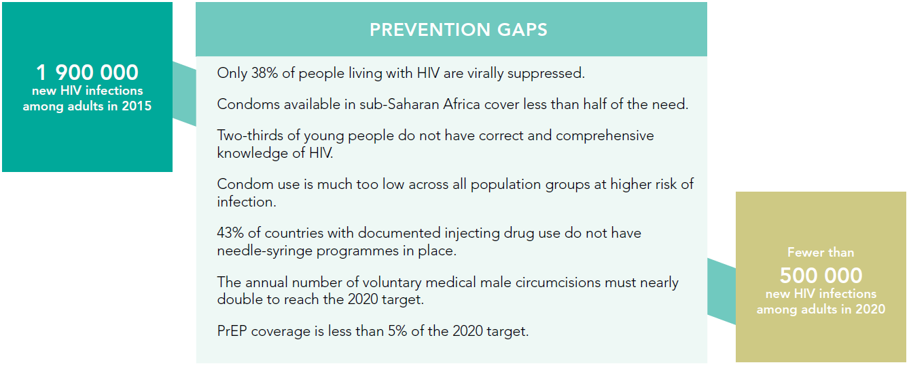

Slide 6
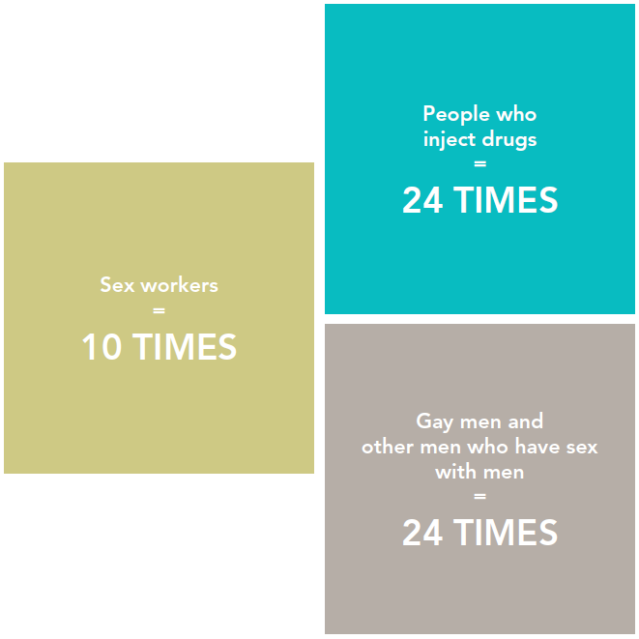
The risk of HIV acquisition compared to adults (aged 15 years and older) in the general population

Slide 7
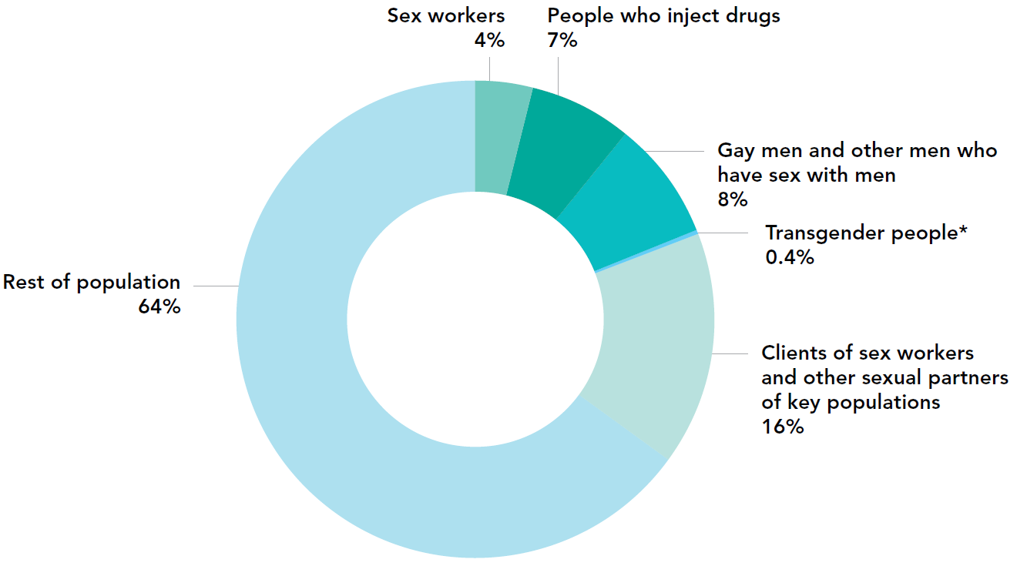
Distribution of new HIV infections by population, global, 2014
* Reflects only Asia and Pacific and Latin America regions.
Source: UNAIDS special analysis, 2016; for more details, see annex on methodology.

Slide 8
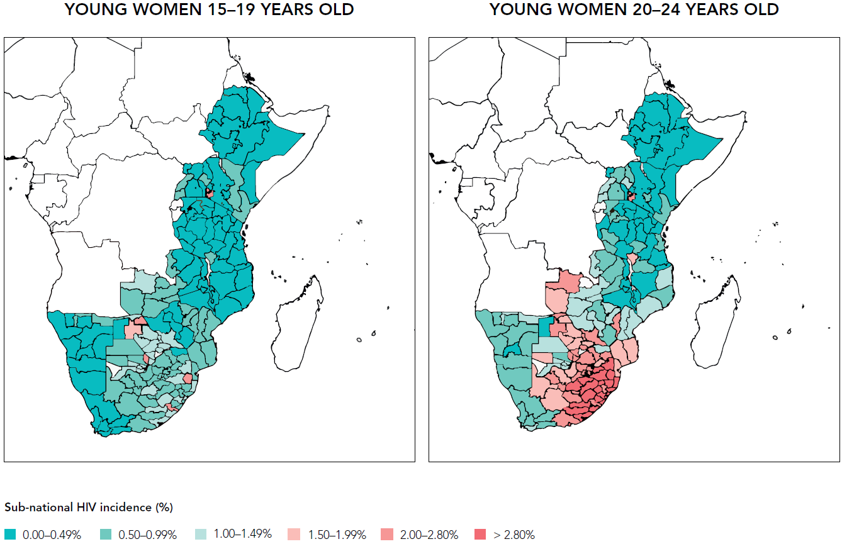
Subnational HIV incidence (%) among young women (aged 15–24 years), by age group, eastern and southern Africa, 2014–2015
Source: UNAIDS special analysis, 2016; for more details, see annex on methodology.

Slide 9
FIVE PREVENTION PILLARS

Slide 10
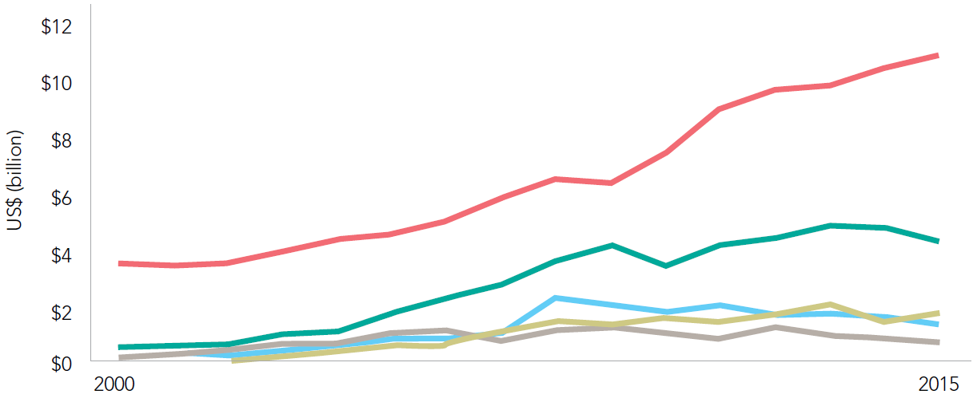
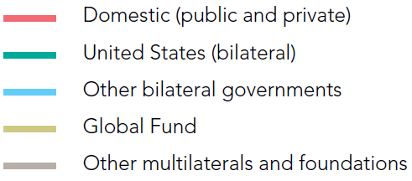
Resources available for HIV by source of funding, 2000–2015
Source: UNAIDS estimates, June 2016; UNAIDS-Kaiser Family Foundation reports on Financing the Response to AIDS in Low- and Middle-Income Countries till 2015, OECD CRS last accessed
June 2016.

Slide 11
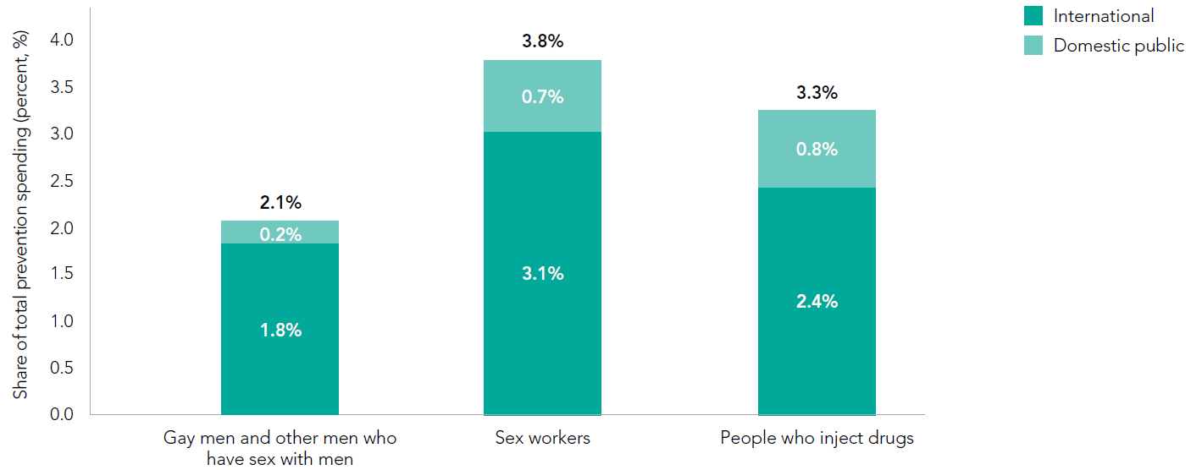
Spending on programmes specifically for key populations as a percentage of total prevention spending by source, 2010–2014
Source: Global AIDS Response Progress Reporting, 2010-2014.

Slide 12
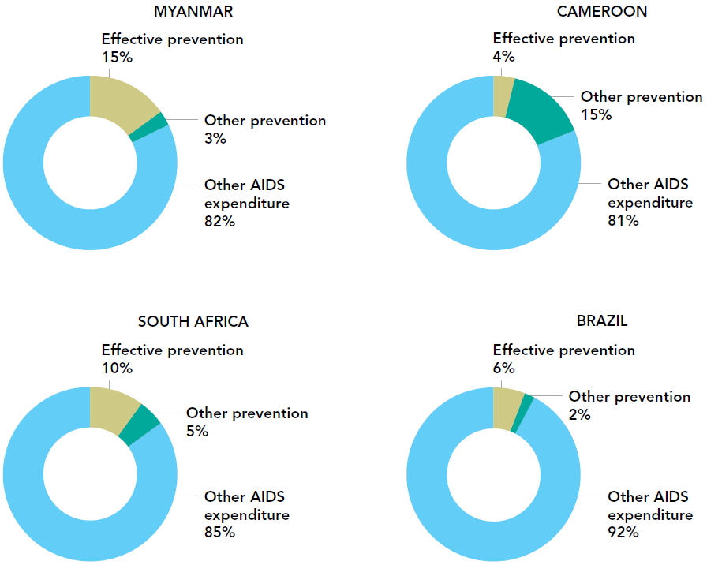
Percentage of investments for effective prevention and other prevention categories, four countries, 2013–2014
Source: Global AIDS Response Progress Reporting.

Slide 13
STRUCTURAL
CHANGE

Slide 14
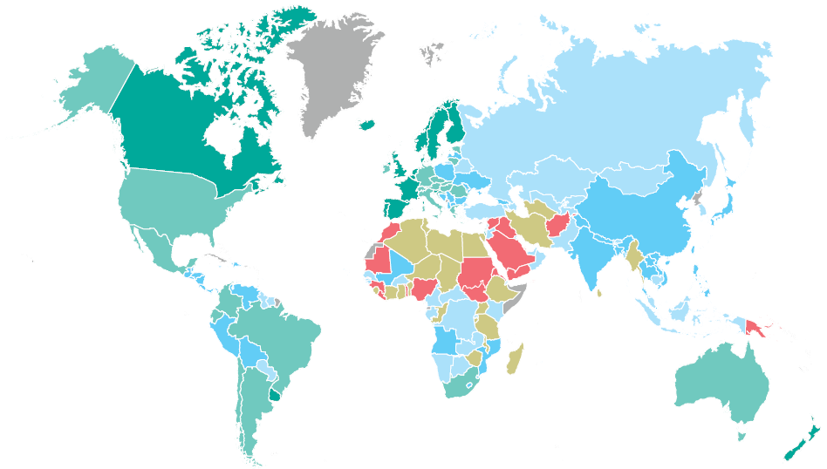
THE HOMOPHOBIC CLIMATE INDEX, 2016
Source: Lamontagne et al, 2016.

Slide 15
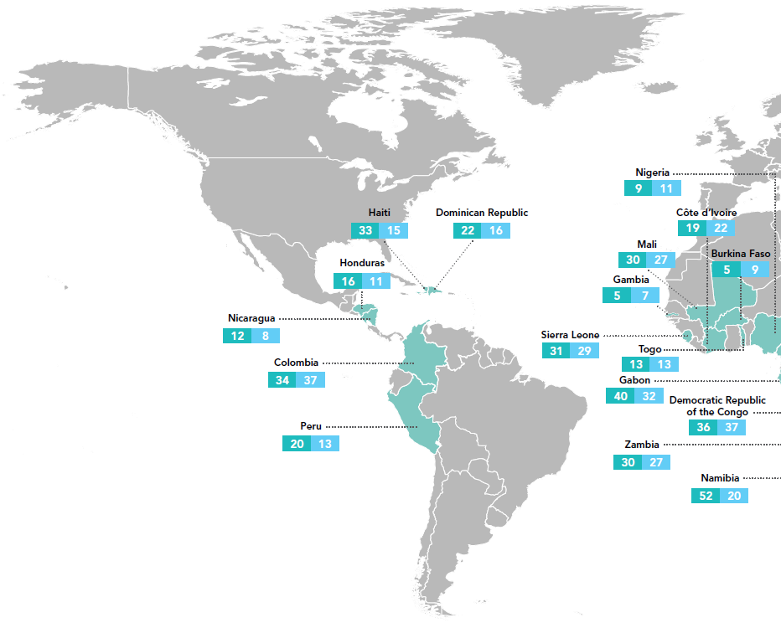
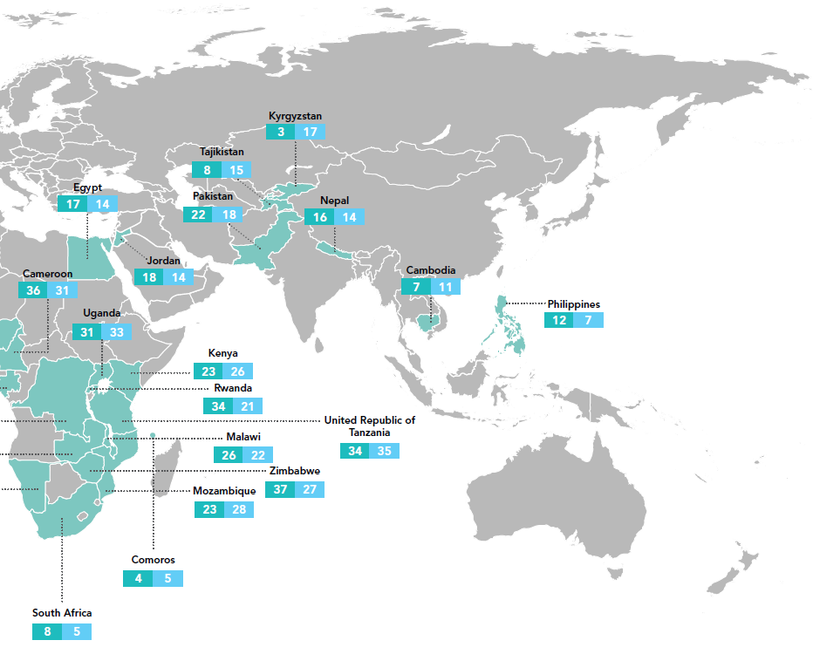
Prevalence of recent intimate partner violence among ever-married or partnered women, aged 15–19 years, compared to those aged 15–49 years, 32 countries, 2010–2014
Source: Population-based surveys, 2010–2014.

Slide 16
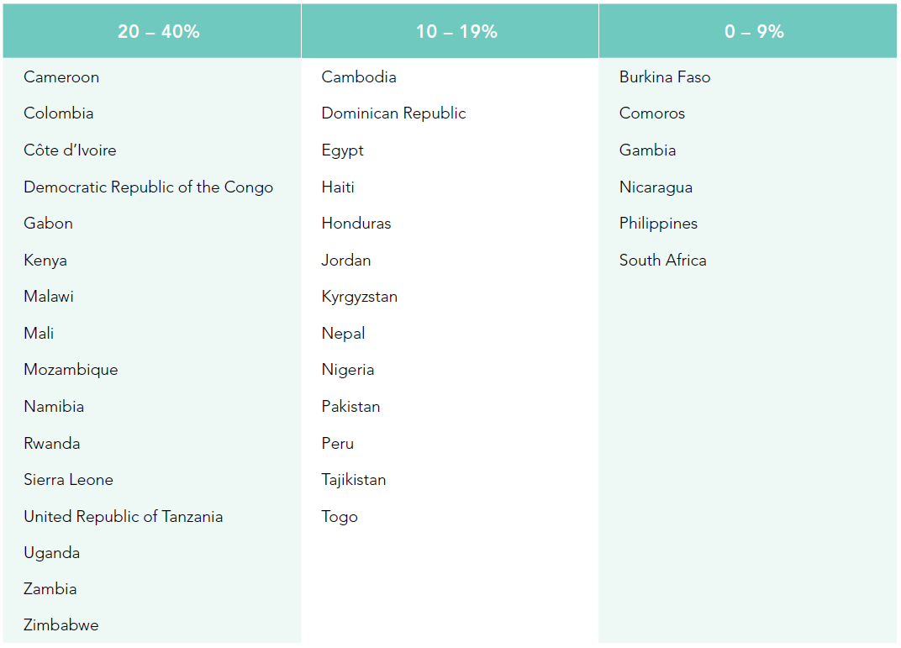
Percent of ever-married or partnered women (aged 15–49 years) reporting experiences of physical and/or sexual violence by a former or current male intimate partner in the past 12 months, most recent data, 2010–2014
Source: Population-based surveys, 2010–2014.

Slide 17
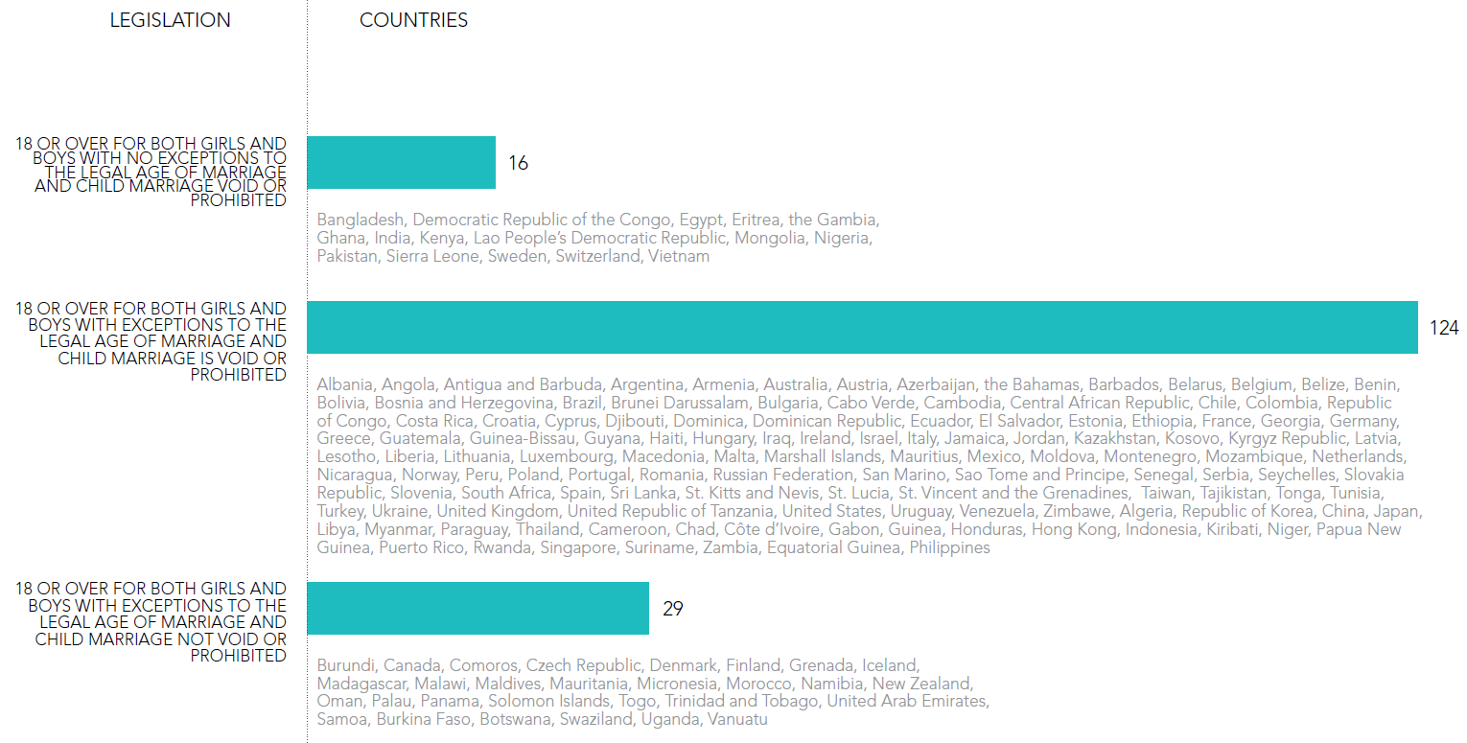
Child marriage legislation, by country, 2015
1/3
Source: Women, business and the law 2016: getting to equal. Washington, DC: World Bank; 2016.

Slide 18
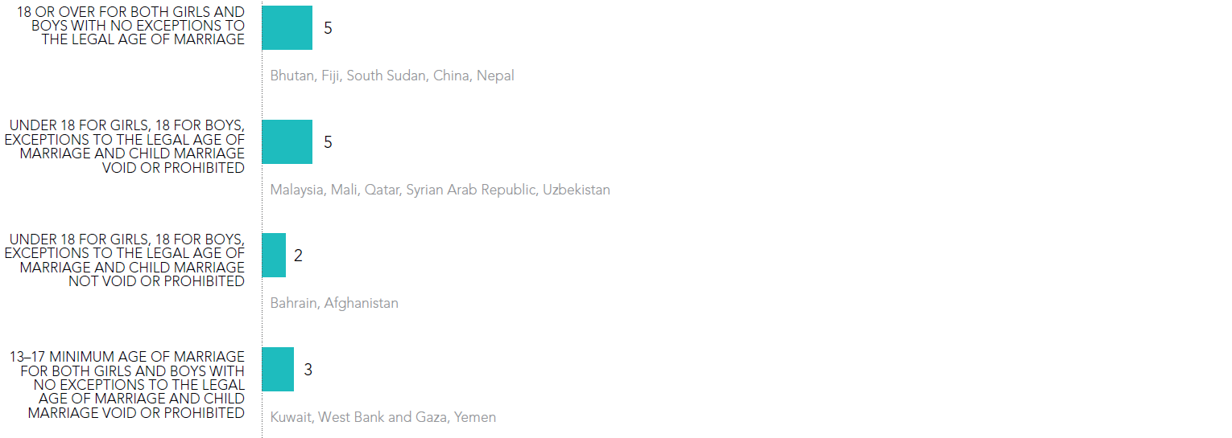
Child marriage legislation, by country, 2015
2/3
Source: Women, business and the law 2016: getting to equal. Washington, DC: World Bank; 2016.

Slide 19
Child marriage legislation, by country, 2015
3/3
Source: Women, business and the law 2016: getting to equal. Washington, DC: World Bank; 2016.

Slide 20
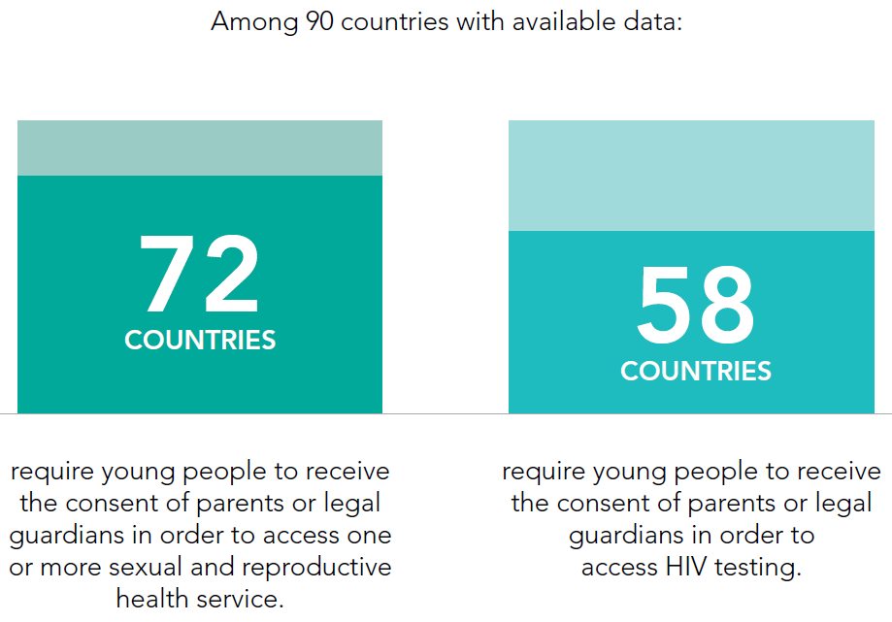
Parental consent for sexual and reproductive health and HIV testing services for young people, 2016
Source: Sexual Rights Initiative. Sexual rights database (http://sexualrightsdatabase.org/map/25/Age%20of%20sexual%20consent%20-%20different%20sex, Accessed 23 June 2016).

Slide 21
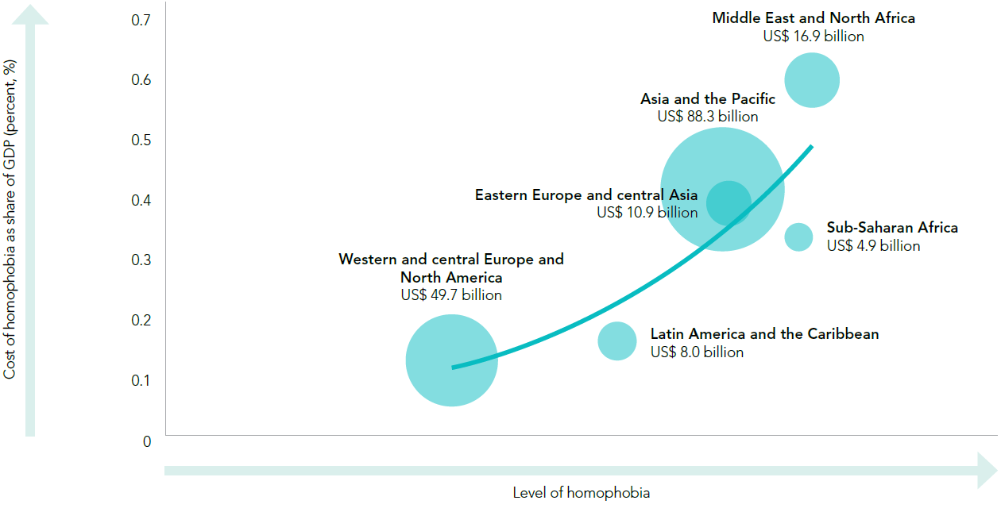
Cost of homophobia as a share of GDP and in value, per region, per year
The size of the bubble represents the total cost of homophobia, per year, in billions of US dollars, per region.
Population of gay men and other men who have sex with men = 3% of males (aged 15–64 years). Elasticity of homophobia = 1.19 ; Regression fit curve R2 = 0.82.

Slide 22
CONDOMS

Slide 23
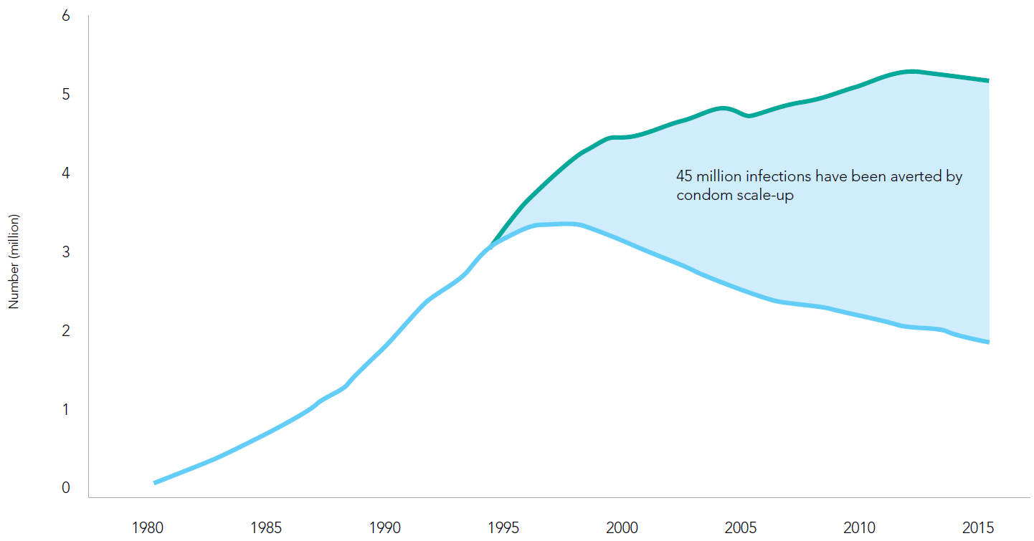
Number of HIV infections averted through condom use, global, 1990–2015
Source: John Stover, Avenir Health, 2016. The Contribution of Condoms to HIV Prevention. Data for Fast-Tracking Condom Programmes. Presented at of the Global Condom Steering Group
21-23 March 2016, Geneva.

Slide 24
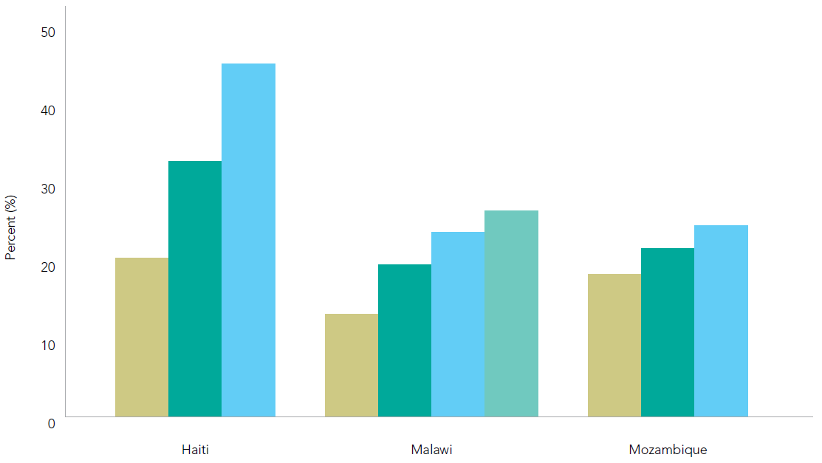
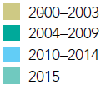
Number of HIV infections averted through condom use, global, 1990–2015
Haiti Malawi Mozambique
Source: Demographic and Health Surveys, 2000-2015.

Slide 25
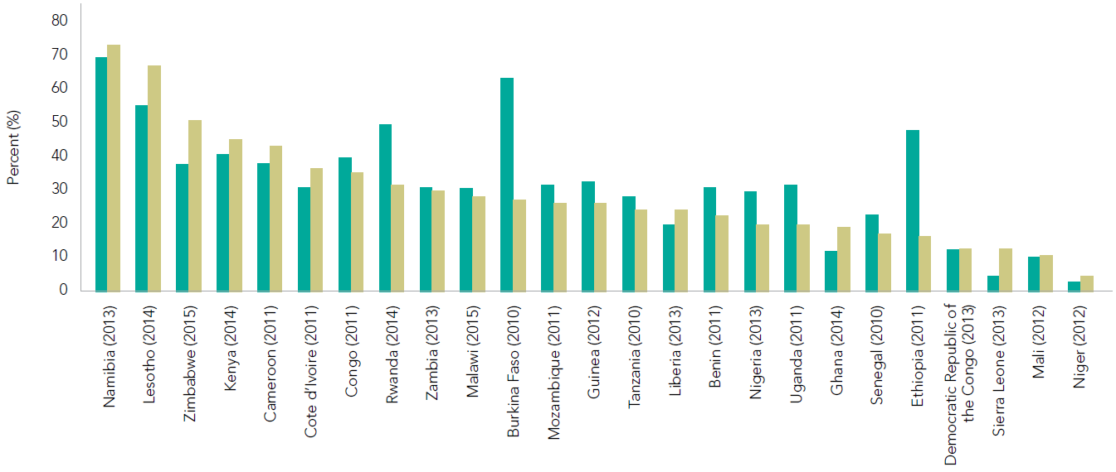
Percent of men and women (aged 15–49 years) who report using a condom at last sexual intercourse among those with multiple partners in the 12 months prior to the survey, sub-Saharan Africa, most recent data, 2010–2015
Source: Demographic and Health Surveys, 2010-2015.

Slide 26
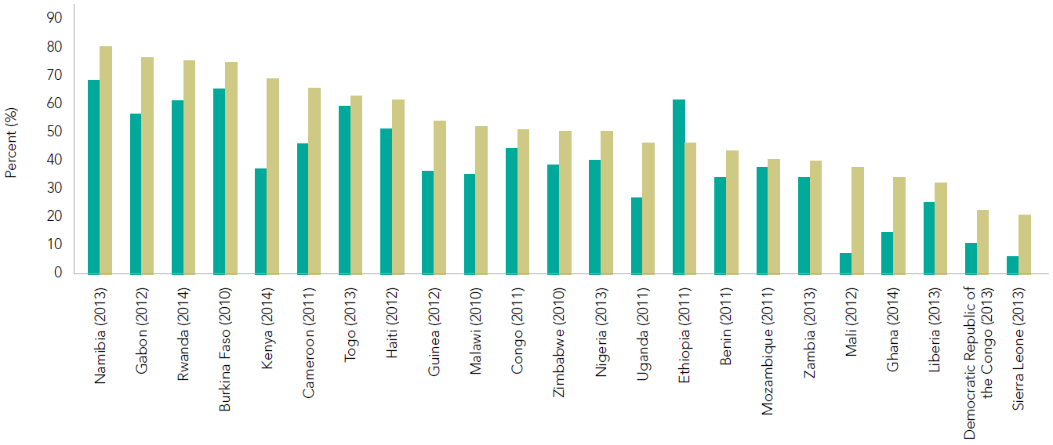
Percent of young women and men (aged 15–24 years) reporting use of a condom at last sexual intercourse with a non-regular partner
in the 12 months prior to the survey, sub-Saharan Africa, 2010–2015
Source: Demographic and Health Surveys, 2010-2015.

Slide 27
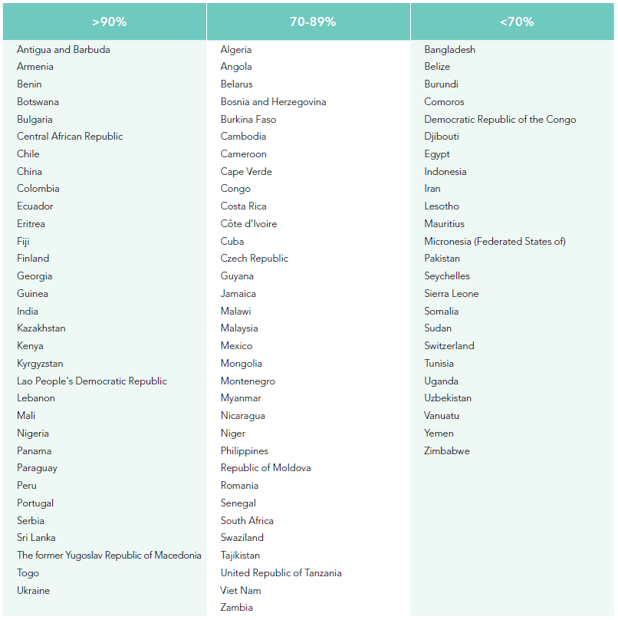
Percent of sex workers reporting condom use with last client, most recent data, 2013–2015
Source: 2016 Global AIDS Response Progress Reporting.

Slide 28
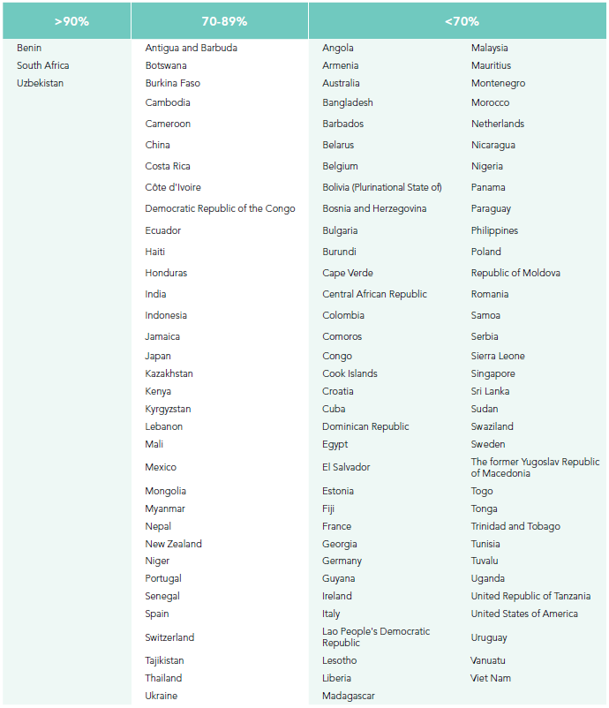
Percent of gay men and other men who have sex with men reporting condom use with last male partner, most recent data, 2013–2015
Source: 2016 Global AIDS Response Progress Reporting.

Slide 29
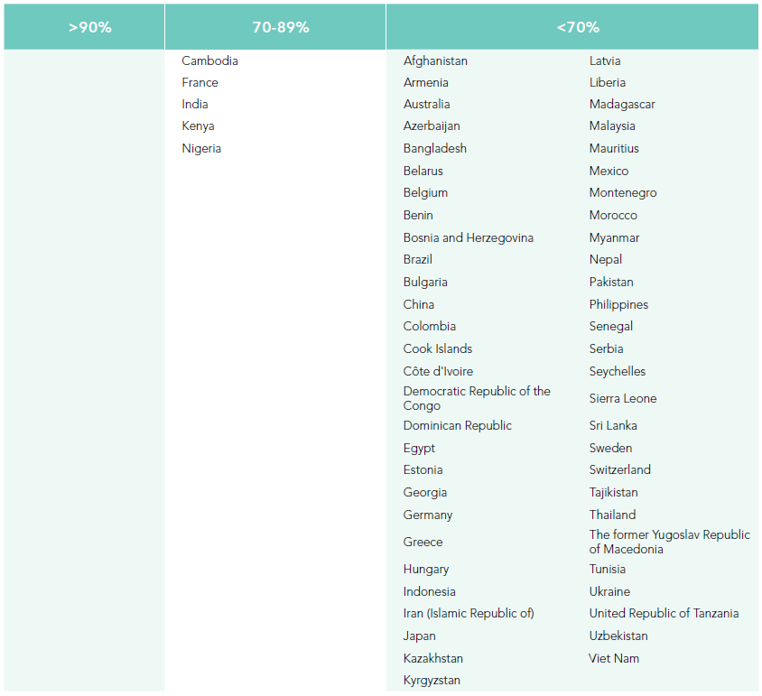
Percent of people who inject drugs reporting condom use with last partner, most recent data, 2013–2015
Source: 2016 Global AIDS Response Progress Reporting.

Slide 30
VOLUNTARY
MEDICAL
MALE
CIRCUMCISION

Slide 31
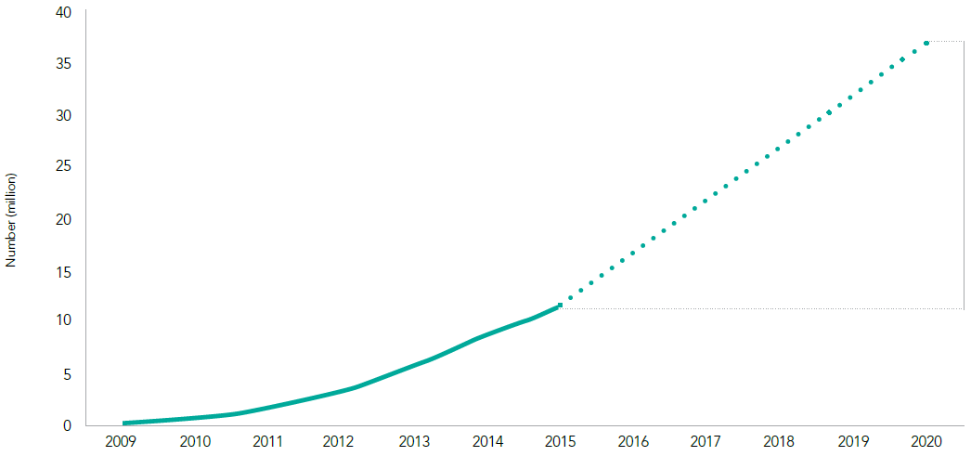
CUMULATIVE NUMBER OF VOLUNTARY MEDICAL
MALE CIRCUMCISIONS, 14 PRIORITY COUNTRIES,
2009–2015, AND 2020 TARGET
25 million
additional
young men in
high-prevalence
settings*
* At the end of 2015 there were 14 priority countries. The 2020 target includes high-prevalence settings within 15 countries—the original 14, plus South Sudan.
Source: 2016 Global AIDS Response Progress Reporting.

Slide 32
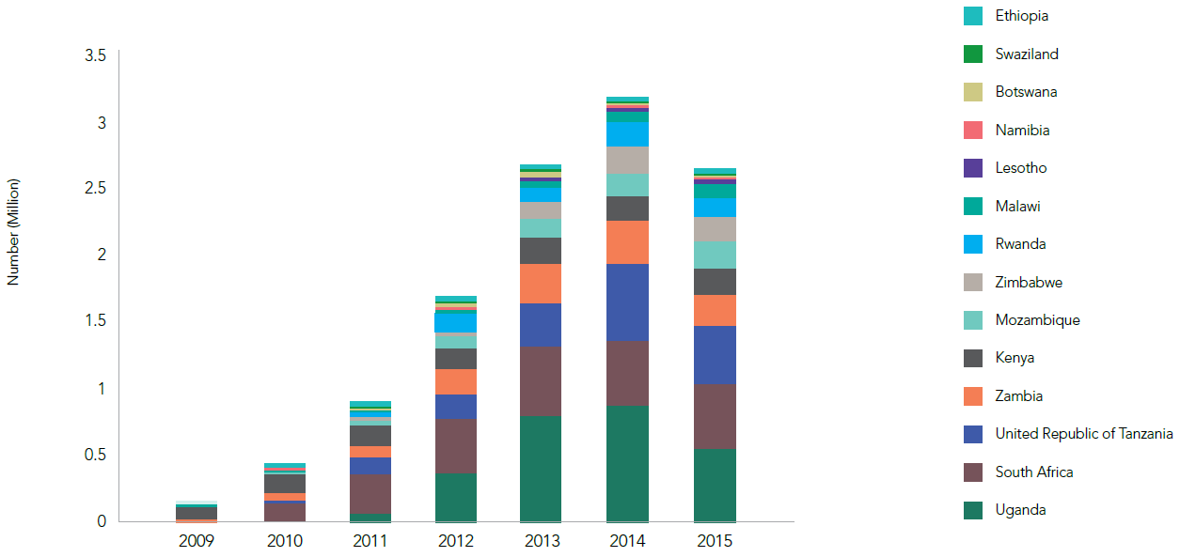
ANNUAL NUMBER OF VOLUNTARY MEDICAL
MALE CIRCUMCISIONS, 14 PRIORITY COUNTRIES,
2009–2015
Source: 2016 Global AIDS Response Progress Reporting.

Slide 33
HARM REDUCTION

Slide 34
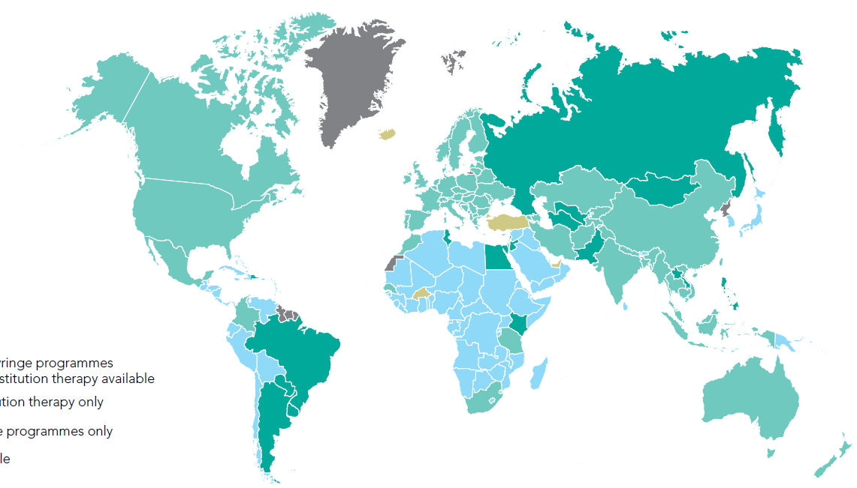
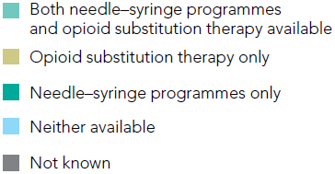
AVAILABILITY OF NEEDLE–SYRINGE EXCHANGE PROGRAMMES AND OPIOID SUBSTITUTION THERAPY, 2014
Source: The global state of harm reduction 2014. London: Harm Reduction International; 2014 (http://www.ihra.net/files/2015/02/16/GSHR2014.pdf).

Slide 35
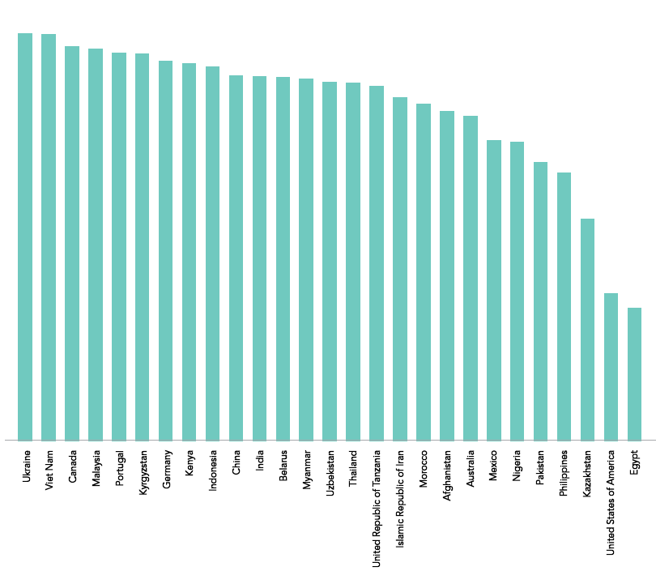
Percent of people who inject drugs who reported using sterile injection equipment for last injection, select countries, most recent data, 2013–2015
100
80
60
Percent (%)
40
20
0
Source: 2016 Global AIDS Response Progress Reporting.

Slide 36
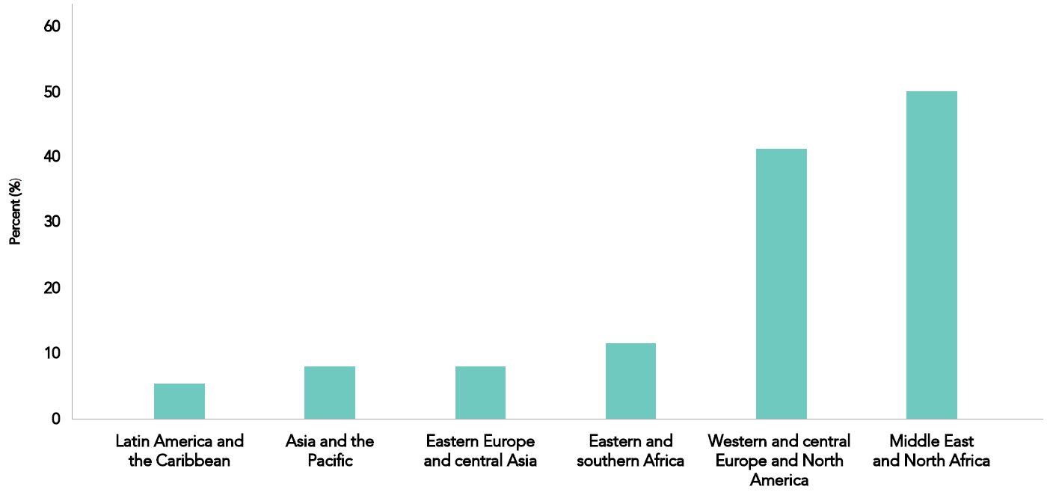
Median percent of people with opioid dependence use receiving opioid substitution therapy, 2015
Source: 2016 Global AIDS Response Progress Reporting; UNODC. World Drug Report 2016.

Slide 37
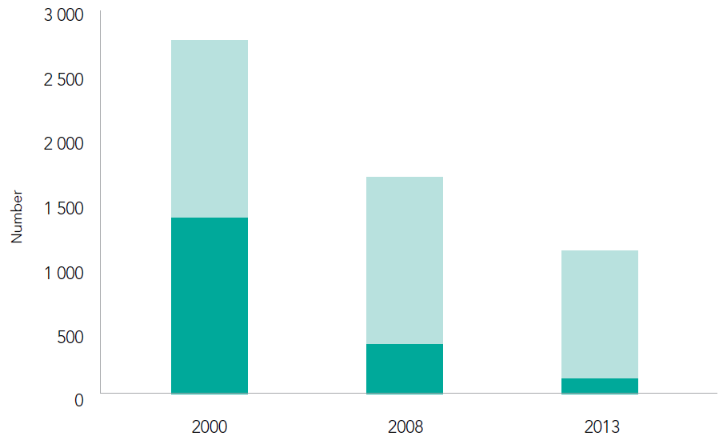
Number of people newly diagnosed with HIV in Portugal since the decriminalization of drug use, 2000–2013
Source: Domoslawski A. Drug Policy in Portugal: the benefits of decriminalization drug use. Warsaw: Open Society Foundations; 2011.

Slide 38
VIRAL
SUPPRESSION

Slide 39
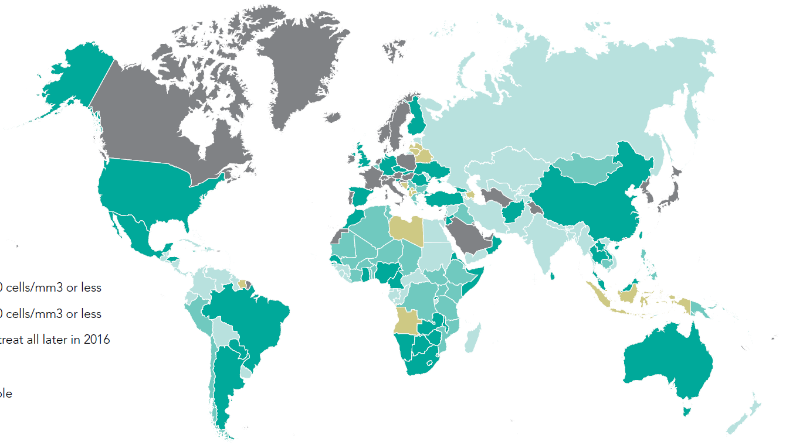
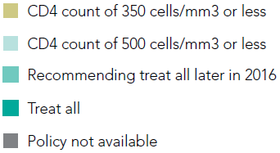
RECOMMENDED ANTIRETROVIRAL TREATMENT
INITIATION THRESHOLD AMONG PEOPLE LIVING WITH HIV PER MINISTRY OF HEALTH GUIDELINES, MID-2016
Source: World Health Organization, 2016.

Slide 40
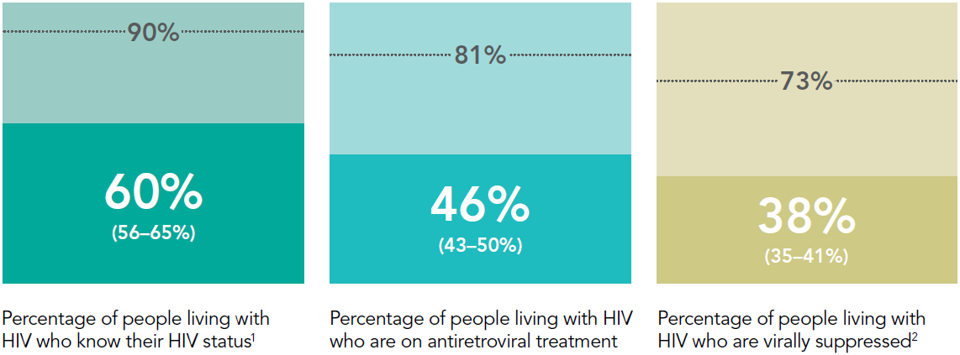
PROGRESS TOWARDS 90–90–90 TARGET, GLOBAL, 2015
¹ 2015 measure derived from data reported by 87 countries, which accounted for 79% of people living with HIV worldwide.
² 2015 measure derived from data reported by 86 countries. Worldwide, 22% of all people on antiretroviral therapy were reported to have received a viral load test during the reporting period.
Source: UNAIDS special analysis, 2016; for more details, see annex on methods.

Slide 41
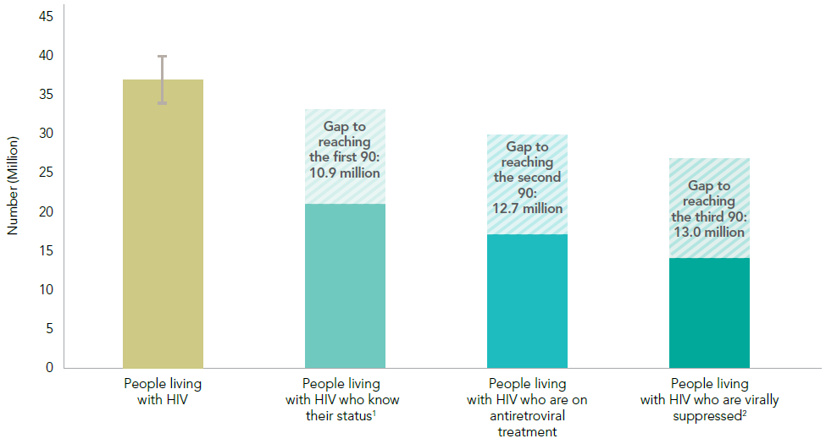
90–90–90 target cascade, global, 2015
¹ 2015 measure derived from data reported by 87 countries, which accounted for 73% of people living with HIV worldwide.
² 2015 measure derived from data reported by 86 countries. Worldwide, 22% of all people on antiretroviral therapy were reported to have received a viral load test during the reporting period.
Source: UNAIDS special analysis, 2016; for more details, see annex on methods.

Slide 42
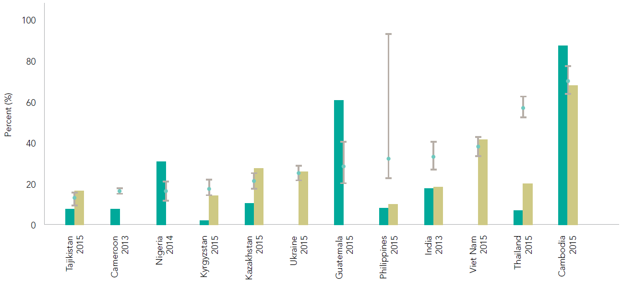
Antiretroviral therapy coverage among select key population groups and the general adult male population (aged 15 years and older), matched by survey year, 2013–2015
Source: UNAIDS, the Global Fund to Fight AIDS, Tuberculosis and Malaria, and the World Health Organization. Key Population Atlas. In press. 2016.

Slide 43
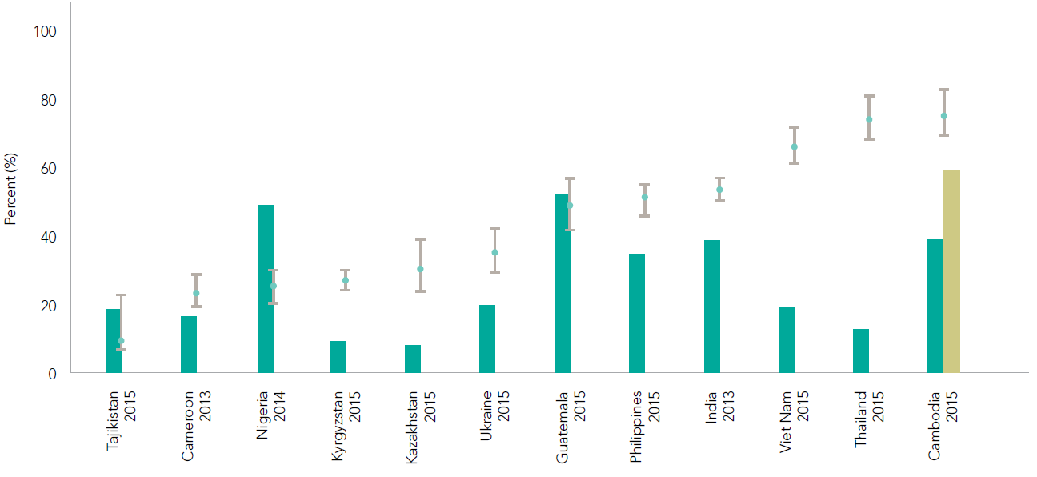
Antiretroviral therapy coverage among select key population groups and the general adult female population (aged 15 years and older), matched by survey year, 2013–2015
Source: UNAIDS, the Global Fund to Fight AIDS, Tuberculosis and Malaria, and the World Health Organization. Key Population Atlas. In press. 2016.

Slide 44
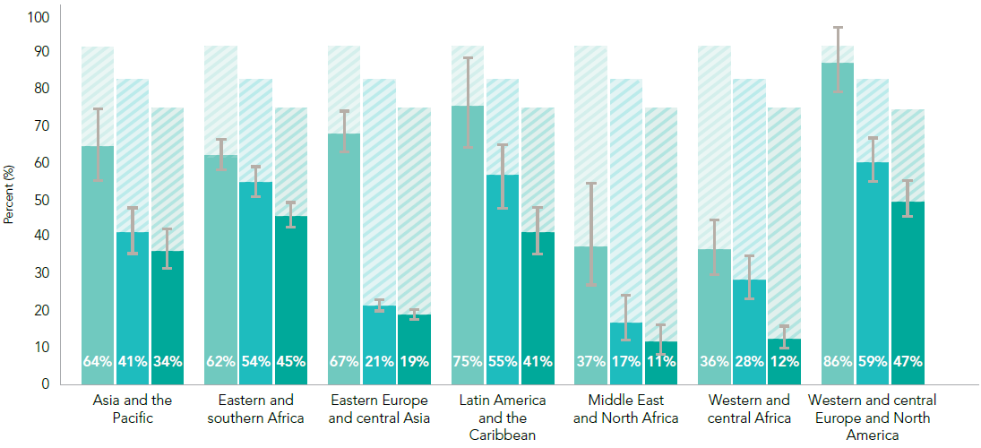
Progress toward the 90–90–90 target, by region, 2015
Source: UNAIDS special analysis, 2016; for more details, see annex on methods.

Slide 45
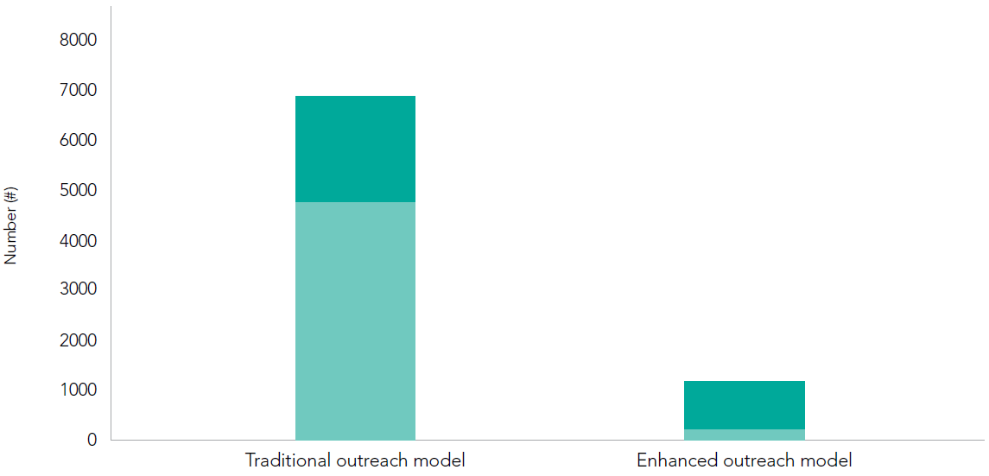
Comparison of models to reach gay men and other men who have sex with men and transgender women with HIV testing, Chiang Mai, Thailand, July 2015–March 2016
Source: LINKAGES Thailand, 2016.

Slide 46
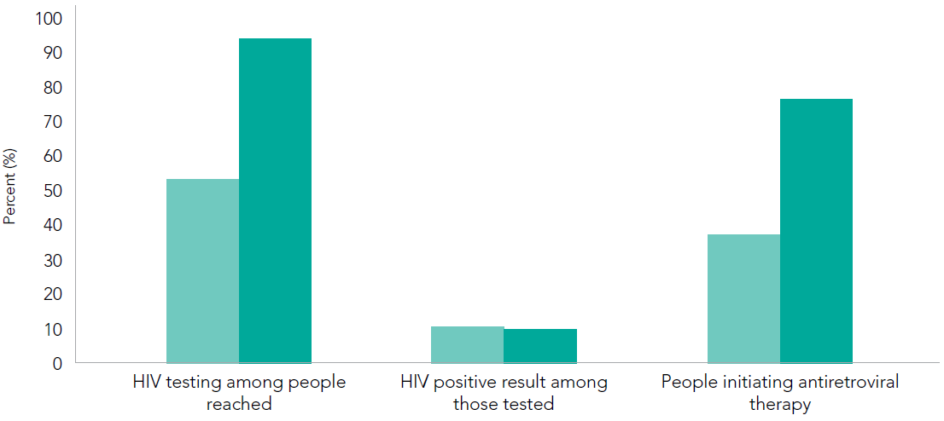
HIV testing and treatment initiation by outreach model type, all sites, Thailand, July 2015–March 2016
Source: LINKAGES Thailand, 2016.

Slide 47
PRE-EXPOSURE
PROPHYLAXIS

Slide 48
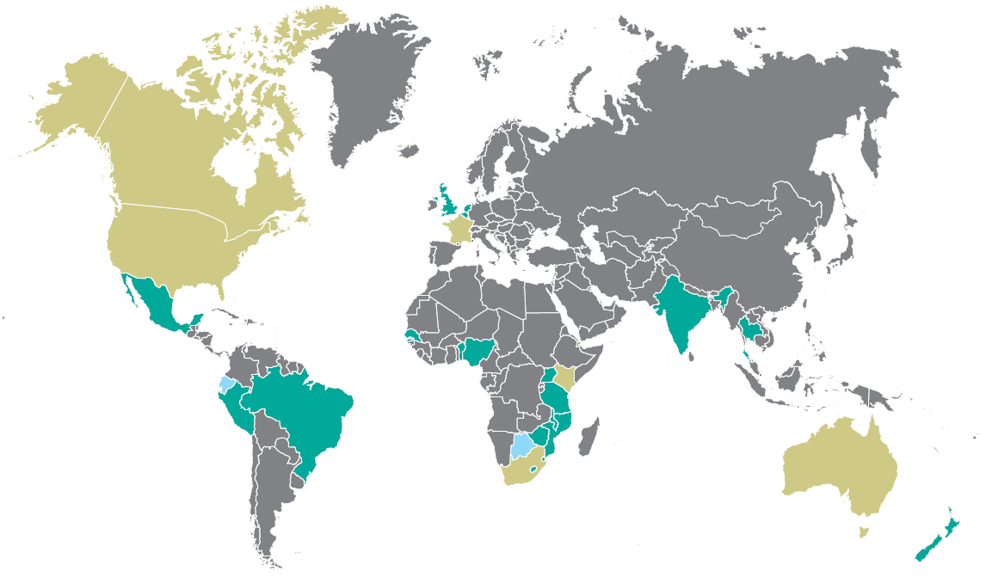
COUNTRIES THAT HAVE DEMONSTRATION PROJECTS OR HAVE APPROVED TENOFOVIR DISOPROXYL FUMARATE/EMTRICITABINE FOR PRE-EXPOSURE PROPHYLAXIS, AS OF JUNE 2016
*These countries also have completed, ongoing and/or planned demonstration projects.
** These projects investigate different aspects of PrEP provision and impact including acceptability, safety, adherence, effect, appropriate service delivery, integration in combination prevention services, costing and associated behavioural aspects. Their aim is to increase access to PrEP for those people who could benefit most from it, especially in situations of stigma, marginalization and criminalization.
Sources: AVAC, U.S. FDAood and Drug Administration, Department of Health, Republic of South Africa, ANSM, MCC, Health Canada, AVERT, and Therapeutic Goods Administration, Department of Health, Australia. (See Notes section for details.)
Notes:
Sources: AVAC, Ongoing and Planned PrEP Open Label, Demonstration and Implementation Projects, as of June 2016 (http://www.avac.org/sites/default/files/resource-files/PrEP_Trials_Demonstration_Projects_June_2016.pdf ); http://www.fda.gov/NewsEvents/Newsroom/PressAnnouncements/ucm312210.htm ; Registrar of Medicines, Medicines Control Council, Department of Health, Republic of South Africa. Press release: Medicines Control Council approves fixed-dose combination of tenofovir disoproxyl fumarate and emtricitabine for pre-exposure prophylaxis of HIV. 3 December 2015; http://ansm.sante.fr/S-informer/Points-d-information-Points-d-information/L-ANSM-etablit-la-RTU-de-Truvada-dans-la-prophylaxie-pre-exposition-au-VIH-Point-d-information; http://www.mccza.com/documents/2e4b3a5310.11_Media_release_ARV_FDC_PrEP_Nov15_v1.pdf ; http://www.hc-sc.gc.ca/dhp-mps/prodpharma/rds-sdr/drug-med/rds-sdr-truvada-187173-eng.php ; https://www.avert.org/news/peru-latest-country-approve-prep; AVAC. South Africa and Kenya Approval of Oral PrEP Should Spur Rollout. 17 December 2015 (http://www.avac.org/blog/south-africa-and-kenya-approval-oral-prep ); Australian Government Therapeutics Goods Administration, Prescription medicines: new or extended uses, or new combinations of registered medicines, 7 July 2016( https://www.tga.gov.au/prescription-medicines-new-or-extended-uses-registered-medicines )

Slide 49
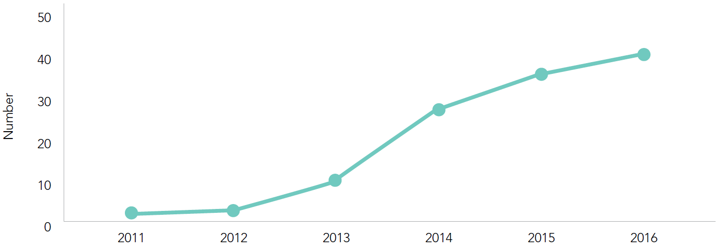
Cumulative number of completed, ongoing and planned PrEP open-label, demonstration and implementation projects, 2011–2016
Source: AVAC, Ongoing and Planned PrEP Open Label, Demonstration and Implementation Projects, as of June 2016 (http://www.avac.org/sites/default/files/resource-files/PrEP_Trials_Demonstration_Projects_June_2016.pdf.)

Slide 50
SOCIAL AND
BEHAVIOUR CHANGE
COMMUNICATION
AND DEMAND
GENERATION

Slide 51
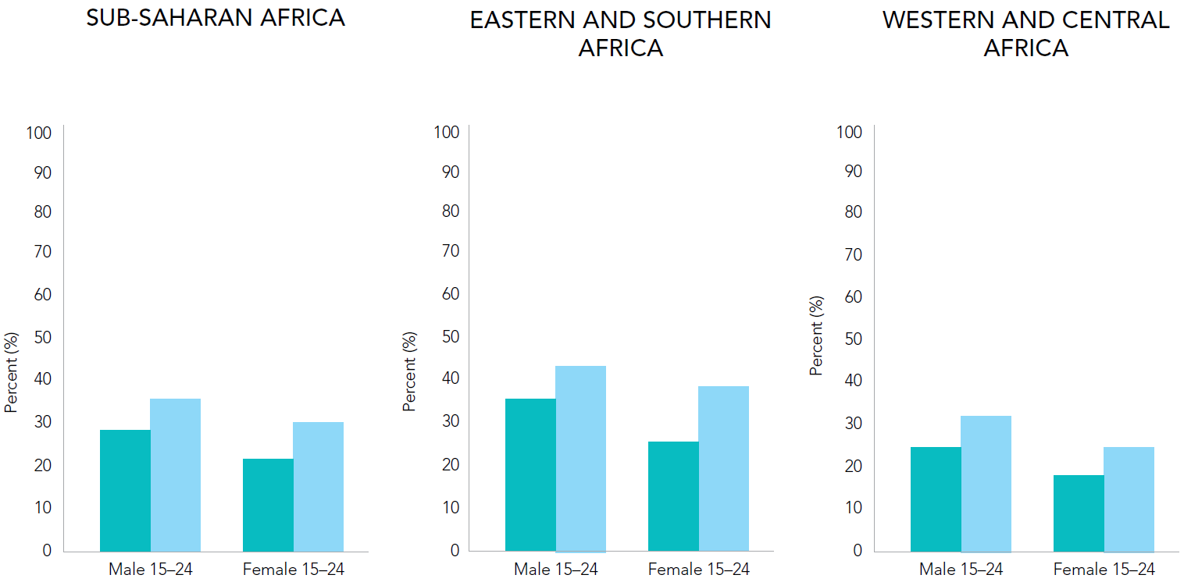
CORRECT AND COMPREHENSIVE KNOWLEDGE
ABOUT HIV AMONG YOUNG PEOPLE (AGED 15–24 YEARS),
SUB-SAHARAN AFRICA, 2000–2008 COMPARED TO 2009–2015
Source: Population-based surveys, 2000–2015.

Slide 52
ELIMINATING
NEW HIV INFECTIONS
AMONG CHILDREN

Slide 53
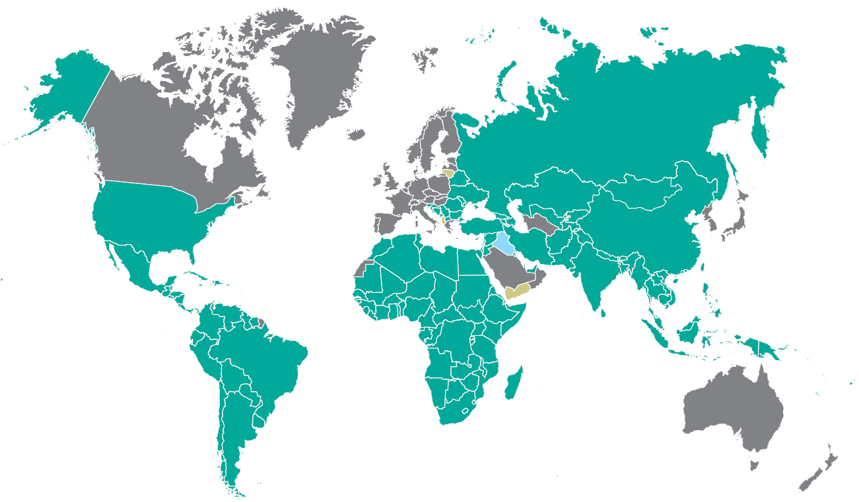
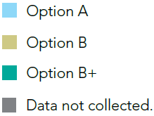
NATIONALLY RECOMMENDED ANTIRETROVIRAL REGIMEN FOR PREVENTING MOTHER-TO-CHILD TRANSMISSION OF HIV, MID-2016
Source: World Health Organization, 2016.

Slide 54
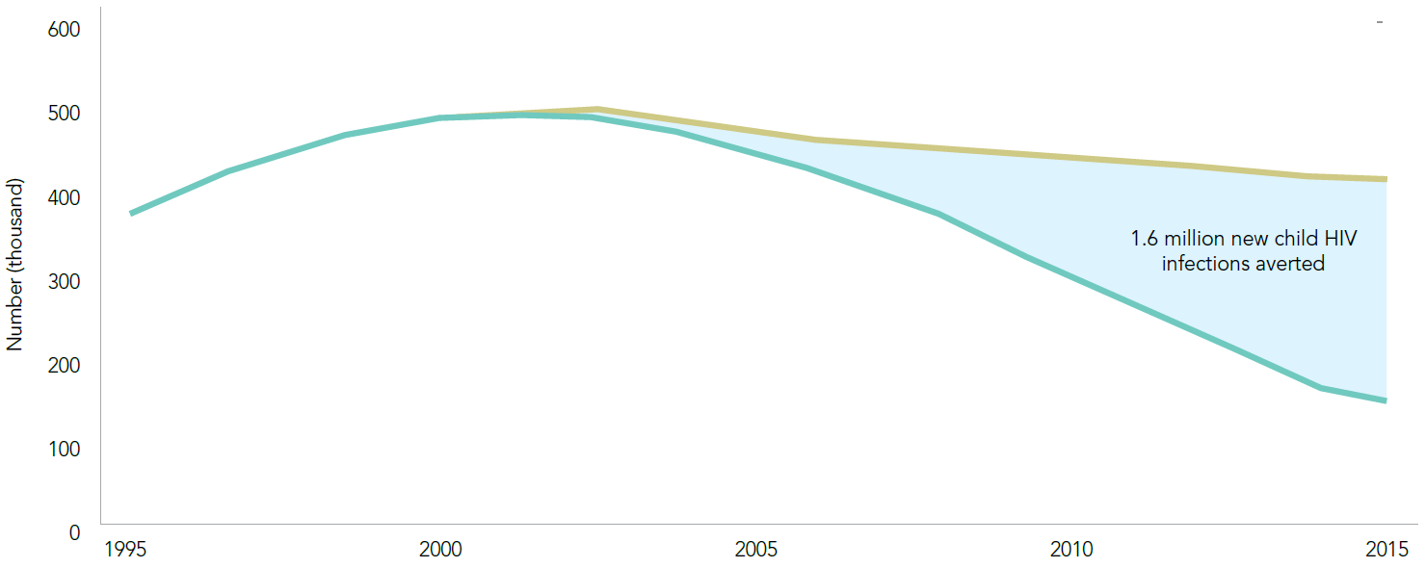
New HIV infections among children (aged 0–14 years) with and without the provision of antiretroviral medicines to prevent mother-to-child transmission, global, 1995–2015
Source: UNAIDS 2016 estimates.

Slide 55
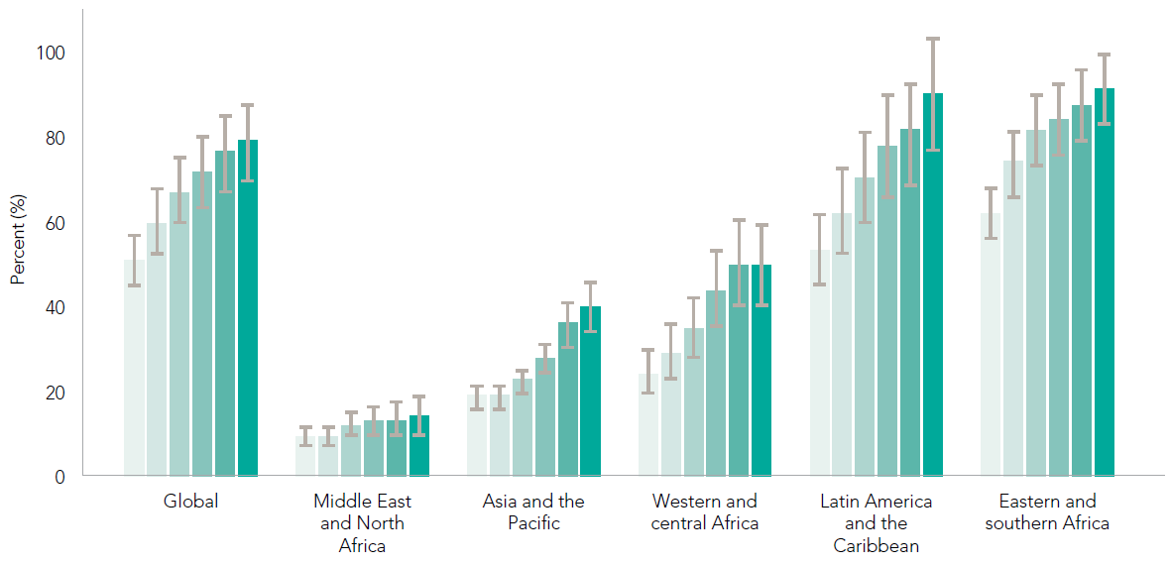
Percent of women receiving antiretroviral medicines to prevent vertical transmission, by region, 2010–2015
Source: 2016 Global AIDS Response Progress Reporting and UNAIDS 2016 estimates.

Slide 56
Distribution of new HIV infections among children (aged 0–14 years), by country, 2015
Source: UNAIDS 2016 estimates.

Slide 57
Mother-to-child transmission rate by region, 2010 and 2015
Source: UNAIDS 2016 estimates.

Slide 58
Antiretroviral medicine regimen used in preventing mother-to-child transmission, global, 2010–2015
Source: 2016 Global AIDS Response Progress Reporting and UNAIDS 2016 estimates.

Slide 59
Trends in unmet need for family planning among married women, select countries, 2000–2015
Source: Demographic and Health Surveys, 2000–2015.

Slide 60
REGIONS
IN FOCUS

Slide 61
Eastern and
southern Africa

Slide 62
New HIV infections among adults (aged 15 years and older), eastern
and southern Africa, 2000–2015
New HIV infections among children (aged 0–14 years), eastern and southern Africa, 2000–2015
Source: UNAIDS 2016 estimates.

Slide 63
Progress towards the 90–90–90 target, eastern and southern Africa, 2015
¹ 2015 measure derived from data reported by 12 countries, which accounted for 77% of people living with HIV in the region.
² 2015 measure derived from data reported by 8 countries. Regionally, 14% of all people on antiretroviral therapy were reported to have received a viral load test during the reporting period.
Source: UNAIDS special analysis, 2016; for more details, see annex on methods.

Slide 64
Distribution of new HIV infections by country, eastern and southern Africa, 2015
Source: UNAIDS 2016 estimates.

Slide 65
Percent change in new HIV infections among adults (aged 15 years and older), eastern and southern Africa, from 2010 to 2015
Source: UNAIDS 2016 estimates.

Slide 66
Distribution of new HIV infections among population groups, eastern and southern Africa, 2014
Source: UNAIDS special analysis, 2016. For more details, see annex on methods.

Slide 67
HIV prevalence among sex workers, eastern and southern Africa, most recent data, 2013–2015
Source: 2016 Global AIDS Response Progress Reporting.

Slide 68
HIV prevalence among gay men and other men
who have sex with men, eastern and southern Africa,
most recent data, 2013–2015
Source: 2016 Global AIDS Response Progress Reporting.

Slide 69
HIV prevalence among people who inject drugs, eastern and southern Africa, 2015, most recent data, 2013–2015
Source: 2016 Global AIDS Response Progress Reporting.

Slide 70
Comprehensive knowledge of HIV prevention among young people (aged 15–24 years), 2000–2015
Source: Demographic and Health Surveys, 2000-2015

Slide 71
Percent change in young people (aged 15–24 years) reporting sexual debut before the age of 15, select countries in eastern and southern Africa, 2000–2008 compared to 2009–2015
Source: 2016 Global AIDS Response Progress Reporting.

Slide 72
Trends in proportion of adults (aged 15–49 years) reporting multiple sexual partnerships in the previous 12 months, select countries
in eastern and southern Africa, 2000–2008 compared to 2009–2015
Source: Demographic and Health Surveys, 2000–2015.

Slide 73
Condom use at last sexual intercourse among people
with multiple partners, select countries in eastern and southern Africa, most recent data, 2009–2015
Source: Population-based surveys 2009–2015.

Slide 74
Western and
central Africa

Slide 75
New HIV infections among adults (aged 15 years and older), western
and central Africa, 2000–2015
New HIV infections among children (aged 0–14 years), western and central Africa, 2000–2015
Source: UNAIDS 2016 estimates.

Slide 76
Progress towards the 90–90–90 target, western and central Africa, 2015
¹ 2015 measure derived from data reported by 12 countries, which accounted for 73% of people living with HIV in the region.
² 2015 measure derived from data reported by 7 countries. Regionally, 2% of all people on antiretroviral therapy were reported to have received a viral load test during the reporting period.
Source: UNAIDS special analysis, 2016; for more details, see annex on methods.

Slide 77
Distribution of new HIV infections by country, western and central Africa, 2015
Source: UNAIDS 2016 estimates.

Slide 78
Percent change in new HIV infections among adults (aged 15 years and older), western and central Africa, from 2010 to 2015
Source: UNAIDS 2016 estimates.

Slide 79
Distribution of new HIV infections among population groups, western and central Africa, 2014
Source: UNAIDS special analysis, 2016. For more details, see annex on methods.

Slide 80
HIV prevalence among gay men and other men
who have sex with men, western and central Africa,
most recent data, 2013–2015
Source: 2016 Global AIDS Response Progress Reporting.

Slide 81
HIV prevalence among sex workers in western and central Africa, most recent data, 2011–2015
Source: 2016 Global AIDS Response Progress Reporting.

Slide 82
Trends in comprehensive, correct knowledge of HIV
among young men and women (aged 15–24 years),
western and central Africa, 2000–2008 to 2009–2014
Source: Population based surveys 2000–2014.

Slide 83
Percent of women and men (aged 15–49 years) using a condom
at last sexual intercourse with a non-marital partner in the year before the survey, most recent data, 2010–2014
Source: Demographic and Health Surveys, 2010–2014.

Slide 84
Condom use at last sexual intercourse among gay men
and other men who have sex with men, western and central Africa, most recent data, 2012–2015
Source: 2016 Global AIDS Response Progress Reporting.

Slide 85
Percent of men and women (aged 15–49 years) who received
an HIV test and the results in the year before the survey,
most recent data, 2010–2014
Source: Demographic and Health Surveys, 2010–2014.

Slide 86
HIV testing coverage among female sex workers, western and central Africa in 2013 and 2015
Source: 2016 Global AIDS Response Progress Reporting.

Slide 87
Asia and
the Pacific

Slide 88
New HIV infections among adults (aged 15 years and older), Asia
and the Pacific, 2000–2015
New HIV infections among
children (aged 0–14 years), Asia
and the Pacific, 2000–2015
Source: UNAIDS 2016 estimates.

Slide 89
Progress towards the 90–90–90 target, Asia and the Pacific, 2015
¹ 2015 measure derived from data reported by 16 countries, which accounted for 93% of people living with HIV in the region.
² 2015 measure derived from data reported by 15 countries. Regionally, 29% of all people on antiretroviral therapy were reported to have received a viral load test during the reporting period.
Source: UNAIDS special analysis, 2016; for more details, see annex on methods.

Slide 90
Distribution of new HIV infections by country, Asia and the Pacific, 2015
Source: UNAIDS 2016 estimates.

Slide 91
Percent change in new HIV infections among adults (aged 15 years and older), Asia and the Pacific, from 2010 to 2015
Source: UNAIDS 2016 estimates.

Slide 92
Distribution of new HIV infections by mode of transmission, select countries, Asia and the Pacific, 1995, 2005 and 2015
Source: Cambodia AIDS Epidemic Model (AEM) - Spectrum 2016, submitted for the Global AIDS Response Progress Reporting and HIV Estimation 2016.
Source: Ministry of Health Malaysia. (2015). AIDS Epidemic Model Malaysia (1980–2030).
Source: National HIV and STI Surveillance and Strategic Information Unit, National Epidemiology Center, Department of Health, Philippines. (2016). Philippines HIV Estimates 1990–2015.
Source: Thailand Working Group on HIV/AIDS Projection (2015).
*heterosexual casual sex among general population
**female sex workers and clients
***spousal transmission from husband living with HIV to wife (serodiscordant couple)
****spousal transmission from wife living with HIV to husband (serodiscordant couple)

Slide 93
HIV prevalence among key populations, select geographical locations in Asia and the Pacific, most recent data, 2013-2015
Source: HIV sentinel surveillance reports and integrated biological and behavioural surveillance reports and 2016 Global AIDS Response Progress Reporting.

Slide 94
Scaled up combination prevention can increase consistent condom use and reduce HIV infections among female sex workers
CAMBODIA, 1999–2011
MAHARASHTRA, INDIA, 2001–2011
THAILAND, 2000–2013
POKHARA, NEPAL, 2004–2011

Slide 95
HIV testing among key populations, Asia and the Pacific, most recent data, 2010–2015
Source: 2016 Global AIDS Response Progress Reporting.

Slide 96
Sterile injecting equipment distributed by harm reduction programmes, Asia and the Pacific, most recent data, 2014–2015
Source: 2016 Global AIDS Response Progress Reporting; UNAIDS. Do No Harm - Health, Human Rights and People who Use Drugs (2016).

Slide 97
Punitive laws in 38 countries in Asia and the Pacific that hamper the HIV response
Source: UNAIDS, Punitive laws hindering the HIV response in Asia and the Pacific (as of June 2016).

Slide 98
The vicious cycle of compulsory detention centres
Source: Based on Kamarulzaman A and McBrayer JL. Compulsory drug detention centres in East and southeast Asia. International Journal of Drug Policy. 2015;26(1):S33–37.

Slide 99
Countries in Asia and the Pacific where community-based HIV testing is piloted
Source: Information based on communications with national HIV programmes and UNAIDS country offices.

Slide 100
Latin America and
the Caribbean

Slide 101
New HIV infections among adults (aged 15 years and older),
Latin America and the Caribbean,
2000–2015
New HIV infections among
children (aged 0–14 years),
Latin America and the Caribbean,
2000–2015
Source: UNAIDS 2016 estimates.

Slide 102
Progress towards the 90–90–90 target, Latin America and the Caribbean, 2015
¹ 2015 measure derived from data reported by 15 countries, which accounted for 76% of people living with HIV in the region.
² 2015 measure derived from data reported by 21 countries. Regionally, 77% of all people on antiretroviral therapy were reported to have received a viral load test during the reporting period.
Source: UNAIDS special analysis, 2016; for more details, see annex on methods.

Slide 103
Distribution of new HIV infections by country, Latin America and the Caribbean, 2015
Source: UNAIDS 2016 estimates.

Slide 104
Percent change in new HIV infections among adults (aged 15 years and older), Latin America and the Caribbean, from 2010 to 2015
Source: UNAIDS 2016 estimates.

Slide 105
Distribution of new HIV infections among population groups, Latin America and the Caribbean, 2014
Source: UNAIDS special analysis, 2016.

Slide 106
HIV prevalence among sex workers, Latin America and the Caribbean, most recent data, 2013–2015
Source: 2016 Global AIDS Response Progress Reporting.

Slide 107
Condom use at last sexual intercourse among gay men and other men who have sex with men, Latin America and the Caribbean, most recent data, 2013–2015
Source: 2016 Global AIDS Response Progress Reporting.

Slide 108
HIV continuum of care cascade among the general population and key populations, Mexico, 2013
Source: National Center for HIV and AIDS Prevention and Control, Mexico 2014.

Slide 109
HIV testing in key populations, Latin America and the Caribbean, most recent data, 2013–2015
Source: 2016 Global AIDS Response Progress Reporting.

Slide 110
HIV testing among sex workers, Latin America and the Caribbean, most recent data, 2013–2015
Source: 2016 Global AIDS Response Progress Reporting.

Slide 111
Middle East and
North Africa

Slide 112
New HIV infections among adults (aged 15 years and older),
Middle East and North Africa,
2000–2015
New HIV infections among
children (aged 0–14 years),
Middle East and North Africa,
2000–2015
Source: UNAIDS 2016 estimates.

Slide 113
Progress towards the 90–90–90 target, Middle East and North Africa, 2015
¹ 2015 measure derived from data reported by 7 countries, which accounted for 77% of people living with HIV in the region.
² 2015 measure derived from data reported by 8 countries. Regionally, 41% of all people on antiretroviral therapy were reported to have received a viral load test during the reporting period.
Source: UNAIDS special analysis, 2016; for more details, see annex on methods.

Slide 114
Distribution of new HIV infections by country, Middle East and North Africa, 2015
Source: UNAIDS 2016 estimates.

Slide 115
Percent change in new HIV infections among adults (aged 15 years and older), Middle East and North Africa, from 2010 to 2015
Source: UNAIDS 2016 estimates.

Slide 116
Distribution of new HIV infections among population groups, Middle East and North Africa, 2014
Source: UNAIDS special analysis, 2016; for more details, see annex on methods.

Slide 117
HIV prevalence among gay men and other men who have sex with men, Middle East and North Africa, most recent data, 2013–2015
Source: UNAIDS 2016 estimates.

Slide 118
HIV prevalence among people who inject drugs, Middle East and North Africa, most recent data, 2013–2015
Source: UNAIDS 2016 estimates.

Slide 119
HIV prevalence among sex workers, Middle East and North Africa, most recent data, 2013–2015
Source: UNAIDS 2016 estimates.

Slide 120
Summary of behavioural data among key populations, most recent data, 2013–2015
Source: 2016 Global AIDS Response Progress Reporting.

Slide 121
Eastern Europe and
Central Asia

Slide 122
New HIV infections among adults (aged 15 years and older), eastern Europe and central Asia, 2010–2015
Source: UNAIDS 2016 estimates.

Slide 123
Progress towards the 90–90–90 target, eastern Europe and central Asia, end-2015
¹ 2015 measure derived from data reported by 11 countries, which accounted for 98% of people living with HIV in the region.
² 2015 measure derived from data reported by 11 countries. Regionally, 77% of all people on antiretroviral therapy were reported to have received a viral load test during the reporting period.
Source: UNAIDS special analysis, 2016; for more details, see annex on methods.

Slide 124
Distribution of new HIV infections by country, eastern Europe and central Asia, 2015
Source: UNAIDS 2016 estimates.

Slide 125
Percent change in new HIV infections among adults (aged 15 years and older), eastern Europe and central Asia, from 2010 to 2015
Source: UNAIDS 2016 estimates.

Slide 126
Distribution of new HIV infections among population groups, eastern Europe and Central Asia, 2014
Source: UNAIDS special analysis, 2016; for more details, see annex on methods.

Slide 127
Prevalence of HIV among people who inject drugs in five cities of the Russian Federation, 2015
Source: Esvero. Report on results of bio-behavioural study among people who inject drugs in Abakan, Barnaul, Volgograd, Naberezhnye Chelny and Perm, 2015.

Slide 128
Use of sterile injection equipment at last injection, select countries, eastern Europe and central Asia, most recent data, 2013–2015
Source: 2016 Global AIDS Response Progress Reporting.

Slide 129
Condom use among key populations, Kazakhstan, 2013–2015
Source: Ganina LY, et al. Review of HIV epidemic in Kazakhstan in 2013–2015. Almaty: 2016.

Slide 130
Treatment cascade of services for people living with HIV in Ukraine, 2015
Source: CDC Ukraine, 2016.

Slide 131
Cost of fixed-dose TDF/FTC/EFV per person per year, 2015
Source: Median prices from the 2014 MSH/WHO International Drug Price Indicator Guide, 2014 edition. Geneva: World Health Organization; 2015 (http://apps.who.int/medicinedocs/
en/m/abstract/Js21983en/).

Slide 132
Western and central
Europe and
North America

Slide 133
New HIV infections among adults (aged 15 years and older),
western and central Europe and North America, 2010–2015
Source: UNAIDS 2016 estimates.

Slide 134
Progress towards the 90–90–90 target, western and central Europe and North America, 2015
¹ 2015 measure derived from data reported by 14 countries, which accounted for 83% of people living with HIV in the region.
² 2015 measure derived from data reported by 16 countries. Regionally, 44% of all people on antiretroviral therapy were reported to have received a viral load test during the reporting period.
Source: UNAIDS special analysis, 2016; for more details, see annex on methods.

Slide 135
Distribution of new HIV infections by country, western and central Europe and North America, 2015
Source: UNAIDS 2016 estimates.

Slide 136
Percent change in new HIV diagnoses by mode of transmission, western and central Europe and North America, from 2010 to 2014
Sources: UNAIDS analysis using data from: European Centre for Disease Prevention, WHO Regional Office for Europe. HIV/AIDS surveillance in Europe 2014; United States Centers for Disease Control
and Prevention. HIV Surveillance Report, 2014; vol. 26; Public Health Agency of Canada. HIV and AIDS in Canada: Surveillance Report to December 31, 2014. Countries not included in the analysis: Estonia, Poland, Italy, Spain, Turkey, Israel and Switzerland.

Slide 137
Distribution of new HIV diagnoses by mode of transmission, western and central Europe and North America, 2014
Sources: UNAIDS analysis using data from: European Centre for Disease Prevention, WHO Regional Office for Europe. HIV/AIDS surveillance in Europe 2014; Centers for Disease Control and
Prevention. HIV Surveillance Report, 2014; vol. 26; Public Health Agency of Canada. HIV and AIDS in Canada: Surveillance Report to December 31, 2014.

Slide 138
Distribution of new HIV diagnoses by mode of transmission, western and central Europe and North America, 2014
Source: UNAIDS analysis using data from: European Centre for Disease Prevention, WHO Regional Office for Europe. HIV/AIDS surveillance in Europe 2014; Centers for Disease Control and
Prevention. HIV Surveillance Report, 2014; vol. 26; Public Health Agency of Canada. HIV and AIDS in Canada: Surveillance Report to December 31, 2014.

Slide 139
Percent of new HIV diagnoses, by mode of transmission and country, EU/EEA, 2014
Source: European Centre for Disease Prevention and Control, WHO Regional Office for Europe. HIV/AIDS surveillance in Europe 2014.

Slide 140
HIV prevalence among people who inject drugs,
western and central Europe and North America,
most recent data, 2011–2015
Source: 2016 Global AIDS Response Progress Reporting

Slide 141
HIV prevalence among gay men and other men who have sex
with men, western and central Europe and North America,
most recent data, 2013–2015
Source: 2016 Global AIDS Response Progress Reporting

Slide 142
HIV prevalence among male and female sex workers in Europe, select countries, most recent data, 2011–2015
Source: 2016 Global AIDS Response Progress Reporting

Slide 143
Median CD4 cell count per mm³ at HIV diagnosis, by mode of transmission, EU/EEA, 2005–2014
Source: European Centre for Disease Prevention and Control, WHO Regional Office for Europe. HIV/AIDS surveillance in Europe 2014.

Slide 144
HIV testing among key populations populations,
western and central Europe and North America,
most recent data, 2011–2015
Source: 2016 Global AIDS Response Progress Reporting

Slide 145
CONCLUSION

Slide 146
Conceptualizing prevention demand-and-supply cascades for adolescent girls and young women

