Slide 1
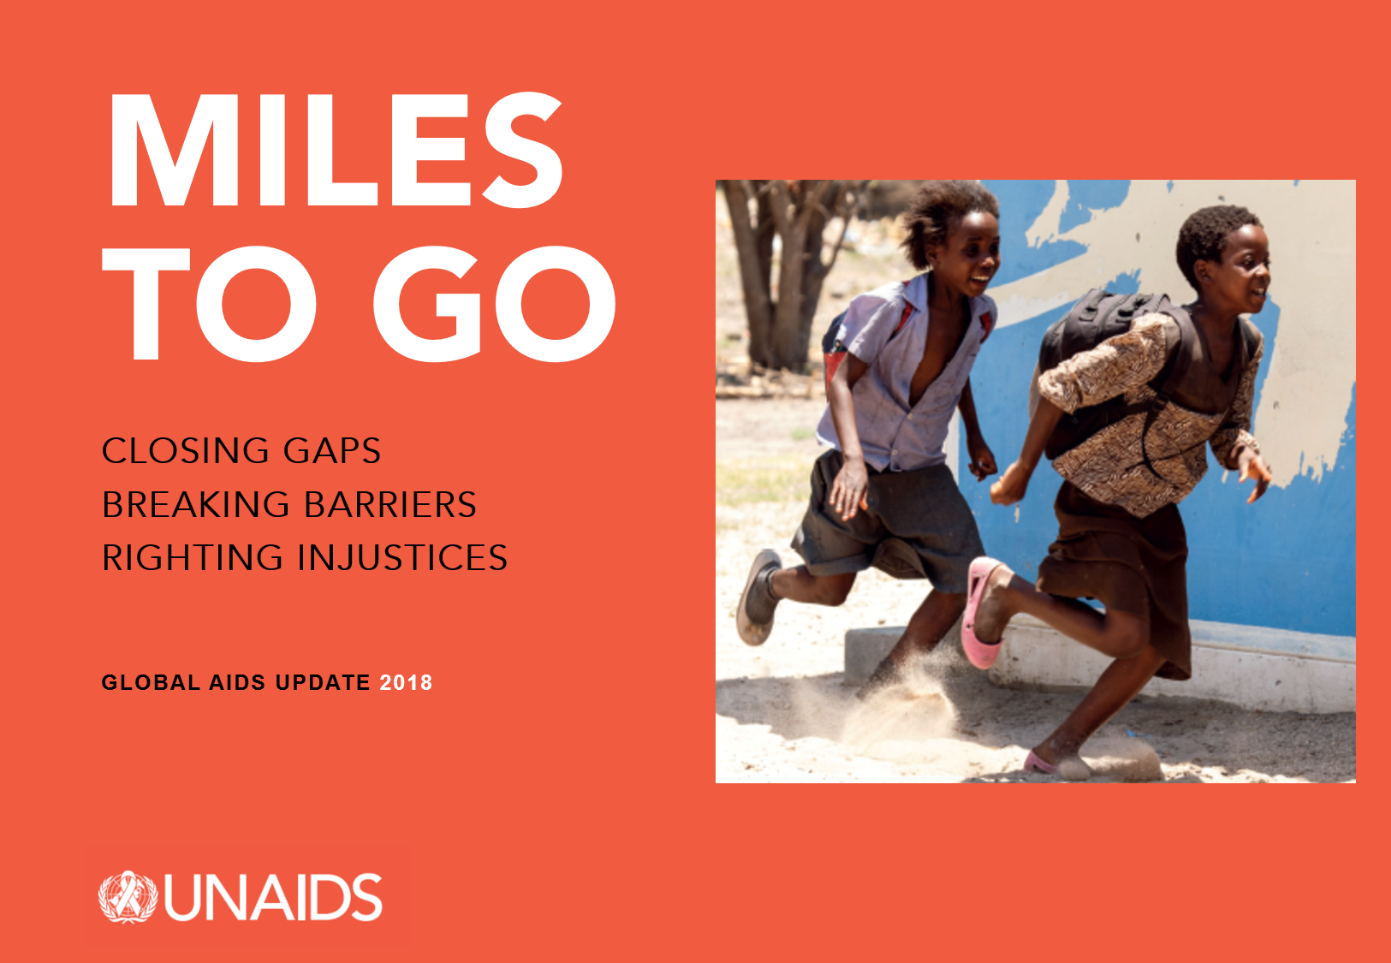

Slide 2
1. Introduction and summary

Slide 3
Investment and innovation driving strong gains
in eastern and southern Africa
Annual new HIV infections, AIDS-related deaths, resource availability and 2020 resource needs
and impact targets for eastern and southern Africa, constant 2016 US dollars, 2010–2017 and 2020 targets
12 000
1 400 000
10 000
1 200 000
1 000 000
Number of new HIV infections
and AIDS-related deaths
Resource availability
2016 constant US$ millions
8000
800 000
6000
600 000
4000
400 000
2000
200 000
0
0
2010
2011
2012
2013
2014
2015
2016
2017
2018
2019
2020
HIV resource availability
Resource needs (Fast-Track)
AIDS-related deaths
New HIV infections
*Resource availability and resource needs in constant 2016 US dollars.
Source: UNAIDS 2018 estimates; GAM/GARPR reports 2005–2018; UNAIDS–Kaiser Family Foundation collaborative project on international assistance disbursements from donor governments in 2017;
Fast-Track update on investments needed in the AIDS response, 2016–2030. Geneva: UNAIDS; 2016.

Slide 4
Men getting the short-term benefit of combination prevention
Coverage of HIV services and HIV incidence, by sex, four locations in eastern and southern Africa, 2006–2017
Rakai, Uganda
Siaya County, Kenya
Incidence (per 100 person-years)
2
100
90
80
70
60
50
40
30
20
10
0
Incidence (per 100 person-years)
2
100
90
80
70
60
50
40
30
20
10
0
1
Per cent
1
Per cent
0
0
2006
2007
2008
2009
2010
2011
2012
2013
2014
2015
2016
2006
2007
2008
2009
2010
2011
2012
2013
2014
2015
2016
Kwazulu-Natal, South Africa
Eswatini
Incidence (per 100 person-years)
8
100
90
80
70
60
50
40
30
20
10
0
Incidence (per 100 person-years)
8
100
90
80
70
60
50
40
30
20
10
0
6
6
4
Per cent
4
Per cent
2
2
0
0
2006
2007
2008
2009
2010
2011
2012
2013
2014
2015
2016
2006
2007
2008
2009
2010
2011
2012
2013
2014
2015
2016
HIV incidence (female)
Antiretroviral therapy coverage (female)
HIV incidence (male)
Antiretroviral therapy coverage (male)
Prevalence of circumcision (male)
Condom use at last sex, nonregular partner (male)
Condom use at last sex, nonregular partner (female)
Sources: Grabowski MK, Serwadda DM, Gray RH, Nakigozi G, Kigozi G, Kagaayi J et al. HIV prevention efforts and incidence of HIV in Uganda. N Engl J Med, 2017;377:2154–66; Uganda Demographic and Health Survey, 2006, 2011, 2016; Vandormael A, Akullian AN, Dobra A, de Oliveira T, Tanser F. Sharp decline in male HIV incidence in a rural South African population (2004–2015). Abstract 46. Conference on Retroviruses and Opportunistic Infections (CROI), Boston (MA), 4–7 March 2018; Vandormael A. Personal Communications. May 2018; South African National HIV Prevalence, HIV Incidence, Behaviour and Communication Survey, 2005, 2008; South African National HIV Prevalence, Incidence and Behaviour Survey, 2012; Nkambule R, Nuwagaba-Biribonwoha H, Mnisi Z, Ao, TT, Ginindza C, Duong YT et al. Substantial progress in confronting the HIV epidemic in Swaziland: first evidence of national impact. Abstract MOAX0204LB. International AIDS Society Conference, Paris, 23–26 July 2017; Swaziland HIV Incidence Measurement Survey, descriptive data tables, 2014; Justman J, Reed JB, Bicego G, Donnell D, Li K, Bock N et al. Swaziland HIV Incidence Measurement Survey (SHIMS): a prospective national cohort study. Lancet HIV. 2017 Feb;4(2):e83–92; Swaziland HIV Incidence Measurement Surveys, 2016, preliminary findings; Multiple Indicator Cluster Survey, 2010, 2014; Borgdorff MW, Kwaro D, Obor D, Otieno G, Kamire V, Odongo F et al. HIV incidence in western Kenya during scale-up of antiretroviral therapy and voluntary medical male circumcision: a populationbased cohort analysis. Lancet HIV. 2018;5(5):e241–9; Kenya Demographic and Health Survey, 2008–2009, and, 2014; National AIDS Control Council, Kenya HIV country profiles, 2016; Spectrum 2018.

Slide 5
Slow global progress
Number of AIDS-related deaths, number of new HIV infections and incidence:prevalence ratio, global,
2000–2017 and 2020 targets
NEW HIV INFECTIONS
4 000 000
3 500 000
3 000 000
2 500 000
2 000 000
1 500 000
1 000 000
500 000
0
INCIDENCE:PREVALENCE RATIO
Number of new HIV infections
0.16
0.14
0.12
0.10
0.08
0.06
0.04
0.02
0.00
Incidence:prevalence ratio
2000
2001
2002
2003
2004
2005
2006
2007
2008
2009
2010
2011
2012
2013
2014
2015
2016
2017
2018
2019
2020
AIDS-RELATED DEATHS
3 000 000
2 500 000
2 000 000
1 500 000
1 000 000
500 000
0
Number of AIDS-related deaths
2000
2001
2002
2003
2004
2005
2006
2007
2008
2009
2010
2011
2012
2013
2014
2015
2016
2017
2000
2001
2002
2003
2004
2005
2006
2007
2008
2009
2010
2011
2012
2013
2014
2015
2016
2017
2018
2019
2020
Source: UNAIDS 2018 estimates.

Slide 6
Rising numbers of people living with HIV
Number of new HIV infections and deaths among
the HIV population (all causes), global, 1990–2017
Number people living with HIV, global, 1990–2017
Number of new HIV infections
and deaths among those living with HIV
5 000 000
4 000 000
3 000 000
2 000 000
1 000 000
0
50 000 000
40 000 000
30 000 000
20 000 000
10 000 000
0
Number of people living with HIV
1990
1993
1996
1999
2002
2005
2008
2011
2014
2017
1990
1993
1996
1999
2002
2005
2008
2011
2014
2017
New HIV infections
Deaths among people living with HIV
Number of people living with HIV
Source: UNAIDS 2018 estimates.

Slide 7
One-year rise in donor funding unlikely to continue
Annual percentage change in HIV resource availability from all sources (public and private), low- and middle-income
countries, 2000–2017
7%
4%
0%
8%
14%
-2%
-1%
30%
1%
1%
17%
15%
23%
16%
24%
4%
6%
2000–2001
2001–2002
2002–2003
2003–2004
2004–2005
2005–2006
2006–2007
2007–2008
2008–2009
2009–2010
2010–2011
2011–2012
2012–2013
2013–2014
2014–2015
2015–2016
2016–2017
Increase
Decrease
Total
Source: UNAIDS resource availability and needs estimates, 2018.

Slide 8
Key populations at higher risk of infection
Relative risk of HIV acquisition, by population group compared to the general population, global, 2017
Gay men and other men who have sex with men
People who inject drugs
Female sex workers
Transgender women
13
times higher
22
times higher
28
times higher
13
times higher
HIV incidence rate within the key population
HIV incidence rate within the general population
Source: UNAIDS special analysis, 2018.

Slide 9
The cost in infections and lives of a five-year delay
Projected new HIV infections and AIDS-related deaths, reaching Fast-Track Targets in 2020 vs reaching Fast-Track
Targets in 2025, 10 countries with highest HIV burden, 2017–2030
1 200 000
1 000 000
800 000
600 000
Number of new HIV infections
NEW HIV INFECTIONS
2.1 million more HIV infections
400 000
200 000
0
New HIV infections if Fast-Track Targets are achieved in 2020
New HIV infections if Fast-Track Targets are achieved in 2025
2017
2018
2019
2020
2021
2022
2023
2024
2025
2026
2027
2028
2029
2030
600 000
500 000
400 000
Number of AIDS-related deaths
AIDS-RELATED DEATHS
300 000
200 000
100 000
0
1.0 million more AIDS-related deaths
AIDS-related deaths if Fast-Track Targets are achieved in 2020
AIDS-related deaths if Fast-Track Targets are achieved in 2025
2017
2018
2019
2020
2021
2022
2023
2024
2025
2026
2027
2028
2029
2030
Source: Avenir Health and UNAIDS. Unpublished analyses based on Fast-Track modelling, 2018.

Slide 10
PART I
Progress towards Fast-Track commitments

Slide 11
2. State of the epidemic

Slide 12
Approaching a 2020 milestone
Number of AIDS-related deaths, global, 1990–2017 and 2020 target
3 000 000
2 500 000
Number of AIDS-related deaths
2 000 000
1 500 000
1 000 000
500 000
0
1990
1991
1992
1993
1994
1995
1996
1997
1998
1999
2000
2001
2002
2003
2004
2005
2006
2007
2008
2009
2010
2011
2012
2013
2014
2015
2016
2017
2018
2019
2020
AIDS-related deaths
Target
Source: UNAIDS 2018 estimates.

Slide 13
Steep decline in deaths in sub-Saharan Africa
Number of AIDS-related deaths, by sex, sub-Saharan
Africa, 1990–2017
Number of AIDS-related deaths, by sex, regions outside
sub-Saharan Africa, 1990–2017
1 200 000
600 000
1 000 000
500 000
Number of AIDS-related deaths
Number of AIDS-related deaths
800 000
400 000
600 000
300 000
400 000
200 000
200 000
100 000
0
1990
1993
1996
1999
2002
2005
2008
2011
2014
2017
0
1990
1993
1996
1999
2002
2005
2008
2011
2014
2017
Females
Males
Source: UNAIDS 2018 estimates.

Slide 14
Insufficient progress on prevention
Number of new HIV infections, global, 1990–2017 and 2020 target
5 000 000
4 500 000
4 000 000
3 500 000
3 000 000
2 500 000
2 000 000
1 500 000
1 000 000
500 000
0
Number of new HIV infections
1990
1991
1992
1993
1994
1995
1996
1997
1998
1999
2000
2001
2002
2003
2004
2005
2006
2007
2008
2009
2010
2011
2012
2013
2014
2015
2016
2017
2018
2019
2020
New HIV infections
Target
Source: UNAIDS 2018 estimates.

Slide 15
Little change in new HIV infections
outside of sub-Saharan Africa
Number of new HIV infections, sub-Saharan Africa and regions outside sub-Saharan Africa, 1990–2017
3 500 000
3 000 000
Number of new HIV infections
2 500 000
2 000 000
1 500 000
1 000 000
500 000
0
1990
1991
1992
1993
1994
1995
1996
1997
1998
1999
2000
2001
2002
2003
2004
2005
2006
2007
2008
2009
2010
2011
2012
2013
2014
2015
2016
2017
Sub-Saharan Africa
Regions outside of sub-Saharan Africa
Source: UNAIDS 2018 estimates.

Slide 16
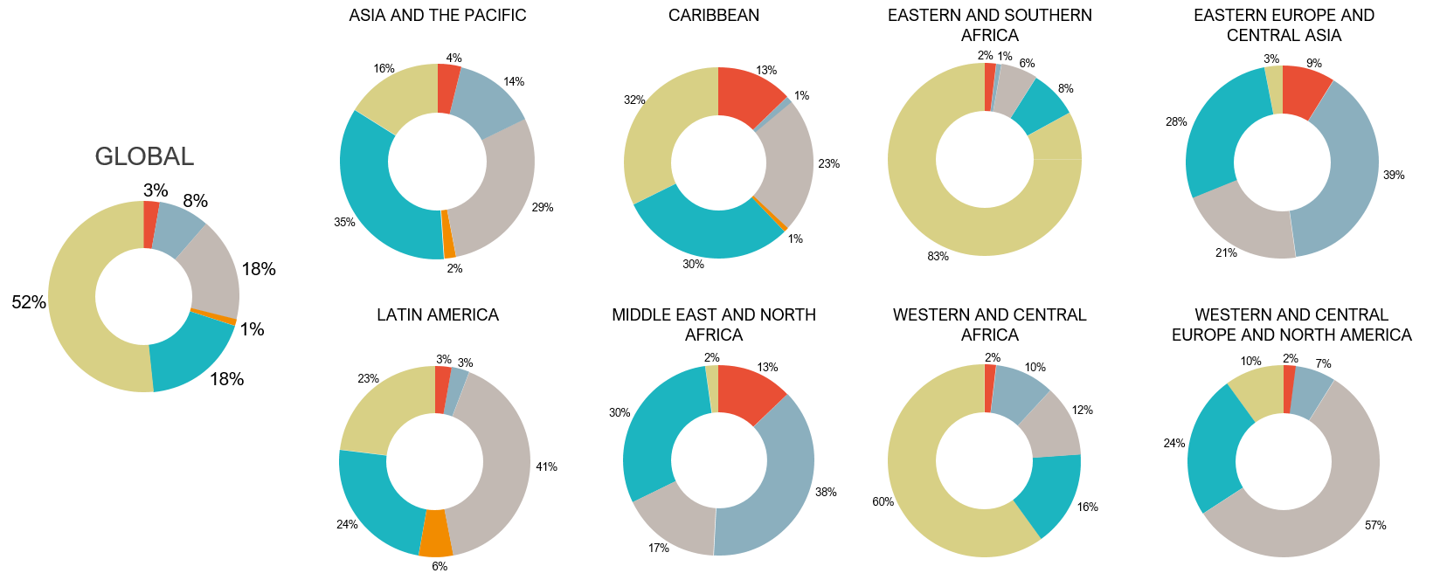
Key populations important in all epidemic settings
Distribution of new HIV infections, by population group, global and by region, 2017
Sex workers
People who inject drugs
Gay men and other men who have sex with men
Transgender women*
Clients of sex workers and other sexual partners of key populations
Rest of population†
* Data are only available from Asia and the Pacific, Caribbean and Latin America. With rare exceptions, reported data are from transwomen who sell sex, but size estimates are increasingly all transgender women.
† Individuals in this category did not report any HIV-related risk behaviour.
Source: UNAIDS special analysis, 2018.

Slide 17
HIV spreads from hotspots
HIV prevalence among adults
(aged15 years and older), by geographic area,
KwaZulu-Natal, South Africa, 2010–2014
Risk of HIV infection among adults (aged15 years and older), by geographic area, KwaZulu-Natal, South Africa, 2010–2014
HIV transmission links among adults (aged15 years and older),
KwaZulu-Natal, South Africa, 2010–2014
Note: On the third map, an intentional random spatial error has been introduced to anonymize individuals’ locations.
Source: Cuadros DF. Assessing the role of geographical HIV hot-spots in the spread of the epidemic. In: CROI 2018 [website]. Boston (MA); c2018 (http://www.croiwebcasts.org/console/player/37086?mediaType=slideVideo&&crd_fl=0&ssmsrq=1528958135518).

Slide 18
Incidence:mortality ratio under 1 in Cambodia
Number of new HIV infections and deaths among the HIV population (all causes), Cambodia, 1990–2017
25 000
Number of new HIV infections and deaths among the HIV population
20 000
15 000
10 000
5000
0
1990
1991
1992
1993
1994
1995
1996
1997
1998
1999
2000
2001
2002
2003
2004
2005
2006
2007
2008
2009
2010
2011
2012
2013
2014
2015
2016
2017
New HIV infections
Deaths among the HIV population
Source: UNAIDS 2018 estimates.

Slide 19
Global progress towards ending the AIDS epidemic
Incidence:prevalence ratio, global and by region, 1990–2017
0.30
0.24
0.18
0.12
0.06
0.00
GLOBAL
0.30
0.24
0.18
0.12
0.06
0.00
ASIA AND THE PACIFIC
0.30
0.24
0.18
0.12
0.06
0.00
CARIBBEAN
Incidence:prevalence ratio
Incidence:prevalence ratio
Incidence:prevalence ratio
2000
2001
2002
2003
2004
2005
2006
2007
2008
2009
2010
2011
2012
2013
2014
2015
2016
2017
2000
2001
2002
2003
2004
2005
2006
2007
2008
2009
2010
2011
2012
2013
2014
2015
2016
2017
2000
2001
2002
2003
2004
2005
2006
2007
2008
2009
2010
2011
2012
2013
2014
2015
2016
2017
0.30
0.24
0.18
0.12
0.06
0.00
EASTERN AND SOUTHERN AFRICA
Incidence:prevalence ratio
0.30
0.24
0.18
0.12
0.06
0.00
EASTERN EUROPE AND CENTRAL ASIA
0.30
0.24
0.18
0.12
0.06
0.00
LATIN AMERICA
Incidence:prevalence ratio
Incidence:prevalence ratio
2000
2001
2002
2003
2004
2005
2006
2007
2008
2009
2010
2011
2012
2013
2014
2015
2016
2017
2000
2001
2002
2003
2004
2005
2006
2007
2008
2009
2010
2011
2012
2013
2014
2015
2016
2017
2000
2001
2002
2003
2004
2005
2006
2007
2008
2009
2010
2011
2012
2013
2014
2015
2016
2017
0.30
0.24
0.18
0.12
0.06
0.00
MIDDLE EAST AND NORTH AFRICA
0.30
0.24
0.18
0.12
0.06
0.00
WESTERN AND CENTRAL AFRICA
0.30
0.24
0.18
0.12
0.06
0.00
WESTERN AND CENTRAL EUROPE AND NORTH AMERICA
Incidence:prevalence ratio
Incidence:prevalence ratio
Incidence:prevalence ratio
2000
2001
2002
2003
2004
2005
2006
2007
2008
2009
2010
2011
2012
2013
2014
2015
2016
2017
2000
2001
2002
2003
2004
2005
2006
2007
2008
2009
2010
2011
2012
2013
2014
2015
2016
2017
2000
2001
2002
2003
2004
2005
2006
2007
2008
2009
2010
2011
2012
2013
2014
2015
2016
2017
Incidence:prevalence ratio
Uncertainty bounds
Target value
Source: UNAIDS 2018 estimates.

Slide 20
Putting epidemic transition into context
Interim set of indicators that measure the drivers, facilitators, manifestations and outcomes of HIV-related stigma and discrimination
DRIVERS AND FACILITATORS OF HIV-RELATED DISCRIMINATION
DISCRIMINATORY ATTITUDES
DISCRIMINATORY LAWS AND POLICIES (NCPI/civil society databases)
SERVICES
VIOLENCE
EXPERIENCED DISCRIMINATION IN HEALTH CARE
AVOIDANCE OF HEALTH CARE BECAUSE OF STIGMA AND DISCRIMINATION
EMPLOYMENT
LAW AND POLICY ENFORCEMENT (NCPI/civil society databases)
SERVICE COVERAGE
MANIFESTATIONS AND OUTCOMES OF HIV-RELATED DISCRIMINATION

Slide 21
Putting epidemic transition into context
DRIVERS AND FACILITATORS OF HIV-RELATED DISCRIMINATION (Details)
DISCRIMINATORY ATTITUDES
Percentage of women and men aged 15–49 years who report discriminatory attitudes towards people living with HIV (GAM/population- based surveys)
Percentage of health facility staff who hold stigmatizing views about people living with HIV (health facility surveys)
DISCRIMINATORY LAWS AND POLICIES (NCPI/civil society databases)
Does your country have laws criminalizing the transmission of, non-disclosure of or exposure to HIV transmission?
Are transgender people criminalized and/or prosecuted in your country?
Is sex work criminalized in your country?
Does your country have laws criminalizing same-sex sexual acts?
Does your country retain the death penalty in law for people convicted of drug-related offences? Is drug use or possession for personal use an offence in your country?
Does your country have laws or policies restricting the entry, stay and residence of people living with HIV?
Is there a law, regulation or policy specifying that HIV testing is (a) solely performed on the basis of voluntary and informed consent, (b) mandatory before marriage, (c) mandatory to obtain a work or residence permit, or (d) mandatory for certain groups?
Does your country have laws requiring parental consent for adolescents to access (a) sexual and reproductive health services, (b) HIV testing or (c) HIV treatment?
Does your country have laws requiring spousal consent for married women to access (a) sexual and reproductive health services or (b) HIV testing?
Is vertical transmission of HIV criminalized in your country?
In your country what is the legal age of marriage? In your country is child marriage (a formal marriage or informal union before age 18) void or prohibited?
Does your country have legislation on domestic violence? If yes, does this legislation cover explicit criminalization of marital rape?
Does your country have legal protections for transgender people?
Does your country have legal protections for sex workers?
Does your country have any laws or other provisions specifying protections based on grounds of sexual orientation?
Does your country have any specific anti-discrimination laws or other provisions that apply to people who use drugs?
SERVICES
Coverage of HIV prevention programmes: Percentage of people in a key population reporting having received a combined set of HIV prevention interventions
Are opioid substitution therapy programmes operational in your country? (NCPI/GAM/civil society databases)
Are needle–syringe programmes operational in your country? (NCPI/GAM/civil society databases)
Does your country have education policies that guide the delivery of life skills-based HIV and sexuality education according to international standards in (a) primary school, (b) secondary school or (c) teacher training? (NCPI)
Does your country have training programmes for police and other law enforcement personnel/members of the judiciary/elected officials (lawmakers, parliamentarians)/health-care workers on human rights and non-discrimination legal frameworks as applicable to HIV? (NCPI)
Does your country have accountability mechanisms in relation to discrimination and violations of human rights in health-care settings? (NCPI)

Slide 22
Putting epidemic transition into context
MANIFESTATIONS AND OUTCOMES OF HIV-RELATED DISCRIMINATION (Detailed)
VIOLENCE
Proportion of ever-married or partnered women aged 15–49 years who experienced physical or sexual violence from a male intimate partner in the past 12 months (GAM/population-based surveys)
Percentage of people living with HIV who have experienced verbal or physical harassment (People Living with HIV Stigma Index surveys)
Percentage of key populations who have experienced verbal, physical or sexual violence (integrated biological and behavioural surveys)
EXPERIENCED DISCRIMINATION IN HEALTH CARE
Percentage of people living with HIV who report experiences of HIV-related discrimination in health-care settings (GAM/People Living with HIV Stigma Index surveys)
AVOIDANCE OF HEALTH CARE BECAUSE OF STIGMA AND DISCRIMINATION
Avoidance of health care among sex workers because of stigma and discrimination (GAM/integrated biological and behavioural surveys)
Avoidance of health care among gay men and other men who have sex with men because of stigma and discrimination (GAM/integrated biological and behavioural surveys)
Avoidance of health care among people who inject drugs because of stigma and discrimination (GAM/integrated biological and behavioural surveys)
Avoidance of health care among transgender people because of stigma and discrimination (GAM/integrated biological and behavioural surveys)
EMPLOYMENT
Have you ever been refused employment or a work opportunity because of your HIV status? Have you ever lost a source of income or job because of your HIV status? (People Living with HIV Stigma Index surveys)
LAW AND POLICY ENFORCEMENT (NCPI/civil society databases)
Can possession of a needle/syringe without a prescription be used as evidence of drug use or cause for arrest in your country?
Have transgender people in your country been arrested or prosecuted for manifestations of their gender identity in the past three years?
Have sex workers in your country been arrested or prosecuted in relation to selling sex in the past three years?
Have people in your country been arrested or prosecuted for consensual same-sex sexual acts in the past three years?
SERVICE COVERAGE
Percentage of people who inject drugs receiving opioid substitution therapy (GAM)
Number of needles and syringes distributed per person who injects drugs per year by needle–syringe programmes (GAM)

Slide 23
3. Combination HIV prevention

Slide 24
Progress on prevention varies
Trends in new HIV infections among adults (aged 15 years and older), by country, 2010–2017
Decrease of 50% or more
Cambodia, Mongolia*, Nepal.
Decrease of 25– <50%
Armenia, Austria, Bahamas, Eswatini, France, Kenya, Kyrgyzstan, Malawi, Mauritania, Myanmar, Netherlands, Portugal, Sierra Leone, South Africa, Trinidad and Tobago, Uganda, Zimbabwe.
Decrease of 5– <25%
Albania*, Barbados, Bulgaria, Cameroon, Central African Republic, Cuba, Democratic Republic of the Congo, Denmark, Dominican Republic, El Salvador, Estonia, Gambia, Georgia, Guatemala, Guinea-Bissau, Guyana, Haiti, Indonesia, Iran (Islamic Republic of), Jamaica, Lesotho, Morocco, Mozambique, Namibia, Nicaragua, Niger, Norway, Peru, Romania, Rwanda, Senegal, Serbia, Singapore, Somalia, Spain, Sri Lanka, Togo, Ukraine, United Republic of Tanzania, Uruguay, Zambia.
Change of +/- <5%
Angola, Bolivia, Brazil, Chad, Comoros*, Ecuador, Gabon, Ghana, Guinea, Italy, Japan, Nigeria, Paraguay, Republic of Moldova, South Sudan, Tajikistan.
Increase of 5– <25%
Argentina, Australia, Azerbaijan, Bahrain*, Bangladesh, Belize, Benin, Botswana, Cape Verde, Congo, Côte d’Ivoire, Djibouti, Equatorial Guinea, Honduras, Liberia, Malaysia, Mali, Mexico, Panama, Papua, New Guinea, Slovenia*, Sudan, Tunisia.
Increase of 25– <49%
Algeria, Belarus, Burkina Faso, Burundi, Costa Rica, Cyprus*, Eritrea, Ethiopia, Greece, Luxembourg*, Pakistan, Russian Federation, Suriname.
Increase of 50% or more
Chile, Czech Republic, Egypt, Hungary, Lithuania, Kazakhstan, Kuwait*, Madagascar, Montenegro*, Philippines, Qatar*, Slovakia, The former Yugoslav Republic of Macedonia*, Uzbekistan.
* Countries with fewer than 100 new infections in the adult population.
Source: UNAIDS 2018 estimates.

Slide 25
Prevention pillars
Five pillars of combination prevention
1 2 3 4 5
Combination prevention for adolescent girls, young women and their male partners in high- prevalence locations
Combination prevention with key populations
Comprehensive condom programmes
Voluntary medical male circumcision and sexual and reproductive health services for men and boys in 14 countries in eastern and southern Africa
Rapid introduction of pre-exposure prophylaxis
Source: Prevention gap report. Geneva: UNAIDS; 2016.

Slide 26
A step-by-step approach
Ten-point plan for accelerating HIV prevention in countries
10
Strengthen accountability for prevention, including all stakeholders.
1
Conduct a strategic assessment of key prevention needs and identify policy and programme barriers to progress.
9
Establish or strengthen
HIV prevention programme monitoring systems.
2
Develop or revise national targets and road maps for HIV prevention 2020.
8
Assess available resources for prevention and develop a strategy to close financing gap.
Accelerating HIV prevention programmes
3
Strengthen national prevention leadership and make institutional changes to enhance HIV prevention oversight and management.
7
Establish or strengthen social contracting mechanisms for civil society implementers and expand community- based programmes.
4
Introduce the necessary policy and legal changes to create an enabling environment for prevention programmes.
6
Develop consolidated prevention capacity- building and a technical assistance plan.
5
Develop guidance, formulate intervention packages and identify service delivery platforms, and update operational plans.
Source: HIV prevention 2020 road map: Accelerating HIV prevention to reduce new infections by 75%. Geneva: UNAIDS; 2017.

Slide 27
HIV prevention for adolescent girls
and young women
Estimated coverage of dedicated HIV prevention programmes for adolescent girls and young women in areas with
high HIV incidence in 10 countries, 2016–2018
100
90
80
70
60
50
40
30
20
10
0
Percentage of all subnational areas (districts or equivalent) in a country
Eswatini
Lesotho
Malawi
Mozambique Namibia
South Africa
Kenya
United Republic of Tanzania
Uganda
Zimbabwe
High-incidence locations not covered
High-incidence locations covered
Low/moderate incidence locations
Notes: Low and moderate HIV incidence means fewer than 0.3 new HIV infections per 100 person-years. High-incidence locations are locations with extremely high HIV incidence (> 2 new infections per 100 person-years),
very high incidence (> 1 per 100 person-years) and high incidence (> 0.3 per 100 person-years) among young women aged 15–24. A subnational area was considered to be covered if the DREAMS package of services
is provided and a modified package of services is provided with Global Fund support. It should be noted that there is variation in the intensity of packages and the level of coverage within subnational areas. The fact that
a subnational area is covered does not mean that all young women in need of programmes are reached.
Source: UNAIDS subnational estimates of HIV incidence; meeting reports of coverage of subnational areas by the United States President’s Emergency Plan for AIDS Relief (PEPFAR), the Global
Fund and other partners; and country reporting to the Global HIV Prevention Coalition.

Slide 28
A scalable programme model
Differentiated HIV prevention packages for adolescent girls, young women and their male partners in high-HIV
incidence settings
Locations
Components
Priority populations
All locations, including low- and medium-incidence settings
(0.0–0.3 infections
per 100 person-years)
Delivered on and integrated into existing facility-based, school-based and media platforms:
Access to sexual and reproductive health services (including contraception, maternal health, gender-based violence and treatment for sexually transmitted infections).
Access to basic HIV services (HIV testing, antiretroviral therapy, condoms, voluntary medical male circumcision and related counselling).
National-level HIV communications (social and behaviour change communication, demand generation through information materials, social marketing, electronic and new media, and so on).
Youth-friendly health systems to make health services accessible to adolescents and young people.
Access to primary and secondary education, including comprehensive sexuality education.
Social support to vulnerable adolescents.
HIV prevention budget contributes to integrating HIV prevention
Population of reproductive age
People living with HIV and people who seek prevention services
Defined priority populations for specific themes and services
Young people
Adolescents in-school and out-of-school
High incidence
(0.3–1.0 infections per 100 person-years)
(in addition to the above)
Delivered through community and other non-health platforms:
Interpersonal HIV prevention (structured interventions and demand generation for services).
Community outreach services (condom distribution, very focused PrEP, and HIV testing services, including prevention counselling).
Selected additional social support (for things such as keeping girls in schools or economic empowerment).
Mostly funded from HIV prevention budget (except social support)
Analyse risk profiles and focus on adolescent girls, young women and male
partners at high risk
Very high incidence
(1.0–2.0 infections per 100 person-years)
Same as above
Same as above, but with expanded coverage
Extremely high incidence (2.0+ infections per
100 person-years)
Same as above
All (or virtually all) adolescent girls, young
women and male partners within the high-incidence location or district

Slide 29
The results of prevention programmes
delivered at scale
HIV prevalence among female sex workers, Cambodia and Thailand, 1989–2016
45
40
35
30
25
20
15
10
5
0
Per cent
1989
1990
1991
1992
1993
1994
1995
1996
1997
1998
1999
2000
2001
2002
2003
2004
2005
2006
2007
2008
2009
2010
2011
2012
2013
2014
2015
2016
Cambodia
Thailand
Source: Sentinel surveillance data extracted from Asia Epidemic Model, Cambodia and Thailand, 2018.

Slide 30
High HIV burden among sex workers
in eastern and southern Africa
HIV prevalence among female sex workers, eastern and southern Africa, most recent data, 2014–2017
100
80
60
40
20
0
Per cent
Angola
Madagascar
Eritrea
Mauritius
Burundi
Ethiopia
United Republic of Tanzania
South Sudan
Namibia
Rwanda
Zambia
Zimbabwe
South Africa
Malawi
Eswatini
Lesotho
Source: 2018 Global AIDS Monitoring.

Slide 31
Blued app use linked to
increased HIV testing
Number of people tested for HIV and diagnosed as HIV-positive, four Beijing clinics, 2015–2017
Resource availability 2016 constant US$ millions
8000
6
6000
5
Per cent
4
4000
3
2000
2
1
0
0
2015
2016
2017
Numbers of HIV tests
Number of people diagnosed as HIV -positive
Percentage of tests that were HIV-positive
Source: Danlan Public Welfare, unpublished analysis, June 2018.

Slide 32
The impact of comprehensive harm reduction,
HIV testing and treatment
Number of people who inject drugs who were diagnosed with HIV, receiving care and achieving viral suppression in
Helsinki, Finland, 1997–2015
250
Number of people who inject drugs
200
150
100
50
0
1997
1998
1999
2000
2001
2002
2003
2004
2005
2006
2007
2008
2009
2010
2011
2012
2013
2014
2015
On antiretroviral therapy with viral load >50
On antiretroviral therapy with viral load <50
In care without antiretroviral therapy
Newly diagnosed
Source: Personal communication, Aurora Day Centre, Helsinki, Finland, 20 June 2018.

Slide 33
Condom availability and use
Per capita condom needs and distribution, men (aged 15–64 years); condom use with a non-regular, non-cohabitating partner,
men (aged 15–49 years), five countries with available data, 2013–2016
70
90
60
80
70
50
60
Number of condoms per man aged 15–64 years
40
50
Percentage of men (aged15–49 years) who used a condom at last sex with a non-regular partner
30
40
20
30
20
10
10
0
0
Sierra Leone
Togo
South Africa
Lesotho
Zimbabwe
Condoms needed per man aged 15–64 years
Condoms distributed per man aged 15–64 years
Condom use among men (aged 15–49 years) with non-regular partner
Source: Condom use data from Demographic and Health Surveys, 2013–2016; condom needs estimates from the UNAIDS Condom Fast-Track tool and national targets (South Africa);
condom distribution data as per country reporting for the GAM and the Global Prevention Coalition Score card (South Africa). All estimates of condom need should be seen as only a rough guide,
as they are informed by reported behaviours and population size estimates, both being subject to bias and uncertainty.

Slide 34
Insufficient condom use during risky sex
Percentage of men and women (aged 15–49 years) reporting use of a condom at last high-risk sex in the past 12 months,
countries with available data, 2012–2017
100
80
60
40
20
0
Per cent
Gabon
Senegal
Togo
Gambia Nigeria
Niger
Burundi Guinea
Liberia
Chad
Ghana
Mali
Democratic Republic of the Congo
Sierra Leone
Zimbabwe
Namibia Lesotho Kenya Malawi South Africa
Rwanda Uganda Comoros Ethiopia Angola Zambia Mozambique
Colombia
Dominican Republic
Guatemala
Haiti
Cambodia
India Timor-Leste
Kyrgyzstan
Male
Female
Source: Population-based surveys, 2012–2017.

Slide 35
Condom use lowest among poor, uneducated women
Percentage of women (aged 15–49 years) who reported using a condom at last high-risk sex in the past 12 months, 24 countries, sub-Saharan Africa, 2012–2017
100
90
80
70
60
50
40
30
20
10
0
Per cent
No education
Primary education
Secondary education
Higher education
Lowest wealth quintile
Percentage of men (aged 15–49 years) who reported using a condom at last high-risk sex in the past 12 months, 24 countries, sub-Saharan Africa, 2012–2017
Second wealth quintile
Middle wealth quintile
100
90
80
70
60
50
40
30
20
10
0
Fourth wealth quintile
Highest wealth quintile
Per cent
Source: Population-based surveys, 2012–2017.

Slide 36
VMMC performance has rebounded…
Annual number of voluntary medical male circumcisions, 14 priority countries, 2008–2017
4 500 000
4 000 000
3 500 000
3 000 000
2 500 000
2 000 000
1 500 000
1 000 000
500 000
0
Number of voluntary medical male circumcisions
2008
2009
2010
2011
2012
2013
2014
2015
2016
2017
Botswana
Ethiopia
Kenya
Lesotho
Malawi
Mozambique
Namibia
Rwanda
South Africa
Eswatini
United Republic of Tanzania
Uganda
Zambia
Zimbabwe
*South Sudan was added in 2016–17 as a priority country for VMMC and has not yet started to report data.
Source: Global AIDS Monitoring, 2018.

Slide 37
…but prevalence of circumcision still low in places
Prevalence of male circumcision (aged 15–49 years), 14 priority countries, 2005–2016
100
90
80
70
60
Per cent
50
40
30
20
10
0
2005
2006
2007
2008
2009
2010
2011
2012
2013
2014
2015
2016
Botswana
Eswatini
Ethiopia
Gambella (Ethiopia)
Kenya
Nyanza (Kenya)
Lesotho
Malawi
Mozambique
Namibia
Rwanda
South Africa
United Republic of Tanzania
Uganda
Zambia
Zimbabwe
Source: Population-based surveys, 2005–2016.

Slide 38
Gay men in Brazil are using PrEP
PrEP users by population, Brazil, January–March 2018
11%
5%
1%
0.2%
83%
Gay men and other men who have sex with men
Transgender women
Heterosexual women
Transgender men
Heterosexual men
Source: Department of Surveillance, Prevention and Control of Sexually Transmitted Infections, HIV/AIDS and Viral Hepatitis, Ministry of Health, Brazil, 2018.

Slide 39
4. 90–90–90

Slide 40
Remarkable progress on HIV testing and treatment
Progress towards 90–90–90,
global, 2017
75%
[55–92%]
79%
[59– >95%]
81%
[60– >95%]
of people living with HIV know their status
of people living with HIV
who know their status
are on treatment
of people on treatment
are virally suppressed
HIV testing and treatment cascade, global, 2017
40
30
Gap to reaching
the first 90:
5.7 million
75%
[55–92%]
Gap to reaching
the first and
second 90s:
8.2 million
Gap to reaching
the three 90s:
9.4 million
Number of people living with HIV (million)
20
59%
[44–73%]
47%
[35–59%]
10
0
People living
with HIV who know
their status
People living
with HIV
on treatment
People living
with HIV who are
virally suppressed
Source: UNAIDS special analysis, 2018; see annex on methods for more details.

Slide 41
Moving towards global targets
HIV testing and treatment cascade, global, 2015–2017
100
90
80
70
60
50
40
30
20
10
0
Per cent
67%
[49–82%]
70%
[52–87%]
75%
[55–92%]
48%
[36–60%]
53%
[40–66%]
59%
[44–73%]
38%
[28–47%]
43%
[32–53%]
47%
[35–59%]
People living with HIV
who know their status
People living with HIV
on treatment
People living with HIV
who are virally suppressed
2015
2016
2017
Source: UNAIDS special analysis, 2018; see annex on methods for more details.

Slide 42
Aiming for the 2020 treatment target
Number of people living with HIV accessing antiretroviral therapy, global, 2000–2017 and 2020 target
35
Number of people on anitretroviral therapy (million)
30
20
15
10
5
0
2000
2001
2002
2003
2004
2005
2006
2007
2008
2009
2010
2011
2012
2013
2014
2015
2016
2017
2018
2019
2020
Number of people living with HIV on antiretroviral therapy
Target
Source: UNAIDS 2018 estimates. Global AIDS Monitoring, 2018.

Slide 43
Progress varies by region (1)
Knowledge of HIV status, treatment coverage and viral load suppression among people living with HIV, 2017¹
100
90
80
70
60
50
40
30
20
10
0
Per cent
Asia and the Pacific
Caribbean
Eastern and southern Africa
Eastern Europe and central Asia
Latin America
Middle East and North Africa
Western and central Africa
Western and central Europe
and North America*
People living with HIV who know their status
People living with HIV on treatment
People living with HIV who are virally suppressed
Gap to reaching the 90–90–90 targets
* Cascade for western and central Europe and North America region is for 2016.
Source: UNAIDS special analysis, 2018; see annex on methods for more details.

Slide 44
Progress varies by region (2)
Progress towards 90–90–90 targets, by region, 2017¹
100
90
80
70
60
50
40
30
20
10
0
Per cent
Asia and the Pacific
Caribbean
Eastern and southern Africa
Eastern Europe and central Asia
Latin America
Middle East and North Africa
Western and central Africa
Western and central Europe
and North America*
People living with HIV who know their status
People living with HIV on treatment
People living with HIV who are virally suppressed
Gap to reaching the 90–90–90 targets
* Progress towards 90–90–90 for western and central Europe and North America region is for 2016.
Source: UNAIDS special analysis, 2018; see annex on methods for more details.

Slide 45
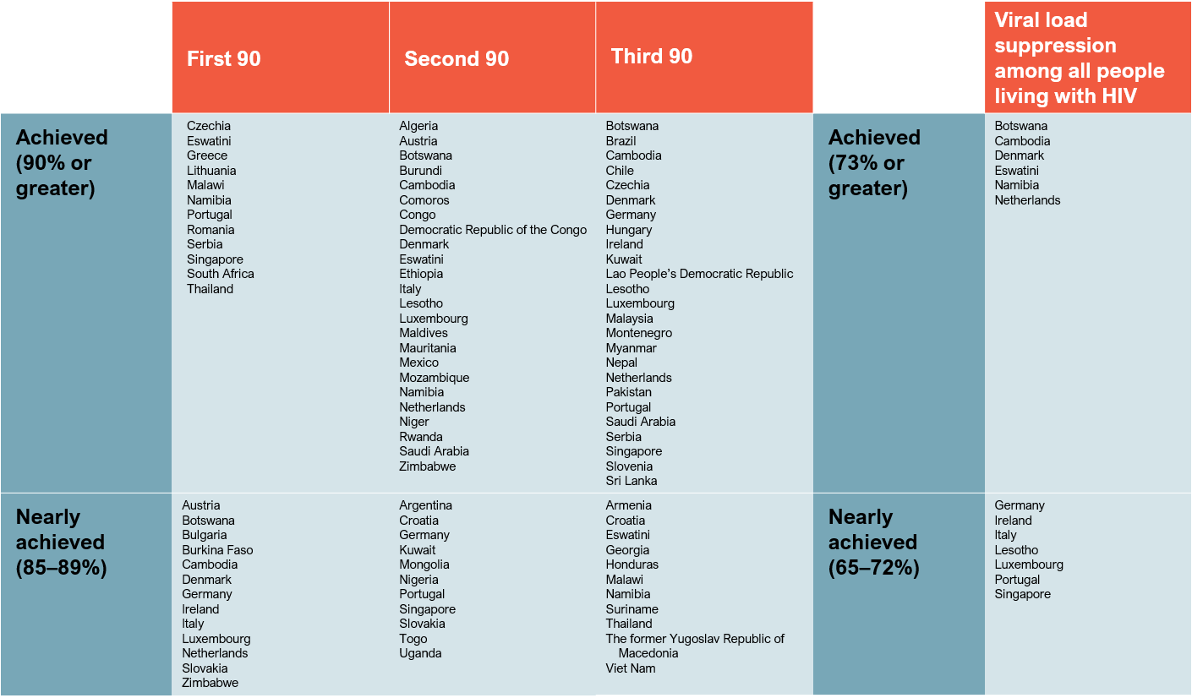
Progress towards 90–90–90, by country, 2017
Countries that have achieved the 90–90–90 targets or are near to achieving them, most recent country data*
* Data are for 2017, except as as follows. 2016: Austria, Czechia, Denmark, Germany, Italy, Luxembourg, Netherlands, Portugal, Serbia, Slovenia. 2015: Croatia and Hungary. Estimates are for citizens
of the country only for Kuwait and Saudi Arabia.
Source: UNAIDS special analysis, 2018; see annex on methods for more details.

Slide 46



Lower treatment coverage among men
Coverage of antiretroviral therapy by sex, global and regional, 2017
100
90
80
70
60
50
40
30
20
10
0
78%
66%
72%
65%
58%
62%
77%
Per cent
61%
50%
57%
39%
53%
49%
49%
32%
33%
27%
29%
Asia
and
the
Pacific
Caribbean
Eastern
and
southern
Africa
Eastern
Europe
and
central
Asia
Latin
America
Middle
East
and
North
Africa
Western
and
central
Africa
Western
and
central
Europe
and
North
America
Global
Women
Men
Source: UNAIDS 2018 estimates; Global AIDS Monitoring, 2018.

Slide 47
Far short of the target for children on treatment
Number of children (aged 0–14 years) accessing antiretroviral therapy, global 2000–2017 and 2018 target
Number of children on antiretroviral therapy
1 800 000
1 600 000
1 400 000
1 200 000
1 000 000
800 000
600 000
400 000
200 000
0
2000
2001
2002
2003
2004
2005
2006
2007
2008
2009
2010
2011
2012
2013
2014
2015
2016
2017
2018
Global
Target
Source: UNAIDS 2018 estimates; Global AIDS Monitoring, 2018.

Slide 48
Supporting adolescents to adhere to treatment
Predicted probabilities of full retention in care among adolescents (aged 10–19 years) by access to protective health
service factors, Eastern Cape, South Africa, 2014–2015
100
90
80
70
Per cent
60
50
40
30
20
10
0
None
Enough cash
for transport
to clinic
Accompanied
to clinic
Clinic staff
are kind
Clinic staff
have enough
time to spend
with adolescent
Clinic are
well-stocked
with antiretroviral
therapy
All 5 protective
health service
factors
Note: Adhering to antiretroviral therapy was defined as both no missed clinic visits over the past year and 90% adherence over the past week.† Individuals in this category did not report any HIV-related risk behaviour.
1 Adhering to antiretroviral therapy was defined as both no missed clinic visits over the past year and 90% adherence over the past week.
Source: Cluver LD, Pantelic M, Toska E, Orkin M et al. STACKing the odds for adolescent survival: health service factors associated with full retention in care and adherence amongst adolescents iving with HIV
in South Africa (in press).

Slide 49
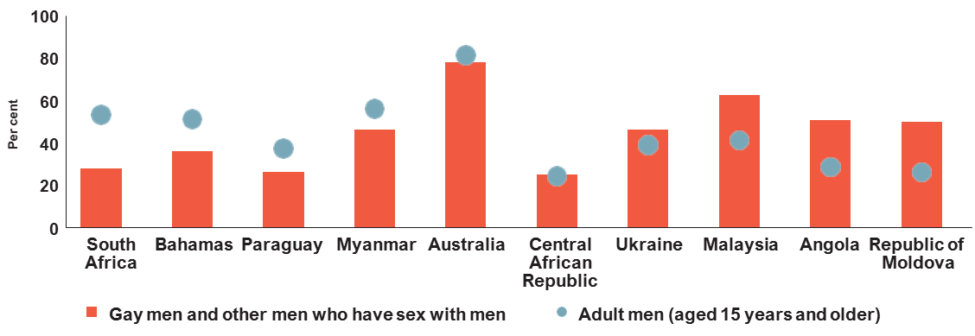
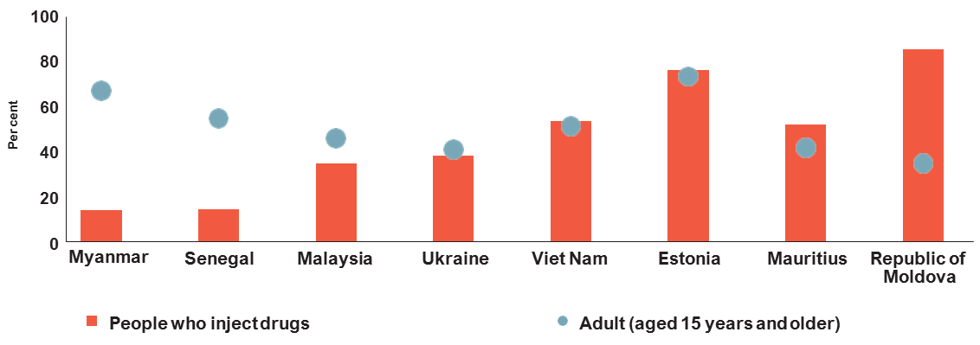
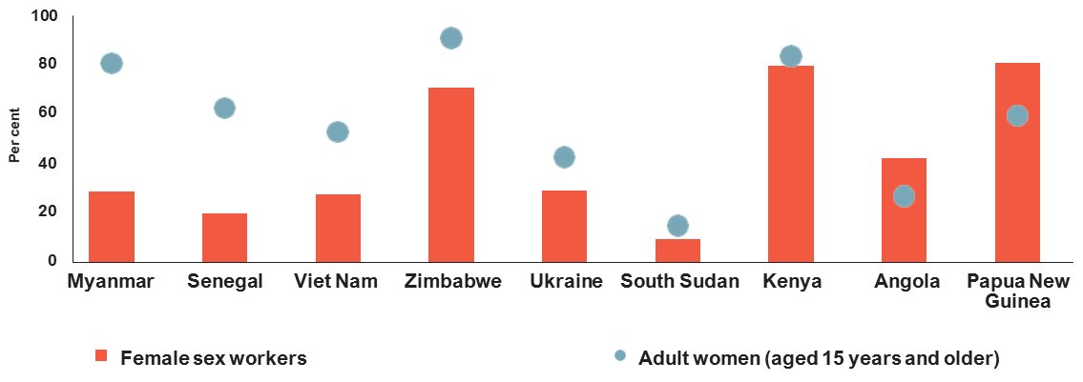
Treatment access often lower among key populations
Antiretroviral therapy coverage, by population, select countries, 2014–2017
Gay men and other men who have sex with men and adult men (aged 15 years and older), 2016–2017
People who inject drugs and all adults
(aged 15 years and older), 2014–2017
Female sex workers and adult women
(aged 15 years and older), 2016–2017
Source: Global AIDS Monitoring, 2018.

Slide 50
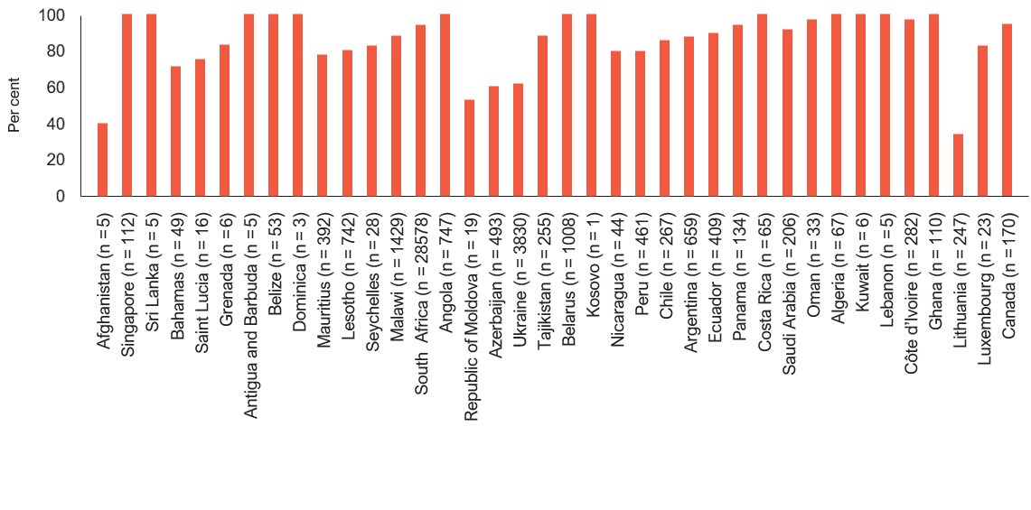
Treatment coverage in prisons often high
Antiretroviral therapy coverage among people living with HIV in prisons, countries with available data, 2016–2017
Source: 2018 Global AIDS Monitoring.

Slide 51
Varying price of dolutegravir
Price of dolutegravir (50mg) in US dollars, per person-year on treatment, 2017
120
Unit price in US dollars per person-year on treatment
$101
100
80
$71
60
$61
$61
$45
$45
40
$32
$30
$30
20
0
Iran
Armenia
Georgia
Argentina
Republic
of Korea
Slovenia
South Africa
Thailand
Zimbabwe
* Progress towards 90–90–90 for western and central Europe and North America region is for 2016.
Source: UNAIDS analysis of data from Government of India customs database, Global Fund to Fight AIDS, Tuberculosis and Malaria price and quality reporting and WHO Global Price Reporting Mechanism.

Slide 52
5. Eliminating mother-to-child
HIV transmission

Slide 53
Additional progress needed to hit 2020 target
New HIV infections among children (aged 0–14 years), global, 2000–2017 and 2020 target
700 000
500 000
400 000
600 000
300 000
200 000
100 000
0
Number of new HIV infections
2000
2001
2002
2003
2004
2005
2006
2007
2008
2009
2010
2011
2012
2013
2014
2015
2016
2017
2018
2019
2020
¹ These World Health Organization estimates include 399 000 adverse birth outcomes in 2012 and 368 000 adverse birth outcomes in 2016.
² Previous estimates of mother-to-child transmission rates did not capture the retention on antiretroviral therapy of pregnant women and the ongoing high levels of incident infections
among pregnant and breastfeeding women.
Source: UNAIDS 2018 estimates.

Slide 54
Start Free Stay Free AIDS Free targets and 2017 status
Target
Status in 2017
By 2018, reduce new HIV infections among children to less than 40 000 per year and to less than 20 000 by 2020.
180 000 [110 000–260 000]
By 2018, reach and sustain 95% of pregnant women living with HIV on lifelong antiretroviral therapy.
80% [61–95%] (Priority country progress in Figure 5.2.)
By 2020, reduce the number of new HIV infections among adolescents and young women to less than 100 000.
340 000 [200 000–490 000]
By 2020, provide voluntary medical male circumcision to an additional 25 million adolescent boys and men, with a focus on young men aged 15–29 years.
6.9 million
By 2020, provide antiretroviral to therapy to 90% of all children living with HIV and at least 1 million adolescents living with HIV.
52% [38–68%]
* Countries with fewer than 100 new infections in the adult population.
Source: UNAIDS 2018 estimates.

Slide 55
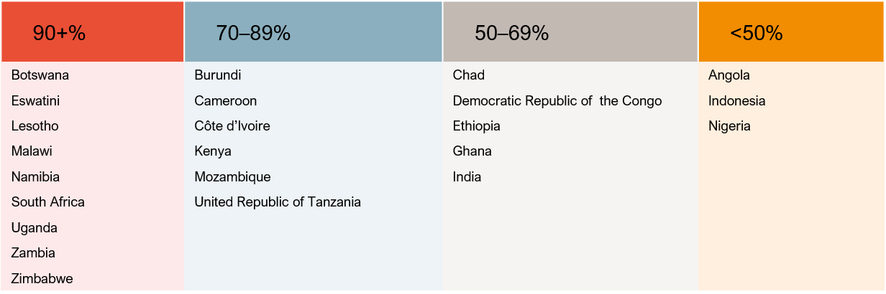
High coverage in high-prevalence countries
Proportions of pregnant HIV-positive women in priority countries receiving antiretroviral medicines to prevent
mother-to-child transmission, 2017
Source: UNAIDS 2018 estimates.

Slide 56
6. AIDS out of isolation

Slide 57
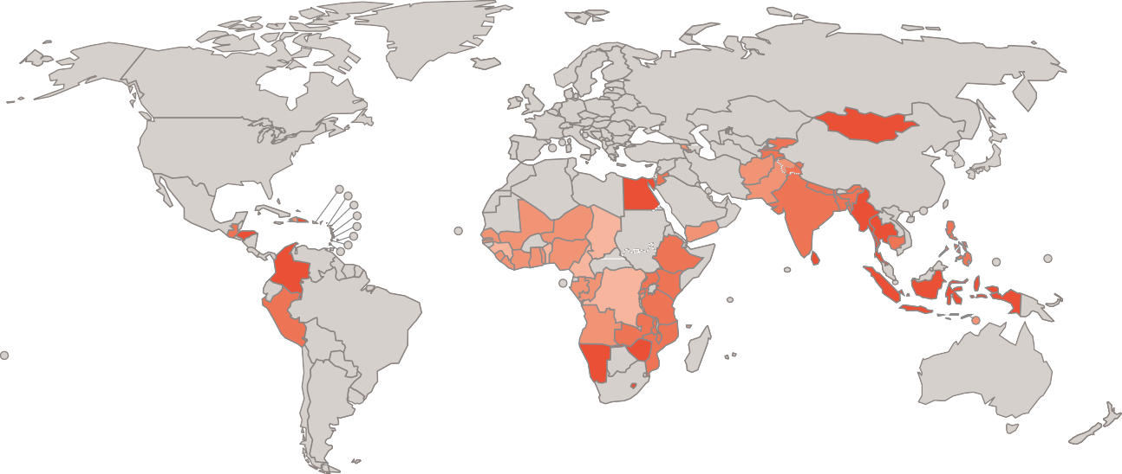
Women are not having their family planning needs met
Percentage of women (aged 15–49 years) who had their demand for family planning satisfied by modern methods,
countries with available data, 2012–2017
0–24%
25–49%
50–74%
75–100%
Data not available
Source: Population-based surveys, 2012–2017.

Slide 58
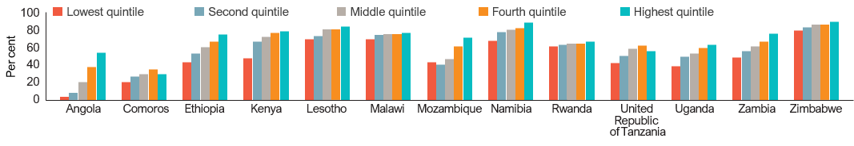
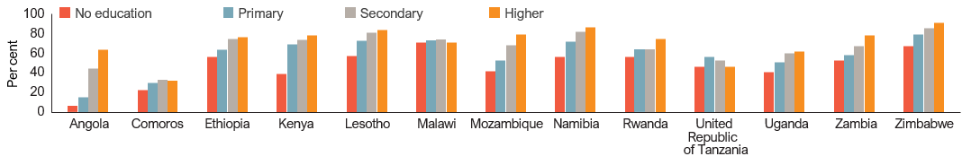
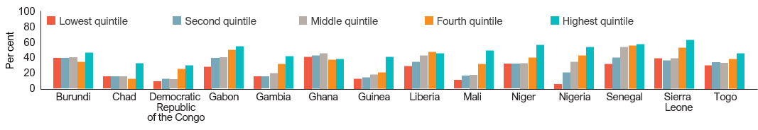
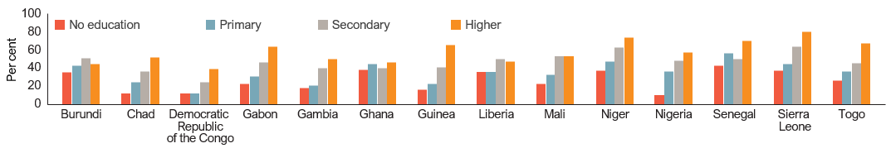
Poor and uneducated women less likely
to access family planning
Percentage of women (aged 15–49 years) who have their demand for family planning satisfied by modern methods,
By education level and wealth quintile, eastern and southern Africa and western and central Africa, 2012–2017
By wealth
quintile
Eastern and
southern Africa
By education
level
By wealth
quintile
Western and
central Africa
By education
level
Source: Population-based surveys, 2012–2017.

Slide 59
TB-related deaths among people living with HIV
concentrated in eight countries
Distribution of tuberculosis-related deaths among people living with HIV, global, 2016
30%
27%
South Africa
Nigeria
Mozambique
United Republic of Tanzania
Kenya
Uganda
3%
4%
10%
Indonesia
Zambia
Rest of the world
4%
9%
6%
7%
Source: Global tuberculosis report 2017. Geneva: World Health Organization; 2017.

Slide 60
Gains in diagnosing and treating HIV
among notified tuberculosis patients
Percentage of notified tuberculosis patients who had a documented HIV test result, sub-Saharan African countries
and countries outside sub-Saharan Africa, 2004–2016
SUB-SAHARAN AFRICA
OUTSIDE SUB-SAHARAN AFRICA
100
100
90
90
80
80
70
70
Per cent
60
Per cent
60
50
50
40
40
30
30
20
20
10
10
0
0
2004
2005
2006
2007
2008
2009
2010
2011
2012
2013
2014
2015
2016
2004
2005
2006
2007
2008
2009
2010
2011
2012
2013
2014
2015
2016
Source: Global tuberculosis database. Geneva: World Health Organization; 2018.

Slide 61
Tuberculosis treatment for people living with HIV
still low
Percentage of people living with HIV with incident tuberculosis who received treatment for both tuberculosis and HIV, global,
2000–2016
100
90
80
70
60
50
40
30
20
10
0
Per cent
2000
2001
2002
2003
2004
2005
2006
2007
2008
2009
2010
2011
2012
2013
2014
2015
2016
Source: 2017 Global AIDS Monitoring; Global tuberculosis report, 2017. Geneva: World Health Organization; 2017.

Slide 62
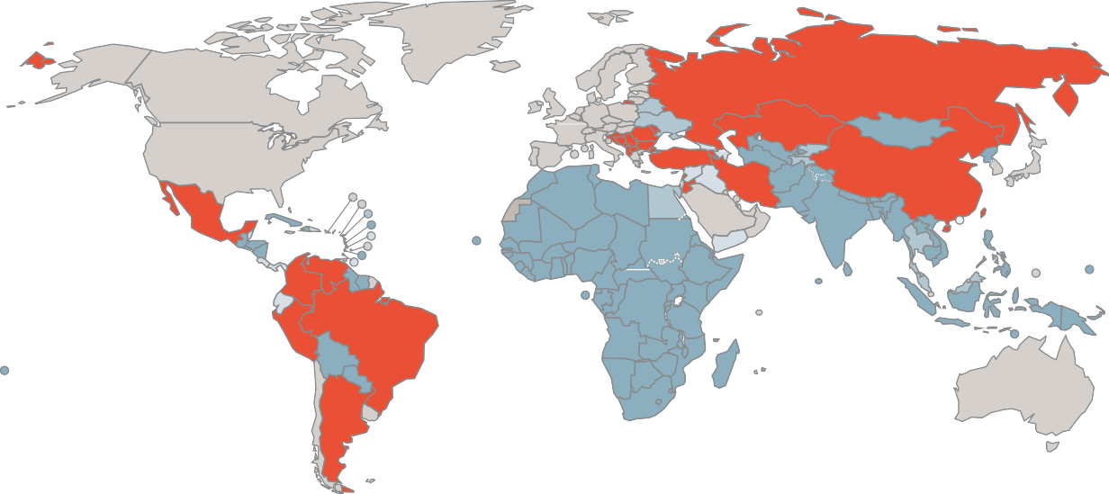

More than one third of people living with hepatitis C
live in countries without access to generic medicines
Availability of generic medicines that can cure hepatitis C, 2017
No agreement
BMS agreement only
GILEAD agreement only
BMS and GILEAD agreement
Not applicable
High-income countries
* Progress towards 90–90–90 for western and central Europe and North America region is for 2016.
Source: Progress report on access to hepatitis C treatment: focus on overcoming barriers in low- and middle-income countries. Geneva: World Health Organization; March 2018

Slide 63
Huge global treatment gap for hepatitis C
Cascade of care for people living with hepatitis C virus infection, by WHO region, 2016
100
2030 target:
90% of infected
are diagnosed
90
80
70
Per cent
60
50
2030 target:
80% of diagnosed
are treated
40
30
20
10
0
Infected
Diagnosed
Started on treatment in 2016
Cured in 2016
Western Pacific
South-East Asia
Europe
Eastern Mediterranean
Americas
African
Gap
Source: Progress report on access to hepatitis C treatment: focus on overcoming barriers in low- and middle-income countries. Geneva: World Health Organization; March 2018.

Slide 64





HPV vaccination policies are critical to progress
Percentage of girls (aged 10–14 years) living in a country with a national vaccination policy that includes
HPV vaccination, by region, 2018
9%
57%
55%
34%
91%
0%
3%
100%
Asia and the Pacific
Caribbean
Eastern
and southern Africa
Eastern
Europe and
central Asia
Latin
America
Middle
East and
North Africa
Western and central Africa
Western and
central Europe
and North
America
Girls (aged 10–14 years)
Girls (aged 10–14 years) living in a country with a national vaccination policy that includes HPV vaccination
Source: 2017 World Population Prospects; 2018 HIV estimates; Immunization Vaccines and biologicals database, World Health Organization (as of 15 June 2018).

Slide 65
All women living with HIV should be screened
for cervical cancer
Proportion of reporting countries that deliver cervical cancer screening integrated in HIV services, by region, 2016
100
80
Per cent
60
40
20
0
Asia
and
the
Pacific
(n = 22)
Caribbean
(n = 10)
Eastern
and
southern
Africa
(n = 19)
Eastern
Europe
and
central
Asia
(n = 11)
Latin
America
(n = 15)
Middle
East
and
North
Africa
(n = 10)
Western
and
central
Africa
(n = 13)
Western
and
central
Europe
and
North
America
(n = 7)
Fully integrated in all health facilities
Integrated in some health facilities
Delivered separately
Source: 2017 National Commitments and Policy Instrument.

Slide 66
7. Investment

Slide 67
A modest increase in financial resources
HIV resource availability in low- and middle-income countries (in constant 2016 US dollars), by source of funding,
2000–2017 and 2020 target
30
25
US$ (billion)
20
15
10
* Estimates for low- and middle-income countries per 2015 World Bank income level classification. All figures are expressed in constant 2016 US dollars.
5
0
2006
2007
2008
2009
2010
2011
2012
2013
2014
2015
2016
2017
2018
2019
2020
Domestic (public and private)
United States (bilateral)
Global Fund to Fight AIDS, Tubercolosis and Malaria
Other international
Resource needs (Fast-Track)
Source: UNAIDS resource availability and needs estimates, 2018.

Slide 68
More consistent growth in domestic investment (1)
Annual percentage change in HIV resource availability from international sources, constant 2016 US dollars, low- and middle-income countries, 2000–2017
48%
3%
8%
8%
6%
11%
-11%
-9%
-7%
-1%
18%
20%
52%
23%
54%
19%
20%
2000
2001
2002
2003
2004
2005
2006
2007
2008
2009
2010
2011
2012
2013
2014
2015
2016
2017
Increase
Decrease
Total
Source: UNAIDS resource availability and needs estimates, 2018.

Slide 69
More consistent growth in domestic investment (2)
Annual percentage change in HIV resource availability from domestic sources (public and private), constant 2016 US
dollars, low- and middle-income countries, 2000–2017
4%
1%
6%
2%
6%
21%
7%
17%
16%
10%
5%
11%
11%
1%
-1%
-3%
2000
2001
2002
2003
2004
2005
2006
2007
2008
2009
2010
2011
2012
2013
2014
2015
2016
2017
Increase
Decrease
Total
Source: UNAIDS resource availability and needs estimates, 2018.

Slide 70
Investment and impact trends
Per capita resource availability for HIV responses and HIV incidence and AIDS-related mortality rates,
low- and middle-income countries, 2006–2017 and 2020 targets
800
0.50
HIV expenditures per person living with HIV (US$)
0.45
Incidence and AIDS-related mortality rates
700
0.40
600
0.35
500
0.30
400
0.25
300
0.20
0.15
200
0.10
100
0.05
0
2006
2007
2008
2009
2010
2011
2012
2013
2014
2015
2016
2017
2018
2019
2020
0.00
HIV resources availability per person living with HIV (US$) Resource needs per person living with HIV (US$)
AIDS-related mortality rate (per 1000) HIV incidence rate (per 1000)
Source: UNAIDS 2018 estimates; GAM/GARPR reports 2005–2018; UNAIDS–Kaiser Family Foundation collaborative project on international assistance disbursements from donor governments in 2017;
Fast-Track update on investments needed in the AIDS response, 2016–2030. Geneva: UNAIDS; 2016.

Slide 71
Insufficient investment and impact
in several regions (1)
Per capita resource availability for HIV responses, HIV incidence and mortality rates, by region, 2006–2017 and 2020 targets
EASTERN AND SOUTHERN AFRICA
CARIBBEAN
HIV expenditures per person living with HIV (US$)
600
500
400
300
200
100
0
5.00
4.00
3.00
2.00
1.00
0.00
Incidence and mortality rates per 1000 population
HIV expenditures per person living with HIV (US$)
2500
0.70
0.60
0.50
0.40
0.30
0.20
0.10
0.00
Incidence and mortality rates per 1000 population
2000
1500
1000
500
2006
2007
2008
2009
2010
2011
2012
2013
2014
2015
2016
2017
2018
2019
2020
0
2006
2007
2008
2009
2010
2011
2012
2013
2014
2015
2016
2017
2018
2019
2020
WESTERN AND CENTRAL AFRICA
EASTERN EUROPE AND CENTRAL ASIA
700
600
1.40
1.20
4000
3500
3000
2500
2000
1500
1000
500
0
0.25
HIV expenditures per person living with HIV (US$)
Incidence and mortality rates per 1000 population
HIV expenditures per person living with HIV (US$)
Incidence and mortality rates per 1000 population
500
400
300
200
0.20
1.00
0.80
0.60
0.40
0.15
0.10
100
0
0.20
0.00
0.05
2006
2007
2008
2009
2010
2011
2012
2013
2014
2015
2016
2017
2018
2019
2020
2006
2007
2008
2009
2010
2011
2012
2013
2014
2015
2016
2017
2018
2019
2020
0.00
HIV resource availability per person living with HIV (US$)
Resource needs per person living with HIV (US$)
Mortality rate (per 1000)
Incidence rate (per 1000)
Source: UNAIDS 2018 estimates; GAM/GARPR reports 2005–2018; UNAIDS–Kaiser Family Foundation collaborative project on international assistance disbursements from donor governments
in 2017; Fast-Track update on investments needed in the AIDS response, 2016–2030. Geneva: UNAIDS; 2016.

Slide 72
Insufficient investment and impact
in several regions (2)
Per capita resource availability for HIV responses, HIV incidence and mortality rates, by region, 2006–2017 and 2020 targets
ASIA AND THE PACIFIC
LATIN AMERICA
HIV expenditures per person living with HIV (US$)
1000
900
800
700
600
500
400
300
200
100
0
0.12
0.10
0.08
0.06
0.04
0.02
0.00
Incidence and mortality rates per 1000 population
2000
1800
1600
1400
1200
1000
800
600
400
200
0
0.25
Incidence and mortality rates per 1000 population
HIV expenditures per person living with HIV (US$)
0.20
0.15
0.10
0.05
2006
2007
2008
2009
2010
2011
2012
2013
2014
2015
2016
2017
2018
2019
2020
2006
2007
2008
2009
2010
2011
2012
2013
2014
2015
2016
2017
2018
2019
2020
0.00
MIDDLE EAST AND NORTH AFRICA
4000
3500
3000
2500
2000
1500
1000
500
0
0.06
0.05
0.04
0.03
0.02
HIV expenditures per person living with HIV (US$)
Incidence and mortality rates per 1000 population
0.01
0.00
HIV resource availability per person living with HIV (US$)
Resource needs per person living with HIV (US$) Mortality rate (per 1000)
Incidence rate (per 1000)
2006
2007
2008
2009
2010
2011
2012
2013
2014
2015
2016
2017
2018
2019
2020
Source: UNAIDS 2018 estimates; GAM/GARPR reports 2005–2018; UNAIDS–Kaiser Family Foundation collaborative project on international assistance disbursements from donor governments
in 2017; Fast-Track update on investments needed in the AIDS response, 2016–2030. Geneva: UNAIDS; 2016.

Slide 73
Varying investment in prevention
Allocations of HIV resources for the five pillars of prevention and all other prevention in selected countries, 2014–2017
ALGERIA, 2017
BENIN, 2016
GEORGIA, 2014
KENYA, 2017
2%
1%
2%
3%
1%
1%
1%
10%
28%
46%
85%
26%
97%
97%
MALAWI, 2017
MEXICO, 2015
SENEGAL, 2015
SOUTH AFRICA, 2017
UKRAINE, 2016
2%
1%
5%
2%
1%
10%
2%
1%
10%
5%
3%
2%
7%
2%
6%
8%
85%
92%
80%
84%
92%
Source: UNAIDS resource availability and needs estimates, 2018; Global AIDS Monitoring reports, 2018.

Slide 74


Stronger country ownership of
treatment programmes
Relationships between per capita gross domestic product and the percentage of HIV response funding
provided by donors, total HIV response compared to treatment programmes, 2016
TOTAL HIV RESPONSE
ANTIRETROVIRAL THERAPY
Per cent share of international resources
100
Per cent share of international resources
100
80
80
60
60
40
40
20
20
0
-2000 2000 4000 6000 8000 10 000
0
12 000 14 000
-2000
2000 4000 6000 8000 10 000 12 000 14 000
Gross domestic product per capita (US$)
Gross domestic product per capita (US$)
Source: GARPR/GAM reports, 2014–2017.

Slide 75
Big impact of a 20% donor cut
The impact of a cut in donor funding for HIV on the percentage of total public spending on HIV as a percentage of total public expenditure on health selected countries, 2017
150
100
Mozambique
Benin
Government expenditure on HIV as a percentage of government health exenditure
Haiti
Nigeria
Kenya
Senegal
Malawi
South Africa
Côte d'Ivoire
El Salvador
50
Democratic
Republic of the
Congo
India
0
Most recently reported
If government
absorbed a 10%
cut in donor funding
If government
absorbed a 20% cut
in donor funding
Source: UNAIDS resource availability and needs estimates, 2018.

