Slide 1
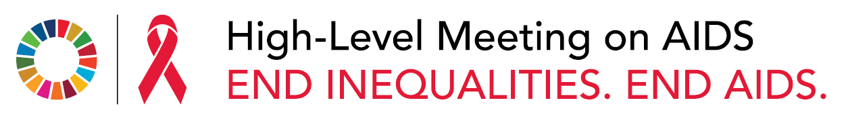

GLOBAL COMMITMENTS, LOCAL ACTION
After 40 years of AIDS, charting a course to end the pandemic

Slide 2
Time is running out on the global effort to end AIDS by 2030
Global progress since the 2016 UN General Assembly High-Level Meeting has been too slow. Targets for 2020 have been missed.
Number of new HIV infections
2 000 000
The 1.5 million people who acquired HIV in 2020 were triple the 2020 target of fewer than 500 000 new infections.
1 500 000
Achievement of the 2025 targets will reduce annual HIV infections to fewer than 370 000 and AIDS-related deaths from
690 000 in 2020 to fewer than 250 000.
1 000 000
500 000
2020 target
0
2016
2020
2025
Source: Special analysis by Avenir Health using preliminary UNAIDS epidemiological estimates, 2021.

Slide 3

THE WORLD CAN NO LONGER AFFORD TO UNDER-INVEST in pandemic preparedness and responses.
WHEN THE GENERAL ASSEMBLY MEETS at its High-Level Meeting on AIDS on 8–10 June 2021, it must seize the moment and commit to taking the actions needed to end AIDS by 2030.
Each additional
US$ 1
invested in the HIV responses of low- and middle-income countries between 2021 and 2030 will bring a return of more than
US$ 7
in health benefits
Source: Lamontagne E, Over M, Stover J. Special analysis for UNAIDS, 2021. Unpublished.

Slide 4
Resource availability for HIV responses, low- and middle-income countries, 2000–2019
25
57%
increase in resources for
HIV responses between 2000 and 2004
75%
increase in resources for
HIV responses between
2005 and 2009
2011 UN General Assembly
High-Level Meeting on AIDS
2016 UN General Assembly
High-Level Meeting on AIDS
20
2007–2009
global
recession
2013–2019
15% increase in
domestic resources
for HIV; 16% decline
in international
resources
15
2030 Agenda
for Sustainable
Development agreed
by the UN General
Assembly
US$ (billion)
Global Fund
established
10
Millennium
Declaration
2006 UN General
Assembly High-Level
Meeting on AIDS
5
PEPFAR
established
26%
increase in resources for
HIV responses between
2010 and 2014
2%
increase in resources for
HIV responses between
2015 and 2019
2001 UN General
Assembly Special
Session on HIV/AIDS
0
2000
2001
2002
2003
2004
2005
2006
2007
2008
2009
2010
2011
2012
2013
2014
2015
2016
2017
2018
2019
Source: UNAIDS financial estimates and projections, 2021.
Note: The countries included across all years (2000–2019) are those that were classified by the World Bank in 2015 as being low- and middle-income. The resource estimates are presented in constant 2019 US dollars.

Slide 5
Numbers of AIDS-related deaths and people receiving HIV treatment, global, 2000–2020
3 000 000
30 000 000
Number of people receiving HIV treatment
Number of AIDS-related deaths
2 500 000
25 000 000
2 000 000
20 000 000
1 500 000
15 000 000
1 000 000
10 000 000
500 000
5 000 000
0
0
2000
2001
2002
2003
2004
2005
2006
2007
2008
2009
2010
2011
2012
2013
2014
2015
2016
2017
2018
2019
2020
Number receiving antiretroviral therapy
Uncertainty bounds
Number of AIDS-related deaths
Source: UNAIDS Preliminary UNAIDS epidemiological estimates, 2021.

Slide 6
Per cent
100
0
10
20
30
40
50
60
70
80
90
Percentage of people aged 15–49 years who report having discriminatory attitudes towards people living with HIV, countries with available data,
2015–2019
Asia and the Pacific
Tonga
Philippines*
Indonesia
Mongolia
Timor-Leste
Kiribati
Lao People’s Democratic Republic
Bangladesh*
Papua New Guinea
Nepal
India
Thailand
Caribbean
Haiti
Suriname
Belize
Cuba
Eastern and southern Africa
Madagascar
Ethiopia
Angola
Uganda
Zimbabwe
Malawi
Eastern Europe and central Asia
Turkmenistan*
Tajikistan*
Albania
Kyrgyzstan*
Armenia
Georgia
Montenegro
Latin America
Costa Rica*
Middle East and North Africa
Jordan
Iraq*
Tunisia
Western and central Africa
Guinea
* Data are for women aged 15 to 49 only.
Source: Population-based surveys, 2015–2019.
Note: Discriminatory attitudes are measured through “No” responses to either of two questions:
(1) Would you buy fresh vegetables from a shopkeeper or vendor if you knew this person had HIV?; and (2) Do you think that children living with HIV should be able to attend school with children who are HIV-negative?
Ghana
Mauritania
Benin
Gambia
Sierra Leone
Senegal
Nigeria
Mali
Côte d’Ivoire
Togo
Chad
Central African Republic
Cameroon
Democratic Republic of the Congo
São Tome e Principe
Burundi

Slide 7
HIV incidence among adolescent girls and young women (aged 15–24 years), subnational levels, sub-Saharan Africa, 2020
Incidence rate per 1000 person-years at risk (PYAR)
No data
< 3 per 1000 PYAR (low) therapy
3–< 10 per 1000 PYAR (high) therapy
10–30 per 1000 PYAR (very high)
Source: Preliminary UNAIDS epidemiological estimates, 2021.
Note: HIV incidence estimated as new HIV infections per 1000 person-years at risk (PYAR).
Countries: For selected countries in sub-Saharan Africa that had the data required to produce subnational HIV estimates.

Slide 8
Annual number of new HIV infections and the 2020 target, global, 1990–2020
4 500 000
4 000 000
Number of new infections
3 500 000
3 000 000
2 500 000
2 000 000
1 500 000
1 000 000
500 000
0
1991
1992
1993
1994
1995
1996
1997
1998
1999
2000
2001
2002
2003
2004
2005
2006
2007
2008
2009
2010
2011
2012
2013
2014
2015
2016
2017
2018
2019
2020
New HIV infections
Uncertainty bounds
2020 target
Source: Preliminary UNAIDS epidemiological estimates, 2021.

Slide 9

Relative risk of HIV acquisition, global, 2019
Gay men and
other men who
have sex with men
26 times
higher risk
than
heterosexual
men
Female sex
workers
30 times
higher risk
than women
in the general
population
People who
inject drugs
29 times
higher risk
than people
who do not
inject drugs
Transgender people
13 times
higher risk
than adults in the
general population
People in prisons and other
closed settings have
6 times higher
HIV prevalence than the
general population
Source: UNAIDS special analysis, 2020.

Slide 10
Distribution of new HIV infections by population, global, 2019
8%
Sex workers
10%
People who
inject drugs
38%
Remaining
population
23%
Gay men and other men who have sex with men
2%
Transgender
people*
19%
Clients of sex workers and sex
partners of all key populations
* Data only included from Asia and the Pacific, the Caribbean, eastern Europe and central Asia, Latin America, and western and central Europe and North America.
Source: UNAIDS epidemiological estimates, 2020 (see https://aidsinfo.unaids.org/); UNAIDS special analysis, 2020.

Slide 11
Distribution of new HIV infections and of the population, by age and sex, sub-Saharan Africa, 2020
Male 0–14
8%
Female 0–14
7%
Male 0–14
21%
Female 0–14
21%
Male 15–24
8%
Female 15–24
25%
Male 25–49
19%
New HIV infections
Male 15–24
10%
Population distribution
Female 15–24
10%
Male 25–49
14%
Female 25–49
14%
Male 50+
3%
Female 25–49
26%
Female 50+
4%
Male 50+
5%
Female 50+
5%
Source: Preliminary UNAIDS epidemiological estimates, 2021.

Slide 12
Top 10 causes of death, adult women (aged 15–49 years), Africa, 2019
Rank | Cause | Number of deaths
1 | HIV- and AIDS-related causes | 136 000
2 | Maternal conditions | 109 700
3 | Tuberculosis | 73 600
4 | Breast cancer | 26 500
5 | Lower respiratory infections | 25 500
6 | Diarrhoeal diseases | 25 100
7 | Cervix uterine cancer | 24 500
8 | Road injury | 24 000
9 | Stroke | 19 200
10 | Interpersonal violence | 16 700
Source: Rounded values of the Global Health Estimates 2019: Deaths by Cause, Age, Sex, by Region, 2000-2019. Geneva, World Health Organization; 2020.

Slide 13
Coverage of antiretroviral therapy, adults and children, global, 2010–2020
100
90
80
70
60
Per cent
50
40
30
20
10
0
2010
2011
2012
2013
2014
2015
2016
2017
2018
2019
2020
Adults (15 years and older)
Children (0–14 years)
Source: Preliminary UNAIDS epidemiological estimates, 2021.

Slide 14
Children living with HIV not receiving treatment, by age group, 2020
39%
10–14 years
38%
0–4 years
23%
5–9 years
Source: Preliminary UNAIDS epidemiological estimates, 2021.

Slide 15
Change in the number of HIV tests
and results returned per month,
compared to baseline,
selected countries, 2020
Change (%)
40
20
0
-20
-40
-60
-80
-100
South Africa
Ethiopia
Uganda
March
April
Kenya
May
June
United Republic of Tanzania
July
August
Indonesia
September
October
Mozambique
November
December
Peru
Rwanda
Source: UNAIDS/WHO/UNICEF HIV services tracking tool, May 2021.
Notes: (1) The baseline is the average of the January and February 2020 reports.
(2) Selected countries fulfilled the following criteria: (a) conducted an average
of between 115 000 and 1.7 million HIV tests in January and February 2020;
(b) provided data for January 2020; (c) had no significant change in the number
of facilities reporting; (d) provided monthly, not cumulative, data;
and (e) had at least four months of data.
Myanmar
Tajikistan

Slide 16
The cost of missing the 2020 targets
New HIV infections and AIDS-related deaths projected through 2020,
and modelled prediction resulting from fast-track interventions, global, 2010–2020
2 500 000
3.2 million more new infections
from 2015 to 2020 than if the Fast-Track
objectives had been met
1 400 000
Number of new infections
1 200 000
1.0 million more deaths from
2015 to 2020 than if the Fast-Track
objectives had been met
2 000 000
Number of deaths
1 000 000
1 500 000
800 000
1 000 000
600 000
400 000
500 000
200 000
0
2010
2011
2012
2013
2014
2015
2016
2017
2018
2019
2020
0
2010
2011
2012
2013
2014
2015
2016
2017
2018
2019
2020
Actual trend
Fast-track
Source: Special analysis by Avenir Health using preliminary UNAIDS epidemiological estimates, 2021.

Slide 17
Targets reinforce each other
HIV infections and AIDS-related deaths estimated through 2020, and modelled predictions
related to progress towards 2025 targets, with and without societal enablers, 2021–2030
2 500 000
Implementation
of the Global AIDS Strategy 2021–2026 to achieve 2025 targets
1 200 000
Implementation
of the Global AIDS Strategy 2021–2026 to achieve 2025 targets
Number of new infections
2 000 000
1 000 000
1.7 million
additional
AIDS-related
deaths
between 2020
and 2030
Number of deaths
800 000
1 500 000
2.5 million
additional
infections
between 2020
and 2030
600 000
1 000 000
400 000
500 000
200 000
0
2015
2020
2025
2030
0
2015
2020
2025
2030
Epidemiological estimates of progress until 2020
Impact if no progress is made on societal enablers
Impact of achieving the full set of 2025 targets
Source: Special analysis by Avenir Health using data from UNAIDS/WHO/UNICEF HIV services tracking tool, January 2021; and UNAIDS epidemiological estimates, 2020.

Slide 18
2019 expenditure and 2025 resource needs, by programme area, low- and middle-income countries
12
10
9.5
9.8
8
8.3
US$ (billions)
6
5.3
4
3.6
3.1
2.5
2.8
2
1.3
1.9
0
0.3
0.2
Primary
prevention
Testing and
treatment
Prevention of
vertical transmission
Societal
enablers
Above
site level
Programme
management
Estimated expenditures, 2019
Resource needs, 2025
Source: UNAIDS financial estimates and projections, 2021.
Note: The resource estimates are presented in constant 2019 US dollars.

Slide 19
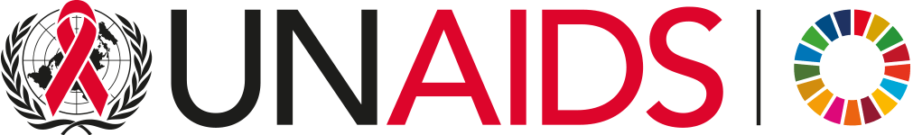
Regional profiles
High-Level Meeting on AIDS | 2021

Slide 20
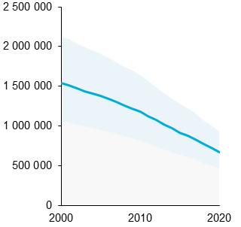
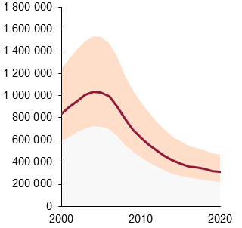
Eastern and southern Africa
Number of new HIV infections
2000–2020
Number of AIDS-related deaths
2000–2020
Percentage change in new HIV infections since 2010
-43%
Percentage change in AIDS-related deaths since 2010
-50%
Number of new HIV infections
Number of AIDS-related deaths
HIV testing and treatment cascade, 2020
Number of people living with HIV
25 000 000
20 000 000
Gap to
reaching
the first 90:
270 000
Gap to
reaching
the first and
second 90s:
770 000
Gap to
reaching
the three 90s:
560 000
New HIV infections
AIDS-related deaths
15 000 000
Source: Preliminary UNAIDS special analysis, 2021.
Source: Preliminary UNAIDS special analysis, 2021.
10 000 000
Distribution of new HIV infections
by population, 2019
Resource availability, 2019,
and resource needs, 2022–2025
89%
[72–>98%]
77%
[60–92%]
70%
[57–83%]
5 000 000
Gay men and
other men
who have sex
with men
6%
12 000
0
People living with HIV
who know their status
People living with HIV
who are on treatment
People living with HIV
who are virally suppressed
Clients of sex workers and sex partners of all key populations
15%
10 000
People who inject drugs
2%
US$ (million)
8000
Sex workers
5%
6000
Source: Preliminary UNAIDS special analysis, 2021.
4000
2000
Remaining
population
72%
0
2019
2022
2023
2024
2025
Source: UNAIDS special analysis, 2020.
Source: UNAIDS financial estimates, May 2021.
Note: The resource estimates are presented in constant 2019 US dollars.

Slide 21
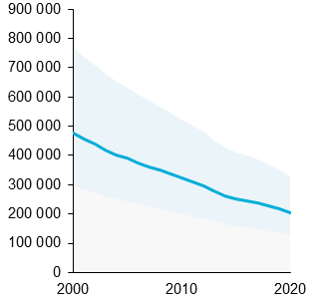
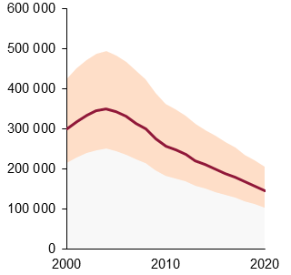
Western and central Africa
Number of new HIV infections
2000–2020
Number of AIDS-related deaths
2000–2020
Percentage change in new HIV infections since 2010
-37%
Percentage change in AIDS-related deaths since 2010
-43%
Number of new HIV infections
Number of AIDS-related deaths
HIV testing and treatment cascade, 2020
Number of people living with HIV
5 000 000
4 500 000
4 000 000
Gap to
reaching
the first 90:
630 000
Gap to
reaching
the first and
second 90s:
380 000
Gap to
reaching
the three 90s:
670 000
New HIV infections
AIDS-related deaths
3 500 000
Source: Preliminary UNAIDS special analysis, 2021.
Source: Preliminary UNAIDS special analysis, 2021.
3 000 000
2 500 000
2 000 000
Distribution of new HIV infections
by population, 2019
Resource availability, 2019,
and resource needs, 2022–2025
1 500 000
77%
[63–94%]
73%
[58–90%]
59%
[49–72%]
1 000 000
500 000
3000
0
Remaining
population
31%
Sex workers
19%
People living with HIV
who know their status
People living with HIV
who are on treatment
People living with HIV
who are virally suppressed
2500
People who inject drugs
2%
US$ (million)
2000
1500
Source: Preliminary UNAIDS special analysis, 2021.
Gay men and other men
who have sex with men
21%
1000
Clients of sex workers
and sex partners of all key populations
27%
500
0
2019
2022
2023
2024
2025
Source: UNAIDS special analysis, 2020.
Source: UNAIDS financial estimates, May 2021.
Note: The resource estimates are presented in constant 2019 US dollars.

Slide 22
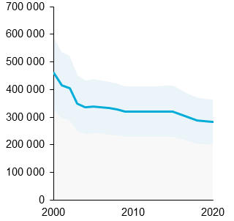
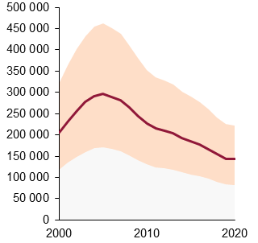
Asia and the Pacific
Number of new HIV infections
2000–2020
Number of AIDS-related deaths
2000–2020
Percentage change in new HIV infections since 2010
-12%
Percentage change in AIDS-related deaths since 2010
-37%
Number of new HIV infections
Number of AIDS-related deaths
HIV testing and treatment cascade, 2020
Number of people living with HIV
6 000 000
5 000 000
Gap to
reaching
the first 90:
680 000
Gap to
reaching
the first and
second 90s:
1.0 million
New HIV infections
AIDS-related deaths
4 000 000
Gap to
reaching
the three 90s:
690 000
Source: Preliminary UNAIDS special analysis, 2021.
Source: Preliminary UNAIDS special analysis, 2021.
3 000 000
Distribution of new HIV infections
by population, 2019
Resource availability, 2019,
and resource needs, 2022–2025
2 000 000
78%
[59–94%]
61%
[46–74%]
1 000 000
64%
[46–78%]
10 000
0
Sex workers
9%
People who inject drugs
17%
People living with HIV
who know their status
People living with HIV
who are on treatment
People living with HIV
who are virally suppressed
Remaining population
2%
8000
US$ (million)
6000
Source: Preliminary UNAIDS special analysis, 2021.
Clients of sex workers
and sex partners of all
key populations
21%
Gay men and
other men
who have sex
with men
44%
4000
2000
Transgender people
7%
0
2019
2022
2023
2024
2025
Source: UNAIDS special analysis, 2020.
Source: UNAIDS financial estimates, May 2021.
Note: The resource estimates are presented in constant 2019 US dollars.

Slide 23
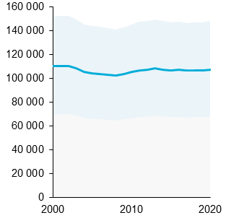
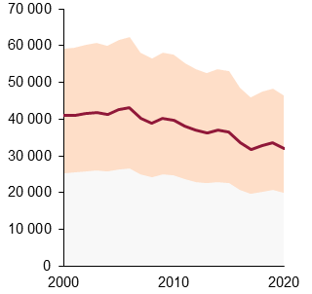
Latin America
Number of new HIV infections
2000–2020
Number of AIDS-related deaths
2000–2020
Percentage change in new HIV infections since 2010
+2%
Percentage change in AIDS-related deaths since 2010
-19%
Number of new HIV infections
Number of AIDS-related deaths
HIV testing and treatment cascade, 2020
Number of people living with HIV
2 500 000
2 000 000
Gap to
reaching
the first 90:
210 000
Gap to
reaching
the first and
second 90s:
330 000
Gap to
reaching
the three 90s:
280 000
New HIV infections
AIDS-related deaths
1 500 000
Source: Preliminary UNAIDS special analysis, 2021.
Source: Preliminary UNAIDS special analysis, 2021.
1 000 000
Distribution of new HIV infections
by population, 2019
Resource availability, 2019,
and resource needs, 2022–2025
80%
[55–>98%]
65%
[43–86%]
60%
[41–78%]
500 000
Sex workers
3%
4500
0
People who inject drugs
2%
4000
People living with HIV
who know their status
People living with HIV
who are on treatment
People living with HIV
who are virally suppressed
Remaining population
23%
3500
US$ (million)
3000
Gay men and
other men
who have sex
with men
44%
2500
Source: Preliminary UNAIDS special analysis, 2021.
Clients of sex workers
and sex partners of all
key populations
22%
2000
1500
1000
500
Transgender people
6%
0
2019
2022
2023
2024
2025
Source: UNAIDS special analysis, 2020.
Source: UNAIDS financial estimates, May 2021.
Note: The resource estimates are presented in constant 2019 US dollars.

Slide 24
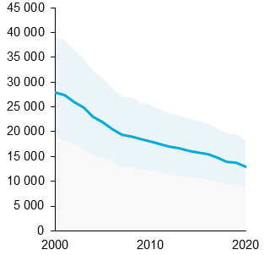
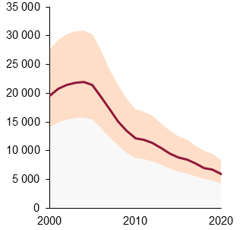
Caribbean
Number of new HIV infections
2000–2020
Number of AIDS-related deaths
2000–2020
Percentage change in new HIV infections since 2010
-28%
Percentage change in AIDS-related deaths since 2010
-51%
Number of new HIV infections
Number of AIDS-related deaths
HIV testing and treatment cascade, 2020
Number of people living with HIV
350 000
300 000
Gap to
reaching
the first 90:
28 000
Gap to
reaching
the first and
second 90s:
47 000
New HIV infections
AIDS-related deaths
250 000
Gap to
reaching
the three 90s:
46 000
Source: Preliminary UNAIDS special analysis, 2021.
Source: Preliminary UNAIDS special analysis, 2021.
200 000
150 000
Distribution of new HIV infections
by population, 2019
Resource availability, 2019,
and resource needs, 2022–2025
100 000
82%
[70–96%]
67%
[55–79%]
59%
[51–69%]
50 000
Sex workers
6%
400
0
350
People living with HIV
who know their status
People living with HIV
who are on treatment
People living with HIV
who are virally suppressed
Remaining population
40%
People who inject drugs
3%
300
Gay men and
other men
who have sex
with men
26%
US$ (million)
250
Source: Preliminary UNAIDS special analysis, 2021.
200
150
100
Clients of sex workers
and sex partners of all
key populations
20%
Transgender people
5%
50
0
2019
2022
2023
2024
2025
Source: UNAIDS special analysis, 2020.
Source: UNAIDS financial estimates, May 2021.
Note: The resource estimates are presented in constant 2019 US dollars.

Slide 25
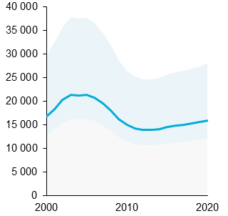
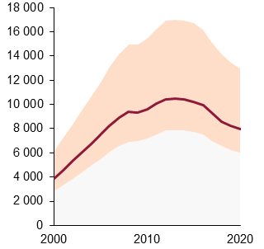
Middle East and North Africa
Number of new HIV infections
2000–2020
Number of AIDS-related deaths
2000–2020
Percentage change in new HIV infections since 2010
+7%
Percentage change in AIDS-related deaths since 2010
-17%
Number of new HIV infections
Number of AIDS-related deaths
HIV testing and treatment cascade, 2020
Number of people living with HIV
250 000
200 000
Gap to
reaching
the first 90:
69 000
Gap to
reaching
the first and
second 90s:
90 000
Gap to
reaching
the three 90s:
80 000
New HIV infections
AIDS-related deaths
150 000
Source: Preliminary UNAIDS special analysis, 2021.
Source: Preliminary UNAIDS special analysis, 2021.
100 000
Distribution of new HIV infections
by population, 2019
Resource availability, 2019,
and resource needs, 2022–2025
60%
[51–82%]
41%
[34–57%]
36%
[31–50%]
50 000
1200
0
Remaining population
3%
Sex workers
12%
People living with HIV
who know their status
People living with HIV
who are on treatment
People living with HIV
who are virally suppressed
1000
Clients of sex workers
and sex partners of all
key populations
19%
US$ (million)
800
600
Source: Preliminary UNAIDS special analysis, 2021.
People who
inject drugs
43%
400
Gay men and other men
who have sex with men
23%
200
0
2019
2022
2023
2024
2025
Source: UNAIDS special analysis, 2020.
Source: UNAIDS financial estimates, May 2021.
Note: The resource estimates are presented in constant 2019 US dollars.

Slide 26
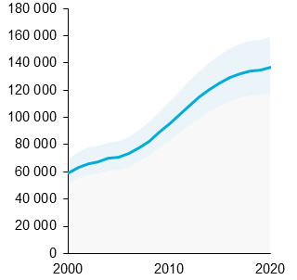
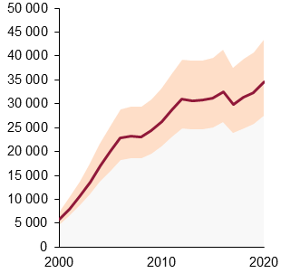
Eastern Europe and central Asia
Number of new HIV infections
2000–2020
Number of AIDS-related deaths
2000–2020
Percentage change in new HIV infections since 2010
+43%
Percentage change in AIDS-related deaths since 2010
+32%
Number of new HIV infections
Number of AIDS-related deaths
HIV testing and treatment cascade, 2020
Number of people living with HIV
180 000
160 000
Gap to
reaching
the first 90:
330 000
Gap to
reaching
the first and
second 90s:
460 000
140 000
Gap to
reaching
the three 90s:
380 000
New HIV infections
AIDS-related deaths
120 000
Source: Preliminary UNAIDS special analysis, 2021.
Source: Preliminary UNAIDS special analysis, 2021.
100 000
80 000
Distribution of new HIV infections
by population, 2019
Resource availability, 2019,
and resource needs, 2022–2025
60 000
70%
[63–78%]
50%
[47–56%]
40 000
53%
[46–60%]
20 000
4000
0
Clients of sex workers and sex partners of all key populations
20%
Remaining
population
1%
3500
People living with HIV
who know their status
People living with HIV
who are on treatment
People living with HIV
who are virally suppressed
3000
Transwomen
1%
Sex workers
8%
US$ (million)
2500
2000
Source: Preliminary UNAIDS special analysis, 2021.
Gay men and other men
who have sex with men
22%
1500
People who
inject drugs
48%
1000
500
0
2019
2022
2023
2024
2025
Source: UNAIDS special analysis, 2020.
Source: UNAIDS financial estimates, May 2021.
Note: The resource estimates are presented in constant 2019 US dollars.

Slide 27
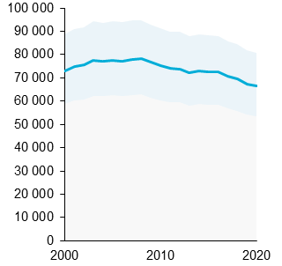
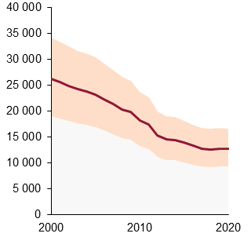
Western and central Europe and North America
Number of new HIV infections
2000–2020
Percentage change in new HIV infections since 2010
-11%
Number of new HIV infections
Number of AIDS-related deaths
2000–2020
HIV testing and treatment cascade, 2020
Percentage change in AIDS-related deaths since 2010
-30%
Number of people living with HIV
2 500 000
Number of AIDS-related deaths
2 000 000
New HIV infections
1 500 000
Source: Preliminary UNAIDS special analysis, 2021.
1 000 000
Distribution of new HIV infections
by population, 2019
90%
[75–>98%]
83%
[68–97%]
74%
[63–85%]
500 000
0
Remaining
population
4%
Sex workers
0.4%
People living with HIV
who know their status
People living with HIV
who are on treatment
People living with HIV
who are virally suppressed
Clients of sex workers
and sex partners of all
key populations
16%
People who inject drugs
15%
AIDS-related deaths
Source: Preliminary UNAIDS special analysis, 2021.
Source: Preliminary UNAIDS special analysis, 2021.
Transgender people
1%
Gay men and
other men
who have sex
with men
64%
Source: UNAIDS special analysis, 2020.

