Slide 1
UNAIDS
2025 Global AIDS Monitoring
Notes:
This presentation provides an overview of the Global AIDS Monitoring mechanism. It is focused on measuring progress towards the global AIDS targets set for 2025 and ending AIDS by 2030.

Slide 2
Components of 2025 GAM reports
Notes:
The Global AIDS Monitoring consists of several components.

Slide 3
2025 GAM reporting
Indicator data
Including disaggregations and sub-national data, where requested
Interim National Commitments and Policy Instrument (NCPI)
Narrative summaries
AIDS Medicines and Diagnostics Survey
Link to the reporting platform:
https://aidsreportingtool.unaids.org/
Notes:
There are 92 quantitative indicators. Countries are asked to state which indicators are relevant to their HIV response, and if there are new data available for each.
Besides the indicators, the reporting platform includes a laws and policies questionnaire called National Commitments and Policy Instrument. The full questionnaire included in GAM every two years consists of two parts, Part A to be completed by government and Part B to be completed by civil society and communities. In 2025 an interim version of the questionnaire is included that consists of a sub-set of questions from Part A that refer to laws and policies that may change more quickly.
The reporting platform also supports the writing of a narrative report, in the form of summaries by commitment areas in the 2021 Political Declaration on HIV and AIDS. The narrative summaries can help in documenting the key observations on the HIV response, and actions required to speed up progress.
The AIDS medicines and diagnostics survey is conducted in collaboration with WHO and is an important tool in monitoring whether the health system is equipping the response appropriately.

Slide 4
Changes to GAM indicators since 2024 reporting
Notes:
The Global AIDS Monitoring structure remains the same as in 2024 and is aligned to the Global AIDS Strategy and the 2021 Political Declaration. Some revisions have been made to existing indicator definitions.

Slide 5
Indicators related to hepatitis C (hepatitis C testing and people co-infected with HIV and hepatitis C virus starting hepatitis C treatment) have been suppressed and replaced with a revised indicator:
7.2 Management of viral hepatitis C
Questions on additional information to provide further context on data reported have been modified for the following indicators:
3.5 Syphilis among pregnant women
7.5 Men with urethral discharge
7.6 Gonorrhea among men
Disaggregations have been removed from one indicator:
7.7 Co-management of tuberculosis and HIV treatment
Clarifying text has been added in the rationale and method of measurement for two indicators:
7.15 Coverage of DSD ART models among people living with HIV currently on ART
7.16 Viral suppression among people living with HIV engaged in DSD ART models

Slide 6
The NCPI for 2025 reporting is an interim questionnaire consisting of a subset of questions from Part A of the full questionnaire included in the 2024 GAM that refer to policies considered to change more rapidly. The wording of some of the questions retained from previous rounds has been refined further. These modifications are based on experiences in previous reporting and to reflect developments in policy recommendations and available technologies.
WHO/AIDS medicines and diagnostics survey: Questions included for 2025 reporting refer to Dolutegravir-based, Protease Inhibitor-based and other treatment regimens, rather than first-line, second-line and third-line/salvage regimens. Questions have been added on the number of sexually transmitted infection, advanced HIV and hepatitis tests done in 2024.

Slide 7
The reporting process
Notes:
In the following slides we illustrate the recommended steps in carrying out the annual national AIDS reporting, dividing it into three phases; 1) preparation; 2) the reporting; and 3) the follow-up.

Slide 8
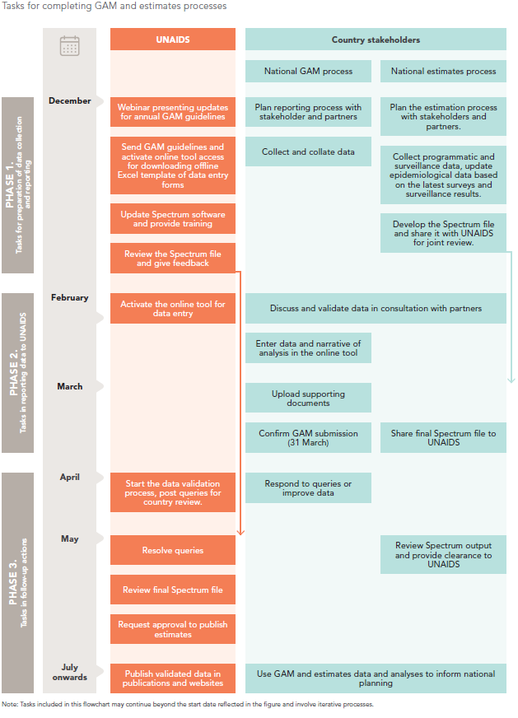
Global AIDS Monitoring reporting process
Notes:
In the preparation phase, from December to February, the national rapporteur receives a confirmation message from UNAIDS on the reporting process.
The preparatory steps are described in the guideline document. They include identifying indicators and data sources, resource persons, and ensuring the participation of key stakeholders such as government and civil society leads and the HIV estimates team to the process.
As part of the finalization process, reported data should be validated and reconciled between all partners in the country, including community-led organizations. The online reporting tool supports this process through the ability to share viewer credentials with national stakeholders.
Several countries have reported that this feature enabled community-led organizations and other partners to view and provide input during the reporting process, enabling wider and more rapid stakeholder consultation and validation.
In the second phase, in March, when conducting the reporting, the national rapporteur enters the relevant data and the narrative report in the online tool; uploads all supporting documents and confirms the GAM submission by the 31st of March.
In the last phase, April to June, the national rapporteur has still some follow-up tasks. UNAIDS may have data queries to the national rapporteurs, which are important to be addressed before the final data set is made public. The rapporteurs can also use extracts from the GAM online reporting tool to inform any public national events, forums or programme reviews on progress towards ending AIDS by 2030.

Slide 9
Spectrum and Naomi estimates
One of the main tools that can be used to obtain denominators for reporting is the Spectrum software package.
Countries can select to use Spectrum estimates as the source for reporting on the following GAM indicators:
1.1. HIV incidence
2.1, 2.2 and 2.3. 95-95-95. HIV testing and treatment
2.7. AIDS mortality
3.1 HIV testing in pregnant women
3.2. Early infant diagnosis (denominator)
3.3. Vertical transmission of HIV
3.4. Preventing the vertical transmission of HIV
Results will be obtained directly from the final national Spectrum file. Reporting on sub-national data for the indicator will be done in the Global AIDS Monitoring reporting tool
For indicators above where sub-national data are requested: if a country has sub-national estimates developed using Naomi, these data will be obtained directly from the final Naomi file.
Notes:
One of the main tools that can be used to obtain denominators for reporting is the Spectrum software package.
To reduce the manual data entry, countries can select to use Spectrum as the source. Results will be obtained directly by UNAIDS from the final national Spectrum file.

Slide 10
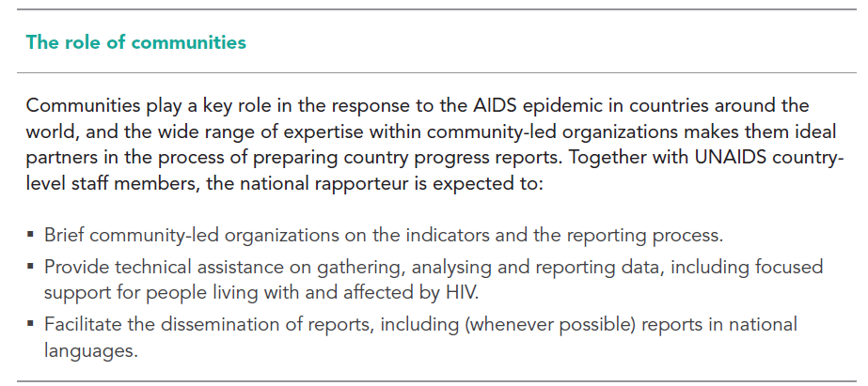
Multisectoral engagement
Countries are encouraged to engage a multisectoral group of stakeholders in the GAM reporting process, including from community-led organizations and appropriate civil society representatives
Notes:
Communities and civil society play important roles in the AIDS response. The reporting process benefits of the close participation of community and civil society representatives who can give insights on the status of the AIDS response, as well as help identify barriers to effective service delivery.

Slide 11
Support during the GAM reporting process
Notes:
In the following we summarize few resources available to you on the reporting process.

Slide 12
Support during the reporting process
Technical assistance is available from UNAIDS, UNICEF and/or WHO country offices
Support is also available from the UNAIDS Data for Impact Practice (AIDSreporting@unaids.org)
Notes:
You may seek for support from UNAIDS, UNICEF or WHO offices present in your country, or email to AIDSreporting@unaids.org

Slide 13
Where to find previously reported data
Notes:
Data reported in previous reporting rounds that have been validated are available on the AIDSinfo.unaids.org web-site.

Slide 14
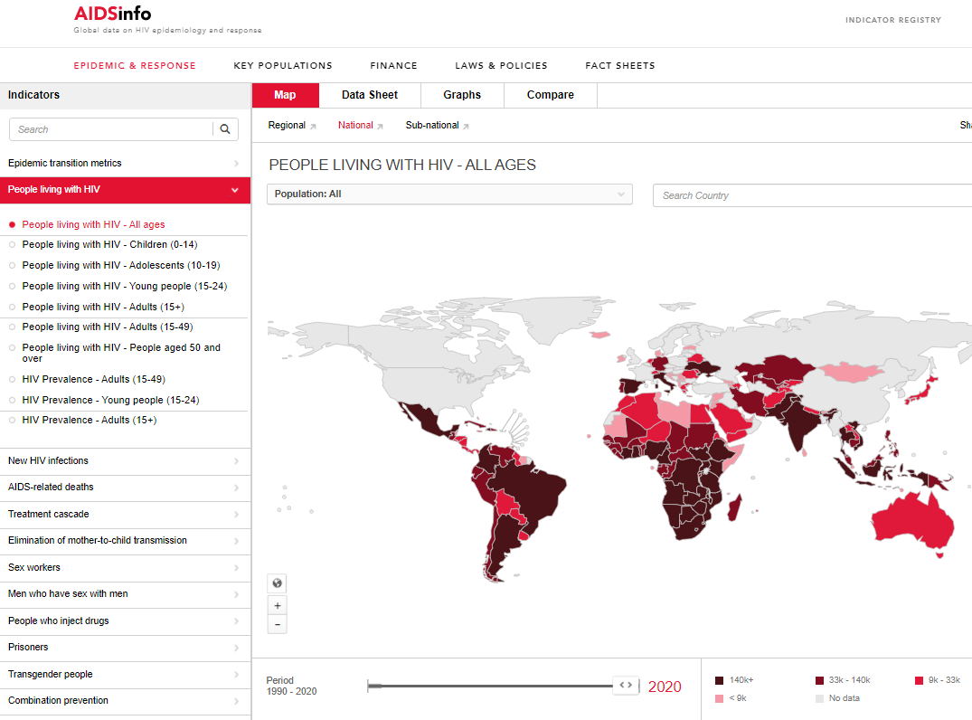
aidsinfo.unaids.org
Notes:
You can view the epidemiological and other indicator data from the main site; using maps, data sheets, graphs, or doing country comparisons.

Slide 15
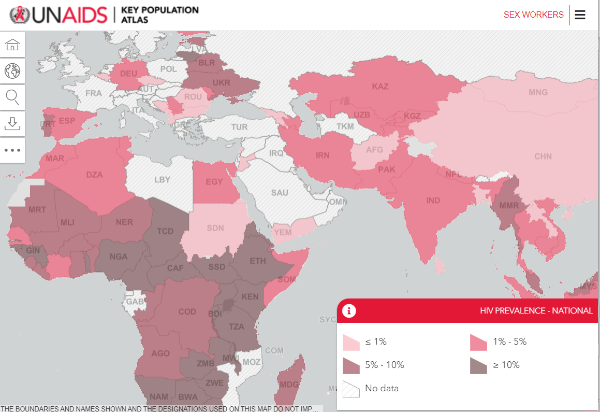
http://kpatlas.unaids.org/dashboard
Notes:
Key Population Atlas focuses on key populations data, covering sex workers, men who have sex with men, people who inject drugs, transgender people, people in prisons and other closed settings and people living with HIV

Slide 16
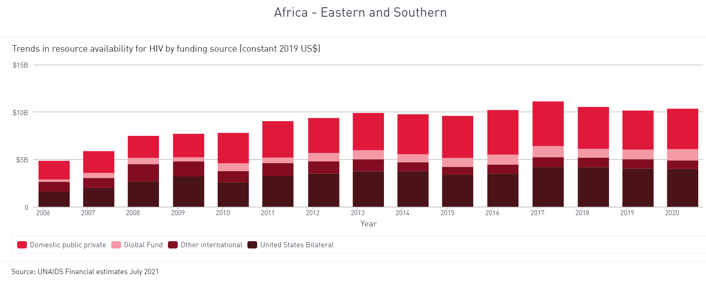
http://hivfinancial.unaids.org/hivfinancialdashboards.html
Notes:
The financial dashboards includes global, regional, and country by country data on the financing and spending of the AIDS response.

Slide 17
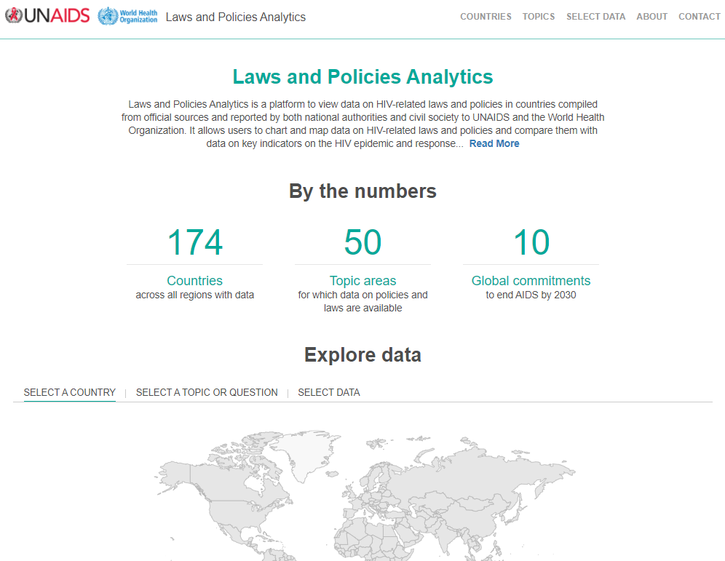
http://lawsandpolicies.unaids.org/
Notes:
In the laws and policies analytics you can look up policy and laws data reported through the NCPI and compiled by UNAIDS from other sources, including country documents and other global databases. Data can be searched by regions or specific countries, by topics and questions, and can be viewed in tables, graphs or maps.

Slide 18
For more information visit:
https://www.unaids.org/en/global-aids-monitoring

