Slide 1
GLOBAL AIDS UPDATE 2019
COMMUNITY ENGAGEMENT

Slide 2
GLOBAL AIDS UPDATE 2019
STATE OF THE EPIDEMIC

Slide 3
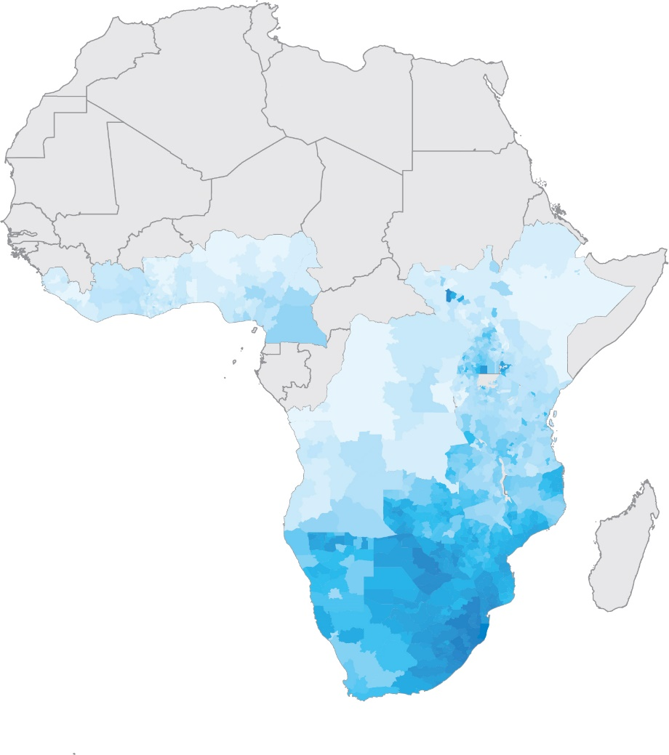
HIV prevalence, adults (aged 15–49 years), by sub-national level,
sub-Saharan Africa, 2018
HIV prevalence (%)
30
25
20
15
10
5
0
Note: Grey = sub-national data not available.
Source: UNAIDS special analysis, 2019.

Slide 4
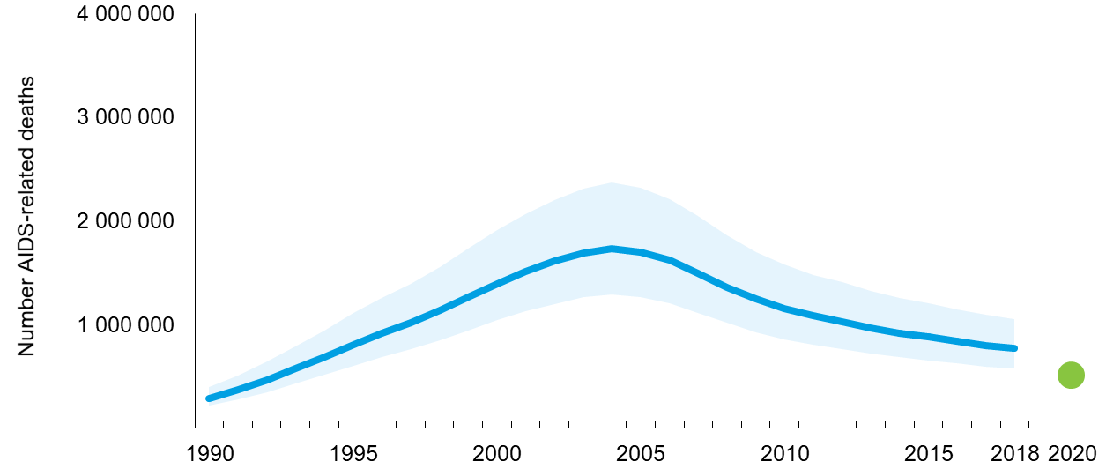
Number of AIDS-related deaths, global, 1990–2018 and 2020 target
0
AIDS-related deaths
Target
Source: UNAIDS 2019 estimates.

Slide 5
Number of AIDS-related deaths, eastern and southern Africa and western
and central Africa, and regions outside sub-Saharan Africa, 1990–2018
1 400 000
Number of AIDS-related deaths
1 200 000
1 000 000
800 000
600 000
400 000
200 000
0
1990
1995
2000
2005
2010
2015
2018
Eastern and
southern Africa
Western and
central Africa
Regions outside
sub-Saharan Africa
Source: UNAIDS 2019 estimates.

Slide 6
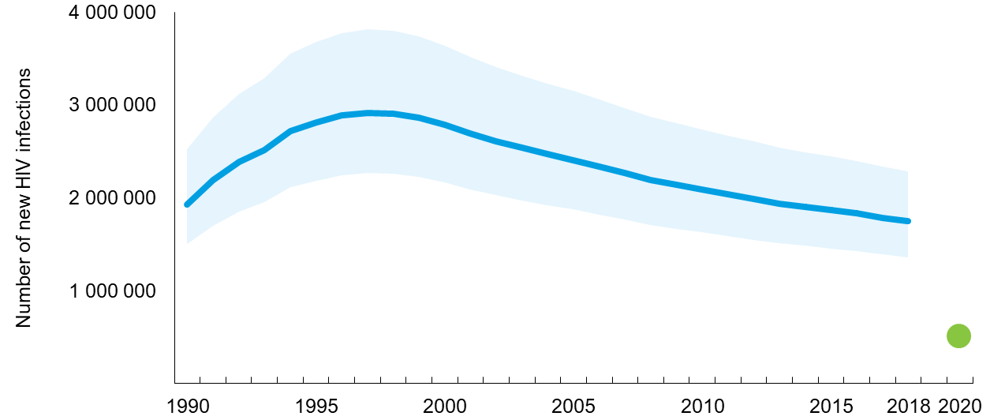
Number of new HIV infections, global, 1990–2018 and 2020 target
0
New HIV infections
Target
Source: UNAIDS 2019 estimates.

Slide 7
Number of new HIV infections, eastern and southern Africa and western
and central Africa, and regions outside sub-Saharan Africa, 1990–2018
2 500 000
Number of new HIV infections
2 000 000
1 500 000
1 000 000
500 000
0
1990
1995
2000
2005
2010
2015
2018
Eastern and
southern Africa
Western and
central Africa
Regions outside
sub-Saharan Africa
Source: UNAIDS 2019 estimates.

Slide 8
Trends in new HIV infections, by region, 2010–2018
Number of new HIV infections
400 000
350 000
300 000
250 000
200 000
150 000
100 000
50 000
0
Number of new HIV infections
120 000
Number of new HIV infections
1 200 000
1 000 000
-9%
100 000
+7%
80 000
800 000
-28%
60 000
-5%
600 000
-21%
-18%
40 000
20 000
0
400 000
200 000
0
2010
2011
2012
2013
2014
2015
2016
2017
2018
2010
2011
2012
2013
2014
2015
2016
2017
2018
2010
2011
2012
2013
2014
2015
2016
2017
2018
Asia and the Pacific
Asia and the Pacific without China and India
Latin America
Latin America without Brazil
Eastern and southern Africa
Eastern and southern Africa without South Africa
Number of new HIV infections
25 000
Number of new HIV infections
180 000
160 000
140 000
120 000
100 000
80 000
60 000
40 000
20 000
0
Number of new HIV infections
350 000
20 000
+10
+29%
300 000
-13%
250 000
200 000
15 000
10 000
+33
150 000
-23%
5000
0
-4%
100 000
50 000
0
2010
2011
2012
2013
2014
2015
2016
2017
2018
2010
2011
2012
2013
2014
2015
2016
2017
2018
2010
2011
2012
2013
2014
2015
2016
2017
2018
Middle East and North Africa
Middle East and North Africa without Iran (Islamic Republic of) and the Sudan
Eastern Europe and central Asia
Eastern Europe and central Asia without the Russian Federation
Western and central Africa
Western and central Africa without Nigeria
Source: UNAIDS 2019 estimates.

Slide 9
Relative risk of HIV acquisition by subpopulations aged 15–49
compared to adults aged 15–49 in the total population, global, 2018
Transgender people
Gay men and other men who have sex with men
People who inject drugs
Sex workers
0
5
10
15
20
25
Relative risk
Note 1: Relative risk compares the incidence of two populations. Incidence for sex workers, people who inject drugs and transgender people was estimated and then divided by the global incidence of HIV among adults aged 15–49, estimated using the Spectrum models. Incidence for gay men and other men who have sex with men was estimated and then divided by the global incidence of HIV among male adults aged 15–49.
Note 2: Transgender people estimates are derived only in the Asia and the Pacific, Caribbean, Latin America, and West and central Europe and North America regions.
Note 3: Relative risk is interpreted as follows: sex workers have 21 times greater risk of acquiring HIV than adults aged 15–49 in the total population
Source: UNAIDS special analyses using Spectrum 2019 results and 2019 Global AIDS Monitoring submissions, supplemented by data
from published literature.

Slide 10
Distribution of new HIV infections (aged 15–49 years),
by population group, 2018
GLOBAL
Eastern and southern Africa
Western and central Africa
Sex workers 3%
People who inject drugs
8%
Sex workers 6%
People who inject drugs
12%
Gay men and other men who have sex with men
4%
Sex workers 14%
Remaining population 36%
People who inject drugs
8%
Remaining population 46%
Gay men and other men who have sex with men
17%
Remaining population 75%
Clients of sex workers and sex partners of other key populations 10%
Gay men and other men who have sex with men
17%
Transgender women
1%
Clients of sex workers and sex partners of other key populations 18%
Clients of sex workers and sex partners of other key populations 25%
Source: UNAIDS special analysis, 2019.

Slide 11
Distribution of new HIV infections (aged 15–49 years),
by population group, 2018
Asia and the Pacific
Caribbean
Eastern Europe and central Asia
Remaining
population
1%
Sex workers 8%
Sex workers 6%
People who inject drugs 2%
Sex workers
7%
Remaining population 22%
People who inject drugs 13%
Clients of sex workers and sex partners of other key populations 29%
Gay men and other men who have sex with men
22%
Gay men and other men who have sex with men
30%
Remaining population 53%
People who inject drugs 41%
Clients of sex workers and sex partners of other key populations 25%
Transgender women
5%
Clients of sex workers and sex partners of other key populations
12%
Gay men and other men who have sex with men
22%
Transgender women
2%
Source: UNAIDS special analysis, 2019.

Slide 12
Distribution of new HIV infections (aged 15–49 years),
by population group, 2018
Latin America
Middle East and North Africa
Western and central Europe
and North America
Sex
workers
3%
People who
inject drugs
3%
Remaining population 5%
Sex workers
0.1%
Sex workers 12%
People who inject drugs 11%
Remaining population 12%
Remaining population
35%
Gay men and other men who have sex with men
40%
Clients of sex workers and sex partners of other key populations 28%
Clients of sex workers and sex partners of other key populations 22%
People who inject drugs 37%
Gay men and other men who have sex with men
51%
Clients of sex workers and sex partners of other key populations 15%
Transgender women
4%
Transgender women 4%
Gay men and other men who have sex with men
18%
Source: UNAIDS special analysis, 2019.

Slide 13
Ratio of new infections to people living with HIV, global and by region
(incidence-prevalence ratio), 2000–2018
Incidence-prevalence ratio
Target value
GLOBAL
Caribbean
Eastern Europe and Central Asia
Incidence-prevalence ratio
30
Incidence-prevalence ratio
30
Incidence-prevalence ratio
30
25
25
25
20
20
20
15
15
15
10
10
10
5
5
5
3
3
3
2000
2005
2010
2015
2018
2000
2005
2010
2015
2018
2000
2005
2010
2015
2018
Middle East and North Africa
Western and Central Europe and North America
Asia and the Pacific
Incidence-prevalence ratio
30
Incidence-prevalence ratio
30
Incidence-prevalence ratio
30
25
25
25
20
20
20
15
15
15
10
10
10
5
5
5
3
3
3
2000
2005
2010
2015
2018
2000
2005
2010
2015
2018
2000
2005
2010
2015
2018
Eastern and Southern Africa
Latin America
Western and Central Africa
Incidence-prevalence ratio
30
Incidence-prevalence ratio
30
Incidence-prevalence ratio
30
25
25
25
20
20
20
15
15
15
10
10
10
5
5
5
3
3
3
2000
2005
2010
2015
2018
2000
2005
2010
2015
2018
2000
2005
2010
2015
2018
Source: UNAIDS 2019 estimates.

Slide 14
Incidence-prevalence ratio, by country, 2018
0–2.99 | 3.0–4.99 |  | 5.0–9.99 |  | 10 and above
Botswana | Argentina | Mexico | Algeria | Indonesia | Afghanistan
Burkina Faso | Australia | Morocco | Angola | Iran (Islamic Republic of) | Bangladesh
Burundi | Bahamas | Myanmar | Armenia | Ireland | Egypt
Cambodia | Cameroon | Namibia | Barbados | Jamaica | Kazakhstan
Denmark | Cape Verde | New Zealand | Belarus | Jordan | Madagascar
El Salvador | Central African Republic | Nicaragua | Belize | Kuwait | Montenegro
Germany | Colombia | Niger | Benin | Kyrgyzstan | North Macedonia
Italy | Côte d’Ivoire | Panama | Bhutan | Latvia | Pakistan
Kenya | Democratic Republic of the Congo | Papua New Guinea | Bolivia | Lebanon | Philippines
Mauritania | Dominican Republic | Peru | Bosnia and Herzegovina | Malaysia | Uzbekistan
Nepal | Eritrea | Romania | Brazil | Mali
Norway | Estonia | Senegal | Chad | Mauritius
Portugal | Eswatini | Somalia | Chile | Mongolia
Rwanda | Ethiopia | South Africa | Congo | Mozambique
Singapore | France | Sri Lanka | Costa Rica | Nigeria
Spain | Gabon | Suriname | Croatia | Oman
Thailand | Guatemala | Togo | Cuba | Paraguay
Viet Nam | Guyana | Uganda | Djibouti | Republic of Moldova
Zimbabwe | Haiti | United Republic of Tanzania | Ecuador | Serbia
 | Honduras | Zambia | Equatorial Guinea | Sierra Leone
 | Israel |  | Finland | South Sudan
 | Japan |  | Gambia | Sudan
 | Lao People’s Democratic Republic |  | Georgia | Syrian Arab Republic
 | Lesotho |  | Ghana | Tajikistan
 | Liberia |  | Guinea | Tunisia
 | Libyan Arab Jamahiriya |  | Guinea-Bissau | Ukraine
 | Luxembourg |  | Hungary | Uruguay
 | Malawi |  | Iceland | Yemen
Source: UNAIDS 2019 estimates.

Slide 15
GLOBAL AIDS UPDATE 2019
A COMBINATION
APPROACH
TO HIV PREVENTION

Slide 16
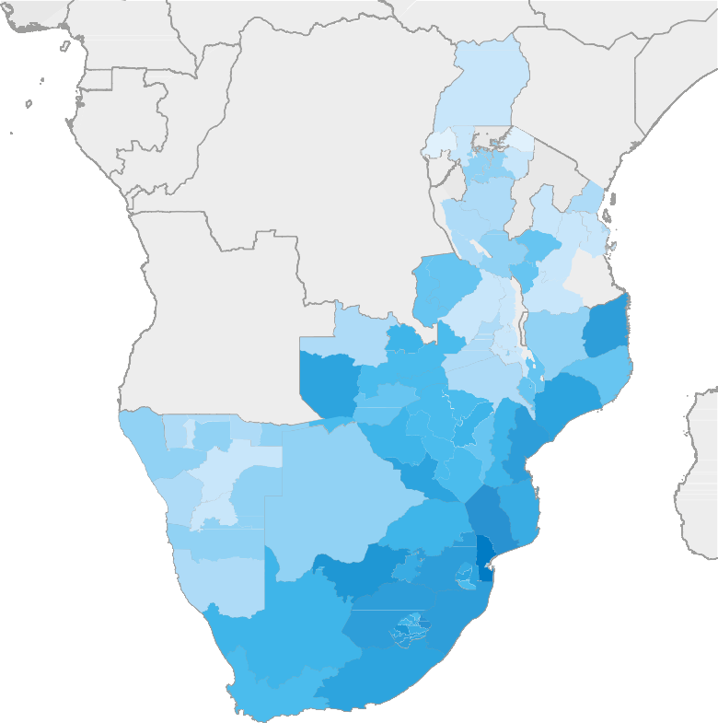
Prevalence of unsupressed HIV (>1,000 copies/ml) among adults
(aged 15 years and older), eastern and southern Africa, 2018
Unsuppressed HIV (%)
30
25
20
15
10
5
0
Note: Grey = sub-national data not available.
Source: UNAIDS special analysis, 2019.

Slide 17
Percentage of sex workers who reported receiving at least two prevention services in the past three months, selected countries, 2016–2018
100
90
80
70
Per cent
60
50
Notes: Possible prevention services received: condoms and lubricant, counselling on condom use and safe sex, and testing of sexually transmitted infections.
The use of an asterisk (*) indicates that data for marked countries come from programme data (which tend to show higher values) and not from a survey.
40
30
20
10
0
Pakistan
Tunisia
Algeria
Sri Lanka
Bangladesh
South Sudan
Dominican Republic
United Republic of Tanzania
Brazil
Sao Tome and Principe
Viet Nam
Guatemala
Nepal*
Philippines
Malaysia
Dominica*
Zimbabwe
Burkina Faso
Tajikistan
Lao People’s Democratic Republic
Niger*
Republic of Moldova
Morocco*
Suriname
Malawi*
Thailand
North Macedonia
Costa Rica
Belarus
Kazakhstan*
Nicaragua
Côte d’Ivoire
Armenia
Singapore
Panama*
Cambodia*
Source: Global AIDS Monitoring, 2016–2018.

Slide 18
Percentage of gay men and other men who have sex with men who reported receiving
at least two prevention services in the past three months, selected countries, 2016–2018
100
90
80
70
Per cent
60
50
Notes: Possible prevention services received: condoms and lubricant, counselling on condom use and safe sex, and testing of sexually transmitted infections.
The use of an asterisk (*) indicates that
data for marked countries come from programme data (which tend to show higher values) and not from a survey.
40
30
20
10
0
Pakistan
Bangladesh
Senegal
Lao People’s Democratic Republic
Dominica
Algeria
Guinea
Cambodia*
Viet Nam
Singapore*
Guatemala
Ireland
Sri Lanka
Saint Vincent and the Grenadines*
Philippines
Brazil
Dominican Republic
Bolivia (Plurinational State of)
Malaysia
Kyrgyzstan
Colombia
Côte d’Ivoire
Niger*
Morocco
North Macedonia
Thailand
Republic of Moldova
Malawi
Belarus
Honduras
Nicaragua
Zimbabwe*
Burkina Faso
Nepal*
Sao Tome and Principe
Panama*
Source: Global AIDS Monitoring, 2016–2018.

Slide 19
Percentage of people who inject drugs who reported receiving at least two prevention services in the past three months, selected countries, 2016–2018
100
90
80
70
Per cent
60
50
Notes: Possible prevention services received: condoms and lubricant, counselling on condom use and safe sex, and sterile injecting equipment.
The use of an asterisk (*) indicates that
data for marked countries come from programme data (which tend to show higher values) and not from a survey.
40
30
20
10
0
Malaysia
Pakistan
Sri Lanka
Uganda
Bangladesh
Viet Nam*
Iran (Islamic Republic of)
Myanmar
Armenia
Republic of Moldova
Kyrgyzstan*
Morocco
Philippines
North Macedonia
Belarus
Tajikistan
Nepal*
Seychelles
Cambodia*
Source: Global AIDS Monitoring, 2016–2018.

Slide 20
Percentage of transgender people who reported receiving at least two prevention services in the past three months, selected countries, 2016–2018
100
90
80
70
Per cent
60
50
Notes: Possible prevention services received: condoms and lubricant, counselling on condom use and safe sex, and testing of sexually transmitted infections.
The use of an asterisk (*) indicates that
data for marked countries come from programme data (which tend to show higher values) and not from a survey.
40
30
20
10
0
Pakistan
Guatemala
Philippines
Nepal*
Bangladesh
Dominican Republic
Sri Lanka
Thailand
Bolivia (Plurinational State of)
Malaysia
Brazil
Honduras
Nicaragua
Cambodia*
Panama*
Source: Global AIDS Monitoring, 2016–2018.

Slide 21
Countries with reported numbers on HIV prevention and treatment services in prisons, 2016–2018
90
80
70
60
Number of countries
50
40
30
20
10
0
Distribution
of sterile
injecting
equipment
Opioid
substitution
therapy
Condom
distribution
Antiretroviral
therapy
HIV testing
Source: Global AIDS Monitoring, 2016–2018.

Slide 22
Bringing together three generations of HIV outreach
Browser and social media ads
Social media
inﬂuencer
Dating app ads
Broad
Lower
Sophisticated
Social profile outreach using online marketing and ads
OUTREACH
3.0
TECHNOLOGY USE
CONVERSION
Community-based organization or Nongovernmental organization
REACH
OUTREACH
2.0
Virtual spot or
social network outreach
Peer-led 1-on-1 chats online
OUTREACH
1.0
Physical spot and
social network-based
outreach using in-person communication
Narrow
Higher
Simple
Peer worker
Source: FHI 360, LINKAGES project. A vision for going online to accelerate the impact of HIV programs. Washington (DC): FHI 360; 2019.

Slide 23
HIV diagnoses by quarter, Jakarta, Indonesia,
January 2017–March 2019
800
700
652
632
600
568
561
525
575
454
495
504
Number of
new HIV
diagnoses
500
400
Four online outreach streams activated;
eight case-ﬁnding
modalities implemented
300
200
100
0
Jan–Mar 2017
Apr–Jun 2017
Jul–Sep 2017
Oct–Dec 2017
Jan–Mar 2018
Apr–Jun 2018
Jul–Sep 2018
Oct–Dec 2018
Jan–Mar 2019
Source: Data from USAID/LINKAGES and the Jakarta Provincial Health Office (provided by FHI360).

Slide 24
Coverage
of needle–syringe programmes and opioid substitution therapy, selected countries, 2014–2018
100
90
Norway
80
France
Malaysia
70
Seychelles
Malta
60
Ireland
Luxembourg
Percentage of people who inject drugs receiving opioid substitution therapy
Cyprus
Greece
Portugal
Austria
Spain
Mauritius
50
Georgia
40
Morocco
Czechia
Australia
30
Serbia
Italy
Finland
Belgium
Viet Nam
Bulgaria
Kenya
Senegal
North Macedonia
Lithuania
Cambodia
20
United Republic of Tanzania
India
Hungary
Poland
Slovenia
Myanmar
Romania
Iran (Islamic Republic of)
Estonia
10
Albania
Latvia
Bosnia and Herzegovina
Indonesia
Mexico
Armenia
Thailand
Belarus
Bangladesh
Kyrgyzstan
Source: Global AIDS Monitoring,
2014–2018.
Ukraine
Nepal
Azerbaijan
Tajikistan
0
Afghanistan
Kazakhstan
Republic of Moldova
0
100
200
300
400
500
600
700
Needles–syringes distributed per year per person who injects drugs

Slide 25
Number of opioid-dependent people on methadone maintenance treatment
and new HIV diagnoses among people who inject drugs, Ireland, 2007–2017
Number on methadone
maintenance treatment
Number of new
HIV diagnoses
12 000
80
10 000
70
60
8000
50
6000
40
4000
30
20
2000
10
0
0
2007
2008
2009
2010
2011
2012
2013
2014
2015
2016
2017
Number of opioid-dependent people on methadone maintenance treatment
New HIV diagnoses among people who inject drugs
Note: There was an outbreak of HIV among homeless synthetic cathinone users in Dublin in 2015. This is reflected in the number of people newly diagnosed with HIV. Please see: Ireland: Country Drug Report. In: European Monitoring Centre for Drugs and Drug Addiction (EMCDDA) [Internet]. Lisbon: EMCDDA; [date unknown] (http://www.emcdda.europa.eu/countries/drug-reports/2019/ireland/drug-related-infectious-diseases_en, accessed 16 June 2019).
Source: Delargy I, Crowley D, Van Hout MC. Twenty years of the methadone treatment protocol in Ireland: reﬂections on the role of general practice.
Harm Reduct J. 2019;16:5.

Slide 26
Condom use among men (aged 15–49 years) at last high risk sex with a nonmarital, noncohabiting partner, national and subnational, countries with available data, 2012–2018
Global target (90%)
Zimbabwe
Harare Chitungwiza
High
Namibia
Oshana
National
Malawi
Zomba City
Lowest subnational
Lesotho
Maseru
Kenya
Nyanza
Highest subnational
Gabon
Haut-Ogooué
South Africa
North-West
Senegal
Dakar
Gambia
Brikama
Medium
Rwanda
Kigali
Uganda
Acholi
Togo
Lomé
Comoros
Ngazidja
Nigeria
Kogi
Zambia
Lusaka
Ethiopia
Harari
Angola
Zaire
Burundi
Bujumbura Mairie
Guinea
Conakry
Mozambique
Maputo City
Low
Liberia
Monrovia
Chad
N'Djaména
Mali
Bamako
Ghana
Upper West
Benin
Littoral (Cotonou)
Democratic Republic of the Congo
Kinshasa
Sierra Leone
Western Urban
0
10
20
30
40
50
60
70
80
90
100
Per cent
Source: Population-based surveys, 2012–2018.

Slide 27
Condom use among sex workers, selected countries, 2014–2018
Consistent condom use in the last reported period
Condom use at last sex
100
90
80
70
Per cent
60
50
40
30
20
10
0
Mexico
Cambodia
Iran (Islamic Republic of)
Zambia
Rwanda
Ukraine
Pakistan
China
Burkina Faso
Malawi
Nigeria
Mongolia
Montenegro
Bangladesh
Eswatini
Viet Nam
Benin
Botswana
Myanmar
Kenya
Uganda
Guyana
Zimbabwe
India
Sri Lanka
Lao People’s Democratic Republic
Peru
Jamaica
Eritrea
Source: Literature review by UNAIDS and the Key Populations Program of the Center for Public Health and Human Rights, Johns Hopkins University.
See references at the end of the chapter for details.

Slide 28
Sites of Sisters clinics and adult HIV prevalence by province,
Zimbabwe, 2017
Chirundu
Kariba
Magunje
Karoi
Nyamapanda
Bindura
Mutoko
Chinhoyi
Murehwa
Gokwe
Harare
Juru
Victoria Falls
Kadoma
Marondera
Hwange
Chivhu
Rusape
Lupane
Redcliff
Mutare
Gweru
Mwuma
Murambinda
HIV prevalence
Bulawayo
Gutu
Birchenough Bridge
10.5–12.0%
Plumtree
Zvishavane
Masvingo
Chipinge
12.1–14.5%
Gwanda
Ngundu
Checheche
14.6–18.0%
West Nicholson
Chiredzi
18.1–21.5%
Sisters clinics sites
Beitbridge
Source: Cowan FM, Chabata ST, Musemburi S, Fearon E, Davey C, Ndori-Mharadze T et al. Strengthening the scale up and uptake of effective
interventions for sex workers for population impact in Zimbabwe. J Int AIDS Soc. [In press].

Slide 29
Engagement of female sex workers in the HIV care cascade
in Zimbabwe, 2011, 2013, 2016/2017/2018
100
90%
80
78%
81%
73%
58%
59%
64%
67%
Respondent-driven
sampling adjusted
proportions in all women
60
54%
52%
48%
40
42%
29%
32%
20
0
HIV positive
Know their
positive HIV
status
On
antiretroviral therapy
Virally
suppressed
2011: 3 sites (n = 836)
2013: 14 sites (n = 2722)
2016/2017/2018: 19 sites (n = 5390)
Source: Cowan FM, Chabata ST, Musemburi S, Fearon E, Davey C, Ndori-Mharadze T et al. Strengthening the scale up and uptake of effective
interventions for sex workers for population impact in Zimbabwe. J Int AIDS Soc. [In press].

Slide 30
Adoption of World Health Organization PrEP recommendation
and guideline development, 2018
Recommendation adopted, guidelines implemented
Recommendation adopted, guidelines pending
Recommendation adopted, no guidelines developed
Recommendation adoption is pending
Recommendation not adopted
No data
Source: 2019 National Commitments and Policy Instrument; Hodges-Mameletzis I, Dalal S, Msimanga-Radebe B, Rodolph M, Baggaley R. Going global: the adoption of the World Health Organization’s enabling recommendation on oral pre-exposure prophylaxis for HIV. Sex Health. 2018;15(6):489-500.

Slide 31
Number of new HIV diagnoses among gay men and other men who have sex with men in New South Wales, Australia, by world area of birth, January 2014 to March 2019
300
250
200
Number
150
100
50
0
2014
2015
2016
2017
2018
Jan–Mar 2019
Australia
Asia
Others
North America, United Kingdom, Ireland, New Zealand
Source: New South Wales HIV strategy 2016–2020 data report: Quarter 1, 2019. Sydney: New South Wales Ministry of Health; 2019.

Slide 32
Annual number of voluntary medical male circumcisions,
15 priority countries, 2008–2018
4 500 000
4 000 000
3 500 000
Number of
voluntary
male circumcisions
3 000 000
2 500 000
2 000 000
1 500 000
1 000 000
500 000
0
2008
2009
2010
2011
2012
2013
2014
2015
2016
2017
2018
Botswana
Eswatini
Ethiopia
Kenya
Lesotho
Malawi
Mozambique
Namibia
Rwanda
South Africa
South Sudan*
Uganda
United Republic of Tanzania
Zambia
Zimbabwe
*South Sudan has only recently initiated a pilot voluntary medical male circumcision programme, and data were reported for the first time in 2018.
This is the reason for low numbers.
Source: 2019 Global AIDS Monitoring.

Slide 33
Proportion of voluntary medical male circumcisions, by age group,
12 priority countries, 2018
Botswana
Eswatini
Ethiopia
Kenya
Lesotho
Mozambique
Namibia
Rwanda
South Sudan
United Republic of Tanzania
Zambia
Zimbabwe
0
10
20
30
40
50
60
70
80
90
100
Per cent
Less than 10 years
10–14 years
15–19 years
20–24 years
25–49 years
50 and above
Source: 2019 Global AIDS Monitoring.

Slide 34
Modelled declines in HIV incidence with/without antiretroviral therapy and voluntary medical male circumcision (VMMC) in Siaya County, western Kenya, 1985–2040
2.0
1.8
1.6
Modelled adult HIV incidence
per 100 person-years
1.4
1.2
1.0
0.8
0.6
0.4
0.2
0
1985
1990
1995
2000
2005
2010
2015
2020
2025
2030
2035
2040
Antiretroviral therapy and VMMC (Siaya epidemic response)
Antiretroviral therapy only (no VMMC)
VMMC only (no antiretroviral therapy)
No interventions (model run without antiretroviral therapy or VMMC)
Source: Bershteyn A, Akullian AN, Klein DJ, Jewell BL, Mutai KK, Mwalili SM. Scale-up of ART and VMMC explains a two-fold decline in HIV
incidence in western Kenya. Conference on Retrovirology and Opportunistic Infections (CROI), Seattle, 4–7 February 2019. Abstract 1087.

Slide 35
Voluntary medical male circumcisions performed, total and by age,
AIDSFree Mozambique Project, Manica and Tete provinces, Mozambique,
2015–2017 fiscal years
 | 2015 (fiscal year) | 2016 (fiscal year) | 2017 (fiscal year)
Target | 65 054 | 62 166 | 95 296
Circumcisions performed | 21 824 | 35 389 | 100 636
Percentage of target achieved | 34% | 57% | 105%
Percentage of total circumcisions on young men aged 15–29 years | 48% | 50% | 58%
Percentage of total circumcisions on men aged 15 years and older | 48% | 54% | 60%
Source: USAID, PEPFAR. Systematically coordinating VMMC supply and demand: a success story. Washington (DC): USAID; October 2018.

Slide 36
Total number of voluntary medical male circumcisions and percentage of clients aged 15–29 years, Chikwawa, Thyolo and Zomba districts, Malawi, 2017–2018
10 000
76%
80
9000
67%
67%
69%
70
8000
64%
60
7000
54%
54%
6000
51%
47%
50
Per cent
5000
42%
41%
40
4000
32%
30
3000
20
2000
1000
10
0
Oct
2017
Nov
2017
Dec
2017
Jan
2018
Feb
2018
Mar
2018
Apr
2018
May
2018
Jun
2018
Jul
2018
Aug
2018
Sep
2018
0
Voluntary medical male circumcisions conducted
Percentage of clients aged 15–29 years
Source: Musiige A, Kawale J, Twahirwa W, Chilembo A, Sakanda S, Mwandi Z et al. Increasing uptake of VMMC: lessons from AIDSFree
Malawi. Arlington (VA): Strengthening High Impact Interventions for an AIDS-free Generation (AIDSFree) Project; 2019.

Slide 37
GLOBAL AIDS UPDATE 2019
THE CASCADE
FROM HIV TESTING
TO VIRAL
SUPPRESSION

Slide 38
HIV testing and treatment cascade, global, 2018
40
35
Gap to reaching the first 90:
4.3 million
Gap to reaching the first and second 90s:
7.4 million
30
25
Gap to reaching
all three 90s:
7.7 million
Number of people living with HIV (million)
20
79%
[67–92%]
15
62%
[46–74%]
53%
[43–63%]
10
5
0
People living with HIV who know their status
People living with HIV on treatment
People living with HIV who are virally suppressed
Source: UNAIDS special analysis, 2019; see annex on methods for more details.

Slide 39
HIV testing and treatment cascade, global, 2015–2018
76%
[65–89%]
79%
[67–92%]
70%
[59–82%]
73%
[62–86%]
62%
[46–74%]
48%
[35–57%]
53%
[39–63%]
57%
[43–69%]
49%
[40–58%]
53%
[43–63%]
39%
[32–47%]
44%
[36–52%]
People living with HIV who know their status
People living with HIV
on treatment
People living with HIV
who are virally suppressed
2015
2016
2017
2018
Source: UNAIDS special analysis, 2019; see annex on methods for more details.

Slide 40
Progress towards 90–90–90 targets, global, 2018
79%
[67–92%]
78%
[69–82%]
86%
[72–92%]
People living with HIV
who know their status
People living with HIV who know
their status and are on treatment
People on treatment who
are virally suppressed
Source: UNAIDS special analysis, 2019; see annex on methods for more details.

Slide 41
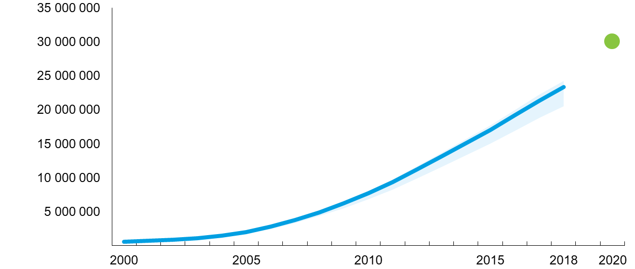
Number of people living with HIV accessing antiretroviral therapy,
global, 2000–2018 and 2020 target
Number of people on antiretroviral therapy
0
Number of people living
with HIV on antiretroviral therapy
Target value
Source: UNAIDS 2019 estimates; 2019 Global AIDS Monitoring.

Slide 42
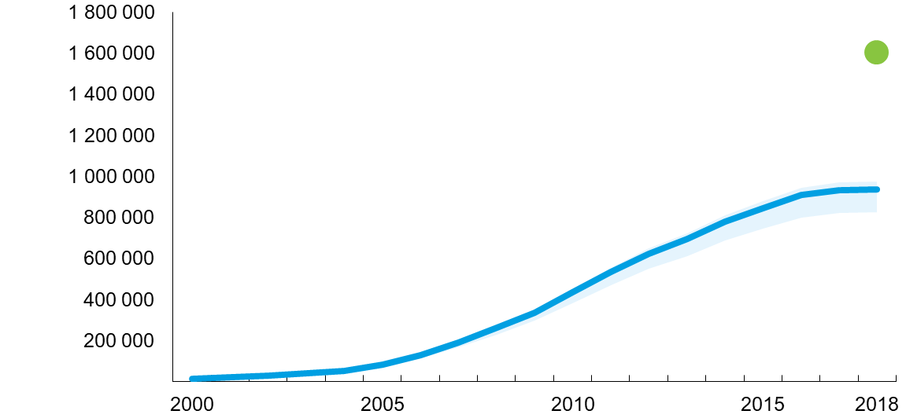
Number of children living with HIV (aged 0–14 years) accessing antiretroviral therapy, global, 2000–2018 and 2018 target
Number of children on antiretroviral therapy
0
Number of children living
with HIV on antiretroviral therapy
Target value
Source: UNAIDS 2019 estimates; 2019 Global AIDS Monitoring.

Slide 43
HIV testing and treatment cascade, by region, 2018
100
90
80
70
Per cent
60
50
40
30
20
10
0
Asia
and
the
Pacific
Caribbean
Eastern
and
southern
Africa
Eastern
Europe
and
central
Asia
Latin
America
Middle
East
and
North
Africa
Western
and
central
Africa
Western
and
central
Europe
and
North
America
People living with HIV who know their status
People living with HIV who are virally suppressed
People living with HIV who are on treatment
Gap to reaching the 90–90–90 targets
Source: UNAIDS special analysis, 2019; see annex on methods for more details.

Slide 44
Progress towards 90–90–90 targets, by region, 2018
100
90
80
70
Per cent
60
50
40
30
20
10
0
Asia
and
the
Pacific
Caribbean
Eastern
and
southern
Africa
Eastern
Europe
and
central
Asia
Latin
America
Middle
East
and
North
Africa
Western
and
central
Africa
Western
and
central
Europe
and
North
America
People living with HIV who know their status
People living with HIV and on treatment who are virally suppressed
People living with HIV who know their status and are on treatment
Gap to reaching the 90–90–90 targets
Source: UNAIDS special analysis, 2019; see annex on methods for more details.

Slide 45
Progress towards 90–90–90, by country, 2018
Countries that have achieved the 90–90–90 targets or are near to achieving them, most recent country data ^{a, b, c}
 | First 90 | Second 90 |  | Third 90 |  | Achieved all three 90s |  | Viral load suppression among all people living with HIV
Achieved (90% or greater) | Botswana | Algeria | Monaco | Australia | Morocco | Botswana | Achieved (73% or greater) | Australia
 | Cabo Verde | Austria | Namibia | Botswana | Myanmar | Denmark |  | Botswana
 | Denmark | Botswana | Netherlands | Brazil | Namibia | Eswatini |  | Cambodia
 | Eswatini | Brunei Darussalam | North Macedonia | Bulgaria | Netherlands | Namibia |  | Denmark
 | Finland | Cabo Verde | Portugal | Cambodia | Saudi Arabia | Netherlands |  | Eswatini
 | Guyana | Cambodia | Qatar | China | Seychelles | United Kingdom |  | France
 | Hungary | Comoros | Rwanda | Croatia | Spain |  |  | Germany
 | Ireland | Czechia | Samoa | Denmark | Sweden |  |  | Iceland
 | Italy | Democratic Republic of the Congo | Saudi Arabia | Estonia | Switzerland |  |  | Ireland
 | Lebanon | Denmark | Senegal | Eswatini | Thailand |  |  | Namibia
 | Malawi | Eswatini | Solomon Islands | France | Ukraine |  |  | Netherlands
 | Namibia | France | Spain | Germany | United Kingdom |  |  | Rwanda
 | Netherlands | Germany | Switzerland | Iceland |  |  |  | Spain
 | Norway | Iceland | United Kingdom | Ireland |  |  |  | Thailand
 | Rwanda | Kiribati | United Republic of Tanzania | Kuwait |  |  |  | United Kingdom
 | South Africa | Kuwait | Zimbabwe | Lebanon
 | Thailand | Mali |  | Lesotho
 | United Kingdom | Mauritius |  | Monaco
 | Zimbabwe | Mexico |  | Montenegro
Nearly achieved (85–89%) | Algeria | Burkina Faso |  | Austria | Suriname |  | Nearly achieved (65–72%) | Comoros
 | Brazil | Congo |  | Barbados | Uganda |  |  | Croatia
 | Comoros | Côte d'Ivoire |  | Comoros | United Republic of Tanzania |  |  | Finland
 | France | Cuba |  | Ecuador | Uruguay |  |  | Italy
 | Germany | Haiti |  | El Salvador |  |  |  | Luxembourg
 | Israel | Honduras |  | Finland |  |  |  | Malawi
 | Kazakhstan | Ireland |  | Georgia |  |  |  | Myanmar
 | Kenya | Italy |  | Italy
 | Lao People's Democratic Republic | Luxembourg |  | Lao People's Democratic Republic
 | Lesotho | Malawi |  | Luxembourg
 | Luxembourg | Mauritania |  | Malawi
 | Malaysia | Mongolia |  | Malta
 | Papua New Guinea | Morocco |  | Mexico
 | Portugal | Suriname |  | North Macedonia
 | Romania | Uganda |  | Oman
 | Serbia | Zambia |  | Rwanda
 | Spain |  |  | Slovakia
 | Zambia |  |  | South Africa
Notes:
ª Selected data for western and central Europe provided by the European Centres for Disease Control and Prevention Dublin Declaration reporting. All estimates are for 2018 except as follows: for 2016: Austria, Denmark, France, Italy and Spain; for 2017: Germany, Israel, Luxembourg, Malta, Netherlands, Portugal, Sweden and the United Kingdom.
^{b} Estimates are for citizens only for Kuwait and Oman.
^{c} Published estimates of 90–90–90 and viral load suppression among people living with HIV are available at AIDSinfo.org for years prior to 2018 for Bosnia and Herzegovina, Canada, India, Japan, Singapore, and the United States of America. Estimates of people living with HIV or 90–90–90 and viral load suppression coverage were not available at the time of publication for Andorra, Argentina, Bahamas, Bahrain, Belgium, Burundi, Chad, Colombia, Costa Rica, Cyprus, Democratic People’s Republic of Korea, Djibouti, Egypt, Fiji, Gabon, Greece, Guinea, Guinea-Bissau, Iraq, Jordan, Latvia, Libya, Liechtenstein, Lithuania, Maldives, the Marshall Islands, Micronesia (Federated States of), Nauru, New Zealand, Niue, Palau, Peru, Poland, the Republic of Korea, the Russian Federation, San Marino, Slovenia, Somalia, the Syrian Arab Republic, Timor-Leste, Tonga, Trinidad and Tobago, Turkey, Turkmenistan, Tuvalu, the United Arab Emirates, Uzbekistan, Vanuatu, Venezuela (Bolivarian Republic of), Viet Nam and Yemen.
Source: UNAIDS 2019 estimates; 2018 Global AIDS Monitoring.

Slide 46
HIV testing and treatment cascade among adults aged 15 years and older, by sex, global, 2018
100
90
80
70
Per cent
60
50
40
30
20
10
0
People living with HIV
who know their status
People living with HIV
on treatment
People living with HIV
who are virally suppressed
Women (15 years and older)
Men (15 years and older)
Source: UNAIDS special analysis, 2019; see annex on methods for more details.

Slide 47
Coverage of antiretroviral therapy by sex (men and women
aged 15 years and older), global and regional, 2018
100
90
80
72%
68%
70
60%
62%
63%
61%
60
Difference between men and women, globally
Per cent
59%
46%
62%
55%
50
50%
50%
40
35%
40%
30
33%
31%
20
10
0
Asia
and
the
Pacific
Caribbean
Eastern
and
southern
Africa
Eastern
Europe
and
central
Asia
Latin
America
Middle
East
and
North
Africa
Western
and
central
Africa
GLOBAL
Men
Women
Source: UNAIDS 2019 estimates; 2019 Global AIDS Monitoring.

Slide 48
Antiretroviral therapy coverage among gay men and other men who have sex with men versus adult male population, selected countries, 2016–2018
100
Gay men and another men who have sex with men
Adult men (aged 15 years and older)
90
80
70
Per cent
60
50
40
30
20
10
0
Ghana
Togo*
Viet Nam
Central African Republic
Paraguay
South Africa
Guatemala*
Barbados*
Ukraine
Bosnia and Herzegovina*
Malaysia*
Kenya
Uganda*
Finland
Botswana
Spain
Zimbabwe*
Australia
France
Luxembourg
Ireland
Germany
Netherlands
Cuba*
United Kingdom
Chile*
Mongolia*
Panama*
Czechia*
Cameroon
Cambodia*
Note: The use of an asterisk (*) indicates that data for marked countries come from programme data (which tend to show higher values) and not from a survey.
Source: 2016–2018 Global AIDS Monitoring; UNAIDS 2019 estimates.

Slide 49
Antiretroviral therapy coverage among people who inject drugs
versus adult population, selected countries, 2016–2018
100
People who inject drugs
Adults (aged 15 years and older)
90
80
70
Per cent
60
50
40
30
20
10
0
Togo*
Bosnia and Herzegovina
Myanmar
Iran (Islamic Republic of)
Cambodia*
Bangladesh*
Romania
Malaysia
Ukraine
Belarus
Mauritius
Viet Nam
Finland
Tajikistan*
Kenya
United Kingdom
Luxembourg
Uganda*
Estonia
France
Spain
Note: The use of an asterisk (*) indicates that data for marked countries come from programme data (which tend to show higher values) and not from a survey.
Source: 2016–2018 Global AIDS Monitoring; UNAIDS 2019 estimates

Slide 50
Antiretroviral therapy coverage among sex workers
versus adult population, selected countries, 2016–2018
100
Sex workers
Adults (aged 15 years and older)
90
80
70
Per cent
60
50
40
30
20
10
0
Sao Tome and Principe
Guatemala
Senegal
Viet Nam
South Africa
Togo*
Ukraine
Bolivia (Plurinational State of)*
Rwanda
Angola
Zimbabwe
Kenya
Tajikistan*
South Sudan*
Chile*
Cambodia*
Cuba*
Botswana
Malawi*
Cameroon
Note: The use of an asterisk (*) indicates that data for marked countries come from programme data (which tend to show higher values) and not from a survey.
Source: 2016–2018 Global AIDS Monitoring; UNAIDS 2019 estimates.

Slide 51
Antiretroviral therapy coverage among transgender people
versus adult population, selected countries, 2016–2018
100
90
80
70
Transgender people
Per cent
60
50
Adults (aged 15 years and older)
40
30
20
10
0
Guatemala*
Uganda*
Cuba*
Chile*
Cambodia*
Note: The use of an asterisk (*) indicates that data for marked countries come from programme data (which tend to show higher values) and not from a survey.
Source: 2016–2018 Global AIDS Monitoring; UNAIDS 2019 estimates.

Slide 52
Comparison of HIV incidence and viral suppression between the intervention communities (arms A and B combined) and control communities (arm C) in HPTN 071 (PopART) trial, 21 urban communities of South Africa and Zambia, 2013–2018
 | Intervention | Control | Relative risk (95% CI) | P-value
HIV incidence | 1.24 | 1.55 | 0.81 (0.66–0.99) | 0.04
Viral suppression
Baseline | 56% | 54%
24 months | 70% | 60% | 1.12 (0.97–1.29) | 0.1
Note: The relative risks for HIV incidence and viral suppression were estimated using methods for community randomized trials. The relative risk for HIV incidence was adjusted for age, sex and baseline HIV prevalence, while the relative risk for viral suppression was adjusted for age and sex.
Source: Special analysis of HPTN 071 (PopART) final results provided to UNAIDS by Sian Floyd, London School of Hygiene and Tropical Medicine.

Slide 53
The community HIV care providers (CHiPs) door-to-door intervention
in the PopART study
CHiPs: Community HIV-care Providers
Door-to-Door Delivery of Intervention
Repeat Visits
to Clients Living with HIV
Including HIV Testing/Retesting
Referral to
Clinic
Source: Hayes RJ, Donnell DJ, Floyd S, Mandla N, Bwalya, J, Shanaube K et al. Impact of universal testing and treatment in Zambia and South Africa:
HPTN071(PopART). Conference on Retroviruses and Opportunistic Infections (CROI), Seattle, 4–7 March 2019. Abstract 92.

Slide 54
Antiretroviral therapy coverage in HPTN 071 (PopART) trial, intervention communities (Arms A and B combined), by age and sex, South Africa and Zambia, 2017
100
90
80
70
60
90–90 target = 81%
Per cent
50
40
30
20
10
0
15–17
18–19
20–24
25–29
30–34
35–39
40–44
45–49
50–54
55–59
60–64
65+
Age (years)
Males
Females
Source: Special analysis of HPTN 071 (PopART) ﬁnal results provided to UNAIDS by Sian Floyd, London School of Hygiene and Tropical Medicine.

Slide 55
GLOBAL AIDS UPDATE 2019
ELIMINATING
MOTHER-TO-CHILD
TRANSMISSION OF HIV

Slide 56
Number of new HIV infections among children (aged 0–14 years),
global, 2000–2018 and 2020 target
800 000
Number of new HIV child infections
700 000
600 000
500 000
400 000
300 000
200 000
100 000
0
2000
2005
2010
2015
2018
2020
New HIV infections
Target
Source: UNAIDS 2019 estimates.

Slide 57
Sources of failures to prevent mother-to-child transmission of HIV:
numbers of new child HIV infections by region, 21 sub-Saharan countries with the highest HIV burden, 2018
60 000
Mother infected during pregnancy; child infected during pregnancy
Mother did not receive antiretroviral therapy during pregnancy;
child infected during pregnancy
50 000
Mother dropped off antiretroviral therapy during pregnancy;
child infected during pregnancy
40 000
Mother started antiretroviral therapy late in the pregnancy;
child infected during pregnancy
Number of new child infections
Mother started antiretroviral therapy during the pregnancy;
child infected during pregnancy
30 000
Pregnancy
Mother started antiretroviral therapy before the pregnancy;
child infected during pregnancy
Mother infected during breastfeeding; child infected during breastfeeding
20 000
Mother did not receive antiretroviral therapy during breastfeeding;
child infected during breastfeeding
Mother dropped off antiretroviral therapy during breastfeeding;
child infected during breastfeeding
10 000
Breastfeeding
Mother started antiretroviral therapy late in pregnancy;
child infected during breastfeeding
0
Mother started antiretroviral therapy during pregnancy;
child infected during breastfeeding
Eastern
Africa
Southern
Africa
Western and central Africa
Mother started antiretroviral therapy before pregnancy;
child infected during breastfeeding
Notes:
Eastern Africa: Ethiopia, Kenya, Uganda, United Republic of Tanzania
Southern Africa: Angola, Botswana, Eswatini, Lesotho, Malawi, Mozambique, Namibia, South Africa, Zambia, Zimbabwe
Western and central Africa: Burundi, Cameroon, Chad, Côte d’Ivoire, Democratic Republic of the Congo, Ghana, Nigeria
Source: UNAIDS 2019 estimates.

Slide 58
Number of new child infections and prevention of mother-to-child transmission coverage, Uganda, 1990–2018
Per cent of pregnant women living with HIV
receiving antiretroviral medicines
to prevent vertical transmission
New HIV child infections
40 000
100
35 000
90
30 000
80
70
25 000
60
20 000
50
15 000
40
10 000
30
20
5000
10
0
0
1990
1992
1994
1996
1998
2000
2002
2004
2006
2008
2010
2012
2014
2016
2018
Pregnant women receiving antiretroviral medicines
New HIV child infections
Source: UNAIDS 2019 estimates.

Slide 59
GLOBAL AIDS UPDATE 2019
CONFRONTING STIGMA
AND DISCRIMINATION

Slide 60
Percentage of people aged 15–49 years who would not buy vegetables from
a shopkeeper living with HIV, countries with available data, 2000–2018
100
90
80
70
Per cent
60
50
40
30
20
10
0
Mongolia
Viet Nam
Nepal
Cambodia
Haiti
Guyana
Belize
Kazakhstan
Armenia
Mauritania
Ethiopia
Uganda
Mozambique
Zimbabwe
Malawi
Lesotho
Kenya
Rwanda
Eswatini
Ghana
Guinea-Bissau
Senegal
Côte d’Ivoire
Nigeria
Congo
Cameroon
Source: Population-based surveys, 2000–2018.

Slide 61
Percentage of people aged 15–49 years who report discriminatory attitudes towards people living with HIV, countries with available data, 2014–2018
100
90
80
70
Per cent
60
50
40
30
20
10
0
Philippines
Timor-Leste
Lao People’s
Democratic Republic
Nepal
India
Thailand
Haiti
Belize
Ethiopia
Angola
Uganda
Zimbabwe
Malawi
South Africa
Tajikistan
Albania
Armenia
Guinea
Mauritania
Sierra Leone
Senegal
Mali
Côte d’Ivoire
Nigeria
Congo
Burundi
Asia and the Pacific
Caribbean
Eastern and
southern Africa
Eastern Europe
and central Asia
Western and central Africa
Note: Discriminatory attitudes are measured through "No" responses to either of two questions: (1) Would you buy fresh vegetables from a shopkeeper or vendor if you knew this person had HIV?; and (2) Do you think that children living with HIV should be able to attend school with children who are HIV-negative?
Source: Population-based surveys, 2014–2018, countries with available data.

Slide 62
Percentage of people aged 15–49 years who would not buy vegetables from a shopkeeper living with HIV, 2013–2018
0–24%
25–49%
50–74%
75–100%
No data
Note: Data for Algeria, Bangladesh, Egypt, El Salvador, Guinea, Kazakhstan, Kyrgyzstan, Panama, Paraguay, the Philippines, the Sudan, Tajikistan, Turkmenistan, Uruguay, Yemen and Viet Nam are for female respondents only.
Source: Population-based surveys, 2013–2018.

Slide 63
Percentage of sex workers who reported experiencing physical
and sexual violence, selected countries, 2014–2018
100
90
80
70
Per cent
60
50
40
30
20
10
0
Sri Lanka
Fiji
Russian Federation
Pakistan
Cape Town (South Africa)
Andhra Pradesh (India)
Benin
Tete (Mozambique)
Papua New Guinea
Vancouver (Canada)
Nepal
United States of America
Jamaica
Guinea
Ethiopia
Guyana
Mongolia
Phnom Penh (Cambodia)
Gambia
Mombasa (Kenya)
China
Eswatini
Iran (Islamic Republic of)
Burkina Faso
Abidjan (Côte d’Ivoire)
Zambia
Croatia
Metro Manila (Philippines)
Mexico
Uganda
Armenia
Dakha (Bangladesh)
Burundi
Cameroon
Dominican Republic
Zimbabwe
Physical violence
Sexual violence
Source: Literature review by UNAIDS and the Key Populations Program of the Center for Public Health and Human Rights, Johns Hopkins University.
See references at the end of the chapter for details.

Slide 64
Percentage of gay men and other men who have sex with men who reported experiencing physical and sexual violence, selected countries, 2014–2018
100
90
80
70
Per cent
60
50
40
30
20
10
0
China
Kampala (Uganda)
Eswatini
Nairobi (Kenya)
Israel
Burkina Faso
Brazil
San Salvador (El Salvador)
Thailand
Abidjan (Côte d’Ivoire)
United Republic of Tanzania
Jamaica
Tijuana (Mexico)
United States of America
India
Mongolia
Tajikistan
Physical violence
Sexual violence
Source: Literature review by UNAIDS and the Key Populations Program of the Center for Public Health and Human Rights, Johns Hopkins University.
See references at the end of the chapter for details.

Slide 65
Percentage of transgender people who reported experiencing physical
and sexual violence, selected countries, 2014–2018
100
90
80
70
Per cent
60
50
40
30
20
10
0
United States of America
Portugal
Ho Chi Minh
(Viet Nam)
Brazil
Jamaica
Beirut
(Lebanon)
Argentina
Cambodia
Canada
Italy
Physical violence
Sexual violence
Source: Literature review by UNAIDS and the Key Populations Program of the Center for Public Health and Human Rights, Johns Hopkins University.
See references at the end of the chapter for details.

Slide 66
Number of countries that criminalize consensual same-sex
sexual relations, global, 1969–2018
160
140
120
100
Number of
UN Member
States
80
60
40
20
0
1969
1975
1980
1985
1990
1995
2000
2005
2010
2015
2018
Africa
Asia
Europe
Latin America and the Caribbean
North America
Oceania
Source: Yang D. Global trends on the decriminalisation of consensual same-sex sexual acts (1969–2019). In: Mendos LR. State-sponsored
homophobia 2019. Geneva: ILGA; March 2019.

Slide 67
Percentage of the global population living in countries that criminalize consensual same-sex sexual relations, global, 1969–2018
80
70
60
50
Per cent
40
30
20
10
0
1969
1975
1980
1985
1990
1995
2000
2005
2010
2015
2018
Africa
Asia
Europe
Latin America and the Caribbean
North America
Oceania
Source: Yang D. Global trends on the decriminalisation of consensual same-sex sexual acts (1969–2019). In: Mendos LR. State-sponsored
homophobia 2019. Geneva: ILGA; March 2019.

Slide 68
Percentage of countries that criminalize consensual same-sex
sexual relations, by region, 2018
Latin America
and the Caribbean
Africa
North America
21/54 (countries)
24/33 (countries)
2/2 (countries)
27%
39%
61%
100%
73%
Asia
Europe
Oceania
20/42 (countries)
48/48 (countries)
8/14 (countries)
48%
43%
52%
57%
100%
Percentage criminalized
Percentage decriminalized
Source: Yang D. Global trends on the decriminalisation of consensual same-sex sexual acts (1969–2019). In: Mendos LR. State-sponsored
homophobia 2019. Geneva: ILGA; March 2019.

Slide 69
Patient grievances, by issue, 52 health facilities in Mozambique,
March 2013–May 2019
Disrespectful treatment
Staff absenteeism/tardiness
Other (infrastructure)
Lack of information regarding patient's health (eg., diagnosis, treatment, test results)
Clinical negligence
Lack of medical/surgical supplies
Lack of medicines
Other (provider behaviour)
Violation of privacy
Other (equipment and medical supplies)
Resolved cases
Lack of sufficient beds/mattresses
Lack of information regarding health services
Cases in process
Lack of machines/machines broken
Lack of hygiene in the health facility
Insufﬁcient dispensing of medicines
lllicit charge/bribery
Failure to fast-track specific populations (elderly, disabled, those living with HIV)
Lack of rapid response to urgent case
Facility does not have electricity
Lack of mosquito nets
Facility does not have bathrooms
Facility does not have water
Violation of conﬁdentiality
Discrimination
Lack of ambulance/fuel
Distance between community and health services
Lack of porches, shade, benches
Lack of access for physically disabled
Other (medicine)
Precarious buildings
Lack of informed consent
Expired medicines
Refusal of care (outside catchment)
Theft or sale of public goods
Ambulance used for unrelated activities
0
200
400
600
800
1000
1200
Source: Programme data from the Moçambique Right to Health Program, March 2013–May 2019, provided to UNAIDS on 11 June 2019.

Slide 70
HIV prevalence among people with disabilities compared to the general population, selected countries, western and central Africa, 2016–2018
10
9
8
7
Per cent
6
5
4
3
2
1
0
Burkina Faso
Cabo Verde
Guinea-Bissau
Niger
Senegal
General population
People with disabilities
Women with disabilities
Men with disabilities
Source: Global Fund to Fight AIDS, Tuberculosis and Malaria, Humanity & Inclusion, West Africa Federation of Persons with Disabilities. Une population
oubliée: résultats des études bio-comportementales [A forgotten population: results from the biobehavioural studies]. Power Point presentation. 2019.

Slide 71
Access to HIV prevention and health-care services and prevalence of violence, people with disabilities, five countries in western and central Africa, 2016–2018
60
50
40
Per cent
30
20
10
0
Burkina Faso
Cabo Verde
Guinea-Bissau
Niger
Senegal
Access to health-care services
Participated in HIV prevention
Experienced violence
Source: Global Fund to Fight AIDS, Tuberculosis and Malaria, Humanity & Inclusion, West Africa Federation of Persons with Disabilities. Une population
oubliée: résultats des études bio-comportementales [A forgotten population: results from the biobehavioural studies]. Power Point presentation. 2019.

Slide 72
GLOBAL AIDS UPDATE 2019
MEETING THE NEEDS
OF WOMEN
AND YOUNG PEOPLE

Slide 73
Percentage of ever-married or partnered women aged 15–49 years who experienced physical and/or sexual violence by an intimate partner in the past 12 months, previous survey (2004–2012) compared to most recent survey (2011–2018)
60
59.3
50
44.3
42.8
42.0
40
39.7
35.3
37.4
36.8
34.6
33.3
33.3
30
30.4
31.7
29.6
29.9
27.4
30.3
31.4
28.6
27.7
26.2
26.7
27.2
26.9
25.5
24.3
26.1
20
28.8
23.0
22.0
22.1
20.7
21.5
22.4
18.0
19.2
17.0
19.5
19.9
19.0
15.4
14.3
16.0
14.9
15.5
15.2
13.7
13.9
14.6
14.1
14.7
14.5
13.9
13.8
10
10.9
11.2
10.0
11.7
10.8
11.0
9.0
7.1
5.5
8.1
5.1
6.5
0
Mexico
Jordan
Cameroon
Democratic Republic
of the Congo
Bangladesh
Cambodia
India
Nepal
Pakistan
Philippines
Timor-Leste
Dominican Republic
Haiti
Kenya
Malawi
Mozambique
Rwanda
United Republic
of Tanzania
Uganda
Zambia
Zimbabwe
South Africa
Tajikistan
Colombia
Peru
Mali
Nigeria
Source: Population-based surveys, 2004–2018.

Slide 74
Number of new HIV infections among young people
(aged 15–24 years), by sex, global, 1990–2018
1 000 000
900 000
Number of new HIV infections
800 000
700 000
600 000
500 000
400 000
300 000
200 000
100 000
0
1990
1995
2000
2005
2010
2015
2018
Males
Females
Source: UNAIDS 2019 estimates.

Slide 75
Number of new HIV infections among young people
(aged 15–24 years), by sex, eastern and southern Africa, 1990–2018
600 000
Number of new HIV infections
500 000
400 000
300 000
200 000
100 000
0
1990
1995
2000
2005
2010
2015
2018
Males
Females
Source: UNAIDS 2019 estimates.

Slide 76
Number of new HIV infections among young people
(aged 15–24 years), by sex, western and central Africa, 1990–2018
200 000
180 000
Number of new HIV infections
160 000
140 000
120 000
100 000
80 000
60 000
40 000
20 000
0
1990
1995
2000
2005
2010
2015
2018
Males
Females
Source: UNAIDS 2019 estimates.

Slide 77
Delivery platforms for scaling up programmes for adolescent girls
and young women and men in settings with high HIV incidence
HEALTH FACILITIES
Youth-friendly services (trained providers, conducive hours).
Access to sexual and reproductive health and HIV services (including condoms, voluntary medical make circumcision, HIV testing, antiretroviral therapy, PrEP, integration of HIV into family planning and prevention and treatment of sexually transmitted infections).
SUBNATIONAL AIDS OFFICE
Makes it happen (leadership, ﬁnancing).
Convenes monthly progress review (community, health and education).
Follows through on problem-solving.
Involves other sectors as needed (e.g. social support, cash transfers).
SCHOOLS
Dedicated HIV prevention communication (risk perception, self-efﬁcacy, and prevention methods and skills).
Comprehensive sexuality education according to international standards.
COMMUNITY-LED ORGANIZATION
Interpersonal communication outreach (e.g., SASA!) and links to new media platforms.
Demand generation and adherence support for HIV prevention, HIV testing services and treatment.
Community service outreach (condoms and HIV testing services).
Transform community norms related to HIV prevention (including norms relating to gender and stigma with local leaders).
Reach women, men, youth and adults through one programme with some differentiated platforms and messages.
Blue font = primary focus of HIV funding.
Black font = complementary health and social sector funding (potentially with contribution of HIV funding).
Source: Fast-Track Implementation Webinar Series. Geneva: UNAIDS; May 2019.

Slide 78
Countries with education policies that guide the delivery of life skills-based
HIV and sexuality education according to international standards, 2019
Primary school
(n = 101)
Secondary school
(n = 103)
Teacher training
(n = 100)
16%
22%
40%
60%
84%
78%
Yes
No
Source: 2019 National Commitments and Policy Instrument.

Slide 79
Percentage of young women (aged 15–24 years) who know of at least one formal source of condoms, by education, countries with available data,
2011–2015
100
90
80
70
Per cent
60
50
40
30
20
10
0
Chad
Congo
Democratic Republic
of the Congo
Côte d’Ivoire
Gabon
Ghana
Guinea
Kenya
Lesotho
Liberia
Mozambique
Namibia
Nigeria
Rwanda
Sierra Leone
United Republic of Tanzania
Togo
Zambia
No education
Primary
Secondary
Higher
Source: Population-based surveys, 2011–2015.

Slide 80
Probability of HIV acquisition, three forms of contraception, ECHO trial participants, Eswatini, Kenya, South Africa and Zambia, 2015–2018
Cumulative probability of HIV acquistion
1.0
DMPA-IM
10
Copper IUD
8
0.8
LNG implantt
6
4
0.6
2
0
0
3
6
9
12
15
18
0.4
0.2
0
0
3
6
9
12
15
18
Months since enrolment
Number at risk
DMPA-IM | 2556 | 2555 | 2478 | 2412 | 2341 | 2077 | 1595
Copper IUD | 2571 | 2571 | 2539 | 2492 | 2440 | 2158 | 1656
LNG implant | 2588 | 2587 | 2534 | 2484 | 2442 | 2166 | 1670
Source: Evidence for Contraceptive Options and HIV Outcomes (ECHO) Trial Consortium. HIV incidence among women using intramuscular depot medroxyprogesterone acetate, a copper intrauterine device, or a levonorgestrel implant for contraception: a randomised, multicentre, open-label trial. The Lancet. 13 June 2019.

Slide 81
GLOBAL AIDS UPDATE 2019
INTEGRATED,
PEOPLE-CENTRED
SERVICES

Slide 82
Number of tuberculosis-related deaths among people living with HIV, global, 2000–2017
800 000
Number of tuberculosis-related deaths
700 000
600 000
500 000
400 000
300 000
200 000
100 000
0
2000
2002
2004
2006
2008
2010
2012
2014
2016
2018
2020
Tuberculosis-related deaths
Target
Source: Global tuberculosis report. Geneva: World Health Organization; 2018.

Slide 83
People living with HIV who received preventive treatment
for tuberculosis, 2000–2018
2 000 000
1 800 000
1 600 000
Number of people
1 400 000
1 200 000
1 000 000
800 000
600 000
400 000
200 000
0
2000
2002
2004
2006
2008
2010
2012
2014
2016
2018
Global
Sub-Saharan Africa
Rest of the world
Note: Data for 2018 are preliminary. Until 2016, countries reported the number of people living with HIV newly enrolled in HIV care who received preventive treatment for tuberculosis. As of 2017, countries could report the number of people living with HIV both newly and/or currently enrolled in HIV care who received preventive treatment for tuberculosis.
Source: 2019 Global AIDS Monitoring; Global tuberculosis report. Geneva: World Health Organization; 2018.

Slide 84
National plans referencing interventions for hepatitis
in people who inject drugs, 2019
Hepatitis plan does not reference interventions for people who inject drugs
Hepatitis plan not accessed
Hepatitis plan references interventions for people who inject drugs
Source: Access to hepatitis C testing and treatment for people who inject drugs and people in prisons—a global perspective. Geneva: World Health Organization; 2019 (https://www.who.int/hepatitis/publications/idu-prison-access-hepatitis-c/en/).

Slide 85
National plans referencing interventions for hepatitis
in people in prisons, 2019
Hepatitis plan does not reference interventions for people in prisons
Hepatitis plan not accessed
Hepatitis plan references interventions for people in prisons
Source: Access to hepatitis C testing and treatment for people who inject drugs and people in prisons—a global perspective. Geneva: World Health Organization; 2019 (https://www.who.int/hepatitis/publications/idu-prison-access-hepatitis-c/en/).

Slide 86
Cervical cancer screening policies and proportion of women living with HIV (aged 30−49 years) screened for cervical cancer, 35 Fast-Track countries
 | Cervical cancer screening and treatment for women living with HIV recommended in the national strategic plan governing the AIDS response (2019) | Cervical cancer screening and treatment for women living with HIV recommended in national HIV treatment guidelines (2019) | Extent to which health facilities are delivering cervical cancer screening integrated in HIV services (2019) | Proportion of women living with HIV (aged 30−49 years) screened for cervical cancer (year)
Angola
Botswana |  |  |  | 30% (2018)
Brazil
Cameroon
Chad
China
Côte d'Ivoire
Democratic Republic of the Congo
Eswatini
Ethiopia
Ghana
Haiti
India |  |  |  | 35% (2016)
Indonesia
Iran (Islamic Republic of)
Jamaica
Kenya
Lesotho |  |  |  | 29% (2014)
Malawi |  |  |  | 19% (2016)
Mali
Mozambique
Myanmar
Namibia
Nigeria
Pakistan
Russian Federation
South Africa
South Sudan
Uganda
Ukraine
United Republic of Tanzania |  |  |  | 18% (2017)
United States of America
Viet Nam
Zambia |  |  |  | 27% (2016)
Zimbabwe |  |  |  | 26% (2015)
 | Yes | Yes | Fully integrated in all health facilities
 | No | No | Integrated in some health facilities
 | No data | No data | Delivered separately | No recent data
 |  |  | No data
Source: 2019 National Commitments and Policy Instrument; population-based surveys, 2014–2017; 2019 Global AIDS Monitoring.

Slide 87
The shift from a referral model to integrated tuberculosis–HIV services
in Balti, Republic of Moldova
Family doctor
Family doctor
AIDS
centre
TB centre
AIDS
centre
TB centre
HIV
programme NGO
TB
programme NGO
HIV
programme NGO
TB
programme NGO
Social service
Social service
Source: Access to HIV and TB prevention, treatment and care: perspective of a civil society organization and patients. Alla Yatsko, Youth Association for the Right to Live. Slide presentation, 15 May 2019.

Slide 88
Tuberculosis cases, treatment success and deaths,
Balti, Republic of Moldova, 2016–2018
140
94%
100
124
90
120
72%
76%
80
100
89
70
Number of people
60
80
73
Per cent
50
60
40
40
30
19
16
20
20
11
10
0
0
2016
2017
2018
New tuberculosis cases, including retreatment cases
Tuberculosis-related deaths
Tuberculosis treatment success rate, including retreatment cases
Source: Access to HIV and TB prevention, treatment and care: perspective of a civil society organization and patients. Alla Yatsko, Youth Association for the Right to Live. Slide presentation, 15 May 2019.

Slide 89
Modelled effects of development accelerators and synergy effects
of all three accelerators
A
B
No emotional or physical abuse
+19% (9–30%)
No emotional or physical abuse
+17% (10–25%)
No community violence
+19% (11–27%)
g
Good mental health
+17% (8–26%)
No community violence
+13% (6–20%)
c
Good mental health
+12% (5–19%)
n
s
s
h
i
u
e
o
t
p
f
o
n
a
l
e
p
S
s
r
o
a
r
P
t
No violence perpetration
+20% (10–30%)
No high-risk sex
+17% (7–27%)
No violence perpetration
+16% (8–23%)
School progression
+9% (3–16%)
C
D
No emotional or physical abuse
+12% (2–33%)
No emotional or physical abuse
+51% (37–64%)
No community violence
+21% (7–34%)
Good mental health
+33% (19–48%)
r
e
School progression
+16% (7–25%)
t
a
HIV care retention
+13% (3–23%)
f
h
n
a
s
s
s
S
c
a
f
,
h
C
e
t
o
r
r
o
o
l
p
s
p
,
u
C
s
a
g
s
n
h
i
t
No violence perpetration
+33% (21–45%)
t
r
HIV care retention
+22% (9–34%)
n
a
e
n
r
s
a
f
P
e
r
The accelerators identified are parenting support (A), safe schools (B), and cash transfers (C); the modelled effects of synergy between all three accelerators are shown in part D. Data are percentage-point improvements (95% CIs) in percentage probabilities of achieving the Sustainable Development Goal-aligned targets compared with no intervention. Double lines indicate a synergy effect of two accelerators, triple lines indicate a synergy effect of all three accelerators.
No high-risk sex
+20% (5–34%)
School progression
+33% (19–47%)

Slide 90
GLOBAL AIDS UPDATE 2019
INVESTING TO END
AN EPIDEMIC

Slide 91
HIV resource availability for HIV in low- and middle-income countries,
2010–2018 and 2020 Fast-Track resource needs (in constant 2016 US dollars)
30
25
US$ (billion)
20
Domestic (public and private)
15
United States (bilateral)
Global Fund
10
Other international
Resource needs (Fast-Track)
5
0
2010
2011
2012
2013
2014
2015
2016
2017
2018
2020
Source: UNAIDS 2019 resource availability and needs estimates.

Slide 92
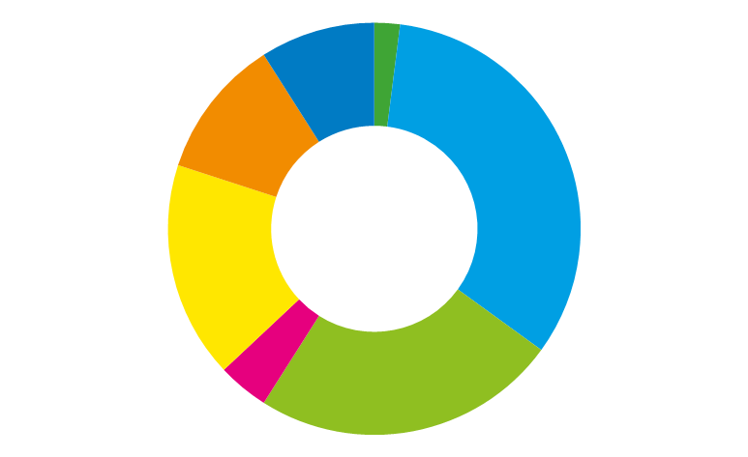
Estimated funding gap comparing current availability of resources
for HIV to estimated need in 2020
9%
2%
11%
33%
Eastern and southern Africa
Western and central Africa
Asia and the Pacific
Caribbean
17%
Eastern Europe and central Asia
Latin America
Middle East and North Africa
4%
24%
Source: UNAIDS 2019 resource availability and needs estimates.

Slide 93
Donor dependency on HIV resources in eastern and southern Africa, with and without South Africa, 2010–2018
100
90
81
80
80
80
75
75
77
72
73
76
70
59
61
61
59
Per cent
60
58
58
54
55
58
50
40
30
20
10
0
2010
2011
2012
2013
2014
2015
2016
2017
2018
Eastern and southern Africa
Eastern and southern Africa, excluding South Africa
Source: UNAIDS 2019 resource availability and needs estimates.

Slide 94
Change in bilateral disbursements, percentage and absolute, nominal US dollars, major donor governments, 2010 versus 2018 and 2017 versus 2018
Donor | Bilateral overseas development assistance for HIV (millions)
 | 2010–2018 | Per cent change | 2017–2018 | Per cent change
Australia | -US$ 63.4 | -79% | US$ 2.8 | 20%
Canada | -US$ 44.1 | -78% | US$ 4.5 | 56%
Denmark | -US$ 89.3 | -58% | -US$ 25.8 | -29%
France | -US$ 51.3 | -78% | US$ 0.6 | 5%
Germany | -US$ 134.5 | -86% | -US$ 0.6 | -3%
Ireland | -US$ 56.2 | -74% | -US$ 4.0 | -17%
Italy | -US$ 10.0 | -88% | -US$ 4.5 | -76%
Japan | -US$ 12.3 | -65% | -US$ 0.3 | -4%
Netherlands | -US$ 105.0 | -34% | US$ 29.5 | 17%
Norway | -US$ 49.0 | -68% | US$ 0.6 | 3%
Sweden | -US$ 49.1 | -49% | US$ 9.1 | 22%
United Kingdom | -US$ 230.7 | -39% | -US$ 157.7 | -30%
United States | US$ 2052.1 | 63% | -US$ 12.4 | 0%
Total | US$ 1157.2 | 23% | -US$ 158.0 | -3%
Source: UNAIDS estimates, based on Kaiser Family Fund–UNAIDS collaboration on donor disbursements for HIV, 2006–2019.

Slide 95
Total HIV resource availability per person living with HIV in constant 2016 US dollars, HIV incidence and AIDS-related mortality rates (per 1000), low- and middle-income countries, 2010–2018 and 2020 targets
800
0.45
700
0.40
Incidence and mortality rates
per 1000 population
HIV resources per person
living with HIV (US$)
600
0.35
500
0.30
400
0.25
0.20
300
0.15
200
0.10
100
0.05
0
0
2010
2011
2012
2013
2014
2015
2016
2017
2018
2020
Resource availability per person living with HIV
Resource needs per person living with HIV
HIV incidence rate (per 1000)
AIDS-related mortality rate (per 1000)
Source: UNAIDS 2019 resource availability and needs estimates; and UNAIDS 2019 estimates.

Slide 96
Total HIV resource availability per person living with HIV in constant 2016 US dollars, HIV incidence and AIDS-related mortality rates (per 1000), low- and middle-income countries in eastern and southern Africa, 2010–2018 and 2020 targets
600
3.5
HIV resources per person
living with HIV (US$)
500
3.0
Incidence and mortality rates
per 1000 population
400
2.5
2.0
300
1.5
200
1.0
100
0.5
0
0
2010
2011
2012
2013
2014
2015
2016
2017
2018
2020
Resource availability per person living with HIV
Resource needs per person living with HIV
HIV incidence rate (per 1000)
AIDS-related mortality rate (per 1000)
Source: UNAIDS 2019 resource availability and needs estimates; and UNAIDS 2019 estimates.

Slide 97
Total HIV resource availability per person living with HIV in constant 2016 US dollars, HIV incidence and AIDS-related mortality rates (per 1000), low- and middle-income countries in western and central Africa, 2010–2018 and 2020 targets
900
0.80
800
0.70
Incidence and mortality rates
per 1000 population
HIV resources per person
living with HIV (US$)
700
0.60
600
0.50
500
0.40
400
300
0.30
200
0.20
100
0.10
0
0
2010
2011
2012
2013
2014
2015
2016
2017
2018
2020
Resource availability per person living with HIV
Resource needs per person living with HIV
HIV incidence rate (per 1000)
AIDS-related mortality rate (per 1000)
Source: UNAIDS 2019 resource availability and needs estimates; and UNAIDS 2019 estimates.

Slide 98
Total HIV resource availability per person living with HIV in constant 2016 US dollars, HIV incidence and AIDS-related mortality rates (per 1000), low- and middle-income countries in Asia and the Pacific, 2010–2018 and 2020 targets
900
0.10
800
0.09
Incidence and mortality rates
per 1000 population
HIV resources per person
living with HIV (US$)
700
0.08
600
0.07
500
0.06
400
0.05
0.04
300
0.03
200
0.02
100
0.01
0
0
2010
2011
2012
2013
2014
2015
2016
2017
2018
2020
Resource availability per person living with HIV
Resource needs per person living with HIV
HIV incidence rate (per 1000)
AIDS-related mortality rate (per 1000)
Source: UNAIDS 2019 resource availability and needs estimates; and UNAIDS 2019 estimates.

Slide 99
Total HIV resource availability per person living with HIV in constant 2016 US dollars, HIV incidence and AIDS-related mortality rates (per 1000), low- and middle-income countries in Latin America, 2010–2018 and 2020 targets
1 800
0.20
1 600
0.18
HIV resources per person
living with HIV (US$)
1 400
0.16
Incidence and mortality rates
per 1000 population
1 200
0.14
1 000
0.12
800
0.10
0.08
600
0.06
400
0.04
200
0.02
0
0
2010
2011
2012
2013
2014
2015
2016
2017
2018
2020
Resource availability per person living with HIV
Resource needs per person living with HIV
HIV incidence rate (per 1000)
AIDS-related mortality rate (per 1000)
Source: UNAIDS 2019 resource availability and needs estimates; and UNAIDS 2019 estimates.

Slide 100
Total HIV resource availability per person living with HIV in constant 2016 US dollars, HIV incidence and AIDS-related mortality rates (per 1000), low- and middle-income countries in the Caribbean, 2010–2018 and 2020 targets
2 000
0.60
1 800
HIV resources per person
living with HIV (US$)
1 600
0.50
Incidence and mortality rates
per 1000 population
1 400
0.40
1 200
1 000
0.30
800
600
0.20
400
0.10
200
0
0
2010
2011
2012
2013
2014
2015
2016
2017
2018
2020
Resource availability per person living with HIV
Resource needs per person living with HIV
HIV incidence rate (per 1000)
AIDS-related mortality rate (per 1000)
Source: UNAIDS 2019 resource availability and needs estimates; and UNAIDS 2019 estimates.

Slide 101
Total HIV resource availability per person living with HIV in constant 2016 US dollars, HIV incidence and AIDS-related mortality rates (per 1000), low- and middle-income countries in the Middle East and North Africa, 2010–2018 and 2020 targets
3 500
0.06
3 000
0.05
Incidence and mortality rates
per 1000 population
HIV resources per person
living with HIV (US$)
2 500
0.04
2 000
0.03
1 500
1 000
0.02
500
0.01
0
0
2010
2011
2012
2013
2014
2015
2016
2017
2018
2020
Resource availability per person living with HIV
Resource needs per person living with HIV
HIV incidence rate (per 1000)
AIDS-related mortality rate (per 1000)
Source: UNAIDS 2019 resource availability and needs estimates; and UNAIDS 2019 estimates.

Slide 102
Total HIV resource availability per person living with HIV in constant 2016 US dollars, HIV incidence and AIDS-related mortality rates (per 1000), low- and middle-income countries in eastern Europe and central Asia, 2010–2018 and 2020 targets
2 500
0.25
HIV resources per person
living with HIV (US$)
2 000
0.20
Incidence and mortality rates
per 1000 population
1 500
0.15
1 000
0.10
500
0.05
0
0
2010
2011
2012
2013
2014
2015
2016
2017
2018
2020
Resource availability per person living with HIV
Resource needs per person living with HIV
HIV incidence rate (per 1000)
AIDS-related mortality rate (per 1000)
Note: Data from the Russian Federation is not included in this analysis.
Source: UNAIDS 2019 resource availability and needs estimates; and UNAIDS 2019 estimates.

