Slide 1
July 2019
Core epidemiology slides

Slide 2
Global summary of the AIDS epidemic  2018
Number of people living with HIV
Total
Adults
Women (15+ years)
Children (<15 years)
Total
Adults
Children (<15 years)
Total
Adults
Children (<15 years)
37.9 million [32.7 million–44.0 million]
36.2 million [31.3 million–42.0 million]
18.8 million [16.4 million–21.7 million]
1.7 million [1.3 million–2.2 million]
1.7 million [1.4 million–2.3 million] 1.6 million [1.2 million–2.1 million]
160 000 [110 000–260 000]
770 000 [570 000–1.1 million]
670 000 [500 000–920 000]
100 000 [64 000–160 000]
People newly infected
with HIV in 2018
AIDS-related deaths in 2018

Slide 3
Global estimates for adults and children  2018
People living with HIV 37.9 million [32.7 million–44.0 million]
New HIV infections in 2018 1.7 million [1.4 million–2.3 million]
AIDS-related deaths in 2018 770 000 [570 000–1.1 million]

Slide 4
About 5000 new HIV infections (adults and children) a day  2018
About 61% are in sub-Saharan Africa
About 500 are among children under 15 years of age
About 4400 are among adults aged 15 years and older, of whom:
─ almost 47% are among women
─ about 32% are among young people (15–24)
─ about 20% are among young women (15–24)

Slide 5
Global estimates for children (<15 years)  2018
Children living with HIV 1.7 million [1.3 million–2.2 million]
New HIV infections in 2018 160 000 [110 000–260 000]
AIDS-related deaths in 2018 100 000 [64 000–160 000]

Slide 6
Regional HIV and AIDS statistics and features  2018
Adults and children living with HIV
Adults and children newly infected with HIV
Adult and child
deaths due to AIDS
Eastern and southern Africa
20.6 million
[18.2 million–23.2 million]
800 000
[620 000–1.0 million]
310 000
[230 000–400 000]
Western and central Africa
5.0 million
[4.0 million–6.3 million]
280 000
[180 000–420 000]
160 000
[110 00–230 000]
Middle East and North Africa
240 000
[160 000–390 000]
20 000
[8500–40 000]
8400
[4800–14 000]
Asia and the Pacific
5.9 million
[5.1 million–7.1 million]
310 000
[270 000–380 000]
200 000
[160 000–290 000]
Latin America
1.9 million
[1.6 million–2.4 million]
100 000
[79 000–130 000]
35 000
[25 000–46 000]
Caribbean
340 000
[290 000–390 000]
16 000
[11 000–24 000]
6700
[5100–9100]
Eastern Europe and central Asia
1.7 million
[1.5 million–1.9 million]
150 000
[140 000–160 000]
38 000
[28 000–48 000]
Western and central Europe and
North America
2.2 million
[1.9 million–2.4 million]
68 000
[58 000–77 000]
13 000
[9400–16 000]
TOTAL
37.9 million
[32.7 million–44.0 million]
1.7 million
[1.4 million–2.3 million]
770 000
[570 000–1.1 million]
The ranges around the estimates in this table define the boundaries within which the actual numbers lie, based on the best available information.

Slide 7
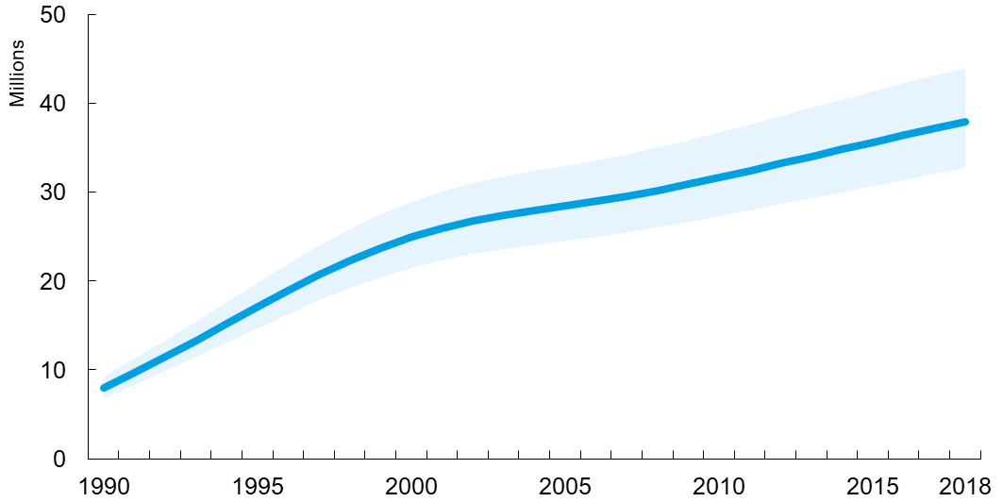
Adults and children estimated to be living with HIV  1990–2018
Adults and children estimated to be living with HIV
Range of uncertainty

Slide 8
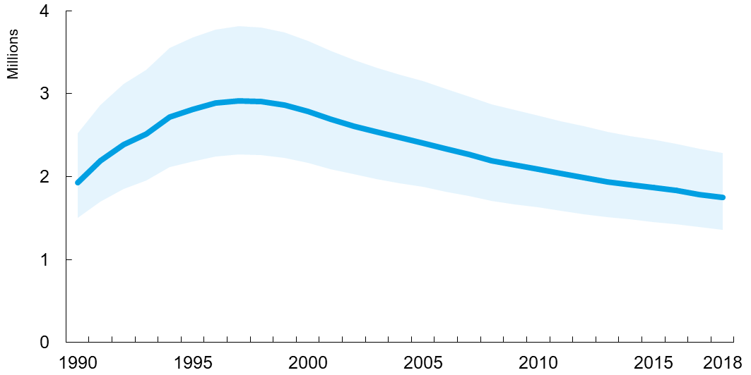
Adults and children newly infected with HIV 1990–2018
Adults and children newly infected with HIV
Range of uncertainty

Slide 9
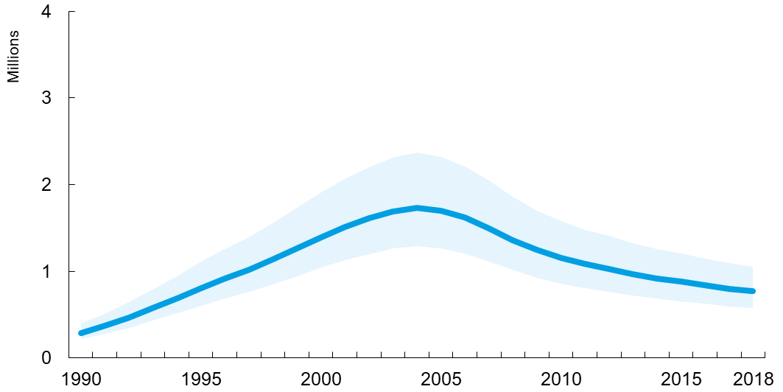
Adult and child deaths due to AIDS  1990–2018
Adult and child deaths due to AIDS
Range of uncertainty

Slide 10
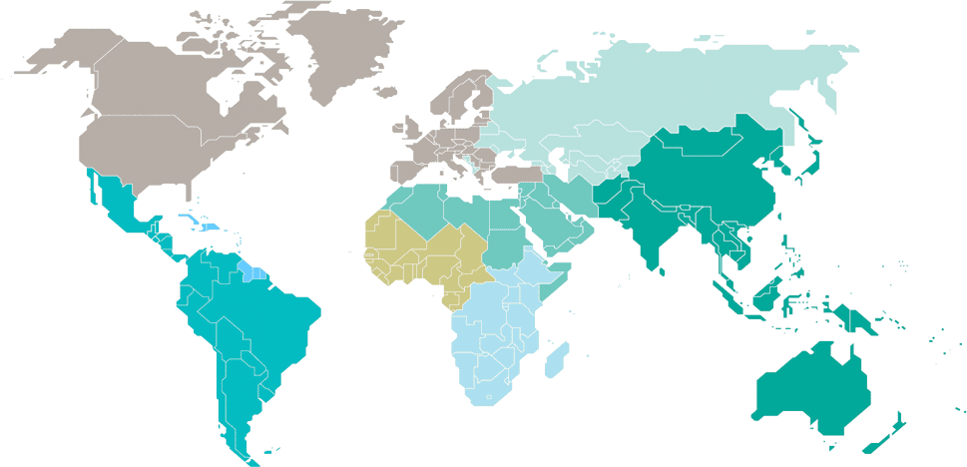
Adults and children estimated to be living with HIV  2018
Eastern Europe and central Asia
1.7 million
[1.5 million–1.9 million]
North America and western and central Europe
2.2 million
[1.9 million–2.4 million]
Caribbean
340 000
[290 000–390 000]
Middle East and North Africa
240 000
[160 000–390 000]
Western and central Africa
5.0 million
[4.0 million–6.3 million]
Asia and the Pacific
5.9 million
[5.1 million–7.1 million]
Latin America
1.9 million
[1.6 million–2.4 million]
Eastern and southern Africa
20.6 million
[18.2 million–23.2 million]
Total: 37.9 million [32.7 million–44.0 million]

Slide 11
Estimated number of adults and children newly infected with HIV  2018
Eastern Europe and central Asia
150 000
[140 000–160 000]
North America and western and central Europe
68 000
[58 000–77 000]
Caribbean
16 000
[11 000–24 000]
Middle East and North Africa
20 000
[8500–40 000]
Western and central Africa
280 000
[180 000–420 000]
Asia and the Pacific
310 000
[270 000–380 000]
Latin America
100 000
[79 000–130 000]
Eastern and southern Africa
800 000
[620 000–1.0 million]
Total: 1.7 million [1.4 million–2.3 million]

Slide 12
Estimated adult and child deaths from AIDS  2018
Eastern Europe and central Asia
38 000
[28 000–48 000]
North America and western and central Europe
13 000
[9400–16 000]
Caribbean
6700
[5100–9100]
Middle East and North Africa
8400
[4800–14 000]
Western and central Africa
160 000
[110 000–230 000]
Asia and the Pacific
200 000
[160 000–290 000]
Latin America
35 000
[25 000–46 000]
Eastern and southern Africa
310 000
[230 000–400 000]
Total: 770 000 [570 000–1.1 million]

Slide 13
Children (<15 years) estimated to be living with HIV  2018
Eastern Europe and central Asia
…*
North America and western and central Europe
…*
Caribbean
11 000
[9000–13 000]
Middle East and North Africa
9900
[6800–14 000]
Western and central Africa
450 000
[320 000–590 000]
Asia and the Pacific
110 000
[95 000–160 000]
Latin America
31 000
[25 000–40 000]
Eastern and southern Africa
1.1 million
[850 000–1.4 million]
Total: 1.7 million [1.3 million–2.2 million]
*Estimates for children are not published because of small numbers.

Slide 14
Estimated number of children (<15 years) newly infected with HIV  2018
Eastern Europe and central Asia
…*
North America and western and central Europe
…*
Caribbean
1100
[660 – 1500]
Middle East and North Africa
1500
[710–2800]
Western and central Africa
58 000
[36 000–87 000]
Asia and the Pacific
12 000
[9800–18 000]
Latin America
3100
[2100–4600]
Eastern and southern Africa
84 000
[57 000–140 000]
Total: 160 000 [110 000–260 000]
*Estimates for children are not published because of small numbers.

Slide 15
Estimated deaths in children (<15 years) from AIDS  2018
Eastern Europe and central Asia
…*
North America and western and central Europe
…*
Caribbean
660
[<500 – 910]
Middle East and North Africa
950
[520–1700]
Western and central Africa
38 000
[24 000–57 000]
Asia and the Pacific
6700
[5100–9600]
Latin America
2000
[1400–3100]
Eastern and southern Africa
49 000
[31 000–80 000]
Total: 100 000 [64 000–160 000]
*Estimates for children are not published because of small numbers.

