Slide 1
WORLD AIDS DAY REPORT | 2021

Slide 2
Percentage change in the number of people living with HIV on antiretroviral therapy,
global, January 2019–June 2021
7.0
6.3
6.0
4.9
5.0
3.9
Increase over
a six-month period (%)
4.0
3.4
3.0
2.0
1.9
1.0
0.0
Jan–Jun 2019
Jul–Dec 2019
Jan–Jun 2020
Jul–Dec 2020
Jan–Jun 2021
Source: UNAIDS special analysis, 2021.

Slide 3
Number of newly identified people living with HIV who initiated antiretroviral therapy,
by week, 10 Nigerian states and territories participating in the Antiretroviral Therapy Surge initiative,
4 May 2019–26 September 2020
9000
Number of persons initiating treatment
8000
7000
6000
5000
4000
Note: Nine Nigerian states participated in the Antiretroviral Therapy Surge Initiative: Akwa Ibom, Benue, Delta, Enugu, Gombe, Imo, Lagos, Nasarawa and Rivers. One territory also participated: the Federal Capital Territory.
3000
2000
1000
0
May
June
July
August
September
October
November
December
January
February
March
April
May
June
July
August
September
Note: On 27 February 2020,
the Nigeria Centre for Disease Control confirmed the first confirmed COVID-19 case.
It activated an Emergency Operations Center on 28 February. Following that, the Government of Nigeria implemented COVID-19 mitigation efforts, including school closures (beginning 19 March), international travel bans (beginning 23 March) and statewide stay-at-home orders (beginning 30 March).
2019
2020
Week of antiretroviral therapy initiation
Newly identified people living with HIV who initiated antiretroviral therapy
Source: Dirlikov E, Jahun I, Odafe SF, Obinna O, Onyenuobi C, Ifunanya M et al. Rapid scale-up of an antiretroviral therapy program before and during the COVID-19 pandemic—nine states, Nigeria,
March 31, 2019–September 30, 2020. MMWR Morb Mortal Wkly Rep. 2021;70(12):421–6.

Slide 4
Countries reporting participation of key populations in developing national policies, guidelines
and/or strategies relating to their health, global, 2017–2021
160
140
26
36
76
54
111
Number of reporting countries
24
33
76
51
98
120
118
109
100
108
100
80
90
82
60
67
55
40
20
34
32
0
Gay men and other men who have sex with men
Sex workers
People who inject drugs
Transgender people
Former and/or current prisoners
Yes - National authority response
No - National authority response
Yes - Civil society response
No - Civil society response
Source: National Commitments and Policy Instrument, 2017–2021.

Slide 5
Average unit prices of antiretroviral medicine procurements, 2020, and percentage change, 2016–2020
Average unit price of antiretroviral
medicine procurement, 2020
US$ 236
US$ 195
US$ 97
US$ 83
US$ 87
US$ 74
US$ 355
LAMIVUDINE ABACAVIR 150MG/300MG
LAMIVUDINE ZIDOVUDINE ABACAVIR
150 MG
300MG
300MG
LAMIVUDINE ZIDOVUDINE EFAVIRENZ
150MG
300MG
600MG
LAMIVUDINE TENOFOVIR DOLUTEGRAVIR 300MG 300MG
50MG
LAMIVUDINE TENOFOVIR EFAVIRENZ
300MG
300MG
600MG
LAMIVUDINE ZIDOVUDINE NEVIRAPINE 30MG 60MG
50MG
DARUNAVIR 400MG
Per cent change in unit price,
2016–2020
0
-10
-10
-10
-11
-20
-30
-31
-40
-50
-46
-43
-60
-55
Percentage change in unit price of antiretroviral medicine procurements, 2016–2020
Source: UNAIDS estimates, based on the country reports to Global AIDS Monitoring 2021 and export data from government customs from 69 low- and middle-income countries.

Slide 6
Density of selected health professionals, per 10 000 population, global and regional, 2013–2019
Oceania
27.44
84.55
South-central Asia
4.60
18.29
Latin America and the Caribbean
29.76
42.79
South-eastern Asia
6.69
33.47
Southern Asia
9.42
19.65
Eastern Asia
20.62
36.23
Northern America
25.87
152.90
Sub-Saharan Africa
2.10
9.94
Europe
47.24
83.21
Northern Africa
8.98
17.96
Western Asia
19.47
33.74
Central Asia
26.81
83.77
Global
17.54
39.05
0
20
40
60
80
100
120
140
160
Number of health professionals per 10 000 population
Nursing and midwifery personnel
Medical doctors
Note: Latest data available (2013–2019).
Source: Global Health Workforce statistics database [database]. Geneva: WHO; c2021 (https://www.who.int/data/gho/data/themes/topics/health-workforce).

Slide 7
Percentage of countries reporting that mechanisms exist to record and address individual complaints of HIV-related discrimination, global, 2017–2021
100
30
22
Per cent of reporting countries
80
78
70
60
40
20
0
Mechanisms established by
the government (n = 130)
Mechanisms established by the community
and/or nongovernmental organizations (n = 70)
Yes
No
Source: National Commitments and Policy Instrument, 2017–2021.

Slide 8
Number of countries with discriminatory and punitive laws, global, 2021
Criminalization or prosecution based on general criminal
laws of HIV transmission, nondisclosure or exposure
45
135
Criminalization and/or prosecution of transgender people
135
24
Criminalization of any aspect of sex work
14
133
Criminalization of same-sex sexual relations
122
71
Possession of a certain limited amount of drugs
for personal use not permitted
22
65
0
20
40
60
80
100
120
140
160
180
200
Countries
No
Yes
Data not available
Source: UNAIDS National Commitments and Policy Instrument 2017–2021 (http://lawsandpolicies.unaids.org/); supplemented by additional sources.

Slide 9
Gender differences along the COVID-19 clinical pathway, available global data, as of October 2021
100
80
63
Per cent
60
52
56
51
54
57
50
50
48
49
46
44
43
40
37
20
0
Vaccinated with
at least one
dose (n = 40)
Fully vaccinated
(n = 24)
Tested for
COVID-19
(n = 12)
Confirmed
cases (n = 92)
Hospitalizations
(n = 16)
ICU admissions
(n = 10)
Deaths
(n = 65)
Male
Female
Note: n = number of countries that reported sex-disaggregated data.
Note: Just two countries (Austria and India) report vaccinations among non-binary people.
Source: The COVID-19 sex-disaggregated data tracker. October update report. Global Health 5050; 2021 (https://globalhealth5050.org/wp-content/ uploads/October-2021-data-tracker-update.pdf).

Slide 10
Clinic user ratings of service quality across three rounds of community-led monitoring at clinics
in Binh Duong and Thai Nguyen, Viet Nam, January 2020–April 2021
Availability of condoms/lubricants
1
7
10
Availability of needles/syringes
1
10
Binh Duong
10
Access to free condoms/lubricants
1
8
10
Access to free needles/syringes
1
10
10
Client comfort
4
8
9
Thai Nguyen
Social health insurance counselling support
9
10
9
Clear and convenient exam procedures
3
8
7
0
1
2
3
4
5
6
7
8
9
10
Availability of condoms/lubricants
Round 1
Round 2
Round 3
Note: Quality of services: 1 = poorest quality; 10 = best quality.
Source: Nguyen LH, Nhat Thi Dang V, Thi Do P, Pllack T, Tuyet Thi Vo N, Tra Dang M et al. Community-led quality improvement of HIV services using community scorecards in Vietnam.
International AIDS Society Conference, 18–21 July 20. Abstract OALD01LB02.

Slide 11
Percentage of the expected population sizes of key populations that are not included
in country-reported size estimates, global, 2020
100
80
Per cent
60
40
20
0
Female sex workers
Men who have sex with men
People who inject drugs
Transwomen
Source: UNAIDS special analysis, 2021.

Slide 12
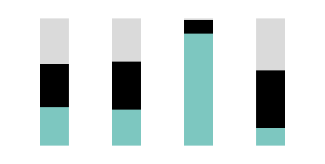
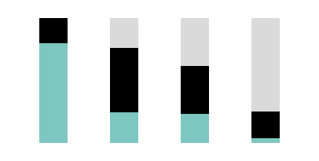
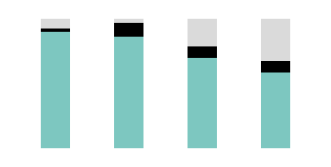
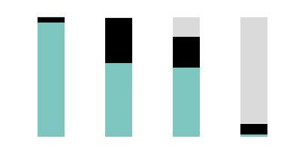
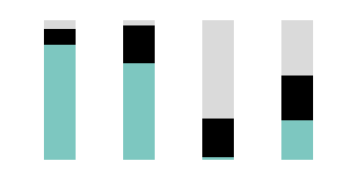
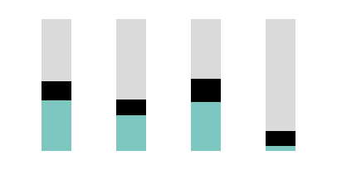
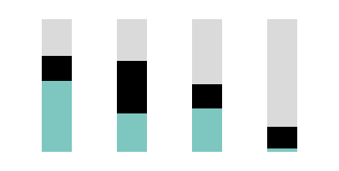
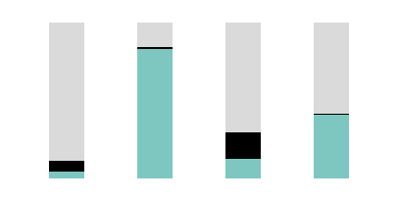
Percentage of the expected population sizes of key populations that are not included
in country-reported size estimates, by region, 2020
Asia and the Pacific
Eastern and southern Africa
Latin America
Western and central Africa
100
100
100
100
80
80
80
80
Per cent
60
Per cent
60
Per cent
60
Per cent
60
40
40
40
40
20
20
20
20
0
Female sex
workers
(n=12)
Men who have sex
with men
(n=9)
People who inject drugs
(n=10)
Transwomen
(n=8)
0
Female sex
workers
(n=3)
Men who have sex
with men
(n=1)
People who inject drugs
(n= *)
Transwomen
(n= *)
0
Female sex
workers
(n=2)
Men who have sex
with men
(n=5)
People who inject drugs
(n=2)
Transwomen
(n=4)
0
Female sex
workers
(n=1)
Men who have sex
with men
(n=4)
People who inject drugs
(n=2)
Transwomen
(n= *)
Caribbean
Eastern Europe and central Asia
Middle East and North Africa
Western and central Europe
and North America
100
100
100
100
80
80
80
80
Per cent
60
Per cent
60
Per cent
60
Per cent
60
40
40
40
40
20
20
20
20
0
Female sex
workers
(n=2)
Men who have sex
with men
(n=3)
People who inject drugs
(n= *)
Transwomen
(n=2)
0
Female sex
workers
(n=7)
Men who have sex
with men
(n=6)
People who inject drugs
(n=8)
Transwomen
(n=1)
0
Female sex
workers
(n=1)
Men who have sex
with men
(n=1)
People who inject drugs
(n=1)
Transwomen
(n= *)
0
Female sex
workers
(n=1)
Men who have sex
with men
(n= *)
People who inject drugs
(n= 2)
Transwomen
(n= 2)
Population within aggregated reported data
* uses global median which includes 29 countries for sex workers, 29 countries for gay men and other men who have sex with men, 25 countries for people who inject drugs and 17 countries for transgender women.
Expected population not represented in nationally adequate country-reported data
Note: A population size estimate was considered to be nationally adequate if it was of sufficient quality and scope to be used in the planning and budgeting of a national AIDS response. The median estimate for female sex workers is based on nationally adequate data from 29 countries, reflecting 17% of the global female population. The median estimate for gay men and other men who have sex with men is based on data from 29 countries, reflecting 12% of the global male population. The median estimate for people who inject drugs is based on data from 25 countries, reflecting 57% of adults globally. The median estimate for transgender women is based on 17 countries, reflecting 17% of the global female population. The number of key populations unaccounted for in reported size estimates apply to 48% of the global female population for sex workers, 70% of the male population for gay men and other men who have sex with men, 80% of men and women for people who inject drugs and 46% of women for transgender women. Countries that have not submitted data are presumed to have no official data and are shown separately in the bars.
Expected population in countries that have not reported
Source: UNAIDS special analysis, 2021.

Slide 13
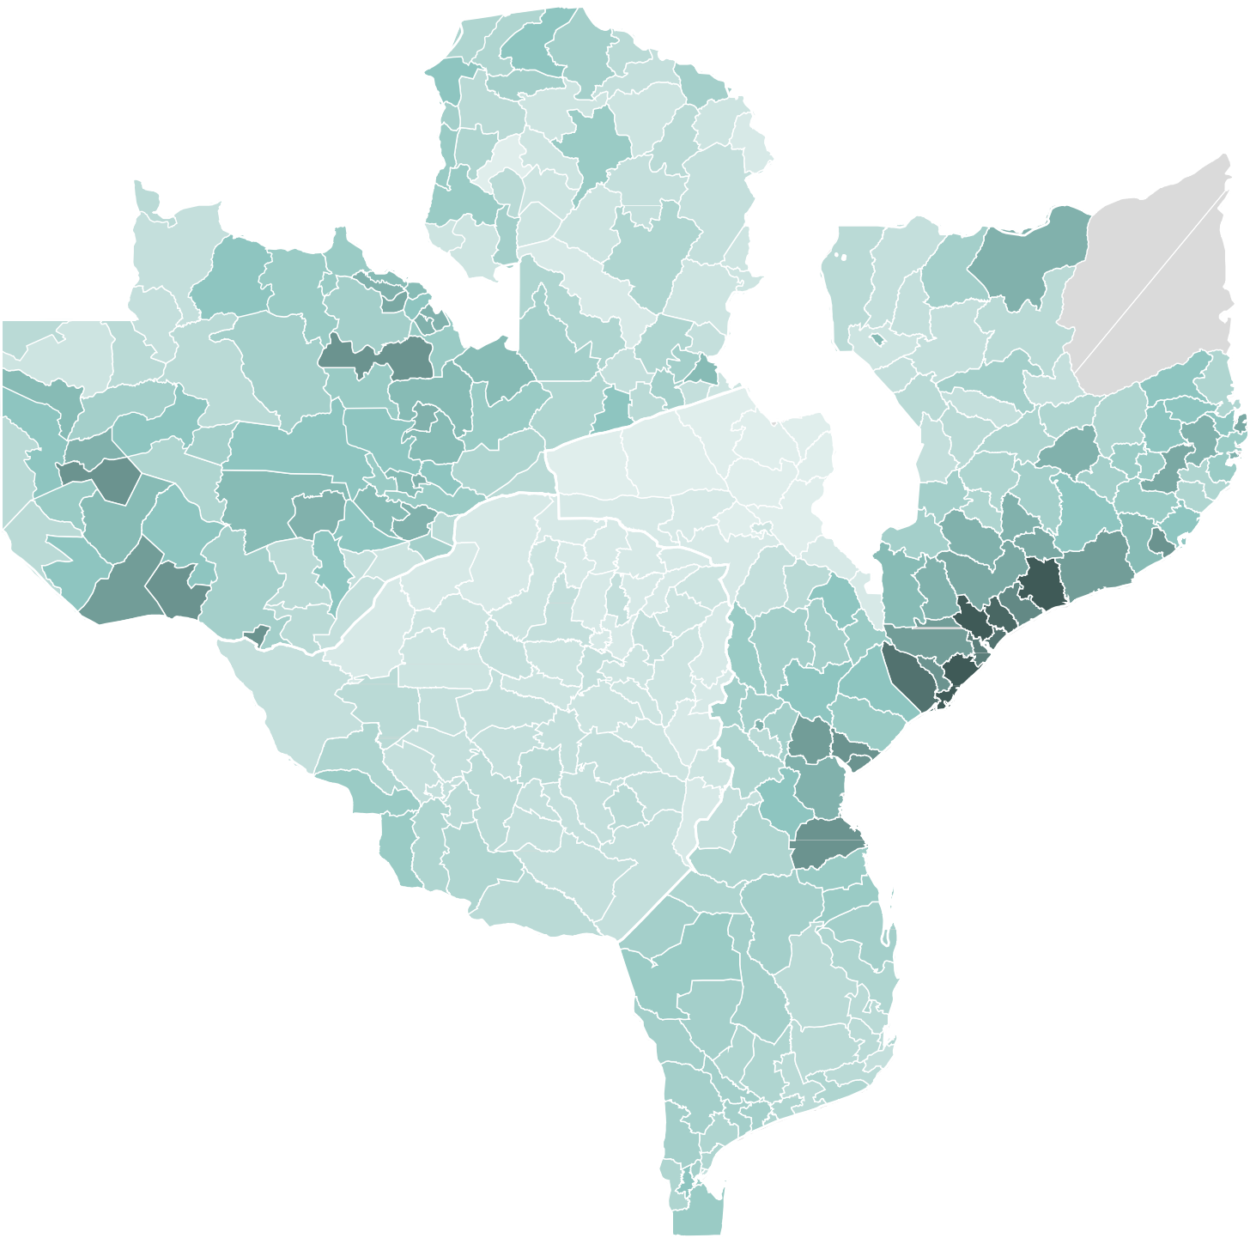
Incidence of HIV infection among adolescent girls and young women (aged 15–24 years),
by subnational administrative level, Zambia, Zimbabwe and Mozambique, 2020
Zambia
Zimbabwe
Mozambique
0
23
Note: HIV incidence estimated as new HIV infections
per 1000 person-years at risk.
Note: No data reported for Cabo Delgado province
in Mozambique.
Incidence rate per 1000 person-years at risk.
No data
Source: UNAIDS epidemiological estimates, 2021.

Slide 14
Distribution of new HIV infections and of the population, by age and sex, sub-Saharan Africa, 2020
New HIV infections, sub-Saharan Africa
Population distribution, sub-Saharan Africa
2%
4%
5%
5%
19%
14%
14%
27%
8%
10%
10%
8%
7%
25%
21%
21%
Female 50+
Female 25–49
Female 15–24
Female 0–14
Male 50+
Male 25–49
Male 15–24
Male 0–14
Source: UNAIDS epidemiological estimates, 2021 (see https://aidsinfo.unaids.org/).

Slide 15
HIV testing and treatment cascade, women (15+) compared to men (15+), sub-Saharan Africa, 2020
Number of women (aged 15+
years) living with HIV (million)
Women (aged 15+ years) living with HIV
16
Gap to reaching the first 95:
630 000
Gap to reaching the first and second 95s:
1.1 million
14
91%
[74– >98%]
Gap to reaching the three 95s:
1.8 million
12
83%
[65–99%]
10
74%
[60–89%]
8
6
4
2
0
Women living with HIV who know their status
Women living with HIV who are on treatment
Women living with HIV who are virally suppressed
Number of men (aged 15+
years) living with HIV (million)
Men (aged 15+ years) living with HIV
10
9
Gap to reaching the first 95:
1.0 million
Gap to reaching the first and second 95s:
1.7 million
8
Gap to reaching the three 95s:
2.0 million
7
84%
[69– >98%]
6
70%
[58–84%]
5
63%
[52–75%]
4
3
2
1
0
Men living with HIV who are on treatment
Men living with HIV
who are virally suppressed
Men living with HIV who know their status
Source: UNAIDS special analysis, 2021.

