Slide 1
KNOWLEDGE IS POWER
KNOW YOUR STATUS,
KNOW YOUR VIRAL LOAD

Slide 2

More than half of people living with HIV not virally suppressed
People living with HIV, by viral suppression status, global, 2017
NOT VIRALLY SUPPRESSED
52.6%
VIRALLY SUPPRESSED
47.4% [35–59%]
Vulnerable to or suffering from AIDS-related illness and able to transmit HIV to others
The immune system can function normally and HIV cannot be transmitted to others
= 1% of people living with HIV globally

Slide 3
Scaling up viral load testing in Côte d’Ivoire
Number of people on treatment and viral load testing coverage, Côte d’Ivoire, 2015–2017
250 000
66%
70
Viral load testing voverage (%)
Number of people on treatment
200 000
60
50
150 000
40
100 000
28%
30
50 000
23%
20
10
0
2015
2016
2017
0
Currently on treatment
Viral load test result
Per cent coverage of viral load testing
Source: Adje-Toure C, CDC-Côte d’Ivoire. Challenges and access to viral load testing in Africa: example of Cote d’Ivoire. Presentation.
(https://www.iasociety.org/Web/WebContent/File/EduFundCoteIvoire_Christiane_Adje-Toure.pdf; accessed 14 November 2018).

Slide 4
Lower viral suppression among children
Percentage of people living with HIV with suppressed viral loads,
children and adults, 11 countries, 2015–2017
100
Viral load suppression (%)
80
60
40
20
0
Cameroon*
Côte d’Ivoire*
Eswatini
Lesotho
Malawi
Namibia
South Africa
Uganda
United Republic
of Tanzania*
Zambia
Zimbabwe
Children (aged 0–14 years)
Adults (aged 15–49 years)
Source: Cameroon Population-based HIV Impact Assessment (CAMPHIA), 2017; Côte d’Ivoire Population-based HIV Impact Assessment (CIPHIA), 2017–2018; The Swaziland HIV Incidence Measurement Survey 2
(SHIMS2), 2016–2017; Lesotho Population-based HIV Impact Assessment (LePHIA), 2016–2017; Malawi Population-based HIV Impact Assessment (MPHIA), 2015–2016; Namibia Population-based HIV Impact
Assessment (NAMPHIA), 2017; South African National HIV Prevalence, Incidence, Behaviour and Communication Survey, 2017; Uganda Population-based HIV Impact Assessment (UPHIA), 2016–2017; Tanzania
HIV Impact Survey (THIS), 2016–2017; Zambia Population-based HIV Impact Assessment (ZAMPHIA), 2015–2016; The Zimbabwe Population-based HIV Impact Assessment (ZIMPHIA), 2015–2016.

Slide 5
An optimized testing scenario
Projected number of HIV tests in an optimized HIV testing strategy,
by testing modality, hypothetical country with a generalized epidemic, 2017–2030
18
16
14
Number of HIV tests (million)
12
10
8
6
4
2
0
2017
2018
2019
2020
2021
2022
2023
2024
2025
2026
2027
2028
2029
2030
Self-testing
Community-based testing
Testing focused on key populations
Mobile testing
Voluntary counselling and testing
Provider-initiated counselling and testing
Source: Avenir Health and UNAIDS, special analysis, 2018.

Slide 6
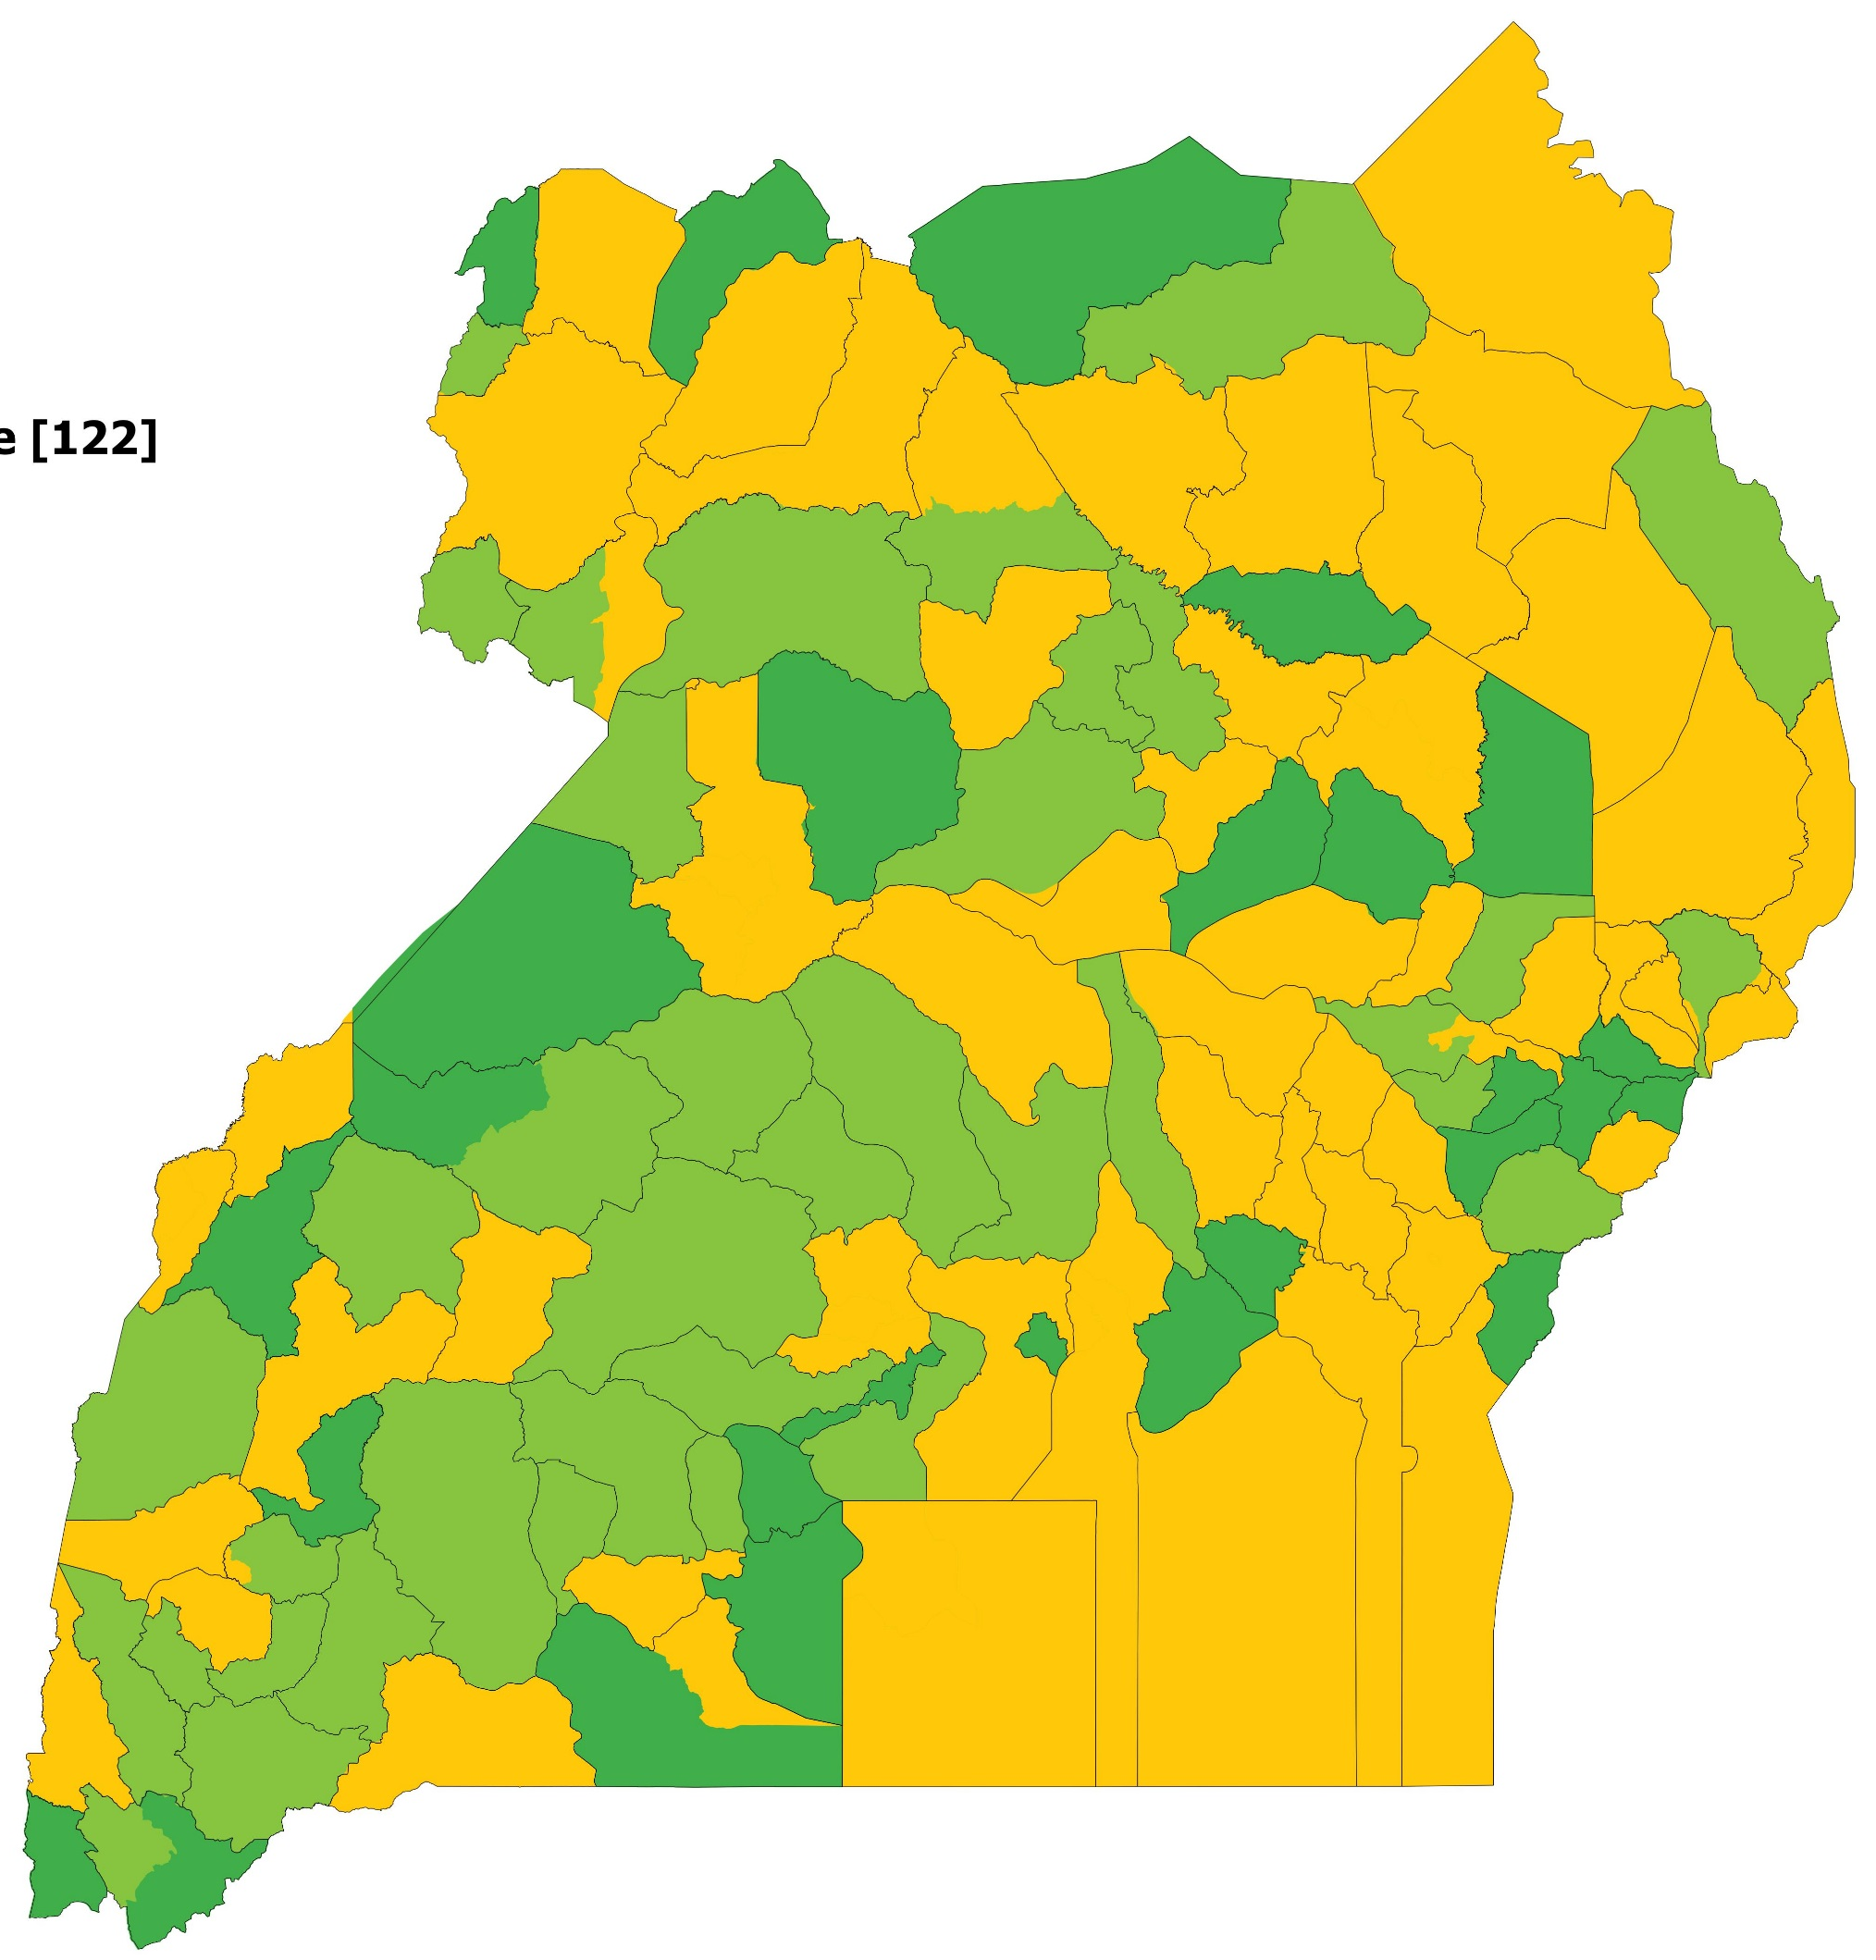
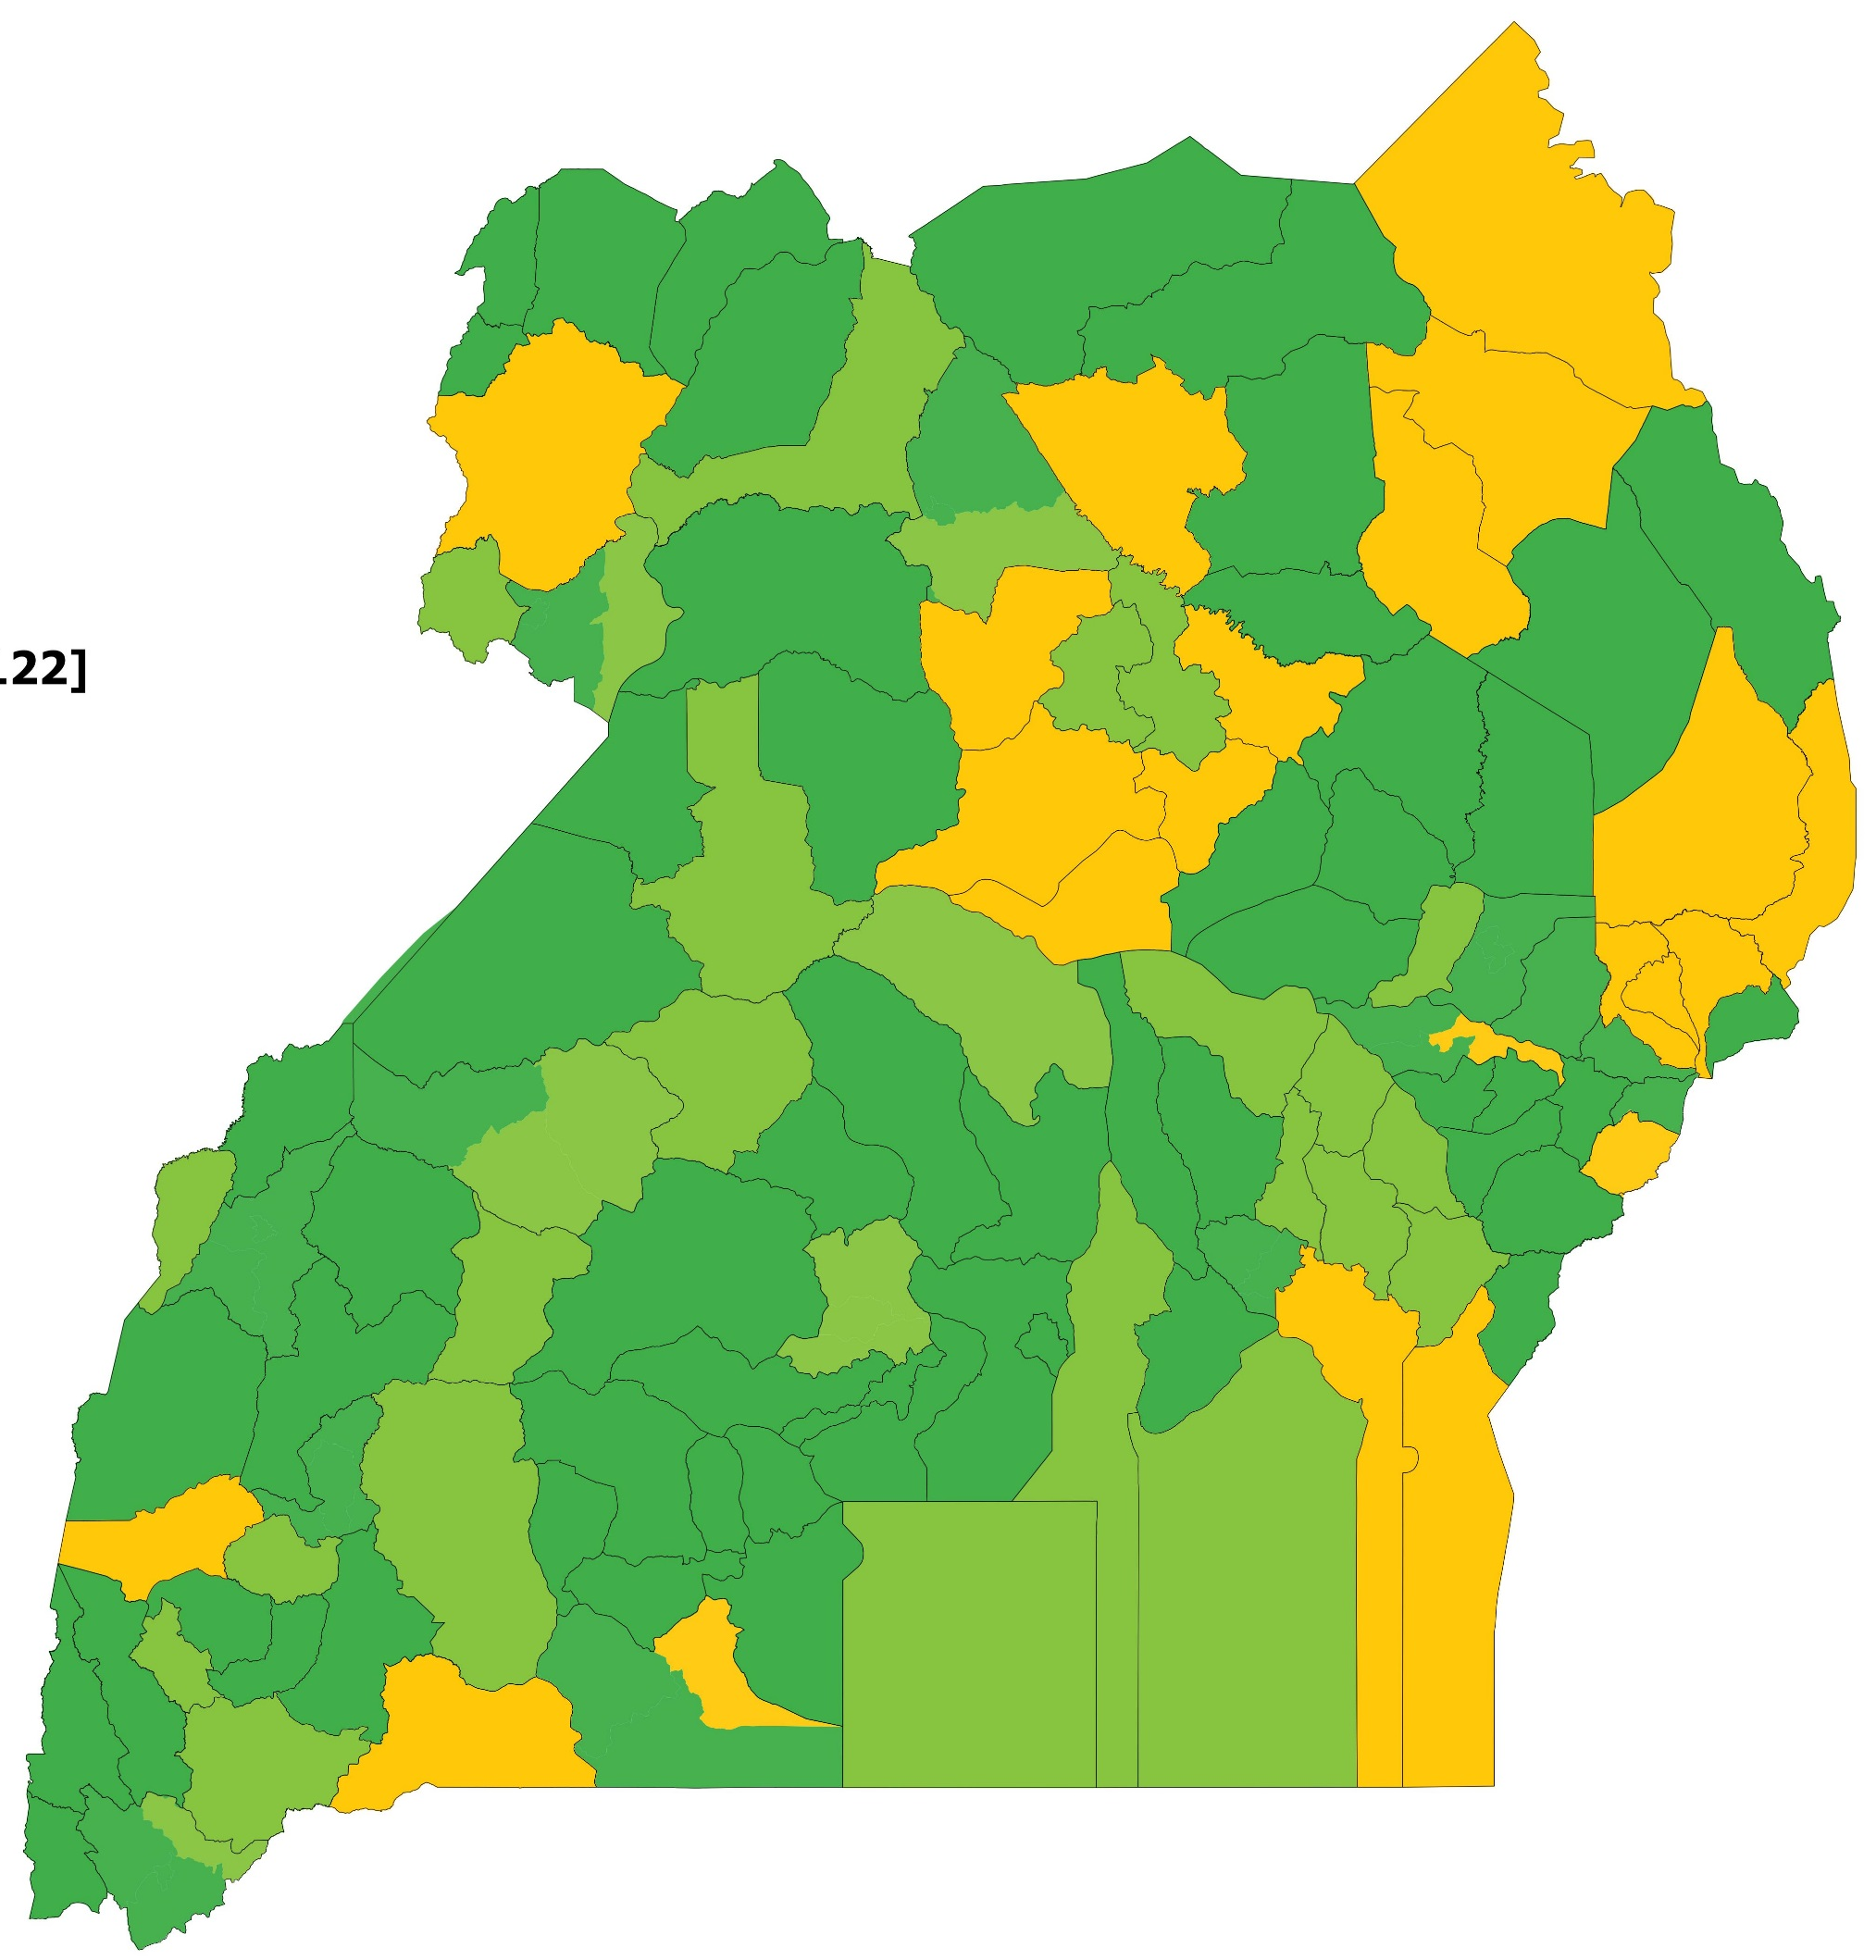
Remarkable viral load testing scale-up
Coverage of viral load testing, by district, Uganda, July 2016–June 2018
JULY 2016 TO JUNE 2017
JULY 2017 TO JUNE 2018
Less than 80%
80–89%
90% or higher
Source: Uganda Viral Load Dashboard, Central Public Health Laboratories, Ministry of Health.

Slide 7
PART I
GAPS AND BARRIERS

Slide 8
Three gaps on the path to viral suppression
Knowledge of status, treatment and viral suppression gaps, global, 2017
TESTING GAP
25.4%
TREATMENT GAP
15.8%
VIRAL SUPPRESSION GAP
11.4%
VIRALLY SUPPRESSED
47.4% [35–59%]
People living with HIV who do not know their status and are not on treatment
People living with HIV who know their status but are not on treatment
People living with HIV on treatment who are not virally suppressed
People living with HIV on treatment who are virally suppressed
NOT ON TREATMENT
ON TREATMENT
= 1% of people living with HIV globally

Slide 9
Three gaps on the path to viral suppression
Knowledge of status, treatment and viral suppression gaps, global, 2015–2017
100
90
25%
Testing gap: Percentage of people with HIV who do not know their status and are not on treatment
80
33%
30%
70
16%
Treatment gap: Percentage of people living with HIV who know their status but are not on treatment
Per cent
60
18%
17%
50
11%
11%
40
11%
Viral suppression gap: Percentage of people living with HIV who are on treatment but not virally suppressed
30
20
38%
43%
47%
10
0
Virally suppressed: Percentage of people living with HIV who are on treatment and virally suppressed
2015
2016
2017
Source: UNAIDS special analysis, 2018.

Slide 10
The growing viral suppression gap in South Africa
Knowledge of status, treatment and viral suppression gaps, South Africa, 2001–2017
100
90
80
70
Per cent
60
50
40
30
20
10
0
2001
2002
2003
2004
2005
2006
2007
2008
2009
2010
2011
2012
2013
2014
2015
2016
2017
Testing gap
Treatment gap
Viral suppression gap
Virally suppressed
Source: Estimates from the Department of Health, South Africa, Thembisa model, 2018.

Slide 11
Trends vary among regions
Knowledge of status, treatment and viral suppression gaps, two regions, 2015–2017
EASTERN AND SOUTHERN AFRICA
LATIN AMERICA
100
26%
23%
19%
100
27%
23%
23%
90
Testing gap: Percentage of people with HIV who do not know their status and are not on treatment
90
80
15%
80
70
20%
17%
70
19%
19%
16%
14%
Treatment gap: Percentage of people living with HIV who know their status but are not on treatment
Per cent
60
Per cent
60
9 %
50
10%
12%
50
12%
12%
52%
40
Viral suppression gap: Percentage of people living with HIV who are on treatment but not virally suppressed
40
42%
45%
30
48%
52%
30
20
45%
Virally suppressed: Percentage of people living with HIV who are on treatment and virally suppressed
20
10
0
10
0
2015
2016
2017
2015
2016
2017
Source: UNAIDS special analysis, 2018.

Slide 12
Low viral suppression among key populations
Median percentage of key populations† living with HIV who are virally suppressed,
by region, 2013–2017
100
90
Viral load suppression (%)
80
70
60
50
40
30
20
10
0
Asia and the Pacific n=16
Eastern Europe and central Asia n=10
Eastern and southern Africa n=8
Latin America and the Caribbean
n=3
Middle East and North Africa n=7
North America n=3
Western and central Africa
n=3
Western and central Europe n=2
† Gay men and other men who have sex with men, sex workers, people who inject drugs and transgender women and men.
Note: The figure reflects a range of sources over a range of years, including early data on viral load suppression among key populations. These data are not representative of viral load suppression among key populations at national level.
Source: See the chapter reference list for detailed sourcing.

Slide 13
Nearly half of HIV-exposed infants are not tested
Percentage of children born to women living with HIV
who were tested for HIV within eight weeks of birth, 23 focus countries, 2017
100
90
95
95
80
81
70
60
65
Per cent
50
52
50
51
51
51
51
51
52
40
46
48
30
34
36
40
20
30
20
23
10
1
1
5
12
0
Angola
Chad
India
Ghana
Kenya
Malawi
Nigeria
Burundi
Zambia
Ethiopia
Uganda
Lesotho
Eswatini
Indonesia
Botswana
Cameroon
Zimbabwe
Namibia
Côte d’Ivoire
Mozambique
South Africa
Focus countries
United Republic of Tanzania
Democratic Republic of the Congo
Source: 2018 Global AIDS Monitoring.

Slide 14
Slow return of test results threatens the lives of infants living with HIV
Early infant diagnosis, turnaround time from sample collection to return of results
and percentage of results returned to caregivers, clinics in urban settings, seven countries, 2016–2017
140
97%
100%
97%
100%
100
120
87%
83%
90
120
120
80
Results returned to caregiver (%)
100
73%
70%
70%
70
97
97
60
Per cent
80
85
87
80
47%
50
60
43%
64
58
61
40
40
33%
52
30
30
20%
29
29
20
20
10
0
0
Eswatini MC
Kenya HBH
Lesotho StJH
Cameroon MBH
Lesotho MSDA
Zimbabwe GPH
Cameroon CMA
Côte d’Ivoire UT
Cameroon CASS
Côte d’Ivoire CMTE
Mozambique CXX
Cameroon CME
Côte d’Ivoire CMSC
Source: Baseline data from EGPAF-supported sites in nine countries (n = 30 infants/site; sampled in 2016–2017).

Slide 15
Avoiding testing out of fear of HIV-related stigma
Percentage of people living with HIV who reported hesitating to get tested for HIV
because of fears of how other people would respond if they tested positive, 2017
41%
32%
23%
UGANDA
SENEGAL
CAMEROON
59%
68%
77%
Hesitated to get tested
Source: People living with HIV Stigma Index surveys, 2017.

Slide 16
Many within key populations avoid testing
Percentage of key populations who reported having avoided HIV testing in the past 12 months
due to stigma and discrimination, countries with available data, most recent data, 2013–2017
100
90
80
70
Per cent
60
50
40
30
20
10
0
Lao People´s
Democratic
Republic
Fiji
Mauritius
Paraguay
Côte
d’Ivoire
Seychelles
Cuba
Bangladesh
Myanmar
Zimbabwe
Gay men and other men who have sex with men
Sex workers
People who inject drugs
Source: Integrated biological and behavioural surveys, 2013–2017.

Slide 17


Number of countries with legislation that hampers
the AIDS response, global, 2018
Criminalize
same-sex sexual
acts
Criminalize
some aspect
of sex work
Criminalize and/or
prosecute
transgender
people
Drug use or
possession
of drugs for
personal use is a
criminal offence
or grounds for
compulsory
detention
Criminalize
non-disclosure,
exposure and/or
transmission of
HIV or
prosecutions exist based on general criminal laws
Restrictions on
entry, stay and
residence for
people living with
HIV
Criminalize vertical
transmission
155 reporting countries
Percentage of countries with punitive laws
Source: See the July 2018 UNAIDS publication, Miles to go, for detailed sourcing.

Slide 18
More tuberculosis–HIV integration required
Percentage of countries reporting delivery of integrated HIV
and tuberculosis services, global, 2017
5%
5%
20%
52%
62%
38%
ART AND TB TREATMENT INTEGRATED (N=116)
43%
33%
42%
HIV counselling and testing integrated with tuberculosis services n=117
Tuberculosis screening integrated in HIV services n=116
Antiretroviral therapy and tuberculosis treatment integrated n=116
Fully integrated in all health facilities
Integrated in some health facilities
Delivered separately
Source: 2017 National Commitments and Policy Instrument.

Slide 19
PART II
OVERCOMING BARRIERS

Slide 20
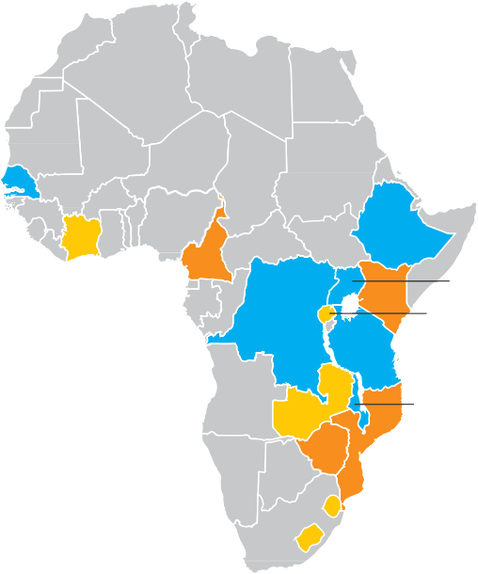
Ready for scale-up
Fifteen early adopters of point-of-care early infant diagnosis
Senegal
Cameroon
Ethiopia
Côte
d’Ivoire
DR
Congo
Kenya
Uganda
Rwanda
EGPAF
United Republic of Tanzania
CHAI/UNICEF
Zambia
Malawi
Overlap
Zimbabwe
Mozambique
Eswatini
Lesotho
Source: Bailey R, Peter T. The role of point-of-care testing for early infant diagnosis. IAS 2018 satellite session: diagnose, treat, innovate: a paradigm shift for ending paediatric AIDS. 23 July 2018 (http://www.pedaids.org/
wp-content/uploads/2018/08/joint-partner-satellite_role-of-POC-EID-23July2018_FINAL_20July2018.pdf, accessed 6 November 2018).

Slide 21
Dramatic gains through point-of-care early infant diagnosis
Percentage of HIV test results returned to a caregiver within 30 days
and percentage of newly diagnosed infants initiated on treatment within 60 days,
select health facilities, Malawi and Mozambique, 2015–2018
Percentage of HIV test results returned to a caregiver within 30 days
Percentage of newly diagnosed infants initiated on antiretroviral therapy within 60 days
100
100
80
80
Per cent
60
Per cent
60
40
40
20
20
0
0
Conventional early
infant diagnosis
Point-of-care early
infant diagnosis
Conventional early
infant diagnosis
Point-of-care early
infant diagnosis
Mozambique
Malawi
Eight-country pooled data
Source: Jani IV, Meggi B, Loquiha O, Tobaiwa O, Mudenyanga C, Zitha A et al. Effect of point-of-care early infant diagnosis on antiretroviral therapy initiation and retention of patients. AIDS. 2018:32(11):1453–63;
Mwenda R, Fong Y, Magombo T, Saka E, Midiani D, Mwase C et al. Significant patient impact observed upon implementation of point-of-care early infant diagnosis technologies in an observational study in Malawi.
Clin Infect Dis. 2018;67(5):701–7; and Elizabeth Glaser Pediatric AIDS Foundation, UNITAID. Issue brief: point-of-care early infant HIV diagnosis. In: Elizabeth Glaser Pediatric AIDS Foundation [website].
Washington (DC): Elisabeth Pediatric AIDS Foundation; 2018 (http://www.pedaids.org/wp-content/uploads/2018/07/2018_POCEID_DoingMoreFaster_digital.pdf, accessed 11 November 2018).

Slide 22
Making the most of limited resources
Hub-and-spoke service delivery model
HUB
SPOKE
SPOKE
Point-of-care early infant diagnosis
Point-of-care early infant diagnosis
Stand-alone sites
Receive samples directly from infants and perform point-of-care early infant diagnosis tests on site.
Hub-and-spoke networks
Hub sites provide testing for infants at that site and for spoke sites. Nearby spoke sites send samples to the hub sites for testing.

Slide 23
Reaching the first two 90s
PopART intervention: Knowledge of HIV status among people living with HIV (first 90) and treatment
coverage among those who know their HIV status (second 90), by age and sex, before and after Round 3 community-based services and household visits, Zambia and South Africa, 2017
First 90 at the start and end
of Round 3, PopART intervention
Second 90 immediately after first household visit (start) and end of Round 3, PopART intervention
100
92
94
92
100
92
90
87
90
89
86
83
80
81
80
80
80
77
70
72
70
68
60
61
60
63
Per cent
50
Per cent
50
40
40
30
30
20
20
10
10
0
Start
End
Start
End
Start
End
Start
End
0
Start
End
Start
End
Start
End
Start
End
Both sexes
(aged 15
years and
older)
Men (aged
35 years
and older)
and women (aged 30
years and
older)
Men (aged
18–34
years)
Women (aged
15–29
years)
Both sexes
(aged 15
years and
older)
Men (aged
35 years
and older)
and women (aged 30
years and
older)
Men (aged
18–34
years)
Women (aged
15–29
years)
Round 3 start
Round 3 end
Target
Source: HIV Prevention Trials Network (HPTN). Data provided to UNAIDS on 15 November 2018.

Slide 24
Increased testing yield among female sex workers
Number of HIV tests, HIV-positive results and testing yield, female sex workers
reached by the LINKAGES project, Democratic Republic of the Congo, 2016–2018
7000
6655
Enhanced peer outreach approach initiated
10
6000
6421
8.6%
9
Number of female sex workers
8
HIV testing yield (%)
5000
4819
4445
5.6%
7
4000
4189
6
4.3%
4.4%
3619
4.6%
4.8%
3452
5
3000
2750
3.4%
3.4%
4
2000
3
1000
2
275
120
163
123
304
203
250
296
1
0
0
July– September 2016
October– December 2016
January– March 2017
April– June 2017
July– September 2017
October– December 2016
January– March 2018
April– June 2018
Female sex workers tested for HIV
Female sex workers who tested HIV-positive
HIV testing yield
Source: USAID, FHI360, PEPFAR. LINKAGES project, October 2018.

Slide 25
The power of positive peers
HIV testing yield from HIV-positive and HIV-negative peer mobilizers,
Haiti, April–June 2018
Female sex workers
Gay men and other men
who have sex with men
500
447
40
Number of gay men and other men who have sex with men
800
716
25
Number of female sex workers
450
420
417
35
700
400
34%
30
600
615
636
21%
20
350
348
HIV testing yield (%)
570
HIV testing yield (%)
300
25
500
15%
15
250
20
400
200
19%
15
300
10
150
117
10
200
100
79
100
90
120
5
50
5
0
0
0
0
HIV-negative peer mobilizers
HIV-positive peer mobilizers
HIV-negative peer mobilizers
HIV-positive peer mobilizers
Number of female sex workers recruited
Number of gay men and other men who have sex with men recruited
Number of female sex workers tested
Number of gay men and other men who have sex with men tested
Number of HIV-positive test results
Number of HIV-positive test results
HIV testing yield
HIV testing yield
Source: USAID, FHI360, PEPFAR. LINKAGES project, October 2018.

Slide 26
Balancing volume and yield
Percentage yield and percentage of HIV-positive tests, by modality,
Zimbabwe, October–December 2017
HIV testing yield
by testing modality
Percentage of HIV-positive tests by testing modality
50
45
40
HIV testing yield (%)
35
30
25
20
15
10
5
0
Facility index testing
Community-based index testing
Targeted mobile testing
Provider-initiated testing and counselling
Facility-based voluntary counselling and testing
Community-based voluntary counselling and testing
Source: Timberlake J. COP 2018 agency oversight and SGAC approval meeting, Zimbabwe. Presentation prepared prior to COP 2018 approval. PEPFAR; 18 April 2018.

Slide 27
Coverage gains through self-testing
Percentage of people who said they had not had an HIV test within the last 12 months,
four districts*, Malawi, 2015 baseline survey and 2017 endline survey
Men
Women
100
100
Per cent
80
Per cent
80
60
60
40
40
20
20
0
0
16–19
years
20–24
years
25–39
years
> 40
years
16–19
years
20–24
years
25–39
years
> 40
years
Baseline
Endline
* Blantyre, Machinga, Mwanza and Neno.
Source: Karin Hatzold, STAR Project Director, Population Services International. HIV self-testing Africa: experiences from HIVST implementation in 6 countries in sub-Saharan Africa. Presentation. 2018.

Slide 28
High yield from peer-assisted self-testing for key populations
Number of people tested, number of HIV-positive tests and yield,
various HIV testing modalities, LINKAGES project, Burundi, April–September 2018
Female sex workers
Gay men and other men
who have sex with men
3500
16
Number of gay men and other men who
have sex with men
1000
900
800
700
600
500
400
300
200
100
0
946
14
Number of female sex workers
3000
14%
3037
14
13%
12
2573
12
HIV testing yield (%)
672
10
HIV testing yield (%)
2500
10
2000
9%
8%
8
8
6
1500
1179
6
1000
1049
5%
4
209
4
4%
172
2
500
219
142
155
2
2%
2%
0
50
0
21
12
27
13
0
Enhanced
peer outreach
approach
Peer
educator
referral
Self-testing
Testing
by health
staff in the
community
Drop-in
centers/
facilities
Social
events
Self-testing
Index
testing
Tested
HIV-positive
HIV testing yield
Source: USAID, FHI360, PEPFAR. LINKAGES project, October 2018.

Slide 29
The self-testing-to-treatment cascade
Self-test kit distribution and use, and linkages to confirmatory testing
and initiation of treatment, LINKAGES project, Burundi, April–September 2018
Female sex workers
Gay men and other men
who have sex with men
1200
Number of HIV test kits and gay men and
other men who have sex with men
400
Number of HIV test kits and
female sex workers
1079
1049
350
1000
281
300
800
97%
250
209
600
14% case finding rate
200
400
150
74%
13% case finding rate
17%
176
100
17%
200
142
137
50
36
27
81%
96%
75%
81%
22
0
0
Number
of self-test kits
distributed
Number
of self-test
kits used
Number
of
reactive
kits
Number
of
confirmed
HIV-positive
tests
Number
of
HIV-positive
persons
initiated on
antiretroviral
therapy
Number
of self-test kits
distributed
Number
of self-test
kits used
Number
of
reactive
kits
Number
of
confirmed
HIV-positive
tests
Number
of
HIV-positive
persons
initiated on
antiretroviral
therapy
Source: USAID, FHI360, PEPFAR. LINKAGES project, October 2018.

Slide 30

National policies and strategies for adherence support,
global, 2017
National policy and/ or strategy on adherence support includes:
Fixed-dose combinations and once-daily regimens
(83 countries)
Peer counsellors (78 countries)
Case management (75 countries)
Adherence clubs and peer support
(63 countries)
Behavioural skills training/ medication adherence training
(57 countries)
National policy and/or strategy on adherence support
(101 of 113 reporting countries)
Text message reminders
(37 countries)
Use of reminder devices
(37 countries)
Peer navigation (34 countries)
Cognitive- behavioural therapy
(31 countries)
113 reporting countries
101 countries with a national policy and/or strategy on adherence support
Countries with adherence support mechanisms
Source: 2017 National Commitments and Policy Instrument.

