Slide 2
World AIDS Day 2025: Overcoming Disruption, Transforming the AIDS Response
1. The HIV response is at risk
The vulnerability of the HIV response
Risks to HIV prevention efforts -
HIV prevention for adolescent girls, young women and survivors of gender-based violence
Risks to HIV responses for key populations
Risks to HIV testing and treatment services
Risks to community-led responses
A growing human rights crisis
Factors limiting domestic fiscal space for HIV investments
2. Important signs of resilience in the HIV response
Regional action to ensure long-term sustainability
Swift action by countries to close funding gaps
Community resilience
Integrating HIV services to improve outcomes and buttress long-term sustainability
3. Towards a sustainable HIV response: reaffirming global solidarity
A new global AIDS strategy: a blueprint to leverage powerful tools to end AIDS
Funding required to achieve the 2030 targets
Critical importance of continuing international support for efforts to end AIDS
Country-led efforts to ensure long-term sustainability of the HIV response
Providing community-led responses with the resources they need
Cultivating and optimizing partnerships
Harnessing innovation to magnify impact and optimize efficiency

Slide 3
The HIV response today
In 2024, 9.2 million people living with HIV were not on treatment; and 11 million people living with HIV still had unsuppressed viral loads. 1.3 million people newly acquired HIV in 2024
OECD reports that external aid for health is predicted to drop by 30–40% between 2023 and 2025, causing immediate and severe disruption to health services
Funding cuts have particularly affected HIV prevention services and communities of people living with HIV, young people, women and key populations of gay men and other men who have sex with men, people who inject drugs, sex workers and transgender persons
The response is evolving in a context of a growing anti-gender and anti-rights movements and when most high-burden countries receiving external financing support for HIV have limited fiscal space and are highly indebted

Slide 4
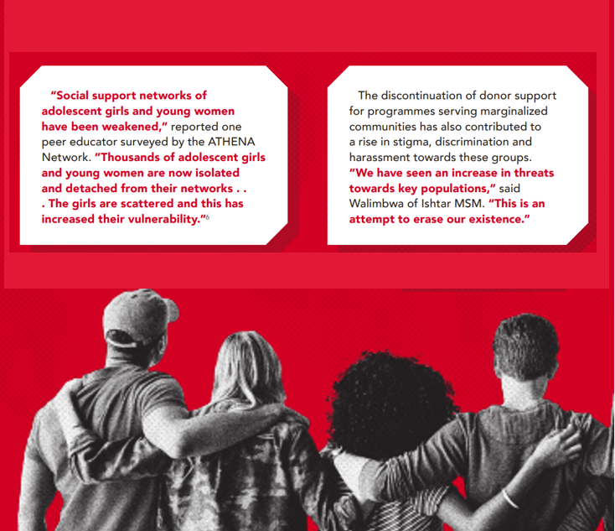
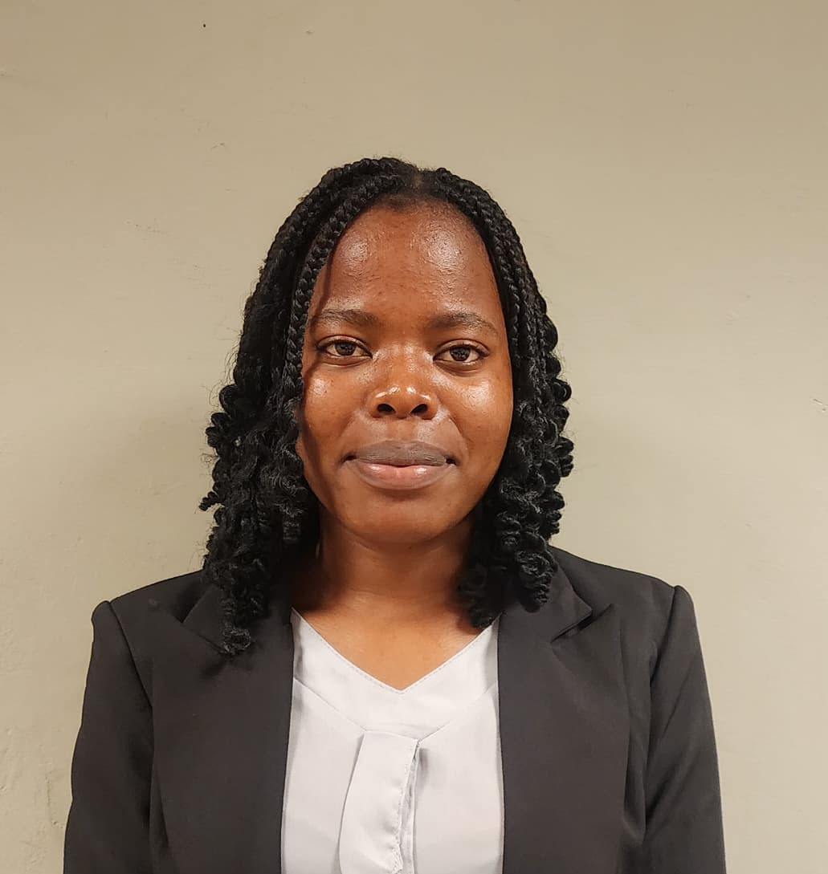
The human impact of disruption
“These
programmes empowered me and transformed my life,”
said Talent Manyoni following the closure of the DREAMS initiative for adolescent girls and young women in Zimbabwe.
“We have seen an increase in threats towards key populations, this is an attempt to erase our existence,” said Walimbwa of Ishtar MSM, Kenya
“We have seen an increase in threats towards key populations, this is an attempt to erase our existence,” said Walimbwa of Ishtar MSM, Kenya
“Social support networks of adolescent girls and young women have been weakened,” reported one peer education from Uganda surveyed by the Athena Network. “Thousands of adolescent girls and young women are now isolated and detached from their networks… the girls are scattered, and this has increased their vulnerability.”
In sub-Saharan Africa SSA new HIV infections declined by:
62% among adolescent boys and young men (15–24 years) and by
51% among adolescent girls and young women (15–24 years)

Slide 5
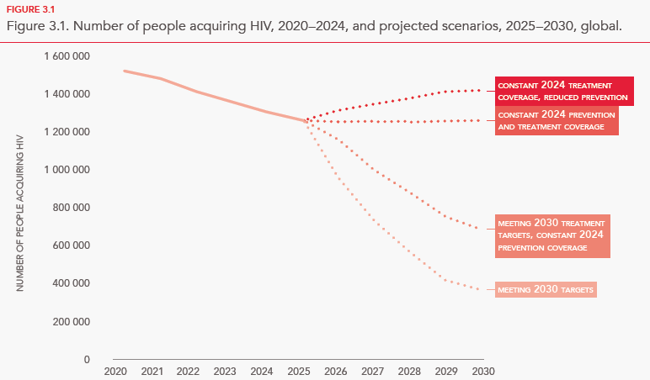
Without renewed commitment, new HIV infections could rise and undermine efforts to end AIDS as a public health threat
Modelling the impact of these funding cuts, UNAIDS projects that in 2030 there would be 1.4 million annual new HIV infections.
Over the period 2025-2030 this would result in an additional 3.9 million people newly acquiring HIV, compared to a scenario of reaching the global HIV targets by 2030.
Source: 2025 UNAIDS epidemiological estimates and Goals projections

Slide 6
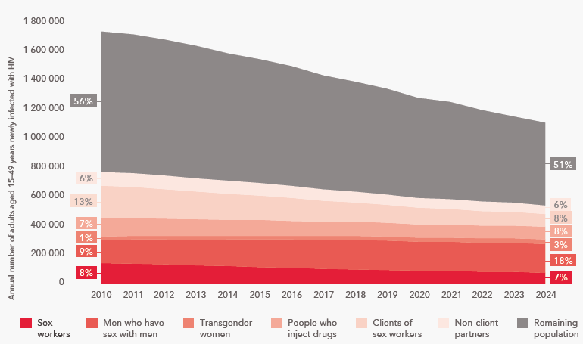
Service disruptions are occurring at a time when the proportion of the HIV burden among some key populations is rising
Key populations (including clients of sex workers) are less than 6% of the adult 15-49 population, but they and their partners bear 49% of new infections in 2024, up from 44% in 2010.
Stark inequalities continue to exist in the risk of acquiring HIV compared to the general adult population:
17x greater for sex workers and transgender women
18x greater for men who have sex with men
34x greater for people who inject drugs
Annual trends in numbers of new adult HIV infections by population, global, 2010–2024
Source: UNAIDS special analyses, 2025.

Slide 7
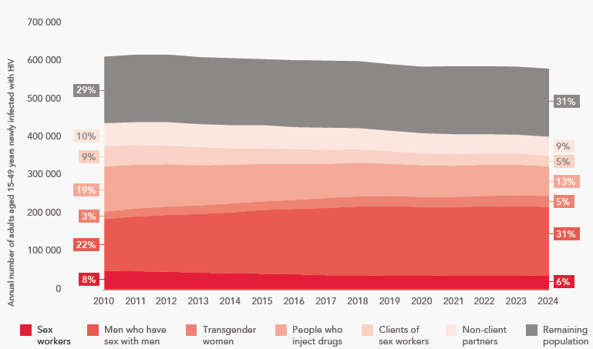
Outside sub-Saharan Africa people from key populations and their partners account for two in three new HIV infections among adults (15-49)
Annual trends in numbers of new adult HIV infections by population, outside sub-Saharan Africa , 2010–2024
Gay men and other men who have sex with men comprise about one in three adults (31%) with newly acquired HIV.
In eastern Europe and central Asia, people who inject drugs were estimated to constitute 25% of all new infections regionally in 2024.
Source: UNAIDS special analyses, 2025.

Slide 8
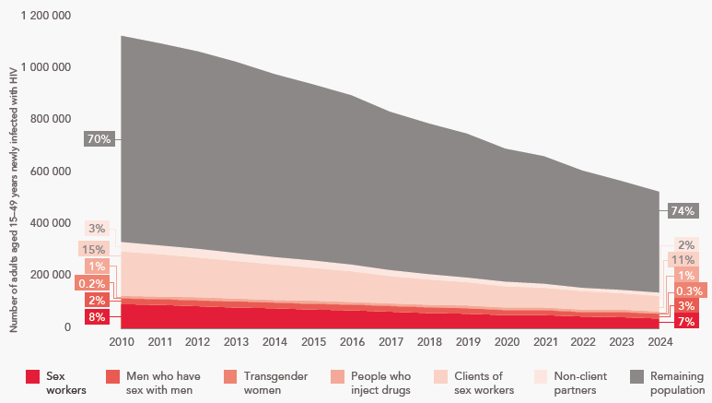
Key populations are being left behind in sub-Saharan Africa
In sub-Saharan Africa, the remaining population accounts for 74% of new HIV infections in 2024.
The strong decline in new HIV acquisitions in the region is mirrored by similar decreases in numbers and proportions of new HIV acquisitions among sex workers, their clients, people who inject drugs and sex partners of key populations.
Men who have sex with men and transgender women have reaped less benefit: their annual acquisition numbers decreased much less, so these groups now share larger proportions of the overall burden of new infections.
Annual trends in numbers of new adult HIV infections by population, sub-Saharan Africa , 2010–2024
Source: UNAIDS special analyses, 2025.

Slide 9
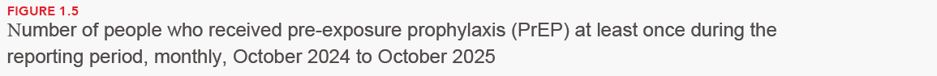
Recent declines in donor HIV assistance greatly affected HIV prevention programmes
The number of people receiving PrEP declined in many countries
31% decline in the number of people receiving PrEP in Uganda
21% decline in Viet Nam
64% decline from December 2024 to August 2025 in Burundi
Cambodia, Ghana, Lao PDR, Mozambique have shown signs of recovery
Access to other proven HIV prevention tools such as male condoms and VMMC is also declining in some countries
Source: Global AIDS Monitoring, UNAIDS-supported national AIDS spending assessments, 2019–2024.

Slide 10
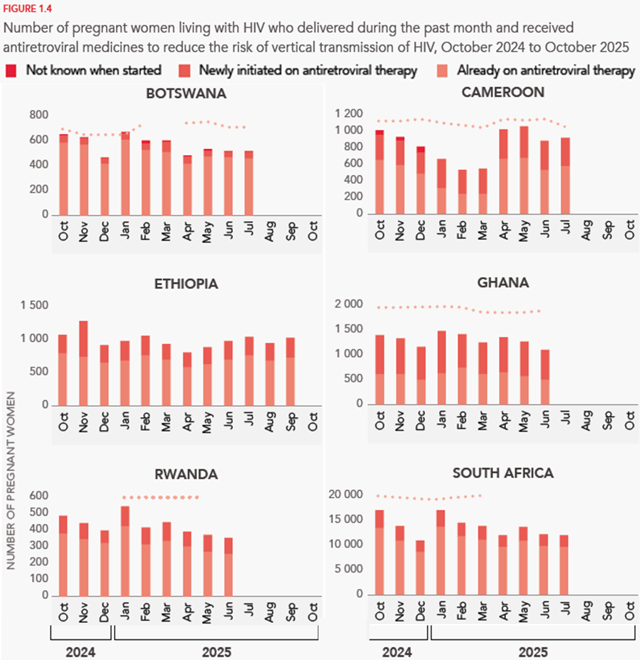
Progress towards eliminating new HIV infections among children is at risk
Numbers of women reached with antiretroviral treatment during pregnancy has remained stable over the first 6 months of 2025.
However, across sub-Saharan Africa, 450 000 pregnant women have lost access to peer educators
One survey reported that early infant diagnosis dropped by 24% between January and July 2025 across 32 countries in eastern and southern Africa
Source: country-reported data through the monthly Global AIDS Monitoring platform (https://aidsinfo.unaids.org/services).

Slide 11
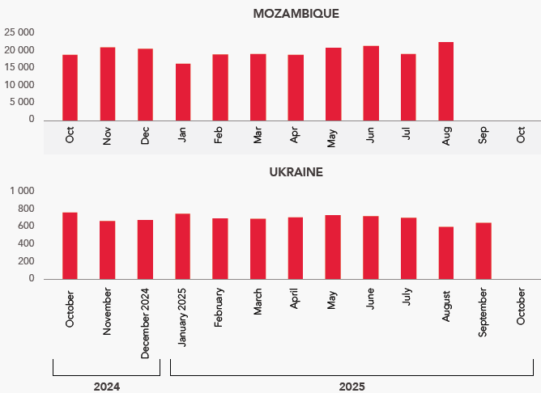
Countries report resilient treatment services
Multiple countries have reported steady numbers or even an increase in new initiations on antiretroviral therapy
Data from 17 of 21 high-burden CQUIN countries showed similar stable numbers (December 2024 and August 2025)
Quality of care is a concern: Ritshidze, in South Africa, documented a “system-wide slide” in HIV clinical services: 48% of clinics reported that funding disruptions impacted clinic capacity
*CQUIN [https://cquin.icap.columbia.edu/event/cquin-9th-annual-meeting/c9m-posters/ ]
Source: country-reported data through the monthly Global AIDS Monitoring platform (https://aidsinfo.unaids.org/services).

Slide 12
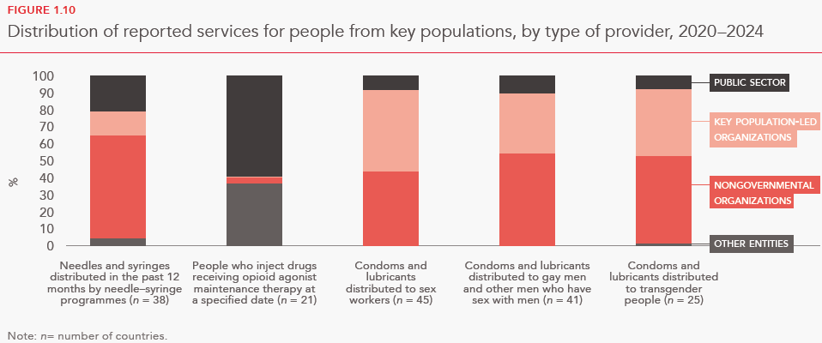
Communities rely on community-led services
80% of key populations at risk of HIV relied on nongovernmental organizations in 2024
Over 60% of women-led HIV organizations have lost funding or been forced to suspend essential programmes. An online survey found that 77% of harm reduction programmes and other HIV services for people who inject drugs had been severely disrupted by funding cuts
Source: UNAIDS Global AIDS Monitoring 2021–2025 (https://aidsinfo.unaids.org/).
Notes:
Across countries, key populations rely on nongovernmental and community-led organizations for HIV services. In 2024, 80% of key populations at risk of HIV relied on NGOs and key-population led organisations.
For the countries that reported data to UNAIDS, more than 80% of sex workers, gay men and other men who have sex with men, and transgender people receive condoms and lubricants from NGOs, including groups led by key populations themselves. And over 70% of all needles and syringes are distributed by NGOs.
When we look at financing, the picture becomes even clearer. Recent data from eight countries that have undertaken national AIDS spending assesment show that community-led organizations rely almost entirely on external donors: 89% of their funding comes from bilateral partners, 10.9% from multilaterals, and less than 0.1% of operating support coming from domestic sources
Therefore the cuts in international HIV assistance are having such severe and immediate consequences for community-led services.”
More than 60% of women-led HIV organizations have already lost funding or been forced to suspend essential programmes.
An online survey found that 77% of harm reduction programmes and other HIV services for people who inject drugs had been severely disrupted by funding cuts
And in a survey of 45 youth-led and youth-serving groups, 60% reported a sudden and significant loss of resources.

Slide 13
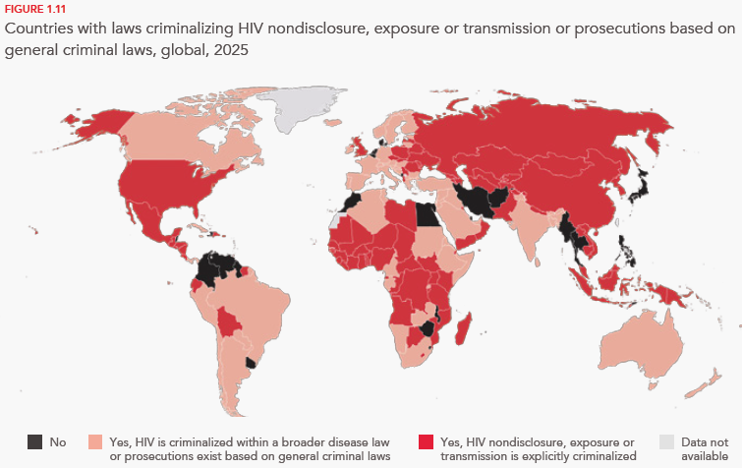
Action is needed to lift punitive laws globally so that services reach people who need them
People living with HIV are still subject to criminal prosecution in 156 countries.
68 countries criminalize some aspect of sex work, 152 criminalize drug possession for personal use, 64 criminalize same-sex relations, and 14 criminalize transgender people
Source: National Commitments and Policy Instrument, 2017–2024, supplemented by additional sources (see http://lawsandpolicies.unaids.org/).
Notes:
For the first time since UNAIDS began tracking punitive laws in 2008, the number of countries criminalizing same-sex sexual activity and gender expression has increased.
In 2025, 168 countries criminalize some aspect of sex work, 152 criminalize drug possession for personal use, 64 criminalize same-sex relations, and 14 criminalize transgender people
And people living with HIV remain vulnerable to criminal prosecution in 156 countries despite experts agreeing these laws are ineffective and not grounded in science.
The report indicates how anti-gender and anti-rights movements are growing in influence and geographic reach, jeopardizing gains on the rights of women and girls, people living with HIV and LGBTIQ+ people, further compounded by the harms caused by HIV funding cuts

Slide 14

Communities have rallied globally and shown their resilience
NEPHAK, a national network of people living with or at risk of HIV in Kenya, is actively advocating for integration of HIV into general medical care and to include HIV treatment in the package of services covered by the national health insurance programme.
In Zimbabwe, the community-led GALZ has worked to preserve and improve the access of LGBTQI+ people to health care by strengthening collaboration with the national health ministry and with municipal governments.
In Uganda, when funding cuts forced the closure of offices of the national network of people living with HIV, the Uganda AIDS Commission stepped in to provide office space and ensure continuation of the network.
Notes:
While community-led responses are reeling from the loss of essential funding, we are also seeing powerful examples of resilience from our partners
In Kenya, NEPHAK — the national network of people living with and affected by HIV — has been pushing back against exclusions created by recent health financing reforms. They mobilized communities, organized public protests, and submitted a formal petition urging the government to include HIV and TB services in the national insurance package.
These are inspiring examples of community resilience but they also highlight the harsh environments in which community-led groups are operating, with funding rapidly disappearing and punitive policies increasing.

Slide 15
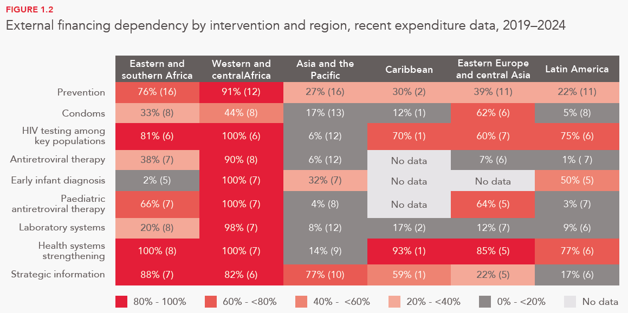
External financing has been crucial for HIV programs, especially sub-Saharan Africa
Without external support, major components of HIV response in high-dependence regions are at risk
HIV prevention and community-led programmes are heavily donor-dependent in many parts of the world.
Source: UNAIDS HIV financial estimates, July 2025.

Slide 16
Many countries are taking actions to address funding situation
Domestic budget increases
Significant national commitments
Innovative financing strategies:
Long-term sustainability roadmaps

Slide 17
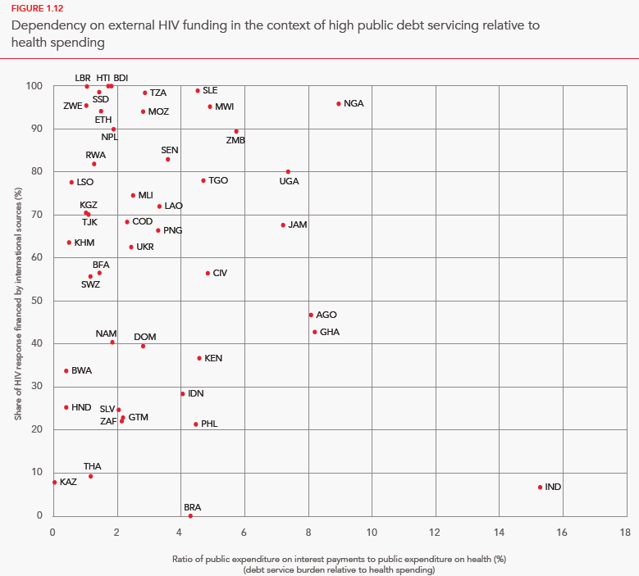
Factors limiting fiscal space for domestic investments
Fiscal space for HIV investments is shrinking
Heavy debt burdens crowd out health budgets allocations
Weak tax systems limit revenue mobilization
Fragility and competing priorities
Source: UNAIDS HIV financial estimates, July 2025.

Slide 18
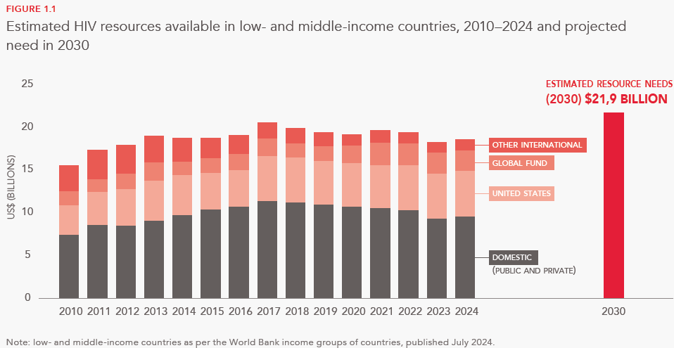
The 2030 funding targets are within reach
UNAIDS estimates that US$ 21.9 billion will be needed annually through 2030 to achieve the global HIV targets in low- and middle-income countries.
In 2024, US$18.7 billion was available of domestic and international resources
Source: UNAIDS HIV financial estimates, July 2025.

Slide 19
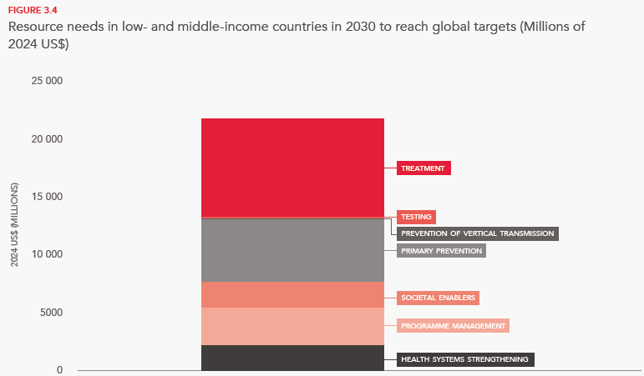
Ending AIDS by 2030 will require substantial financial resources (US$21.9 billion) in low- and middle-income countries
Treatment and prevention represent the largest share of the needed funding.
Source: Stover J, Mattur D, Siapka M, Pliakas T, Valladares-Cardona R. The impact and cost of reaching the UNAIDS global HIV targets. medRxiv. 2025-07.

Slide 20
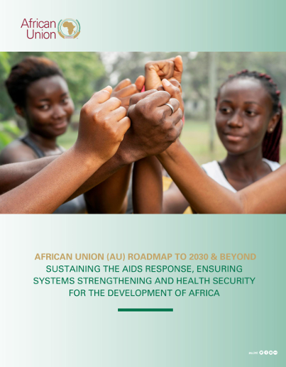
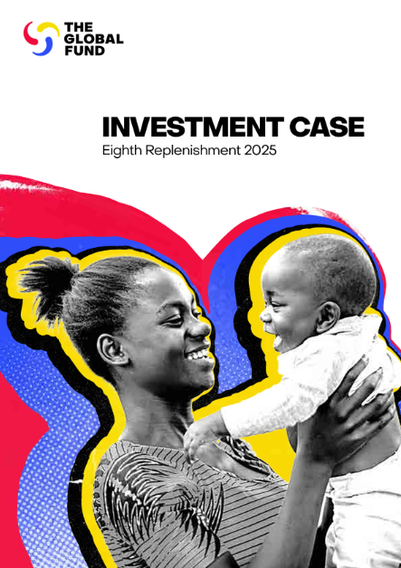
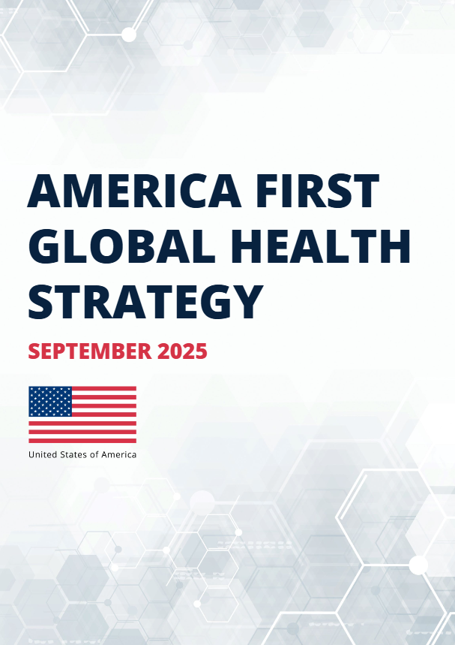
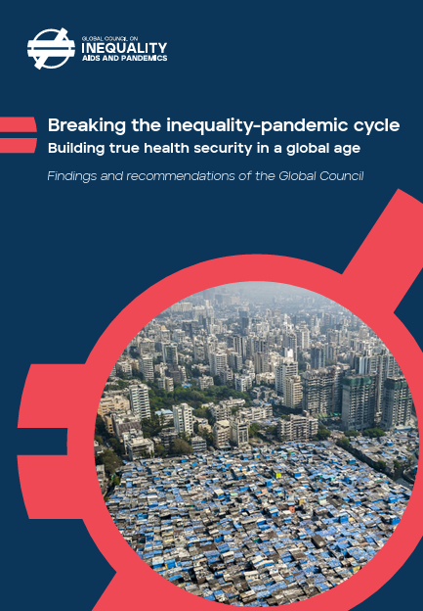
The Global response to HIV is evolving

Slide 21
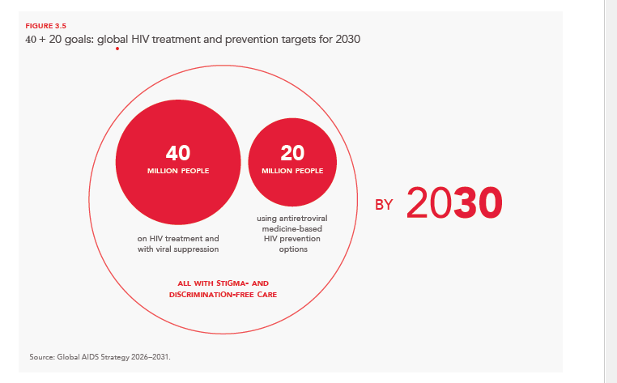
With the new Global AIDS Strategy 2026-2031, together we can end AIDS by 2030 and build a sustainable response
The Strategy provides a clear roadmap to ensure success and long-term sustainability in the decades-long global response to AIDS
Ending AIDS entails expanding both HIV treatment and HIV prevention, while ensuring supportive, stigma-free care for everyone by 2030
The global HIV response is within reach of its ultimate goal—to end AIDS as a public health threat and build a sustainable response
By
Source: Global AIDS Strategy 2026–2031
Notes:
Building on the new Global AIDS Strategy 2026-2031, we can end AIDS by 2030 and build a sustainable response. If countries scale up HIV services to reach the 2030 HIV targets, 3.3 million additional new HIV infections could be averted compared to maintaining HIV treatment and HIV prevention services at 2024 coverage levels.

Slide 22
Key messages
1. The HIV epidemic is not over and our previous progress is at risk
At the end of 2024 over nine million people living with HIV were not on treatment. 1.3 million people newly acquired HIV in 2024
Abrupt reductions in international HIV assistance in 2025 have deepened existing funding shortfalls
2. Declines in donor HIV assistance devastated HIV prevention and community services that could lead to increases in new HIV infections
The recent funding cuts will potentially flat line previously increasing treatment coverage and reduce HIV prevention services. This particularly affects HIV prevention programmes for young people and key populations, and community-led services that are heavily dependent on external financing
Modelling the impact of these funding cuts, UNAIDS projects that in 2030 there would be 1.4 million annual new HIV infections
3. There is hope: important signs of country and community resilience are emerging and global solidarity will be essential
Countries are showing resilience when it comes to HIV treatment delivery. Communities are rallying all over the world
Countries are making efforts to increase domestic revenue but many high burden countries face competing priorities.
The renewed commitments of two primary funders of global HIV programmes (PEPFAR and the Global Fund) provide opportunities for countries to reach the people who need services the most. This can only be achieved when communities are engaged
Building on the new Global AIDS Strategy 2026-2031, we can end AIDS by 2030 and build a sustainable response

