Slide 1




Slide 2
WHY WE ARE HERE AND WHY IT STILL MATTERS?
The world is faced with multiple issues: conflict, crises, and geopolitical uncertainty.
Yet - AIDS is not over.
Ending AIDS is still possible, but only if we do not give up.
UNAIDS’ mandate: to lead, guide, and coordinate the global HIV response.
This is not a UNAIDS strategy, it is a strategy for the world.
Grounded in dignity, equity, human rights, science, and community leadership.
Notes:
In a world consumed with conflict, crises, human rights erosion, and political uncertainty, some are quietly asking whether ending AIDS is still possible, whether it is still realistic, whether it is still a priority.
And our answer, collectively, must be clear and courageous: yes, ending AIDS is still possible. But it will only be possible if we don’t give up.
That is why we need a strategy, not because the world is calm, but because the world is turbulent.
This is not a UNAIDS strategy. This is a strategy uniting the world.
A roadmap grounded showing what it will take to end AIDS as a public health threat.

Slide 3
WHY NOW?
We are at a historic crossroads in the HIV response.
The science, tools, and community strength exist to end AIDS as a public health threat.
Political will and financing are fragile; this may be our last window of opportunity.
This strategy is a call to decisive action.
Choosing action now means choosing courage over fatigue and hope over resignation.
Notes:
We are at a historic crossroads. The science exists. The tools exist. Communities have never been more resolved.
But political will and financing are fragile, the window could close. This moment may be our last opportunity to align global momentum and end AIDS once and for all.
This Strategy is not about maintaining systems. It is about transforming them.
It is not about incremental change. It is about decisive action.
It calls on all of us, governments, donors, civil society, communities, and leaders, to choose courage over fatigue, and hope over resignation.

Slide 4
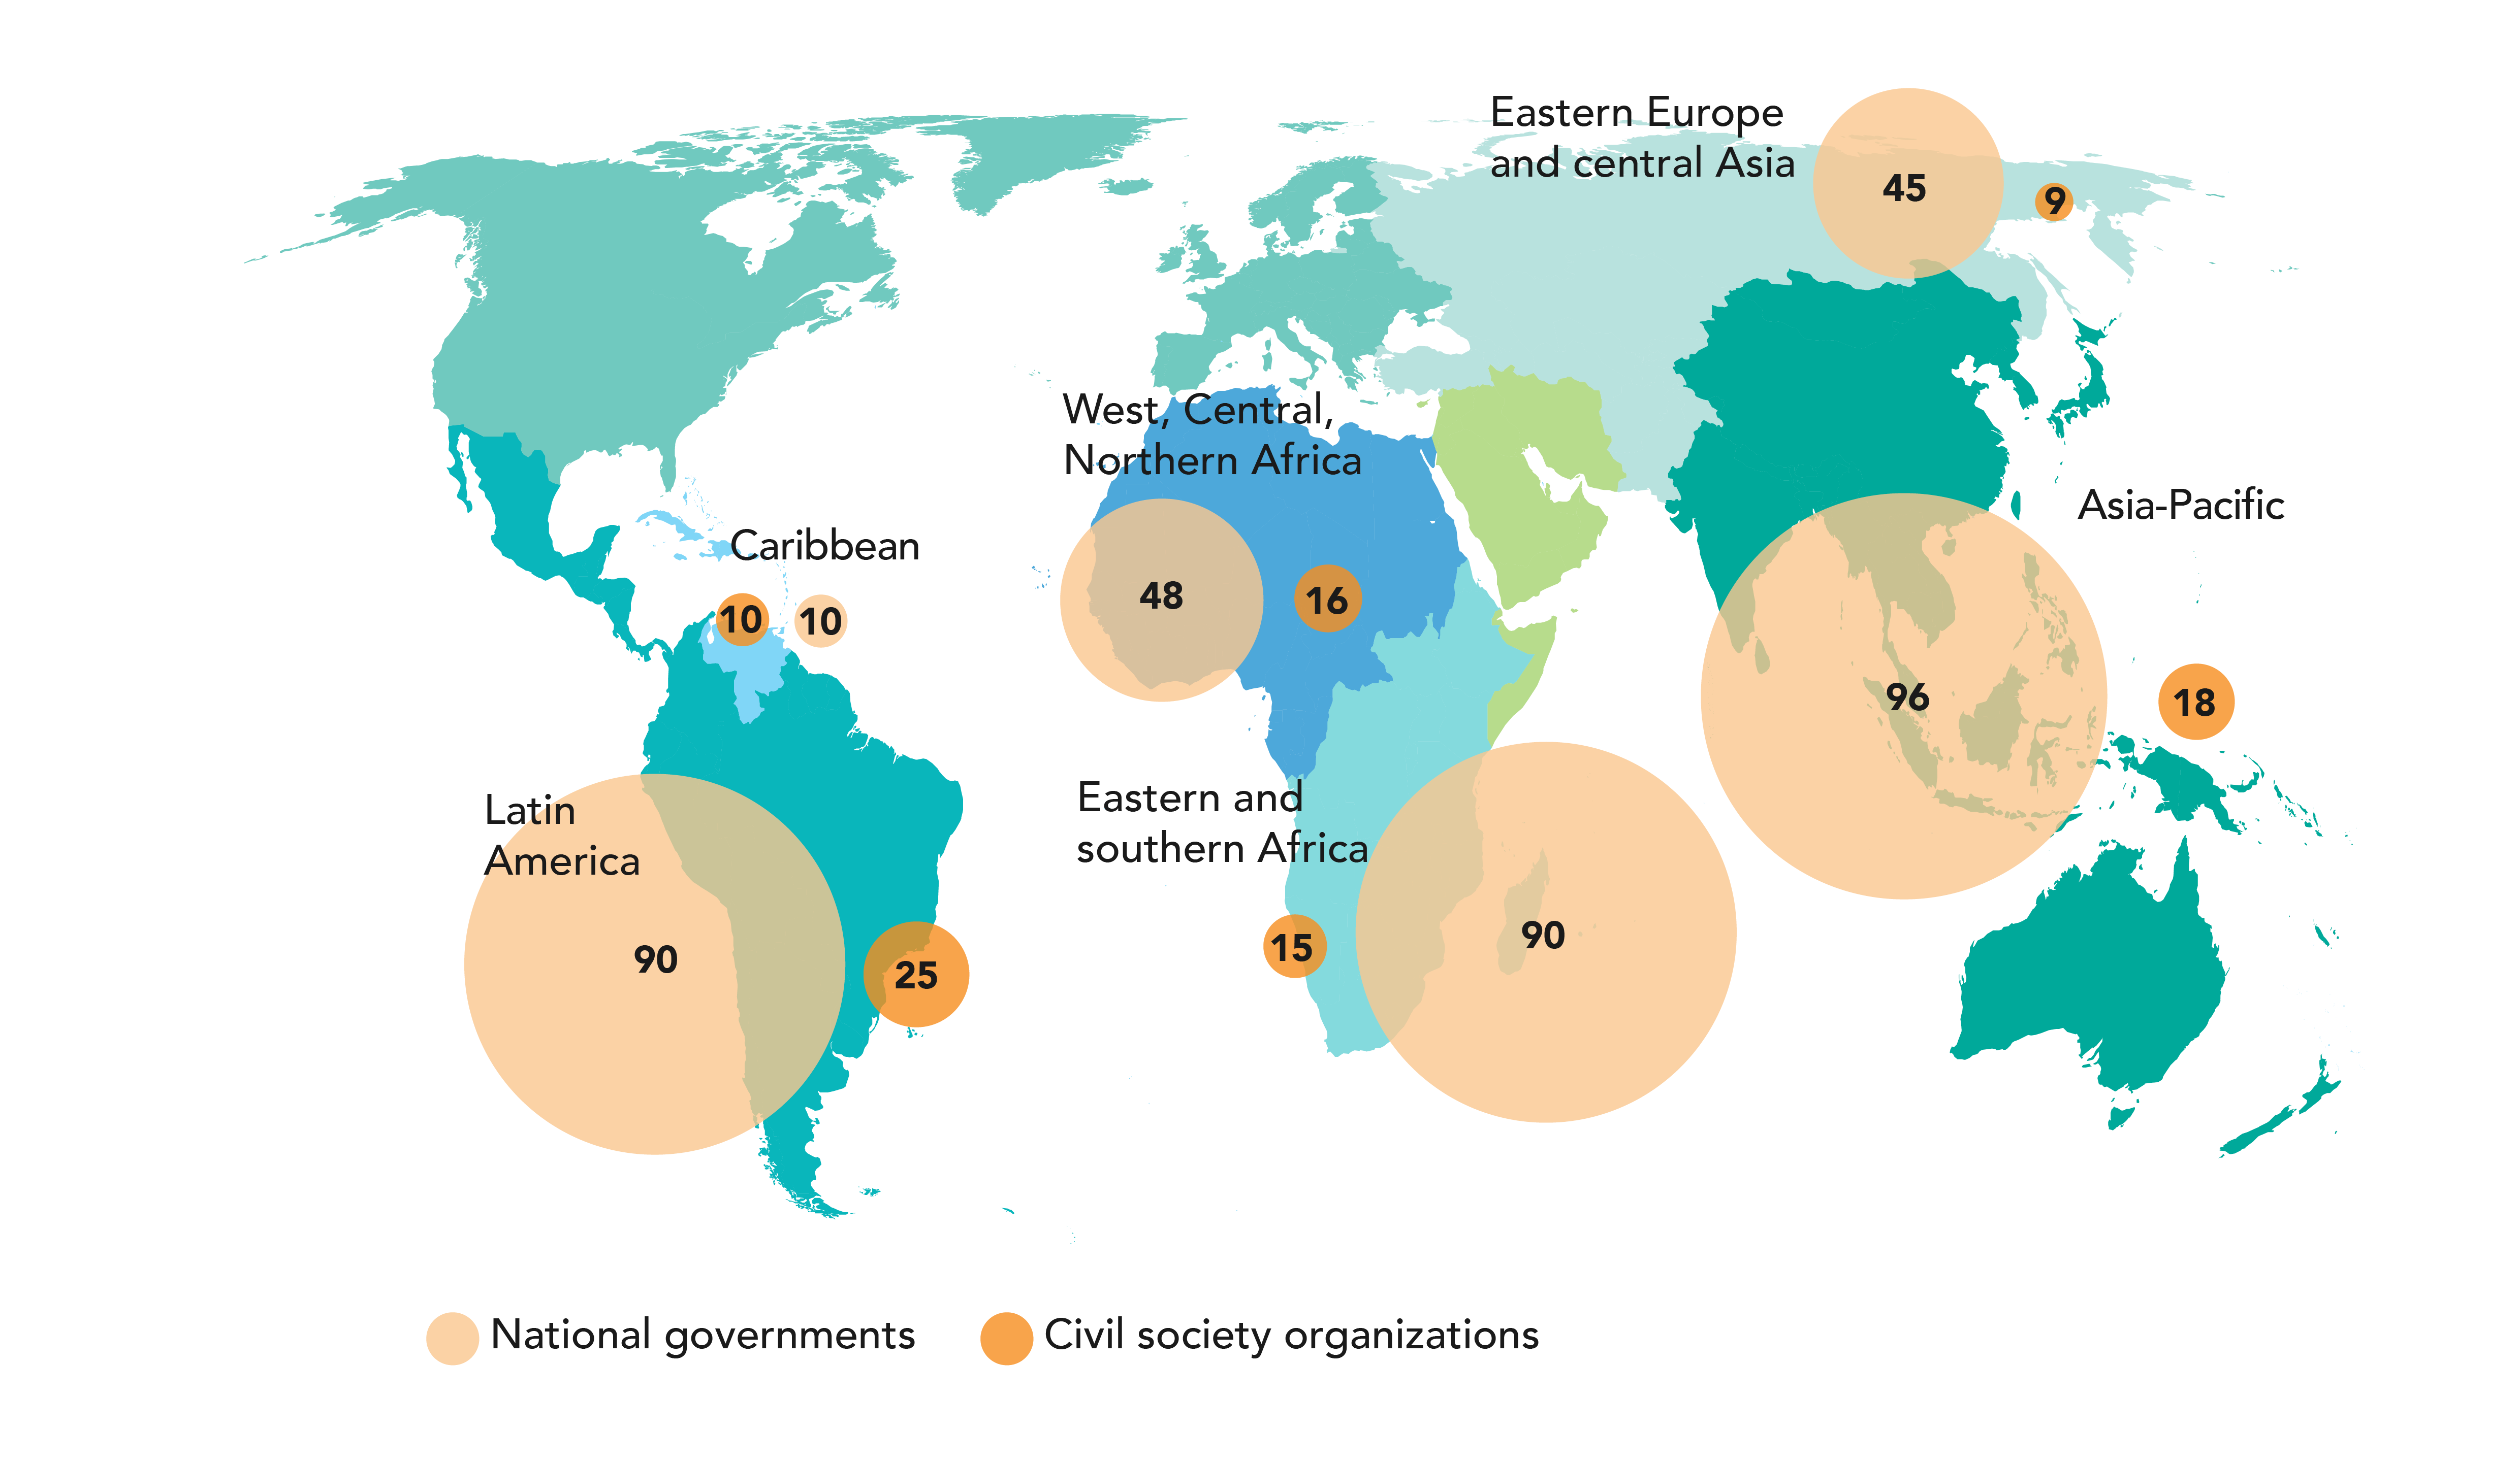
HOW THE STRATEGY WAS BUILT
Summary of consultation reached through in-depth regional, national government and community consultations (March to May 2025)
Extensive consultative process involving over 5,000 people and networks.
Digital surveys, dialogues, and national and regional conversations throughout the year.
Two global multi-stakeholder consultations with broad and diverse representation.
Voices included: people living with HIV, youth, key populations, private sector, governments, donors, civil society, researchers and UN partners.
Have we heard you? Yes, we have.
Notes:
This Strategy was not written behind closed doors.
It was shaped by thousands of voices, across regions, identities, sectors, and experiences.
It came from people living with HIV, young people, key populations, governments, donors, researchers, parliamentarians, and UN partners. Through surveys, regional dialogues, virtual consultations, and deep lived-experience conversations, you helped us shape it, stress-test it, and strengthen it.

Slide 5

FOUR BUILDING BLOCKS OF THE STRATEGY
Mid-term review of the current Strategy (Global Report July 2024)
Recommended 2030 targets identified
The Strategy is grounded in four core building blocks, shaped by today’s HIV epidemiology and response landscape, and designed to set ambitious, yet achievable targets for 2030.
Sustainability roadmaps
Ongoing strategy consultations
Notes:
4 building blocks
The Strategy has been developed on the basis of 4 building blocks
The mid-term review (see below)
The Recommended Global AIDS Targets (see below)
The sustainability roadmaps that are currently being developed in countries
The Strategy consultations with countries, civil society, experts, the private sector took place between March and October 2025.

Slide 6
It starts with people
Reducing inequalities and upholding people’s rights to access HIV prevention, testing, treatment and care services, including for women and girls, men and boys, children, and key populations affected or at risk of HIV.
The Global AIDS Strategy 2026 – 2031 invites a collective recommitment to the ambition to end AIDS by 2030.
Country-leadership for sustaining inclusive multisectoral HIV national responses
Community leadership at all levels of the response
That involves
Notes:
The Global AIDS Strategy invites a collective recommitment to the ambition to end AIDS by 2030. It starts with people.
That involves:
Country-leadership for sustaining inclusive multisectoral HIV national responses
Reducing inequalities and upholding people’s rights to access HIV prevention, testing, treatment and care services, including for women and girls, men and boys, children, and key populations affected or at risk of HIV.
Community leadership at all levels of the response

Slide 7
What’s new in the global AIDS strategy?
2025
2030
Scaled-up HIV responses
End AIDS and build sustainability
Intervention-centred
People-centred
Large number of targets, some of
which were statements of intent and
not measurable
Fewer targets that are adoptable by
countries, subnational areas and subpopulations
Vertical HIV programmes
Integration of HIV services in national programmes
Greater focus on access to services and diversifying methods ¬ self-care models, community-led programmes
Focus on provision of services
High donor dependence and donor- driven HIV responses
Country-owned and -led responses. Shared responsibility differentiated by income
Global strategies
Both global and regional strategies
Notes:
This new Global AIDS Strategy is not business as usual. It responds to the world we are in now, a world of overlapping crises, widening inequalities, shrinking civic space, and new health and economic shocks. What is new is not only the framing, but the level of ambition:
A sharper focus on inequalities, structural barriers, and the people who are most left behind.
A deeper commitment to human rights, gender equality, and decriminalization.
Stronger commitment to communities as leaders and decision-shapers.
Better integration with broader health and development agendas, including universal health coverage and preparedness for future crises.
Clearer lines of accountability, who must do what, by when, and with which resources.
In short, this Strategy is designed not just to sustain progress, but to close the gaps that are still costing lives.

Slide 8
Ending aids and building a sustainable response
Sustain the Response - Country-led, resilient and ready for the future
Through people-focused care and powering communities, with a lens of ending inequalities
End
AIDS, End
Inequalities
People-focused services-equity, dignity, and access
Community leadership
The Strategy sets out three priorities
Centered on ending AIDS and ending inequalities
Notes:
The Strategy sets out three priorities centered on ending AIDS and ending inequalities
Priority 1: Sustaining the Response. Mapping out a country-led response that is resilient, and ready for the future for people living with, affected by or at risk of HIV
Priority 2: People-focused services– equity, dignity, and access for people living with, at risk of, or affected by HIV
Priority 3: Community leadership at all levels of the Strategy from financing and integration through delivery of services and accountability.

Slide 9
2026 – 2031 global aids strategy
The strategy is structured around three priorities and eight result areas
PRIORITY 1
SUSTAIN THE RESPONSE
PRIORITY 2
PEOPLE-FOCUSED SERVICES
PRIORITY 3
Community leadership
Three priorities and eight results areas are recommended to build a sustainable response and end AIDS as a public health threat by 2030
Country-led, resilient and ready for the future
Equity, dignity and access
Empowered communities leading the HIV responses
RESULT AREA 1
`Ensure financing for people-centred global and national HIV responses
RESULT AREA 4
Scale up HIV prevention options that bring together biomedical, structural, community and behavioural interventions.
RESULT AREA 8
Empower communities to lead
RESULT AREA 2
Integrate HIV interventions and HIV-related health and community systems with primary health care, broader health systems and key non-health sectors
RESULT AREA 5
Guarantee equitable access to available, accessible, acceptable and high-quality HIV testing, treatment and care
RESULT AREA 6
End stigma and discrimination and uphold human rights and gender equality in the HIV responses
RESULT AREA 3
Invest in essential information systems and data collection in multiple sectors, including communities
RESULT AREA 7
Ensure equitable access to scientific, medical and technological innovations in HIV prevention, testing, treatment and care
LOCAL, REGIONAL AND MULTIATERAL ACTION TO END AIDS
Notes:
The Global AIDS Strategy aims to be more focused and prioritized. The last strategy included 15 areas for action – 10 priority areas and 5 crosscutting. We are putting forward 8 results areas. Throughout the result areas, from financing to HIV prevention, you will find actions that aim to build sustainability of the response, ensure full community engagement and strengthen country systems and health security.

Slide 10

Priority 1
Sustain
The
response
Results area 1
Ensure financing for people-centred national and global HIV responses
Ensure alignment and full integration in the design, costing and budgeting of national HIV plans
Develop an evolved financing model to transition to domestic financing
Grow domestic revenue
Blended financing instruments
Integrate HIV financing
Increase development assistance for health
Establish pooled funding mechanisms
Greater accountability for commitments towards domestic financing
Improve public financial management systems
Integrate HIV services, (including community services) in national public and private health benefit packages
Eliminate user fees and reduce out-of-pocket expenses
Investment in a rights-based approach to sustainability and development of HIV sustainability roadmaps
Leverage regional organizations and south-south cooperation
Community leadership is monitored and benefits from dedicated allocations
Country-led, resilient, and ready for the future for people living with, affected by or at risk of HIV
Notes:
Under priority 1 – the action areas focus on financing, systems integration, and data.
For financing the response to HIV, it is essential for national strategic plans to be integrated within national structures for a coherent national response. Funding sources need to be diversified, especially domestic financing. Country-led responses should not result in increased user fees that might drive people away from services. Sustainability roadmaps will be critical and must involve communities.

Slide 11

Priority 1
Sustain
The
response
Results area 2
Integrate HIV interventions and HIV-related health and community systems with primary health care (PHC), broader health system and key non-health sectors
Ensure political leadership and operational mechanisms for integration of HIV into national health systems
Integrate HIV-focused systems and services into PHC and broader public health systems
Simplify HIV service delivery and focus on essential HIV care and prevention
Integrate HIV-focused community systems and services
Strengthen collaboration and co-financing across sectors
Multisectoral programmatic coordination and inclusion
Embed a human rights-based approach to the integration of HIV services with stigma-free, gender transformative, youth responsive and key population-appropriate services
Embed HIV into disaster preparedness plans and humanitarian responses
Robust accountability systems and metrics
Strengthen global health security and country resilience to pandemics
Country-led, resilient, and ready for the future for people living with, affected by or at risk of HIV
Notes:
Integration of the HIV response into national systems particularly into primary health care is a clear priority. This involves investing in capacity-building of health services. It involves embedding a human rights based approach to the integration of HIV services with stigma-free, gender transformative, youth responsive and key population-appropriate services.

Slide 12

Priority 1
Sustain
The
response
Results area 3
Invest in essential information systems and data collection by sectors and communities
Invest and maintain robust routine data systems, case surveillance with effective data governance and stewardship, including ensuring confidentiality
Support and link multiple and identify innovative data sources and systems including population viral suppression
Household surveys
Case surveillance and civil registration
Modelling to inform programme decisions
Advance interoperability of health systems, with shared electronic health and social records
Ensure systematic differences between and within groups are measured to identify inequalities
Formalise collaboration between government- and community-led monitoring structures for mutual accountability and operational synergy
Use information on expenditures in all data analyses to inform planning
Strengthen health workers' digital capacities through systematic training programmes
Introduce a new paradigm for routine HIV prevention needs estimates through annual modelling of the number of people in need of HIV prevention.
Country-led, resilient, and ready for the future for people living with, affected by or at risk of HIV
Notes:
Strong data and information systems will be essential. These need to incorporate multiple sources to inform national responses. Community led monitoring will be essential to measure the quality of services and strengthen accountability.

Slide 13

Priority 2
PEOPLE-FOCUSSED SERVICES
Results area 4
Scale up biomedical, structural, community and behavioral options for HIV prevention
Scale up the availability of an optimal mix of prevention options
Rapidly introduce and scale up equitable access to PrEP options to provide at least 20 million person-years of PrEP globally in 2030
Reinvigorate market approaches to condoms and self-testing.
Expand self-care in HIV prevention by making products (condoms, self-tests, clean needles more widely available (e.g. pharmacies)
Increase demand for HIV prevention with people-centered digital and peer-led outreach campaigns.
Integrate offer of HIV prevention as standard of care in health-care settings
Develop sustainable prevention programme models for locations with high HIV incidence in sub-Saharan Africa, particularly for young and adult women and men at higher risk of HIV including behavioural interventions and comprehensive sexuality education
Expand culturally sensitive, male-targeted interventions that promote HIV testing, condom use, PrEP and health-seeking behaviours
Develop a scaled system of trusted access programmes for key populations including sex workers, gay men and other MSM, transgender people and people who inject drugs in line with country context.
Strengthen and scale up comprehensive harm reduction services for people who inject drugs
EQUITY, DIGNITY, AND ACCESS FOR PEOPLE LIVING WITH, AT RISK OF, OR AFFECTED BY HIV
Notes:
Under priority 2 – the recommendations focus on scale-up of essential HIV prevention, testing, treatment and care services but also on how to improve delivery.
The Strategy highlights the critical need to seize the opportunities of new HIV prevention and treatment options, including long-acting formulations, quality diagnostics, and embedding services within the communities through differentiated service delivery at all levels.

Slide 14
Priority 2
PEOPLE-FOCUSSED SERVICES
Results area 5
Ensure available, accessible, acceptable and quality HIV testing treatment and care for people living with HIV
Deliver HIV treatment to 40 million people by 2030 through stigma- and discrimination-free services.
Strengthen differentiated service delivery of HIV testing, treatment and care
Accelerate design and scale-up of people-centered services that integrate HIV services with services for co-infections and other infectious diseases (TB, Hep B and C), sexual and reproductive health, STIs, cervical cancer, maternal and child health, NCDs, chronic diseases, mental health and GBV.
Involve people living with HIV and key population networks in the design, delivery and monitoring of integrated HIV services
Invest in tailored HIV literacy and service capacity strengthening for health-care providers and communities (e.g. early diagnosis, U=U, viral suppression, long-term care of people, advanced HIV disease)
Ensure availability of and equitable access to accurate, high-quality HIV testing and treatment products worldwide
Deploy new technologies and programme innovations to optimize the decentralization and effectiveness of HIV testing, treatment and adherence support
Advance and support legal and policy reforms that enable task shifting and community-led service delivery
Strengthen national information systems to monitor the quality and performance of HIV testing and treatment services
EQUITY, DIGNITY, AND ACCESS FOR PEOPLE LIVING WITH, AT RISK OF, OR AFFECTED BY HIV
Notes:
The Strategy recommends to accelerate the design and scale-up of people-centered services that integrate HIV services with services for co-infections and other infectious diseases, sexual and reproductive health, STIs, cervical cancer, maternal and child health, NCDs, chronic diseases, mental health and gender-based violence.
It highlights the critical role of networks of people living, affected by and at risk of HIV to design and implement programmes that meet the needs of those who need them the most.

Slide 15

Priority 2
PEOPLE-FOCUSSED SERVICES
Results area 6
End stigma and discrimination and uphold human rights and gender equality in the HIV response
Ensure that all people can access stigma- and discrimination-free services
Remove legal barriers to services for key populations, marginalized groups, and women and girls
End discriminatory laws and practices against women and girls
Embed rights-based approaches in health systems
Recognize key populations in health strategies
Institutionalize human rights protections and training
Provide legal and rights-based support in HIV, health and other sectors including prisons
Scale up financing and implementation of interventions that address human rights barriers and unequal gender norms
Protect Civic Space for engagement of communities of people living with, affected by and at risk of HIV
Strengthen the capacities of legislators and other political actors to participate in the HIV response
EQUITY, DIGNITY, AND ACCESS FOR PEOPLE LIVING WITH, AT RISK OF, OR AFFECTED BY HIV
Notes:
Priority 2 also highlights that we cannot achieve our goals without lifting societal barriers and improving access to innovation.
Multisectoral action is needed more than ever to ensure all people can receive stigma and discrimination free services and to lift criminalising laws. Violence, especially gender-based violence are a huge barrier to progress in the response. The Strategy put forward concrete action to ensure that services reach the people who need them the most.

Slide 16

Priority 2
PEOPLE-FOCUSSED SERVICES
Results area 7
Ensure equitable access to scientific, medical and technological innovations in HIV prevention, testing, treatment and care
Promote reforms to strengthen supply chains of health products
Prioritize market access strategies that ensure essential medicines and other health products
Promote equitable access to quality-assured health technologies for HIV and related co-infections and co-morbidities
Improve the transparency of markets for HIV-related health technologies
Promote balanced legal frameworks that enhance countries’ capacities to manage intellectual property rights through using a public health lens
Foster local and/or regional pharmaceutical production
Encourage alternative mechanisms to incentivize innovation within the health sector
Leverage AI and digital health for HIV prevention, testing, treatment and care, using clear ethical and human rights-based principles
Encourage partnerships with governments, donors, legal experts, civil society including networks of people living with, affected by or at risk of HIV, private sector and supply chain networks
Address the digital divide systematically by investing in connectivity infrastructure, affordable devices, primary data systems and digital literacy programmes
EQUITY, DIGNITY, AND ACCESS FOR PEOPLE LIVING WITH, AT RISK OF, OR AFFECTED BY HIV
Notes:
At the policy level we can also do much more to improve equitable access to medicines and innovations, and to leverage digital health. The Strategy puts forward actions to support country leadership in this direction.

Slide 17

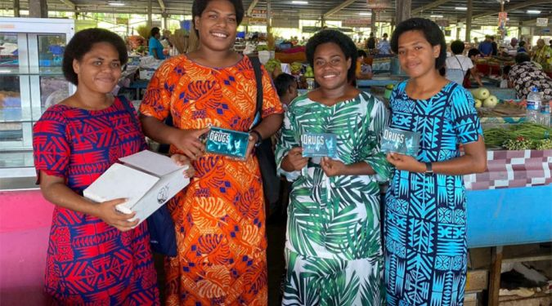
Priority 3
COMMUNITY LEADERSHIP IN THE HIV RESPONSE
Results area 8
Strengthen community leadership
Institutionalize and formally designate community representation (including of people living with HIV, key populations, women and young people) in coordination and decision-making mechanisms
Formally recognize and institutionalise the important roles of communities in co-developing policy guidance
Reform policies and regulatory frameworks to ensure communities can participate in all levels of the response
Resource all components of community responses to HIV
Enact effective social contracting mechanisms
Sustain and scale-up community-led service delivery systems.
Enable and resource community-led monitoring (CLM) and research.
Support youth leadership in the HIV response
Capacity-strengthening, resilience and preparedness of community-led organizations and service providers
Support community engagement in the sustainability planning processes, and support the integration of community services and advocacy as part of national systems, including the establishment or expansion of social contracting
Notes:
Under priority 3 – the recommendations from the community consultations propose how to better integrate community-led systems into national responses while promoting the key role of communities for leadership, service delivery and accountability. Ensuring mechanisms for social contracting and monitoring the funding for communities are part of the concrete actions that can ensure this is translated into a reality.

Slide 18
16 top-line targets to end AIDS as a public health threat by 2030 and ensure sustainability of the HIV response after 2030
Ensure available accessible, acceptable and high-quality HIV treatment and care for people living with HIV
95% of people living with HIV know their HIV status
95% of people living with HIV know their HIV status receive treatment
95% of people living with HIV who are on treatment have a suppressed viral load
By 2030, reduce new HIV infections by 90% from 2010 and continued 5% decline per year after 2030
……..
Reduce AIDS-related deaths by 90% from 2010
……..
Ensure sustainability of the HIV response after 2030
Scale up HIV prevention options that bring together biomedical, structural and behavioral interventions
90% of people in need of prevention use prevention options(PrEP, PEP, condoms, needle-syringe programmes, opioid against maintenance therapy)
End stigma and discrimination and uphold human rights and gender equality in the HIV response
<10% of people living with HIV and people from key and vulnerable populations experience stigma and discrimination
<10% experience gender inequality or violence
<10% of countries have punitive legal and policy environment that restrict access to services
Ensure community leadership in the HIV response
Community led-organizations deliver 30% of testing and treatment support services
Community led-organizations deliver 80% of prevention options
Community led-organizations deliver 60% of social enabler progammes
95% of people receiving HIV Prevention or treatment services also receive needed sexual and reproductive health services(including for sexually transmitted infections)
95% of pregnant women living with HIV and their newborns receive maternal and newborn care that integrates or links to comprehensive HIV services, including for prevention of HIV and hepatitis B virus and treatment of syphilis
Integrate HIV services, with primary health care, broader health systems and other sectors
Ensure sustainable financing for person-centered national and global HIV responses
Reduce out-of-pocket expenses for HIV in line with universal health coverage
Increase percentage of HIV expenditure that is domestic
US$21.9 billion mobilized for HIV investments for low-and middle -income countries
All countries have access to equitable pricing for diagnostics and therapeutics
The targets will be disaggregated as appropriate be gender, age and key population
PEP: post-exposure prophylaxis PrEP: pre-exposure prophylaxis
Notes:
What will the Strategy enable us to achieve? The actions recommended in the Strategy are aimed at enabling countries to achieve the 16 top-line targets towards ending AIDS as a public health threat by 2030.
Some of these targets are new – the consolidated HIV prevention target, the integration and financing targets.
Whereas some are proposed to be extended – the 95’s, the 10’s and the 30-80-60 as these were not achieved in 2025.

Slide 19
The foundation of the Global AIDS Strategy 2026-2031
40
MILLION
PEOPLE
20
MILLION
PEOPLE
40 + 20 goals: global HIV treatment and prevention targets for 2030
BY 2030
Accessing antiretroviral medicine-based HIV prevention options
On HIV treatment and with viral suppression
ALL WITH STIGMA- AND DISCRIMINATION-FREE CARE
Source: Global AIDS Strategy 2026-2031
Notes:
In short, the Global AIDS strategy aims to reach people either with the HIV treatment or the HIV prevention services that they need, all within a safe and supportive environment. Our global goal to end AIDS can be translated that by 2030:
40 million people living with HIV are on treatment and virally suppressed
20 million people have access to ARV-based HIV prevention options
All with stigma and discrimination-free care

Slide 20
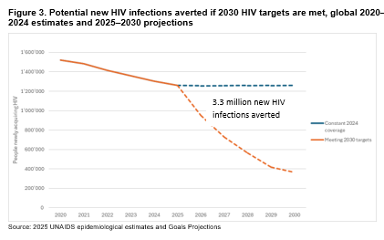
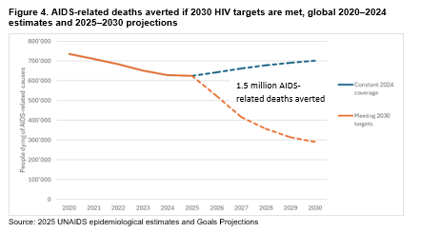
Reaching the 2030 targets will save millions of lives
Achieving 2030 targets could avert 3.3 million new HIV infections and 1.5 million AIDS-related deaths (2025–2030)
Source: UNAIDS 2025 estimates and Projections from April 2025 using Avenir Health Goals Model.
Notes:
Ending AIDS as a public health threat, or “ending AIDS” in short, is defined as a 90% reduction in both the number of people newly acquiring HIV and the number of people dying of an AIDS-related cause from the 2010 estimates. Achieving the proposed 2030 HIV targets will bring most countries in reach of this goal.
This means bridging current gaps in services and enabling environments, which will avert 3.3 million infections and 1.5 million AIDS-related deaths between 2025 and 2030.

Slide 21
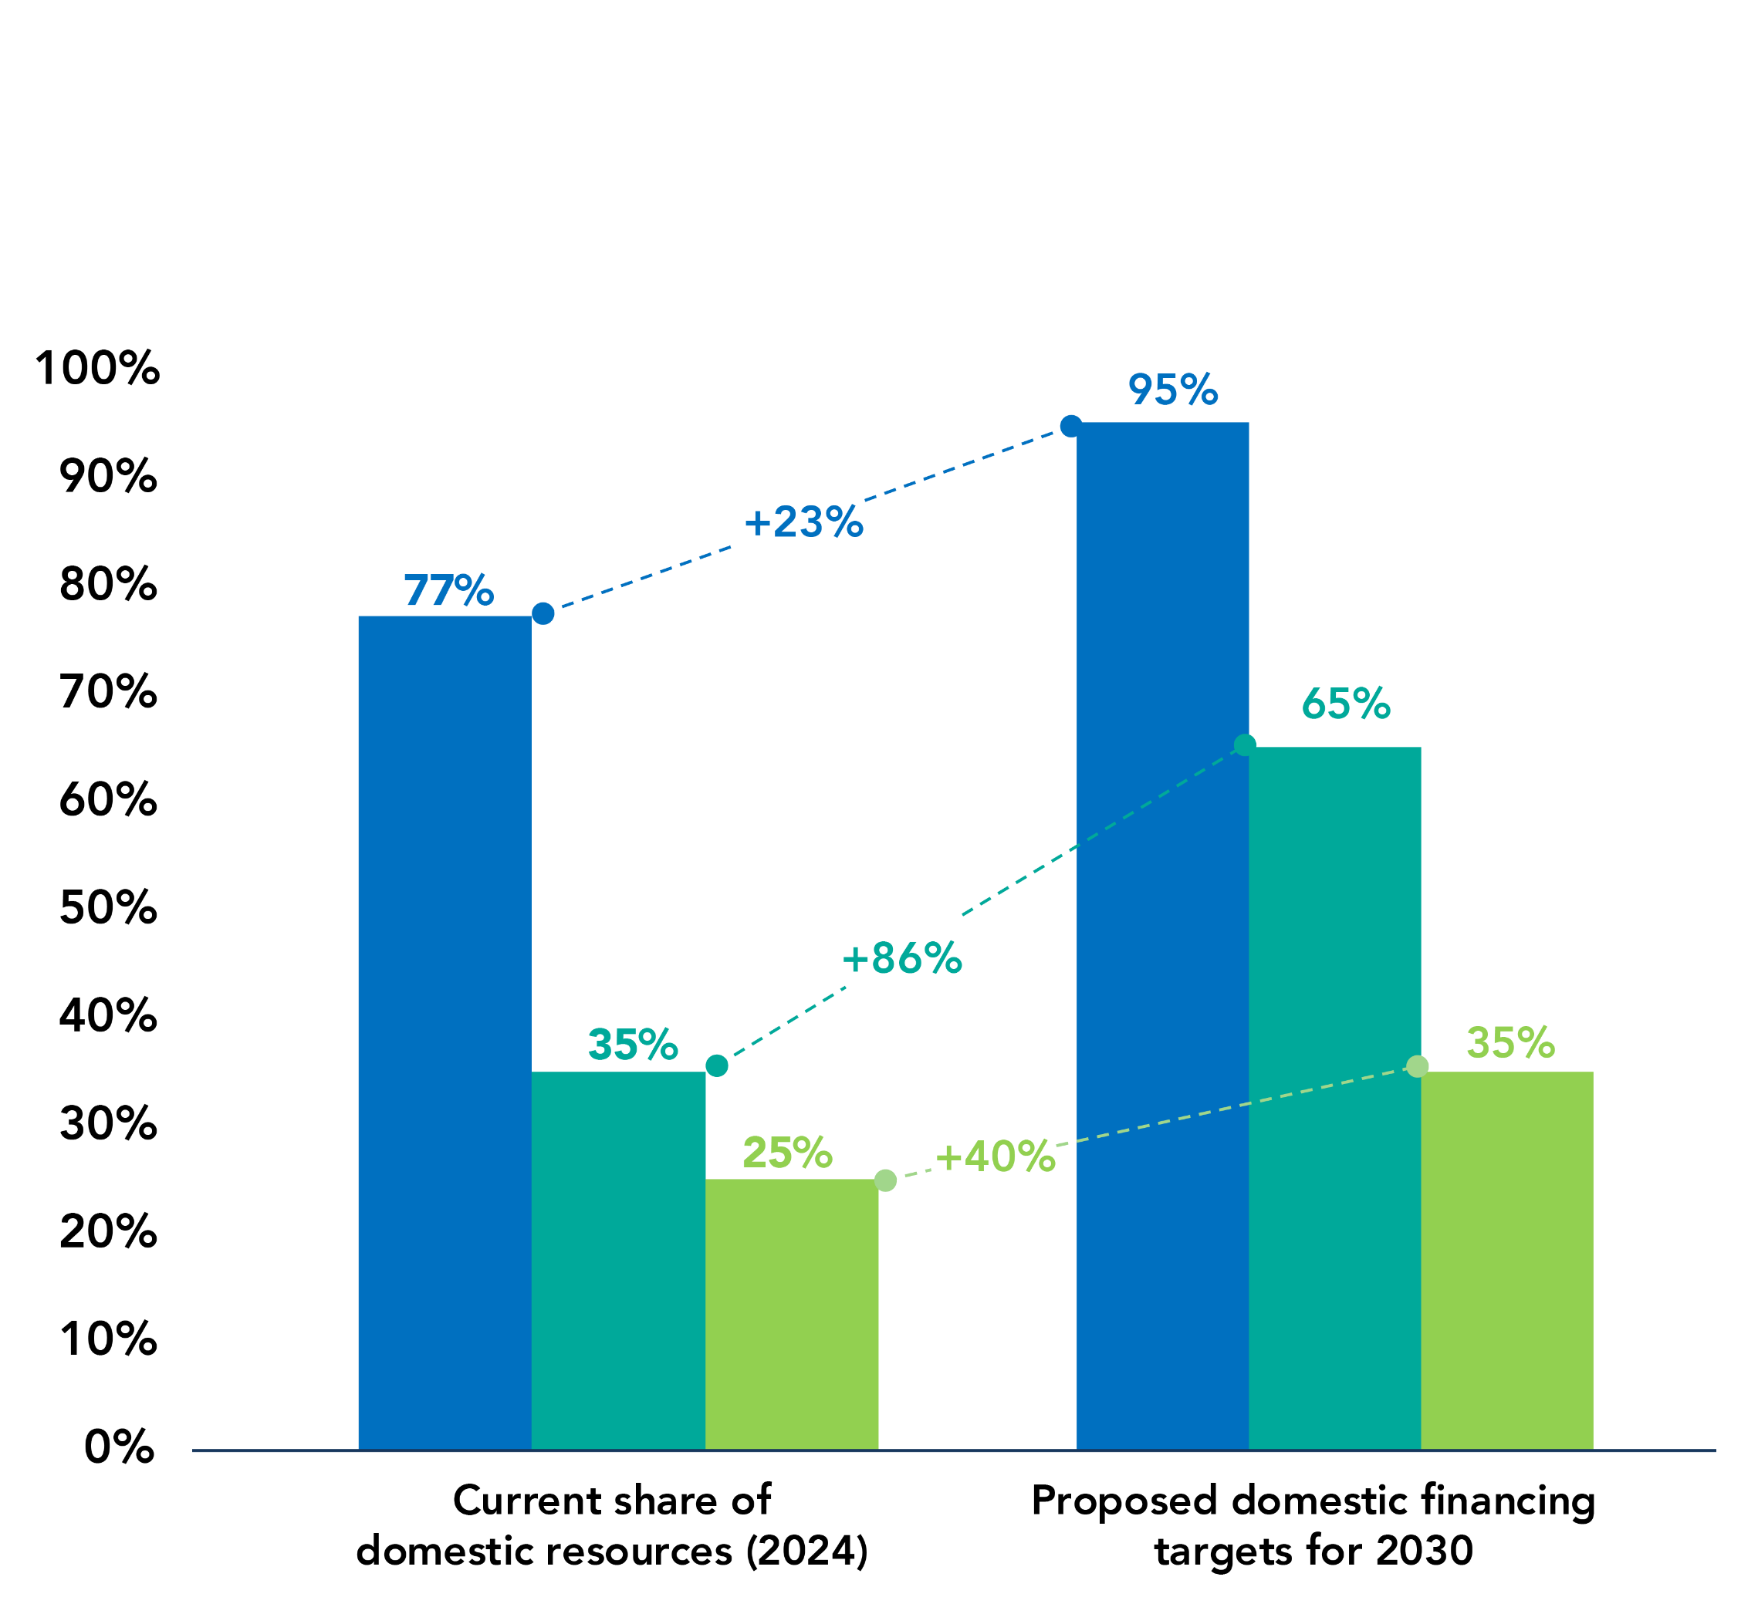
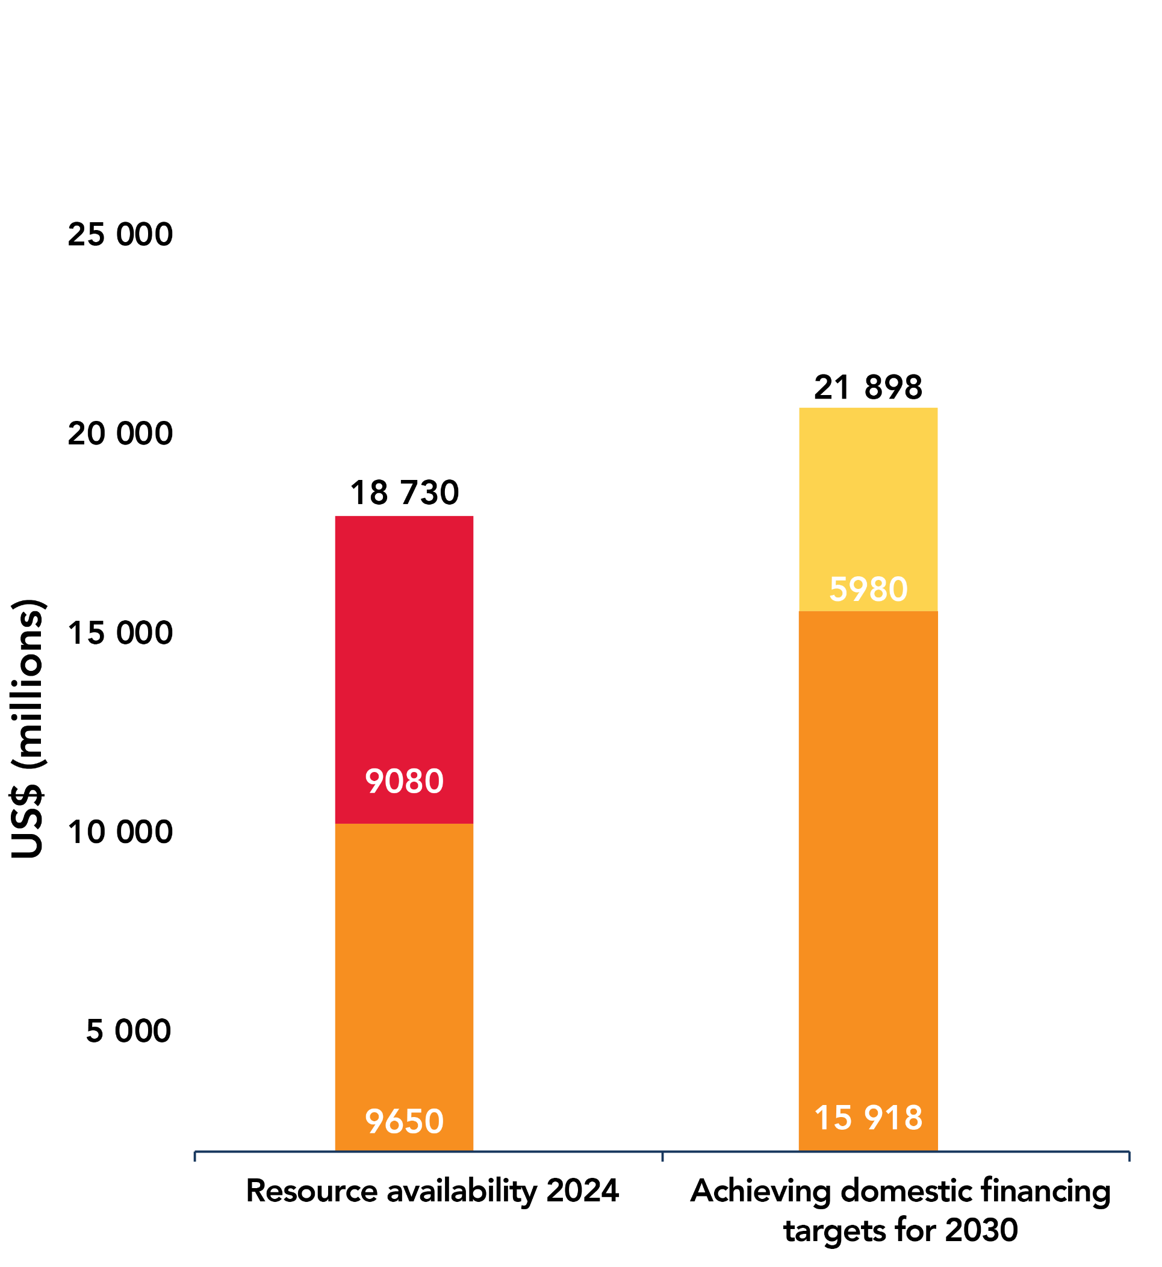
How much does it cost to achieve the 2030 targets?
Figure 5. Estimated HIV resources available in low- and middle-income countries in 2024, estimated resource needs in 2030, and scenario in which domestic HIV financing targets are met
Current share of domestic resources and proposed domestic financing targets for 2030 in low-, lower-middle-and upper-middle-income countries
Estimated HIV resources available in low-and middle-income
countries in 2024 and estimated needs for 2030
UNAIDS estimates that US$ 21.9 billion needed annually until 2030 to achieve global HIV targets in LMICs.
This is reduction by 7.4 bn from the earlier 2021 estimate of US$ 29.3 billion to reach 2025 targets
LMICs face a $3.2 billion shortfall, a 14.6% funding gap compared to the annual resources needed to achieve the 2030 target.
The most annual resource needs in 2030 will be in upper-middle-income countries(46%) compared to 34% in lower-middle-income, and 20% in low-income.
Upper-middle income countries
Lower-middle income countries
Low-income countries
Domestic
International
Unmet resource need
Note: the domestic financing targets reflect the average share of domestic resources across different income groups by 2030. Within each group—particularly among lower-middle-income and low-income countries—there is significant variation in disease burden and fiscal capacity across countries. These targets aim to encourage greater domestic ownership at the national level for a collective increase across each of the income groups.
Source: UNAIDS financial estimates, July 2025.
Notes:
UNAIDS estimates that US$ 21.9 billion will be needed annually until 2030 to achieve global HIV targets in low- and middle-income countries.
This is reduction by $7.4 bn from the earlier 2021 estimate of US$ 29.3 billion to reach 2025 targets
In 2024, LMICs faced a $3.2 billion shortfall, a 14.6% funding gap compared to the annual resources needed to achieve the 2030 target. This gap is likely to increase with the funding cuts announced in 2025.
The highest annual resource needs in 2030 will be in upper-middle-income countries 46% compared to 34% in lower-middle-income, and 20% in low-income.

Slide 22


Accounting for regional specificity for people living with, affected by or at risk of HIV
Caribbean
Progress: 21% drop in new HIV acquisitions; 62% drop in AIDS-related deaths, 18 countries validated for EMTCT.
Challenges: One of the highest prevalence outside of Africa (esp. Haiti), youth vulnerability, stigma, heavy reliance on external aid especially for HIV prevention
Priorities: Financial sustainability, climate-resilient systems, HIV prevention, youth-led services, and community leadership and monitoring.
Focus: Reduce transmission of HIV and other STIs, reduce stigma and discrimination and expand and improve treatment services
Asia Pacific
Progress: 17% drop in new HIV infections and 53% decline in AIDS-related deaths since 2010
Challenges: Second-largest HIV epidemic; low PrEP uptake; treatment gaps; stigma. Despite increase in domestic financing, reliance on external support for prevention
Priorities: Adequate financing, strengthen health systems, integrate services, scale up HIV prevention and treatment, reach key populations and champion community leadership
Focus: Digital systems, youth education, and legal reform.
Notes:
The PCB asked us to provide regional specificity and through regional and country consultations, eight regional chapters are included. These highlight the differences in regional epidemic and financial contexts but also how the Global AIDS Strategy is relevant and can be taken forward in every region.
Asia Pacific has the second largest epidemic globally, largely driven by new HIV acquisitions among key populations. It is also very advanced when it comes to sustainability and integration of services. Priorities for the future include a strong focus on HIV prevention for people most at risk, and young people.
The Caribbean region has made tremendous strides in eliminating vertical transmission and lifting some criminalizing laws. Young people and key population remain very vulnerable, and violence is an exacerbating factor. Priorities include improving sustainability and access to people-centered services.

Slide 23
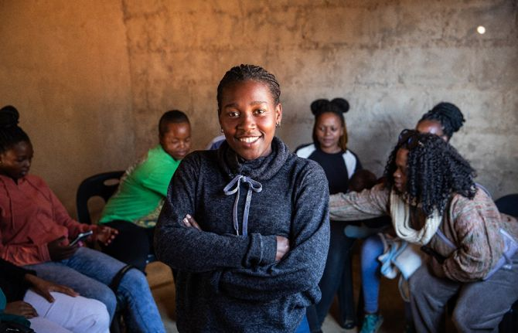

Accounting for regional specificity for people living with, affected by or at risk of HIV
Eastern Europe and Central Asia
Progress: Strong community leadership and growing regional collaboration.
Challenges: Rising HIV acquisitions and deaths; weak treatment cascade; shrinking civic space; punitive legislation; criminalization of key populations.
Priorities: Emergency and sustainable financing; humanitarian coordination and cross-border care; combination prevention; integrated, stigma-free service delivery; linkage and retention; equitable prison healthcare; legal reform; civic-space protection.
Focus: Institutionalizing community-led responses and data systems.
Eastern and Southern Africa
Progress: High testing and treatment coverage; 95-95-95 targets nearly met. Region included more than half of all people living with HIV.
Challenges: Funding cuts especially for prevention, low paediatric coverage, gender inequality, reach key populations with discrimination-free services
Priorities: Integrated services, HIV testing, treatment and care, youth and KP centered strategies, gender equality, and institutionalise community-leadership.
Focus: Sustainable financing, ending inequalities
Notes:
Eastern and Southern Africa is the region most affected by HIV, and also the region where the highest investments have been made resulting in great gains in the response, nearly reaching the 95 targets in a number of countries. These gains must be protected and built upon, HIV prevention requires sustained investment, while more effort is needed to bridge inequalities and reach those being left behind.
Eastern Europe and central Asia is one of the few regions in the world where new HIV infections are still on the rise. The epidemic is fueled by persistent inequities in access to services for key populations amid punitive laws affecting key populations. The Strategy sets out clear evidence-informed recommendations to address this growing epidemic.

Slide 24
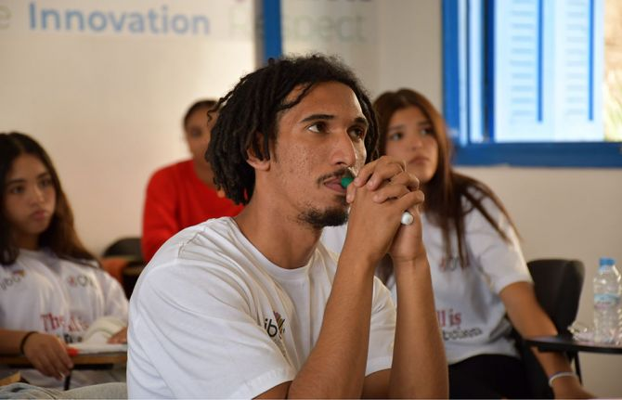
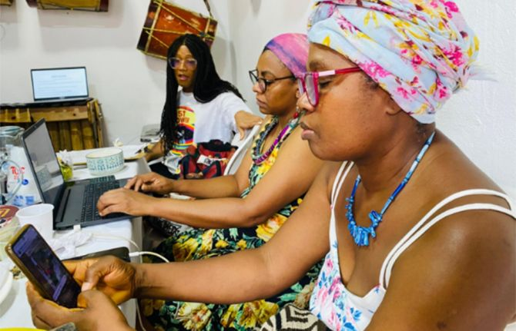
Accounting for regional specificity for people living with, affected by or at risk of HIV
Middle East and North Africa
Progress: Low prevalence rate overall – 2% of new HIV infections globally
Challenges: 94% increase in new HIV acquisitions; criminalization of key populations.
Priorities: Financing, humanitarian integration, data systems, and legal reform.
Focus: Youth access, stigma-free care, and community workforce development.
Latin America
Progress: Sustainable financing, community leadership,
Challenges: Rising HIV acquisitions (13%); youth and marginalized populations most affected, equitable access to commodities
Priorities: Domestic financing, integrated health systems, stigma reduction, and rights-based access for hard-to-reach people living with, at risk of, or affected by HIV
Focus: Prevention, sustainability, anti discrimination efforts, community leadership.
Notes:
Latin America has been a leader in the HIV response, especially when it comes to sustainability, integration, community leadership and lifting societal barriers. Ensuring HIV services reach the most marginalized remains a priority as well as ensuring equitable access to medicines and innovations.
The Middle East and North Africa has historically had a lower HIV prevalence rate however new HIV infections are rising due to lack of people-centered services for those most at risk of HIV and societal barriers.

Slide 25

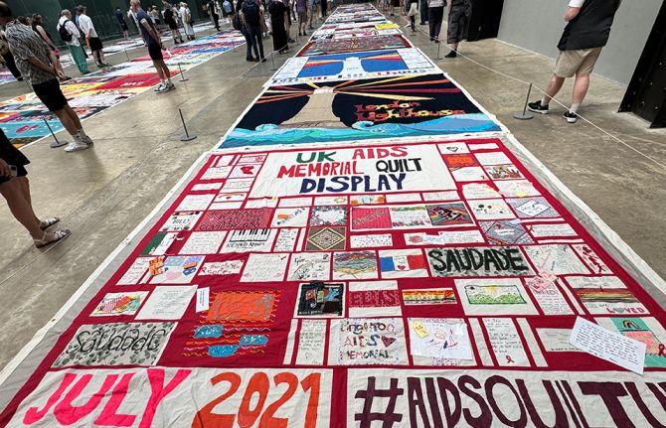
Accounting for regional specificity for people living with, affected by or at risk of HIV
Western and Central Europe & North America
Progress: Decline in acquisitions and deaths; aging population of people of living with HIV.
Challenges: Persistent stigma, criminalization, and health disparities.
Priorities: Long-term care for people living with HIV, digital tools, equity-driven data, and community engagement.
Focus: Integrated care, social determinants, and legal reform.
Western and Central Africa
Progress: Progress on reaching 95 targets
Challenges: High acquisition rates among women and youth; low paediatric treatment; fragile systems overall.
Priorities: Domestic financing, integrated services, local data use, and stigma reduction.
Focus: Community health centers, legal literacy, and youth-led initiatives.
Notes:
Western and central Africa is one of the regions with the highest burden of HIV. Progress needs to be sustained with increased domestic investments, systems strengthening overall, not only for HIV, and addressing rising inequalities and societal barriers.
The HIV response is a global one and ending AIDS can be achieved in every region. The HIV epidemic in Western and central Europe and North America is not over and action is needed to ensure integrated long-term care for people living with HIV and to reduce stigma and discrimination.

Slide 26


Partnerships for Progress: Local, Regional and Multilateral Actions to End AIDS
Local Action for Greater Impact
Regionalism and the Global Response to HIV
Inclusive Multilateralism and the Global Response to HIV
The role of the Joint Programme in support to the Global AIDS Strategy
Notes:
As we have shown, country and community leadership are central to the strategy. But a number of other actors will play a critical role. The strategy highlights :
The role of the sub-national level. Local authorities have a critical role to play in securing the multisectorality – working across health, education, police and other sectors such as for the prison populations or in supporting migrant and refugee populations with services
Regional organizations such as the African Union, the Caribbean Community or the Association of Southeast Asian Nations are critical actors for the sustainability of the global HIV response. The Strategy highlights how regional institutions can support domestic financing, local production and south-south cooperation and support civil society.
Targets, accountability and international standards for the response to HIV are developed at the global level. Multilateral action is also necessary to ensure sustainable financing; advance normative guidance and international standards; convene actors in the global response towards collective action; increase access to new biomedical tools; and guide science and research.
The Strategy highlights in brief the role of the Joint Programme on HIV with some of the key roles that together the UN organizations play in support to the AIDS response

Slide 27

UNAIDS Global Accountability System for HIV
Routine Monitoring of Country Progress Against Targets
2026 HLM and political declaration, country NSPs
Set 2030 Global AIDS Targets
Develop 2026-2031 Global AIDS Strategy
Notes:
The Joint Programme supports accountability for the HIV response to ensure that everyone is served. This is done through a four-pronged approach: beginning with the Global AIDS target setting, which is then translated into the Global AIDS Strategy that we are presenting today. The Strategy leads to the high-level meeting and Political Declaration, which then feeds into the development of national strategic plans (NSPs) at country-level. UNAIDS works together with countries and communities to monitor the targets – this is the UN’s responsibility and promise to those living with and affected by HIV.

Slide 28

Global AIDS Strategy 2026-2031 Timeline
April 2025
Multi-stakeholder consultation
October 2025
Multi-stakeholder consultation
PHASE 1:
SCOPING AND STAKEHOLDERS
PHASE 3:
PRIORITIZATION
AND CRITERIA
PHASE 5:
WRITING
Structuring of consultations into thematic areas
Process
Mapping
June ’26
High-level
meeting
Situation analysis & Proposed solutions
Outline of Strategy to PCB
PHASE 2:
DEFINING PROBLEMS AND SOLUTIONS
PHASE 4:
DISCUSSION AND GUIDANCE
PHASE 6:
ADOPTION
June ‘25
PCB
Dec ‘25
PCB
EXPERT INPUT (REGIONS, CSOs, COUNTRIES, NAY-SAYERS, ACADEMICS)
STAKEHOLDER/PARTNER ENGAGEMENT
COMMUNICATION - ONLINE ENGAGEMENT - SURVEY, CAMPAIGN
2024
2025
2026
Notes:
We are at a critical milestone at the end of a year of consultations and collaboration. The Strategy will serve as the basis for the 2026 Political Declaration on Ending AIDS that will be taken to the 2026 High level meeting on AIDS in June next year.

Slide 29

THANK YOU!
We thank all of you for your contributions

