Slide 1

GLOBAL AIDS WORLD AIDS DAY REPORT | 2020
PREVAILING AGAINST PANDEMICS
BY PUTTING PEOPLE AT THE CENTRE

Slide 2
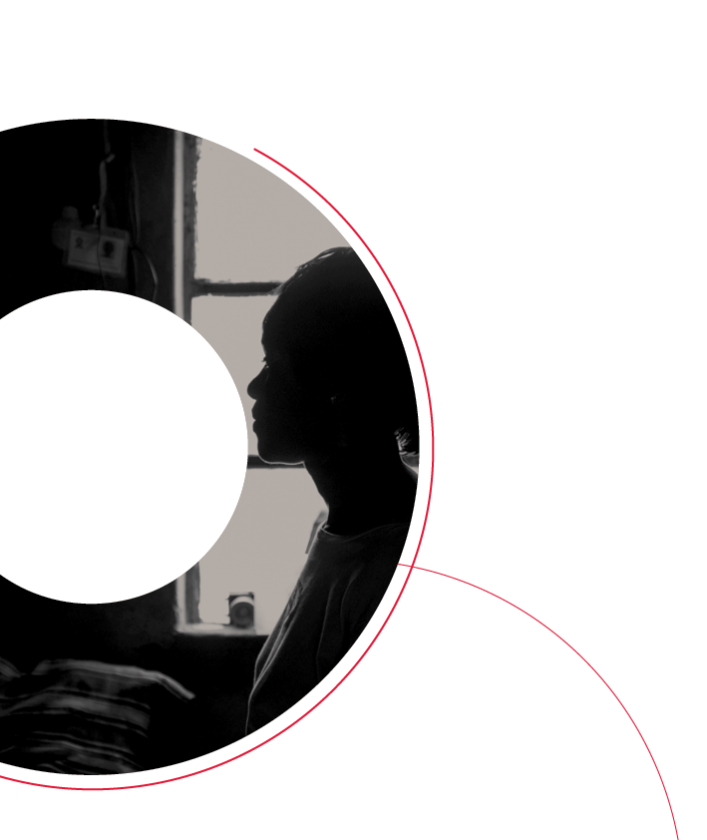
GLOBAL AIDS WORLD AIDS DAY REPORT | 2020
INTRODUCTION
AND SUMMARY

Slide 3

Top-line targets for 2025
95%
Less than
10%
use combination prevention
90%
of countries have
95%
95%
of people living
punitive laws
of women access HIV and sexual and reproductive health services
with HIV and
and policies
of PLHIV know
their HIV status
people at risk are
linked to
Less than
PEOPLE LIVING WITH HIV AND COMMUNITIES AT RISK AT THE CENTRE
people-centred
10%
and
context-specific
experience
integrated
stigma and
95%
services
discrimination
95%
Less than
coverage of
services for eliminating vertical
transmission
of PLHIV who know their status initiate treatment
10%
experience
95%
gender inequality
on treatment are virally suppressed
and violence

Slide 4
Projected impact of reaching the 2025 targets
HIV infections
2 500 000
UNAIDS epidemiological
estimates of progress
until the end of 2019
Projected impact of
scaling up and achieving
the 2025 targets
Projected impact of
maintaining 2025 targets
during 2026–2030
2 000 000
Number
of new HIV infections
1 500 000
1 000 000
Asia and the Pacific
500 000
Eastern Europe and central Asia
Eastern and southern Africa
2010
2011
2012
2013
2014
2015
2016
2017
2018
2019
2020
2021
2022
2023
2024
2025
2026
2027
2028
2029
2030
Latin America and the Caribbean
Middle East and North Africa
AIDS-related deaths
Western and central Africa
1 200 000
UNAIDS epidemiological
estimates of progress
until the end of 2019
Projected impact of
scaling up and achieving
the 2025 targets
Projected impact of
maintaining 2025 targets
during 2026–2030
Western and central Europe and North America
Total
1 000 000
800 000
Number of AIDS-related deaths
600 000
400 000
Source: Special analysis by Avenir Health using 2025 targets and UNAIDS epidemiological estimates, 2020 (https://aidsinfo.unaids.org/) (see annex on methods).
200 000
2010
2011
2012
2013
2014
2015
2016
2017
2018
2019
2020
2021
2022
2023
2024
2025
2026
2027
2028
2029
2030

Slide 5
Number of people living with HIV accessing antiretroviral therapy,
global, 2010–June 2020 and end–2020 target
2020 target
30
25
20
Number of people (millions)
26 million people
on HIV treatment
worldwide in
June 2020
13
10
5
0
2010
2011
2012
2013
2014
2015
2016
2017
2018
2019
Jun.
2020
Dec.
2020
Number of people living with HIV on antiretroviral therapy
Source: UNAIDS 2020 estimates; UNAIDS Global AIDS Monitoring, 2020 (https://aidsinfo.unaids.org/); UNAIDS/WHO/UNICEF HIV services tracking tool, November 2020.

Slide 6

GLOBAL AIDS WORLD AIDS DAY REPORT | 2020
THE FAST-TRACK
LEGACY—SUCCESSES
AND SHORTCOMINGS

Slide 7
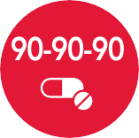




Fast-Track commitments for 2020
2020 TARGETS MISSED
IMPACT-LEVEL MILESTONES
To reduce new HIV infections to fewer than 500 000 by 2020
To reduce AIDS-related deaths to fewer than 500 000 by 2020
To eliminate HIV-related stigma and discrimination by 2020
10 COMMITMENTS
1
2
3
4
5
Ensure that 30 million people living with HIV
have access to treatment through meeting the
90–90–90 targets by 2020.
Eliminate new HIV infections among children by 2020 while ensuring that 1.6 million children have access to HIV treatment by 2018 and
1.4 million by 2020.
Ensure access to combination prevention
options, including preexposure prophylaxis,
voluntary medical male circumcision, harm
reduction and condoms, to at least 90% of people by 2020, especially young women and adolescent girls in high HIV-prevalence countries and key populations—gay men and other men who have sex with men, transgender people, sex workers and their clients, people who inject drugs and prisoners.
Eliminate gender inequalities and end all forms of violence and discrimination against women and girls, people living with HIV and key populations by 2020.
Ensure that 90% of young people have the skills, knowledge and capacity to protect themselves from HIV and that they access to sexual and reproductive health services by 2020, in order to reduce the number of new HIV infections among adolescent girls
and young women to below 100 000 per year.
6
7
8
9
10
Ensure that 75% of people living with, at risk of and affected by HIV benefit from HIV-sensitive social protection by 2020.
Ensure that at least 30% of all service delivery is community-led by 2020.
Ensure that HIV investments increase to
US$ 26 billion by 2020, including a quarter for
HIV prevention and 6% for social enablers.
Empower people living with, at risk of and affected by HIV to know their rights and to access justice and legal services to prevent and challenge violations of human rights.
Commit to taking AIDS out of isolation through people-centred systems to improve universal health coverage, including treatment for tuberculosis, cervical cancer and hepatitis B and C.

Slide 8
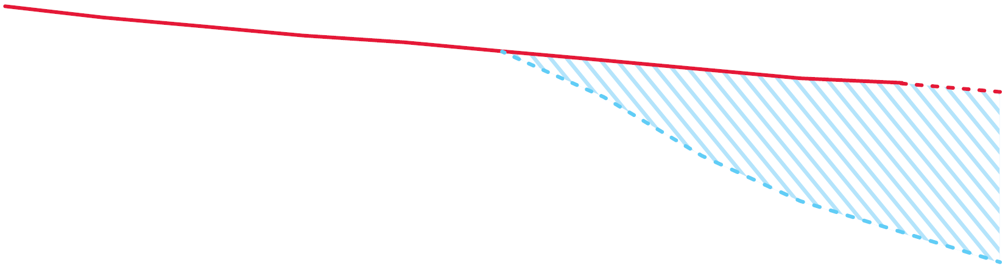
New HIV infections projected through 2020, and modelled prediction
resulting from Fast-Track interventions, global, 2010–2020
2 500 000
3.5 million more new infections
from 2015 to 2020 than if the Fast-Track
objectives had been met
2 000 000
1 500 000
Number
of new
infections
1 000 000
500 000
0
2010
2011
2012
2013
2014
2015
2016
2017
2018
2019
2020
Actual trend
Projected
Fast-Track
Source: Special analysis by Avenir Health using UNAIDS epidemiological estimates, 2020 (see https://aidsinfo.unaids.org/).

Slide 9
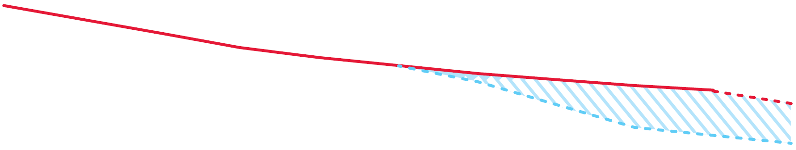
AIDS-related deaths projected through 2020, and modelled prediction
resulting from Fast-Track interventions, global, 2010–2020
1 400 000
820 000 more deaths from
2015 to 2020 than if the Fast-Track
objectives had been met
1 200 000
1 000 000
800 000
Number
of deaths
600 000
400 000
200 000
0
2010
2011
2012
2013
2014
2015
2016
2017
2018
2019
2020
Note: Methods for the estimation of AIDS-related mortality have been improved since 2016. As a result, the most recent estimates for AIDS-related mortality (orange line) are lower before 2016 than the estimates that were used to calculate the 2020 targets (green dotted line).
Actual trend
Projected
Fast-Track
Source: Special analysis by Avenir Health using UNAIDS epidemiological estimates, 2020 (see https://aidsinfo.unaids.org/).

Slide 10
Percentage change in HIV incidence among key populations, global, 2010–2019
40
+25%
20
+5%
0
-7%
-5%
Change in incidence, per cent
-20
-40
-60
2020 target = 75% reduction
-80
-100
Female sex workers
People who inject drugs
Gay men and
other men who have sex with
men
Transgender people
Source: UNAIDS special analysis of available key population data, 2020.

Slide 11
Percent of people living with HIV who experienced different forms of discrimination
in health-care settings, countries with available data, 2013–2018
Greece
Ability to obtain antiretroviral therapy conditional on the use of certain forms of contraception
Kyrgyzstan
Congo
Kazakhstan
Health-care professional has ever told other people about their HIV status without their consent
Tajikistan
Burundi
Forced to submit to a medical or health procedure (including HIV testing) because of their HIV status in the past 12 months
Côte d'Ivoire
Costa Rica
South Korea
Denied health services because of their HIV status at least once in the last 12 months
Peru
Honduras
Malawi
Zimbabwe
0
5
10
15
20
25
30
35
40
45
50
Per cent
Source: People Living with HIV Stigma Index surveys, 2013–2018.

Slide 12
HIV testing and treatment cascade, global, 2015–2019
100
90
80
70
60
Per cent
50
40
30
20
10
71
74
77
79
81
49
54
59
62
67
41
46
51
54
59
0
People living with HIV
who know their status
People living with HIV
who are on treatment
People living with HIV
who are virally suppressed
2015
2016
2017
2018
2019
Source: UNAIDS special analysis, 2020 (see annex on methods).

Slide 13
Major gaps towards HIV prevention coverage targets
(28 Global HIV Prevention Coalition countries, unless otherwise indicated), 2018–2019
2020 commitments made by the United Nations General Assembly in 2016 | Indicator (date of assessment) | Progress achieved by end-2019
90% of adolescent girls and young women in high prevalence setting have access to comprehensive prevention services | % of high-incidence locations covered with comprehensive programmes for adolescent girls and young women | 41%
90% of key populations everywhere have access to comprehensive prevention services | % of key populations who reported receiving at least two prevention services in the past three months | Sex workers: 44% Gay/MSM: 30% People who inject drugs: 34%
20 billion condoms per year are made available in low- and middle-income countries | % of condom distribution need met | 59%
An additional 25 million young men are voluntarily medically circumcised in 15 countries in Africa between 2016 and 2020 | % of VMMC target achieved | 15 million VMMCs (cumulative since 2016)
3 million people at high risk access PrEP | Number of people on PrEP (global data) | 590 000
Source: Global HIV Prevention Coalition special analysis of Global AIDS Monitoring data, 2019 and 2020 (see https://aidsinfo.unaids.org/), and other programmatic data reported by countries
through the Global HIV Prevention Coalition.

Slide 14
Resource availability and key funding sources for HIV in low- and middle-income countries, 2000–2019, with 2020 resource needs target
28
Resource availability (billion US dollars)
23
18
13
8
3
2000
2001
2002
2003
2004
2005
2006
2007
2008
2009
2010
2011
2012
2013
2014
2015
2016
2017
2018
2019
2020
Domestic (public and private)
United States (bilateral)
Global Fund
Other international
Resource needs target
Source: UNAIDS financial estimates, July 2020 (see http://hivfinancial.unaids.org/hivfinancialdashboards.html).
Note: Constant 2016 US dollars.

Slide 15

GLOBAL AIDS WORLD AIDS DAY REPORT | 2020
RESPONDING TO AND
LEARNING FROM
COVID-19

Slide 16
Change in the number of people currently on antiretroviral therapy per month, compared to baseline, selected countries, 2020
10
5
Percent
change
0
-5
-10
-15
Haiti
Botswana
Dominican
Republic
Peru
South Africa
March
April
May
June
July
August
September
25
countries reported
sufficient monthly
data to analyze trends
16
countries did not
experience
disruptions
3
countries experienced
disruptions of at least one month and then fully rebounded
6
countries experienced
more sustained
disruptions
Source: UNAIDS/WHO/UNICEF HIV services tracking tool, November 2020.
Note: The baseline is the average of January and February reports.
Note: Selected countries fulfilled the following criteria: (a) provided data for January and February 2020; (b) reported on at least 50 people receiving services in January; (c) had at least 50%
of facilities reporting during the month; and (d) had at least six months of data.

Slide 17
Change in the number of HIV tests and results returned per month,
compared to baseline, selected countries, 2020
40
20
0
Percent
change
-20
-40
-60
-80
-100
Rwanda
Uganda
South Africa
Sierra Leone
Lesotho
March
April
May
June
July
August
September
19
countries reported
sufficient monthly
data to analyze trends
1
country did not
experience
disruptions
2
countries experienced
disruptions and then fully rebounded by September
16
countries
experienced sustained disruptions
Source: UNAIDS/WHO/UNICEF HIV services tracking tool, November 2020.
Note: The baseline is the average of January and February reports
Note: Selected countries fulfilled the following criteria: (a) provided data for January and February 2020; (b) reported on at least 50 people receiving services in January; (c) had at least 50%
of facilities reporting during the month; and (d) had at least six months of data.

Slide 18
Change in the number of people newly initiating antiretroviral therapy per month, compared to baseline, selected countries, 2020
100
80
60
40
Percent
change
20
0
-20
-40
-60
Jamaica
Nigeria
Rwanda
Mozambique
Cameroon
Sierra Leone
Botswana
March
April
May
June
July
August
September
28
countries reported
sufficient monthly
data to analyze trends
1
country did not
experience
disruptions
6
countries experienced
disruptions and then fully rebounded
21
countries experienced
more sustained
disruptions
Source: UNAIDS/WHO/UNICEF HIV services tracking tool, November 2020.
Note: The baseline is the average of January and February reports.
Note: Selected countries fulfilled the following criteria: (a) provided data for January and February 2020; (b) reported on at least 50 people receiving services in January; (c) had at least 50%
of facilities reporting during the month; and (d) had at least six months of data.

Slide 19
Change in the number of pregnant women tested for HIV per month,
compared to baseline, selected countries, 2020
15
10
5
0
Percent
change
-5
-10
-15
-20
-25
-30
-35
Cambodia
Ethiopia
Kenya
Lesotho
South Africa
Uganda
March
April
May
June
July
August
September
13
countries reported
sufficient monthly
data to analyze trends
1
country did not
experience
disruptions
6
countries experienced
disruptions and then fully rebounded by September
6
countries
experienced
sustained disruptions
Source: UNAIDS/WHO/UNICEF HIV services tracking tool, November 2020.
Note: The baseline is the average of January and February reports.
Note: The six countries selected were among 13 that fulfilled the following criteria: (a) had data for January 2020; (b) had more than 50 pregnant women in January data; (c) had more than 50%
of facilities reporting or data from 50% of estimated births; and (d) had at least six months of data.

Slide 20
Change in the number of pregnant women receiving antiretroviral therapy during pregnancy per month, compared to baseline, selected countries, 2020
20
10
0
Percent
change
-10
-20
-30
-40
-50
-60
Rwanda
Lesotho
Zimbabwe
Kenya
South Africa
March
April
May
June
July
August
September
10
countries reported
sufficient monthly
data to analyze trends
1
country did not
experience
disruptions
3
countries experienced
disruptions and then fully rebounded by September
6
countries
experienced sustained disruptions
Source: UNAIDS/WHO/UNICEF HIV services tracking tool, November 2020.
Note: The baseline is the average of January and February reports.
Note: Selected countries fulfilled the following criteria: (a) provided data for January 2020; (b) reported on at least 50 pregnant women living with HIV in January; (c) had at least 50%
of facilities reporting, or data from 50% of pregnant women living with HIV; and (d) had at least six months of data.

Slide 21
Change in the number of gay men and other men who have sex with men reached by HIV interventions per month, compared to baseline, selected countries, 2020
150
100
Percent
change
50
-0
-50
-100
Cambodia
Jamaica
Kenya
South Africa
Honduras
Togo
March
April
May
June
July
August
September
16
countries reported
sufficient monthly
data to analyze trends
2
countries did not
experience
disruptions
4
countries experienced
disruptions and then rebounded
4
countries experienced sustained disruptions through the last reported month
Source: UNAIDS/WHO/UNICEF HIV services tracking tool, November 2020.
Note: The baseline is the average of January and February reports.
Note: The six countries selected were among 13 that fulfilled the following criteria: (a) provided data for January 2020; (b) had no significant change in the number of facilities reporting;
(c) provided monthly, not cumulative, data; and (d) had at least six months of data.

Slide 22
Change in the number of people who inject drugs receiving opioid substitution therapy per month, compared to baseline, selected countries, 2020
10
5
Percent
change
0
-5
-10
-15
Indonesia
Myanmar
Armenia
Kazakhstan
March
April
May
June
July
8
countries reported
sufficient monthly
data to analyze trends
7
countries did not
experience significant
disruptions
1
country experienced sustained disruptions through the last
reported month
Source: UNAIDS/WHO/UNICEF HIV services tracking tool, November 2020.
Note: The baseline is the average of January and February reports.
Note: Selected countries fulfilled the following criteria: (a) provided data for January 2020; (b) had no significant change in the number of facilities reporting; (c) provided monthly,
not cumulative, data; and (d) had at least six months of data.

Slide 23
Modelled projection of new HIV infections and AIDS-related deaths in three different scenarios of disruption associated with the COVID-19 pandemic, global, 2019–2025
New HIV infections
AIDS-related deaths
2 000 000
800 000
1 800 000
Number of new HIV infections
700 000
No disruption
1 600 000
Number of AIDS-related deaths
Disruption for 3 months
1 400 000
600 000
Disruption for 6 months
1 200 000
Disruption for 2 years
500 000
1 000 000
800 000
400 000
600 000
Source: Special analysis by Avenir Health using data from UNAIDS/WHO/UNICEF HIV services tracking tool, November 2020 and UNAIDS epidemiological estimates, 2020 (https://aidsinfo.unaids.org/). See annex on methods,
Note: Several scenarios with different disruption durations (3 months, 6 months and 2 years) have been modelled. Based on a UNAIDS review of the impact of COVID-19 on HIV services, we assumed that during a disruption: (a) the rate of increase in antiretroviral therapy coverage would be half the pre-COVID-19 rate; (b) there would be no VMMC; (c) 20% of the population would experience a complete disruption of services to prevent vertical transmission; and (d) there would be no PrEP scale-up.
400 000
300 000
200 000
200 000
2019
2020
2021
2022
2023
2024
2025
2019
2020
2021
2022
2023
2024
2025
 | Additional new HIV infections | Additional AIDS-related deaths
Three-month disruption | 123 000 | 69 000
Six-month disruption | 142 000 | 79 000
Two-year disruption | 293 000 | 148 000

Slide 24
Scale-up of 3-month dispensing of HIV antiretroviral therapy, all ages and children, mainland Tanzania, 2019–2020
100
Per cent
90
80
70
60
50
40
30
20
10
0
Sep.
2019
Oct.
2019
Nov.
2019
Dec.
2019
Jan.
2020
Feb.
2020
Mar.
2020
Apr.
2020
May
2020
Jun.
2020
Proportion of eligible people living with HIV receiving multimonth dispensing (all ages)
Proportion receiving multimonth dispensing, aged 5–9 years
Proportion receiving multimonth dispensing aged 10–14 years
Source: PEPFAR Tanzania FY 20 Q3 POART. PEPFAR Implementing Partner meeting. PEPFAR; 22 October 2020.

Slide 25
Number of people receiving antiretroviral
therapy by month, all ages, mainland Tanzania, January–June 2020
Net increase in the number of people receiving antiretroviral therapy by month, all ages,
mainland Tanzania, January–June 2020
1 360 000
30 000
First COVID-19 case
1 340 000
First COVID-19 case
25 000
1 320 000
1 300 000
20 000
Number
Number
1 280 000
15 000
1 260 000
10 000
1 240 000
1 220 000
5 000
1 200 000
Jan.
2020
Feb.
2020
Mar.
2020
Apr.
2020
May
2020
Jun.
2020
Jan.
2020
Feb.
2020
Mar.
2020
Apr.
2020
May
2020
Jun.
2020
Source: PEPFAR Tanzania FY 20 Q3 POART. PEPFAR Implementing Partner meeting. PEPFAR; 22 October 2020.

Slide 26

GLOBAL AIDS WORLD AIDS DAY REPORT | 2020
2025 AIDS TARGETS

Slide 27
Investment framework for the development of the 2025 AIDS targets
Development synergies
HIV services
Services proven to prevent HIV infections or AIDS-related mortality.
Enablers
A law, system or action that positively modifies the effectiveness of an HIV service.
Societal enablers
Service enablers
Societal enablers include supportive laws and policies, and societies that respect gender equality and do not discriminate against PLHIV and key populations.
HIV services
Service enablers include the linkage or integration of services, differentiated service delivery and community-led services.
PEOPLE LIVING
WITH HIV AND COMMUNITIES AT
RISK AT THE
CENTRE
System enablers include infrastructure, strategic planning, budgeting and management systems, monitoring and evaluation systems and communications systems.
System enablers
Development
synergies
Broader efforts in different sectors that advance the results of the HIV response. Examples include efforts to end poverty and fulfil the right to health and other human rights.

Slide 28
Top-line targets for 2025
HIV services |  |  | Integration | Social enablers
95–95–95 testing and treatment targets achieved within all subpopulations and age groups. | 95% of women of reproductive age have their HIV and sexual and reproductive health service needs met; 95% of pregnant and breastfeeding women living with HIV have suppressed viral loads; and 95% of HIV-exposed children are tested by 2025. | 95% of people at risk of HIV infection use appropriate, prioritized, person- centred and effective combination prevention options. | Adoption of people- centred and context- specific integrated approaches that support the achievement of the 2025 HIV targets and result in at least 90% of people living with HIV and individuals at heightened risk of HIV infection linked to services for other communicable diseases, non-communicable diseases, sexual and gender-based violence, mental health and other services they need for their overall health and well-being. | 10–10–10 targets for removing societal and legal impediments to an enabling environment that limit access or utilization of HIV services.
 |  |  |  | Less than 10% of countries have punitive legal and policy environments that deny or limit access to services. | Less than 10% of people living with HIV and key populations experience stigma and discrimination. | Less than 10% of women, girls, people living with HIV and key populations experience gender inequality and violence.
 |  |  |  | Achieve SDG targets critical to the HIV response (i.e., 1, 2, 3, 4, 5, 8, 10, 11, 16 and 17) by 2030.

Slide 29
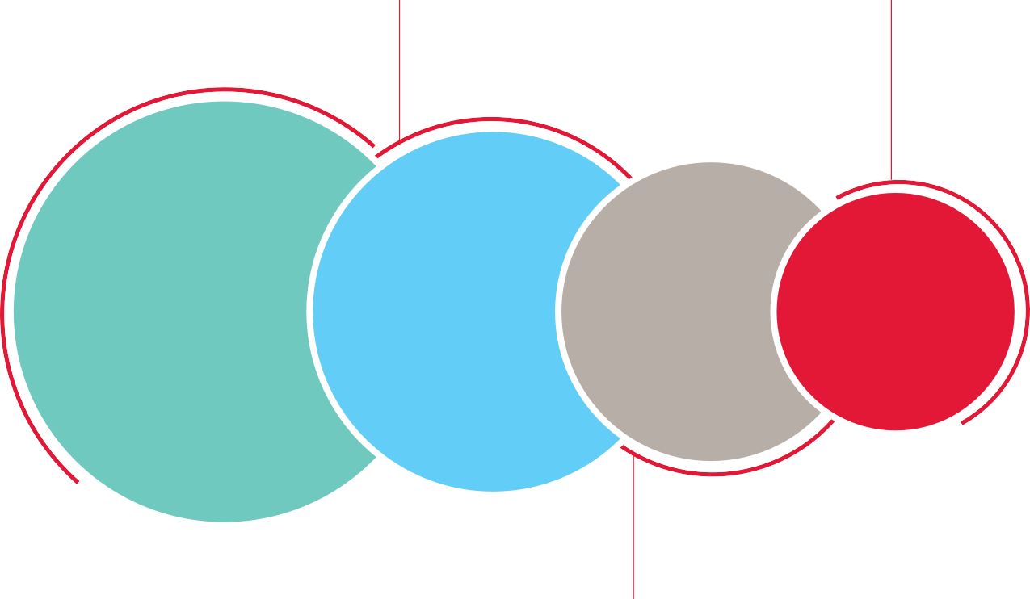
Sexual and reproductive health and rights within the 2025 AIDS targets
Decriminalization of same-sex sexual relationships
Gender equitable laws and policies
Reduction of stigma and discrimination
Family planning
STI services
Comprehensive sexuality education
Wider efforts on sexual and reproductive rights
HIV-SPECIFIC SOCIETAL ENABLERS
INTEGRATION
HIV SERVICES
Gender-based violence services
HPV vaccination, cervical cancer screening and treatment
Gender-affirming therapy
Enabling environment
Service delivery

Slide 30
HIV service areas have considerable overlap
There are no clear divisions among HIV prevention, testing and treatment,
the prevention of vertical transmission, and sexual and reproductive health services
PRIMARY PREVENTION
SEXUAL AND REPRODUCTIVE HEALTH
SERVICES
HIV
TESTING
AND
TREATMENT
PREVENTION OF VERTICAL TRANSMISSION

Slide 31
Detailed testing and treatment targets
Children (aged 0–14 years) | Adolescent girls and young women (aged 15–24 years) | Adolescent boys and young men (aged 15–24 years) | Adult women (aged 25 years and older) | Adult men (aged 25 years and older) | People on the move (such as migrants and refugees)
Gay men and other men who have sex with men | Transgender people | Sex workers | People who inject drugs | People in prisons and other closed settings
95% of people within the subpopulation who are living with HIV know their HIV status
95% of people within the subpopulation who are living with HIV and who know their HIV status are on antiretroviral therapy
95% of people within the subpopulation who are on antiretroviral therapy have suppressed viral loads

Slide 32
Detailed targets for sexual and reproductive health services and eliminating
vertical HIV transmission
Population | Target
Women of reproductive age in high HIV prevalence settings, within key populations and living with HIV | 95% have their HIV prevention and sexual and reproductive health service needs met
Pregnant and breastfeeding women | 95% of pregnant women are tested for HIV, syphilis and hepatitis B surface antigen at least once and as early as possible. In high HIV burden settings, pregnant and breastfeeding women with unknown HIV status or who previously tested HIV-negative should be re-tested during late pregnancy (third trimester) and in the post-partum period.
Pregnant and breastfeeding women living with HIV | 90% of women living with HIV on antiretroviral therapy before their current pregnancy
 | All pregnant women living with HIV are diagnosed and on antiretroviral therapy, and 95% achieve viral suppression before delivery
 | All breastfeeding women living with HIV are diagnosed and on antiretroviral therapy, and 95% achieve viral suppression (to be measured at 6–12 months)
Children (aged 0–14 years) | 95% of HIV-exposed infants receive a virologic test and parents provided the results by age 2 months
 | 95% of HIV-exposed infants receive a virologic test and parents provided the results after the cessation of breastfeeding
 | 95–95–95 testing and treatment targets achieved among children living with HIV

Slide 33
Thresholds for the prioritization of HIV prevention methods
 | Criterion | Very high |  | High | Moderate and low
Sex workers | National adult (15–49 years) HIV prevalence | >3% |  | >0.3% | <0.3%
Prisoners | National adult (15–49 years) HIV prevalence | >10% |  | >1% | <1%
Gay men and other men who have sex with men | UNAIDS analysis by country/region | Proportion of populations estimated to have incidence >3% |  | Proportion of populations estimated to have incidence 0.3–3% | Proportion of populations estimated to have incidence <0.3%
Transgender people | Mirrors gay men and other men who have sex with men in absence of data | Proportion of populations estimated to have incidence >3% |  | Proportion of populations estimated to have incidence 0.3–3% | Proportion of populations estimated to have incidence <0.3%
People who inject drugs | UNAIDS analysis by country/region | Low needle–syringe programme and opioid substitution therapy coverage |  | Some needle–syringe programme; some opioid substitution therapy | High needle–syringe programme coverage with adequate needles and syringes per person who injects drugs; opioid substitution therapy available
 | Criterion | High and very high |  | Moderate | Low
Adolescent girls and young women | Combination of [national or subnational incidence in women 15–24 years] AND [reported behaviour from DHS or other (>2 partners; or reported STI in previous 12 months)] | 1–3% incidence AND high-risk reported behaviour | >3% incidence | 0.3–<1% incidence and high-risk reported behaviour OR 1–3% incidence and low-risk reported behaviour | <0.3% incidence OR 0.3–<1% incidence and low-risk reported behaviour
Adolescent boys and young men | Combination of [national or subnational incidence in men 15–24 years] AND [reported behaviour from DHS or other (>2 partners; or reported STI in previous 12 months)] | 1–3% incidence AND high-risk reported behaviour | >3% incidence | 0.3–<1% incidence and high-risk reported behaviour OR 1–3% incidence and low-risk reported behaviour | <0.3% incidence OR 0.3–<1% incidence and low-risk reported behaviour
Adults (aged 25 and older) | Combination of [national or subnational incidence in adults 25–49 years] AND [reported behaviour from DHS or other (>2 partners; or reported STI in previous 12 months)] | 1–3% incidence AND high-risk reported behaviour | >3% incidence | 0.3–<1% incidence and high-risk reported behaviour OR 1–3% incidence and low-risk reported behaviour | <0.3% incidence OR 0.3–<1% incidence and low-risk reported behaviour
Serodiscordant partnerships | Estimated number of HIV-negative regular partners of someone newly starting on treatment | Risk stratification depends on choices within the partnership: choice of timing and regimen of antiretroviral therapy for the HIV-positive partner; choice of behavioural patterns (condoms, frequency of sex); choice of PrEP

Slide 34
Detailed HIV prevention targets for key populations
KEY POPULATIONS | Sex workers | Gay men and other men who have sex with men | People who inject drugs | Transgender people | Prisoners and others in closed settings
Condoms/lubricant use at last sex by those not taking PrEP with a non-regular partner whose HIV viral load status is not known to be undetectable (includes those who are known to be HIV-negative) | -- | 95% | 95% | 95% | --
Condom/lubricant use at last sex with a client or non-regular partner | 90% | -- | -- | -- | 90%
PrEP use (by risk category) Very high High Moderate and low | 80% 15% 0% | 50% 15% 0% | 15% 5% 0% | 50% 15% 0% | 15% 5% 0%
Sterile needles and syringes | -- | -- | 90% | -- | 90%
Opioid substitution therapy among people who are opioid dependent | -- | -- | 50% | -- | --
STI screening and treatment | 80% | 80% | -- | 80% | --
Regular access to appropriate health system or community-led services | 90% | 90% | 90% | 90% | 100%
Access to post-exposure prophylaxis as part of package of risk assessment and support | 90% | 90% | 90% | 90% | 90%

Slide 35
Detailed HIV prevention targets for the general population
GENERAL POPULATION |  | Risk by prioritization stratum
 |  | Very high |  | Moderate | Low
All ages and genders | Condoms/lubricant use at last sex by those not taking PrEP with a non-regular partner whose HIV viral load status is not known to be undetectable (includes those who are known to be HIV-negative) | 95% |  | 70% | 50%
 | PrEP use (by risk category) | 50% |  | 5% | 0%
 | STI screening and treatment | 80% |  | 10% | 10%
Adolescents and young people | Comprehensive sexuality education in schools, in line with UN international technical guidance | 90% |  | 90% | 90%
 |  | Strata based on geography alone
 |  | Very high (>3%) | High (1–3%) | Moderate (0.3–1%) | Low (<0.3%)
All ages and genders | Access to post-exposure prophylaxis (PEP) (non-occupational exposure) as part of package of risk assessment and support | 90% | 50% | 5% | 0%
 | Access to PEP (nosocomial) as part of package of risk assessment and support | 90% | 80% | 70% | 50%
Adolescent girls and young women | Economic empowerment | 20% | 20% | 0% | 0%
Adolescent boys and men | VMMC | 90% in 15 priority countries
People within serodiscordant partnerships | Condoms/lubricant use at last sex by those not taking PrEP with a non- regular partner whose HIV viral load status is not known | 95%
 | PrEP until positive partner has suppressed viral load | 30%
 | PEP | 100% after high-risk exposure

Slide 36
HIV infections projected through 2020, and modelled predictions related to progress on societal enablers, 2021–2030
AIDS-related deaths projected through 2020, and modelled predictions related to progress on societal enablers, 2021–2030
2 500 000
1 200 000
Number of new HIV infections
2 000 000
Number of AIDS-related deaths
1 000 000
1 500 000
800 000
1 000 000
600 000
500 000
400 000
200 000
2010
2012
2014
2016
2018
2020
2022
2024
2026
2028
2030
2010
2012
2014
2016
2018
2020
2022
2024
2026
2028
2030
Annual new HIV infections, UNAIDS epidemiological estimates, 2020
Annual AIDS-related deaths, UNAIDS epidemiological estimates, 2020
No progress on societal enabler targets
No progress on societal enabler targets
Progress towards the societal enabler targets
Progress towards the societal enabler targets
Source: Special analysis by Avenir Health using data from UNAIDS/WHO/UNICEF HIV services tracking tool, November 2020; and UNAIDS epidemiological estimates, 2020
(https://aidsinfo.unaids.org/). See annex on methods.

Slide 37
Change in HIV incidence over 10 years in countries with favourable and unfavourable societal environments, by male condom use at last higher risk sex, 2010–2019
40
20
0
Change in
HIV incidence
over 10 years,
%
-20
-40
-60
-80
-100
60
80
95
Condom use at last higher risk sexual encounter, men, %
Most favourable societal environment (75th percentile)
Least favourable societal environment (25th percentile)
Source: UNAIDS special analysis using structural equation modelling; see methods annex.
Note: The level of the societal enabling environment is a composite indicator based on four groups of societal enabling environments: (1) gender-equal societies; (2) societies free from stigma and discrimination; (3) improved access to justice and punitive laws lifted; and (4) joint action with broader development sector. The estimation was performed by applying multivariate panel regression data
with structural equations modeling for the statistical analysis of unobserved constructs.

Slide 38
AIDS-related mortality among people living with HIV by antiretroviral therapy coverage in countries with favourable and unfavourable societal environments, 2017–2019
3.0
2.5
2.0
AIDS-related
mortality %
1.5
1.0
0.5
0
50
75
90
Antiretroviral therapy coverage %
Most favourable societal environment (75th percentile)
Least favourable societal environment (25th percentile)
Source: UNAIDS special analysis using structural equation modelling; see methods annex.
Note: The level of the societal enabling environment is a composite indicator based on four groups of societal enabling environments: (1) gender-equal societies; (2) societies free from stigma and discrimination; (3) improved access to justice and punitive laws lifted; and (4) joint action with broader development sector. The estimation was performed by applying multivariate panel regression data
with structural equations modeling for the statistical analysis of unobserved constructs.

Slide 39

Countries with discriminatory and punitive laws, global, 2019
32
129
111
92
69
Criminalization and/or prosecution of transgender people
(n = 134)
Criminalization of any aspect of sex work
(n = 140)
Criminalization of drug use or consumption and/or possession of drugs for personal use
(n = 134)
Criminalization of HIV transmission, non-disclosure or exposure
(n = 151)
Criminalization of same-sex sexual relations
(n = 194)
Reporting countries
Countries with punitive laws
Source: UNAIDS National Commitments and Policy Instrument, 2017 and 2019 (see http://lawsandpolicies.unaids.org/); supplemented by additional sources (see references in Annex).

Slide 40
Percentage of people aged 15 to 49 years who report discriminatory attitudes towards people living with HIV, countries with available data, 2014–2019
100
90
80
70
Percent
60
50
40
30
20
10
0
Philippines*
Indonesia
Mongolia
Timor-Leste
Lao PDR
Nepal
India
Thailand
Haiti
Suriname
Belize
Madagascar
Ethiopia
Angola
Uganda
Zimbabwe
Malawi
South Africa
Tajikistan*
Albania
Kyrgyzstan*
Armenia
Georgia
Jordan
Iraq*
Tunisia
Guinea
Mauritania
Benin
Gambia
Sierra Leone
Senegal
Nigeria
Mali
Côte d’Ivoire
Congo
Burundi
*Data are for women aged 15 to 49 only.
Middle East
and North
Africa
Eastern and
southern Africa
Eastern Europe
and central Asia
Asia and the Pacific
Caribbean
Western and central Africa
Source: Population-based surveys, 2014–2019.
Note: Discriminatory attitudes are measured through "No" responses to either of two questions: (1) Would you buy fresh vegetables from a shopkeeper or vendor if you knew this person had HIV?; and (2) Do you think that children living with HIV should be able to attend school with children who are HIV-negative?

Slide 41
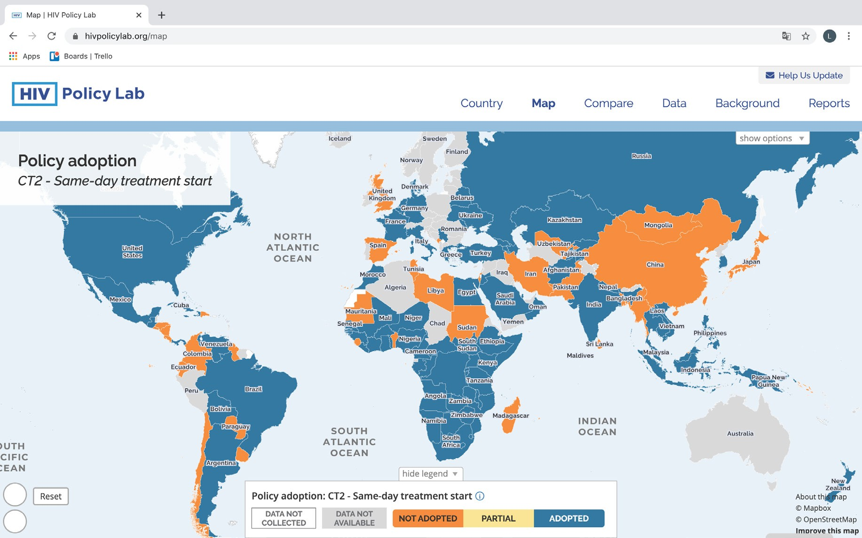
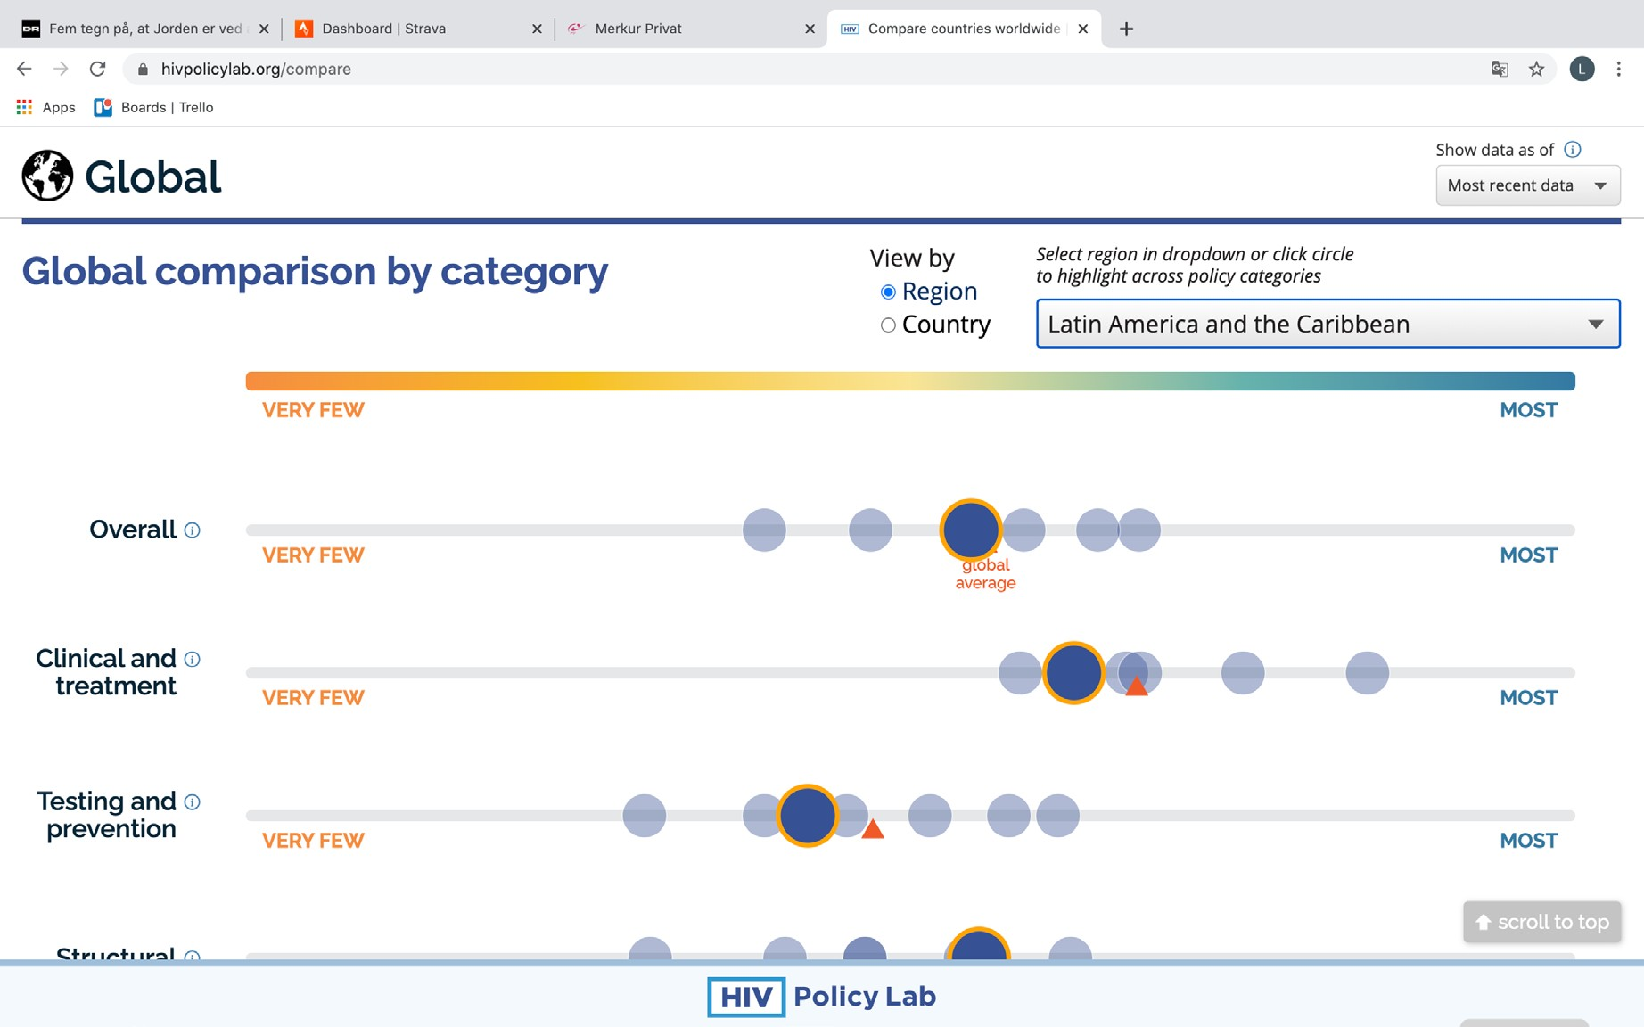
Illustrations of data presentation on the HIV Policy Lab website

Slide 42
Detailed targets for integration
Population | Target
People living with HIV | 90% of patients entering care through HIV or tuberculosis services are referred for tuberculosis and HIV testing and treatment at one integrated, collocated or linked facility, depending on the national protocol. And 90% of people living with HIV receive tuberculosis preventive treatment.
 | 90% have access to integrated or linked services for HIV treatment and cardiovascular diseases, cervical cancer, mental health, diabetes diagnosis and treatment, education on healthy lifestyle counselling, smoking cessation advice and physical exercise.
Children (aged 0–14 years) | 95% of HIV-exposed newborns and infants have access to integrated services for maternal and newborn care, including prevention of the triple vertical transmission of HIV, syphilis and hepatitis B virus.
Adolescent boys and young men (aged 15–24 years) | 90% of adolescent boys (aged 15+ years) and men (aged 25–59 years) have access to VMMC integrated with a minimum package of services⁵ and multidisease screening⁶ within male-friendly health-care service delivery in 15 priority countries.
Adult men (aged 25+)
School-aged young girls (aged 9–14 years) | 90% of school-aged young girls in priority countries have access to HPV vaccination, as well as female genital schistosomiasis (S. haematobium) screening and/or treatment in areas where it is endemic.⁷
Adolescent girls and young women (aged 15–24 years) | 90% have access to sexual and reproductive health services that integrate HIV prevention, testing and treatment services. These integrated services can include, as appropriate to meet the health needs of local population, HPV, cervical cancer and STI screening and treat, female genital schistosomiasis (S. haematobium) screening and/or treatment, intimate partner violence (IPV) programmes, sexual and gender-based violence (SGBV) programmes that include post-exposure prophylaxis (PEP), emergency contraception and psychological first aid.⁸
Adult women (aged 25+)
Pregnant and breastfeeding women | 95% have access to maternal and newborn care that integrates or links to comprehensive HIV services, including for the prevention of the triple vertical transmission of HIV, syphilis and hepatitis B virus.
Gay men and other men who have sex with men | 90% have access to HIV services integrated with (or link to) STI, mental health and IPV programmes, SGBV programmes that include PEP, and psychological first-aid.
Sex workers | 90% have access to HIV services integrated with (or link to) STI, mental health and IPV programmes, SGBV programmes that include PEP and psychological first-aid.
Transgender people | 90% of transgender people have access to HIV services integrated with or linked to STI, mental health, gender-affirming therapy, IPV programmes, and SGBV programmes that include PEP, emergency contraception and psychological first aid.
People who inject drugs | 90% have access to comprehensive harm reduction services integrating or linked to hepatitis C, HIV and mental health services.
People in prisons and other closed settings | 90% have access to integrated tuberculosis, hepatitis C and HIV services.
People on the move (migrants, refugees, those in humanitarian settings, etc.) | 90% have access to integrated tuberculosis, hepatitis C and HIV services, in addition to IPV programmes, SGBV programmes that include PEP, emergency contraception and psychological first aid. These integrated services should be person-centred and tailored to the humanitarian context, the place of settling and the place of origin.
Notes:
⁵ The minimum package of services delivered along with VMMC includes safer sex education, condom promotion, the offer of HIV testing services and management of STIs.
⁶ Additional services such as diabetes, hypertension and/or tuberculosis screening, and malaria management. To be adjusted depending on the location.
⁷ Low- and middle-income countries with HPV and HIV coinfections.
⁸ For all subpopulations, PEP includes HIV testing and risk exposure assessment.

Slide 43

GLOBAL AIDS WORLD AIDS DAY REPORT | 2020
REACHING
THE TARGETS

Slide 44

GLOBAL AIDS WORLD AIDS DAY REPORT | 2020
ANNEX
ON METHODS

Slide 45
Detailed targets for sexual and reproductive health services and eliminating
vertical HIV transmission
Component | Study | Indicator | aOR | Odds of 90 | Odds with stigma | Achievement with stigma
Testing | Golub and Gamarel (2013) | Likelihood of testing | 0.54 | 9 | 4.86 | 0.83
Linkage | Sabapathy et al. (2017) | Late linkage to care | 1.71–1.82 | 9 | 5.10 | 0.84
 | Gesesaw et al (2017) | Late presentation to care | 2.4 (1.6–3.6) | 9 | 3.75 | 0.79
Adherence | Katz et al. (2013) | Non-adherence | 1.74 | 9 | 5.17 | 0.84

